Slide 1
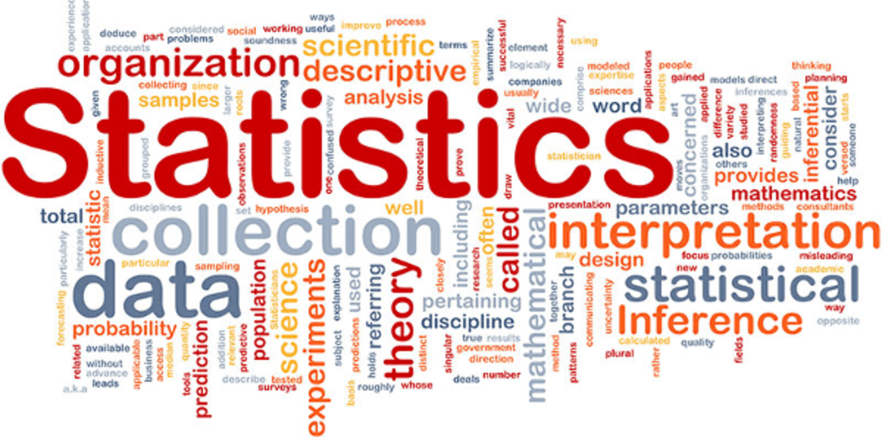
8.2 Displaying Data

Slide 2
Goals for the Day
Frequency Tables (Distributions)
Graphical Displays of Data
1
2

Slide 3
Frequency Tables (Distributions)
1

Slide 4
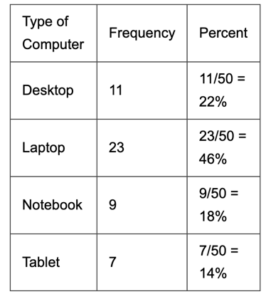
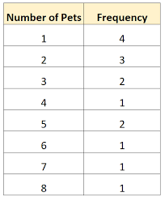
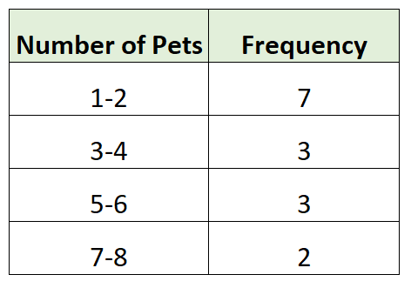
Frequency Tables (Distributions)
1
Summarize datasets by counting the number of observations for each category, distinct value or interval.
Can be used for categorical data and quantitative (numerical) data.
Relative Frequency
Count
Grouped Frequency Distribution
Total = 50
Find count between 4 and 7 inclusive:
4, 5, 6, and 7

Slide 5
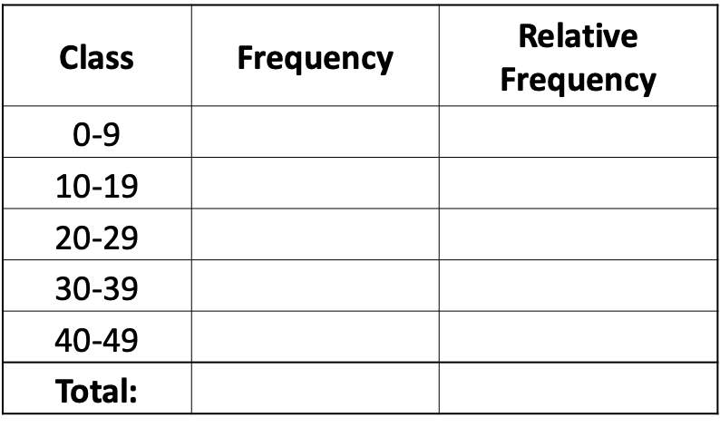
Example 1
1
Construct a frequency table using the data below.
38, 33, 5, 5, 47, 29, 24, 42, 3, 18, 30, 46, 25, 44, 40, 42, 39, 44, 29, 13
Lower class limit = 0
3
3/20 = 0.15
Upper class limit = 9
2
2/20 = 0.1
4
4/20 = 0.2
Class width =
Lower₂ – Lower₁
4
4/20 = 0.2
10 = 40 – 30
7
7/20 = 0.35
20
20/20 = 1

Slide 6
Graphical Displays of Data
2

Slide 7
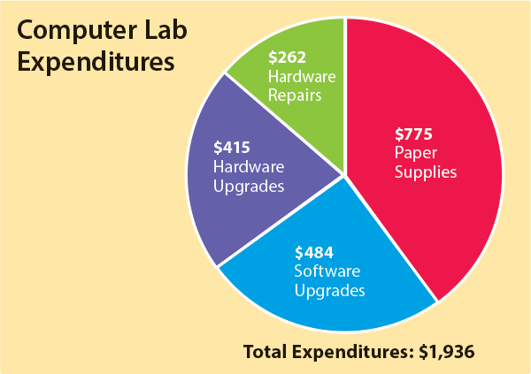
Pie Charts
2
Pie Charts
Compare parts to a whole.
Slices represent the proportion of a category
Type of Data: Categorical
Advantages:
* Simple and common
Disadvantages:
* Harder to compare area than heights
* Not useful when there are lots of categories
* Easy to be misleading if visually distorted (3D, one slice is larger) or labels are not clear)

Slide 8
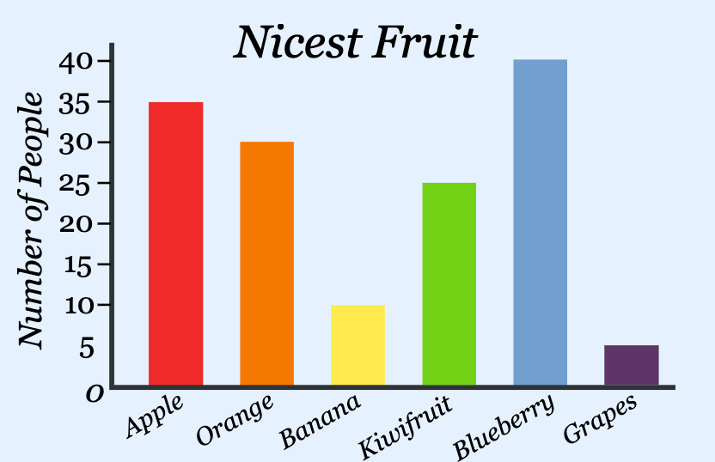
Bar Graphs
2
Bar Graphs
Height of the bar represents the amount of data
in each category.
Can be counts or relative frequencies.
Type of Data: Categorical
Advantages:
* Simple and common and easy to read
Disadvantages:
* Misleading if:
- Bars are not equal width
- Inconsistent vertical scale
- Vertical scale is truncated (not start at 0)

Slide 9
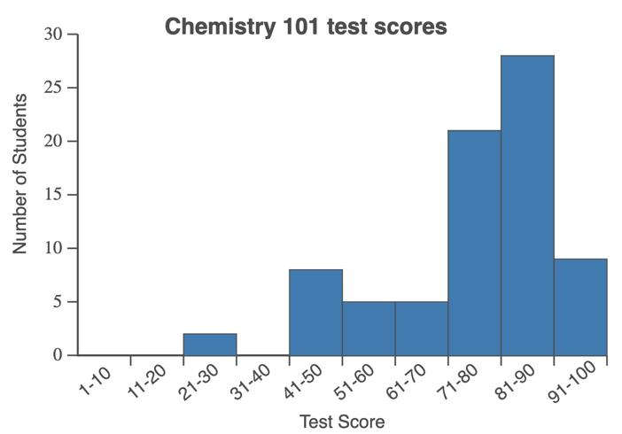
Histograms
2
Histograms
Height of the bar represents the amount of data in each class.
Can be counts or relative frequencies.
Type of Data: Quantitative
Advantages:
* Simple
* Can show lots of data very concisely
* Shows “shape” or distribution of data
Disadvantages:
* Class width impacts the plot drastically
* Misleading if:
- Bars are not equal width
- Inconsistent horizontal / vertical scale
- Vertical scale is truncated (not start at 0)

Slide 10
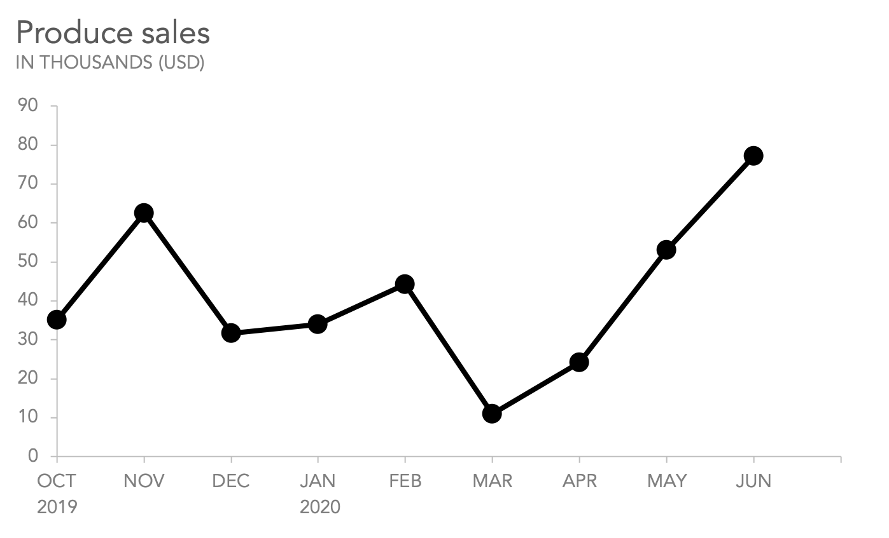
Line Graphs
2
Line Graphs
Shows changes in a numerical variable over time.
Type of Data: Quantitative
Advantages:
* Shows trends over time
Disadvantages:
* Misleading if:
- Inconsistent horizontal / vertical scale
- Vertical scale is truncated (not start at 0)

Slide 11
Good Graphs
2
Good Graphs: A clear graph should have a title, labels on the vertical and horizontal axis, and should reference the source of the data.

