Slide 1

8.4 The Normal Distribution

Slide 2
Goals for the Day
Normal Distribution Properties
Z-scores
Finding probabilities
1
2
3

Slide 3
Normal Distribution Properties
1

Slide 4
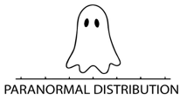
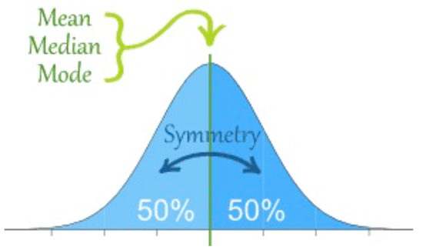
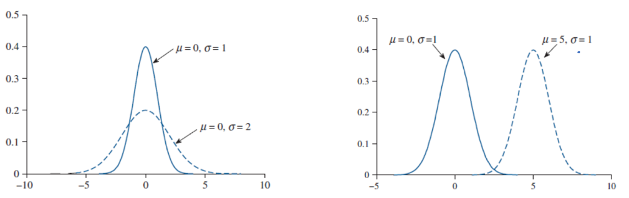
Normal Distribution Properties
1
It’s a symmetric, unimodal and bell-shaped distribution
→ which implies mean = median = mode.
Total area under curve (probability) is equal to 1 = 100%.
Completely described by its mean 𝜇 (location) and standard deviation 𝞂 (spread).

Slide 5
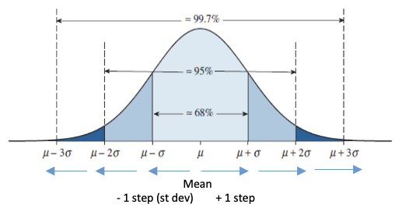
How we use the normal curve
1
The normal distribution allows us to find any probability, not just for points that lie exactly 1, 2, or 3 standard deviations (“steps”) away from the mean like with the empirical rule!

Slide 6
Z-scores
2

Slide 7

Z-scores
2
Z-scores (“Standard” scores in Hawkes Certify)
Definition: A z-score standardizes observations based on the mean (center) and standard deviation (spread) of the distribution
Allows for comparisons on different scales.
Ex) ACT vs SAT
Formula: $z=\frac{x−μ}{σ}=\frac{x −\overline{x}}{s}=\frac{obs −mean}{st dev}$

Slide 8
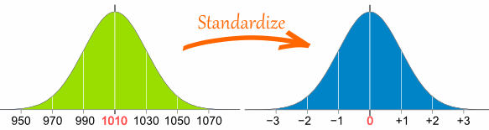
Z-scores
2
Interpretation: A z-score tells us how many standard deviations an observation is away from the mean.
STEPS
– below
Mean
+ above

Slide 9
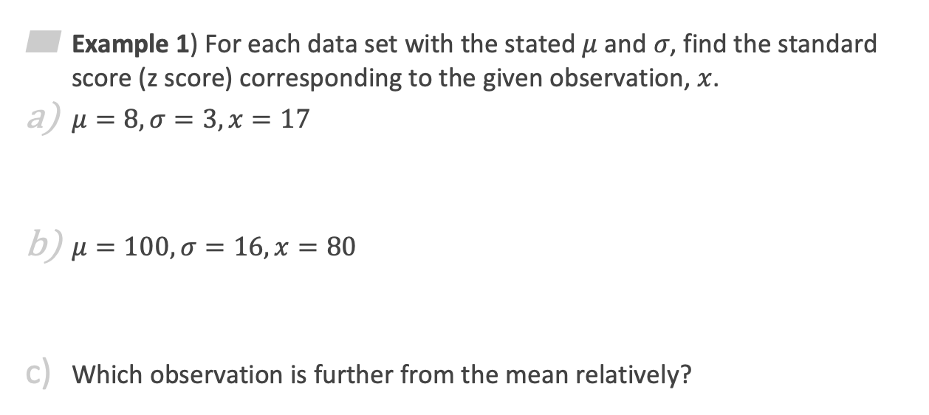


Z-scores Examples
2
Example 1) For each data set with the stated $μ$ and $σ$, find the standard score (z score) corresponding to the given observation, $x$.
$μ=8, σ=3, x=17$
$μ=100, σ=16, x=80$
Which observation is further from the mean relatively?
$$z=\frac{17 −8}{3}=3$$
Above mean
$$z=\frac{80 −100}{16}=−1.25$$
Below mean
(a) because z = 3 is a “larger” value

Slide 10
Finding Probabilities
3

Slide 11
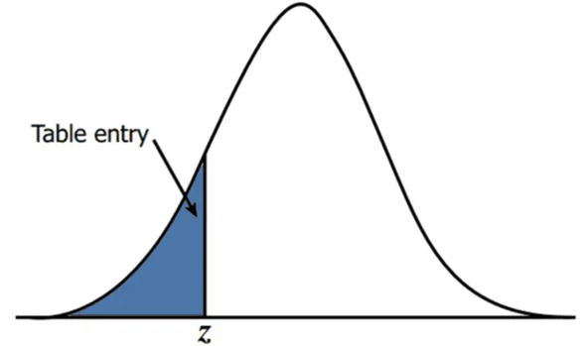
Finding probabilities based on the Normal Distribution
3
Handout: Normal Distribution Table
Use the handout to convert z-scores to percentiles (“left probabilities”).
ALWAYS gives probability LESS THAN Z: P(Z < z).
“LEFT”

Slide 12
Different Types of Probabilities
3
Draw, Label and Shade curve
Left Probability = Table (directly)
Right Probability = 1 – Left (table)
Between Probability = Left Z₂ – Left Z₁
Outside Probability = Left Z₁ + Right Z₂

