Slide 1
Data Analysis Project

Slide 2
Members
Name Contribution
KEY

Slide 3
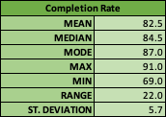
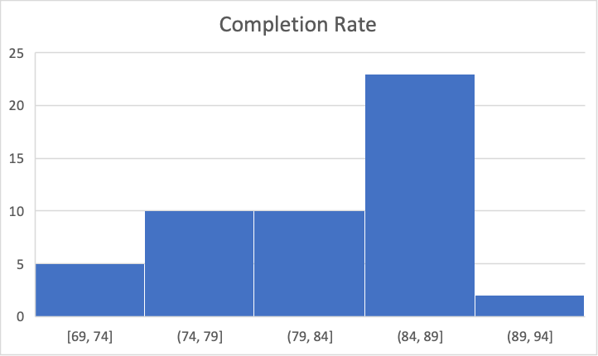
Part 1 – Completion Rate by State
The average completion rate was 82.5% with standard deviation of about 6%.
New Mexico had the lowest completion rate of 69%, while Iowa had the highest with 91%. Thus completion rates were generally in the 70%s and 80%s.
Completion rates are a left skewed distribution with the majority of rates between 74% and 89%. Only two states had rates above 89%, and the most common rate is between 84% and 89%

Slide 4
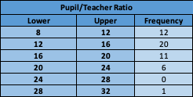
Part 2 – Pupil/Teacher Ratio
Pupil/teacher ratios are right skewed, with the majority of ratios between 8 and 20 students per teacher. Only one state had a ratio greater than 24, making it an outlier.

Slide 5
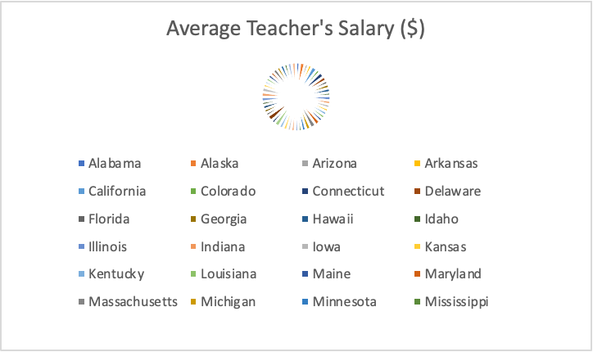
Part 3 – Average Teacher’s Salary
While the bar graph is better than the pie chart, both are not good displays because there are too many categories (states) to be comparing them each individually in the same display.
The graphs are too cluttered with too much information, and it is hard to glean any meaningful information.

Slide 6
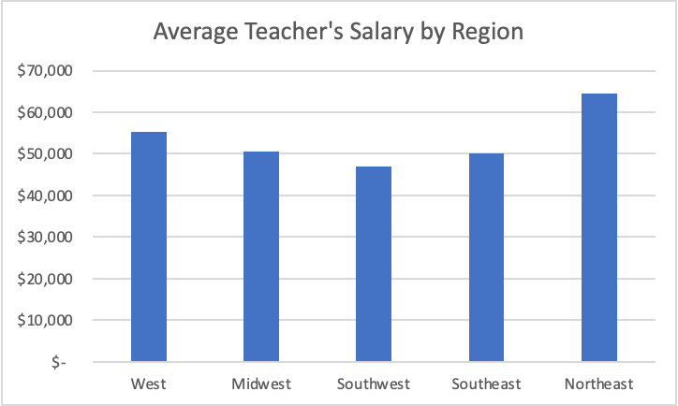
Part 4 – Average Teacher Salary by Region
These displays are way better than the previous because there is a reasonable number of categories. So we can now much more easily make meaningful comparisons between the regions.
The Northeast region has the highest average teacher's salary of almost $65,000, while all other regions are between about $46,000 and $55,000. The Southwest was the lowest with about $46,000.

Slide 7
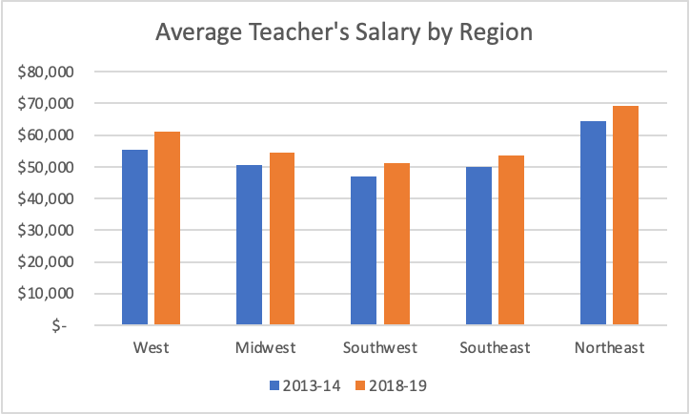
Part 4 – Continued…
These bar graphs are now incorporating information about another year instead of only displaying 2013-14 data. It allows us to compare how average salaries have changed through time, in addition to how it differs by region.
The side-by-side bar graph is a better display than the stacked bar graph because the visual comparisons between years across regions can be made much easier. Every region's average teach salary increased slightly (around $5,000) from 2013-14 to 2018-19, likely due to inflation. It doesn't appear that one region had a significantly larger or smaller increase than the others over the 5 years.

Slide 8
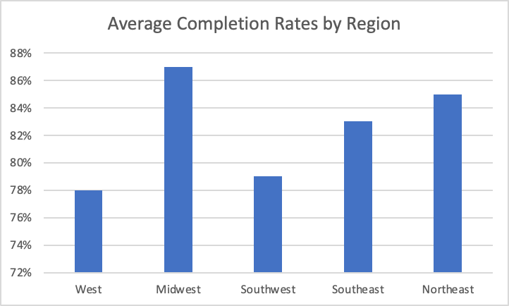
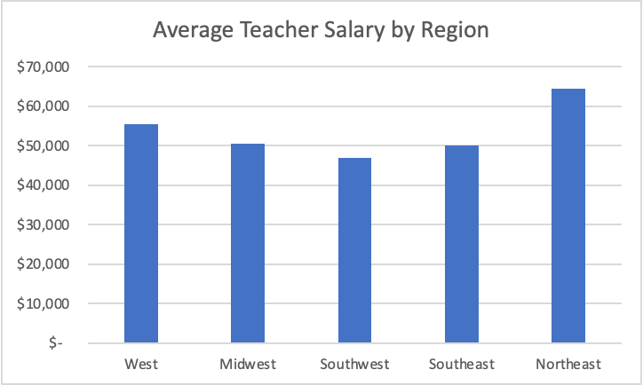
Part 5 – Data by Region
The Southwest region has the lowest average completion rate, the lowest average teacher salary and the highest average pupil/teacher ratio. While the Midwest and Northeast who have the highest average completion rates have higher average teacher salaries and the lowest pupil/teacher ratios.
These trends suggest that there is an association between completion rates and teacher salaries and a pupil/teacher ratios. Specifically that low teacher salaries and high pupil/teacher ratios could be contributing factors to the lower completion rates. There are of course other factors, but these two specifically could be an important reason for the differences in completion rates across regions of the US.

