Slide 1

6.5 Budgeting

Slide 2
Goals for the Day
Definitions
Steps to Creating a Budget
Examples
1
2
3

Slide 3
Definitions
1

Slide 4
Definitions
1
A budget is a financial plan for your income over a defined period of time.
Planning ahead to be ready for the unexpected, rather than being reactive to what happens in the now.
Net Income (take home pay) is equal to total, or gross, income minus taxes.
Net Income = Gross Income – Taxes
Disposable income is the money left over after taxes and expenses.
Disposable income = Net income – Expenses

Slide 5
Steps to Creating a Budget
2

Slide 6
Steps to creating a budget
2
Big picture, we need to know the following to create a budget:
What is your monthly net income (after tax income)? What are your necessary expenses? How much disposable income is left?
Steps to create a budget:
Calculate monthly income
Calculate monthly expenses
Subtract expenses from income
Allocate any remaining funds or make adjustments

Slide 7









Steps to creating a budget
2
Step 1 – Calculate monthly income
Example: Hannah makes $45,000 per year and expects to pay approximately 20% for all taxes.
How much of her income can Hannah expect to pay in taxes?
What is Hannah’s net income?
What is Hannah’s monthly take-home pay?
$$=45,000 ×\frac{20}{100}$$
$$Taxes = Salary × Tax rate$$
$$=\$9000$$
$$Net Income = Salary − Taxes$$
$$=45,000−9,000$$
$$=\$36,000$$
$$Monthly Take Home Pay=\frac{Net income}{12}$$
$$=\frac{36,000}{12}$$
$$=\$3,000$$

Slide 8
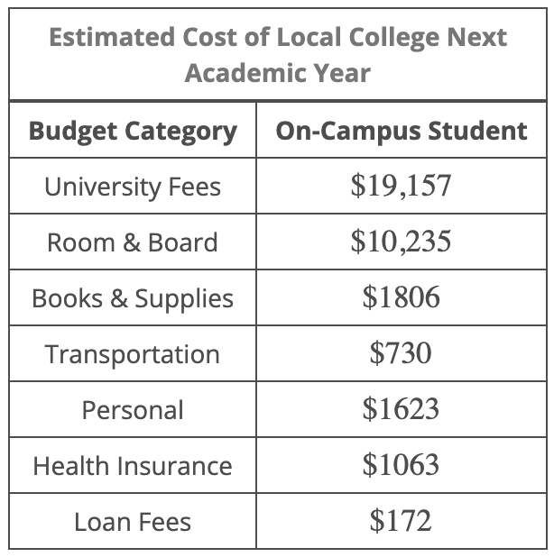
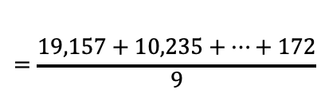






Steps to creating a budget
2
Step 2 – Calculate monthly expenses
Example: Using the information provided in the given table, determine how much monthly income would be necessary to budget for
loan fees over the 9-month academic year.
all the expenses of over the 9-month academic year.
$$=\frac{172}{9}$$
$$\frac{Loan fees}{9}$$
$$=\$19.11$$
$$=\frac{19,157+10,235+…+172}{9}$$
$$\frac{∑\left(all expenses\right)}{9}$$
$$=\frac{34,786}{9}$$
$$=\$3,865.11$$

Slide 9






Steps to creating a budget
2
Step 3 – Subtract expenses from income income
Example: Monica has a yearly salary of $28,700. Her employer withholds $3052 in state and federal taxes and $2180 in FICA taxes throughout the year. She has the following monthly costs: transportation is $220, cell phone bill is $50, student loans require $180 in repayment, and rent is $350. She is using the average monthly costs for each of the following in order to gain an idea of other monthly expenses: utilities are $260, internet is $105, health insurance is $299, and groceries are $210.
What is Monica’s monthly net pay amount?
How much money is left each month for discretionary spending after all necessities are accounted for?
Monthly
$=\frac{23,468}{12}=\$1,955.67$
$$Net Income = Salary − Taxes$$
$$=28,700−(3,052+2,180)$$
$$=\$23,468$$
→
$$Disposable income= Monthly Take Home Pay−Expenses$$
$$=1,955.67 −(220+50+…+210)$$
$$=\$281.67$$

Slide 10


Steps to creating a budget
2
Step 4 – Allocate remaining funds or make adjustments
Example: Determine the approximate monthly cost of spending $16.64 on takeout at least 3 times a week. (Assume four weeks in a month.)
$$Monthly cost= Expense × \# times × \# weeks$$
$$=16.64 × 3 × 4$$
$$=\$199.68$$

Slide 11
Budgeting Rule
2
Ultimately, a sound budget will cover all of your needs, some of your wants, and put you on a path of saving for emergencies and the future.
One such general recommendation is the 50/30/20 budgeting rule is to allow:
50% of your net income for necessities,
no more than 30% for wants
and at least 20% for savings and paying down debt.

Slide 12
Examples
3

Slide 13
Example #1
3
The Lees have a combined net income of $7026 a month. Find the amount they should allot for each category if they aim to follow the 50/30/20 rule for their budget. Round your answers to the nearest cent, if necessary.
Necessities: $3,513
Wants: $2,107.80
Savings: $1,405.20

Slide 14
Example #2
Dwayne is self-employed. Based on last year, his projected state and federal taxes for this year will be approximately $10,200. Determine how much Dwayne should put aside…
each month in order to have enough to pay his estimated quarterly taxes?
each quarter in order to have enough to pay his estimated quarterly taxes?
Monthly = $850
Quarterly = $2,550

