Slide 1
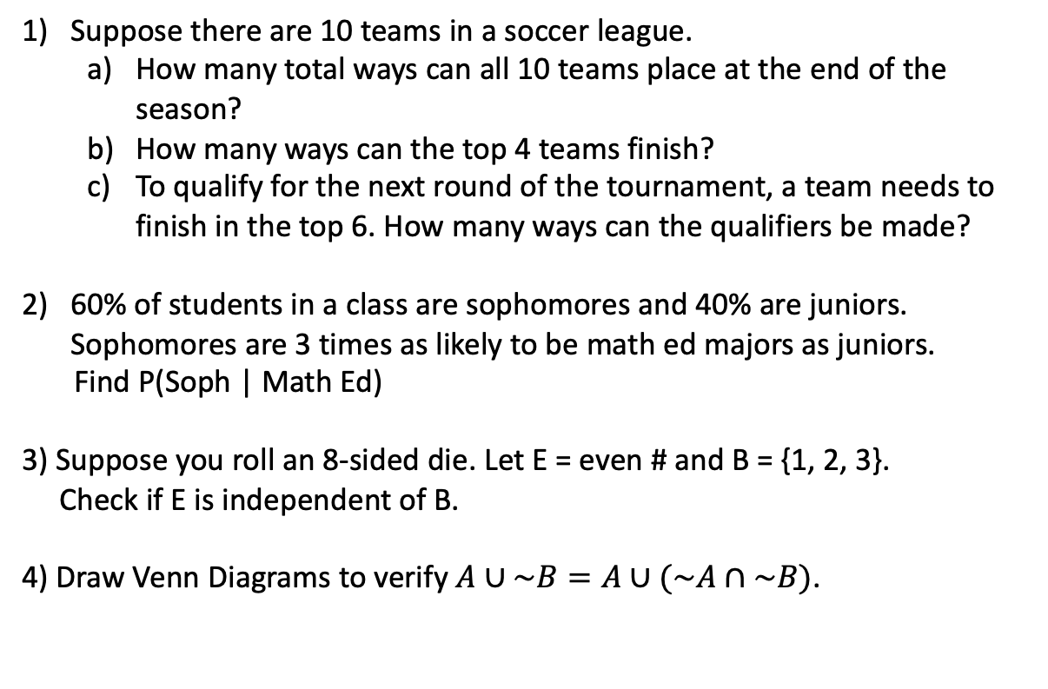
Suppose there are 10 teams in a soccer league.
  How many total ways can all 10 teams place at the end of the season?
  How many ways can the top 4 teams finish?
  To qualify for the next round of the tournament, a team needs to finish in the top 6. How many ways can the qualifiers be made?
60% of students in a class are sophomores and 40% are juniors. Sophomores are 3 times as likely to be math ed majors as juniors.
Find P(Soph | Math Ed)
3) Suppose you roll an 8-sided die. Let E = even # and B = {1, 2, 3}.
Check if E is independent of B.
4) Draw Venn Diagrams to verify $A∪\sim B=A∪(\sim A∩\sim B)$.

Slide 2
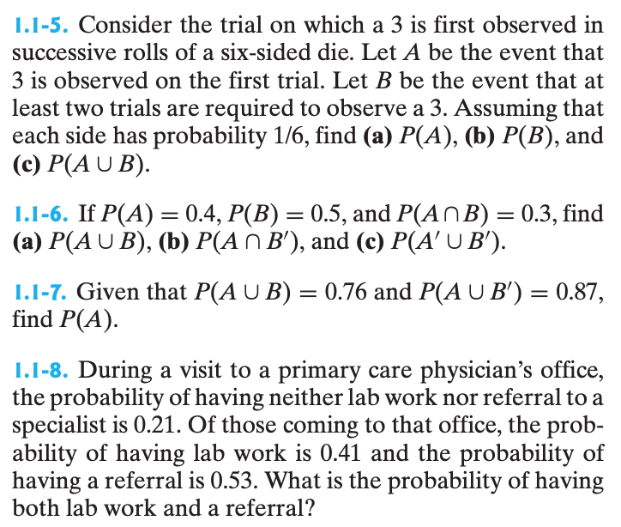
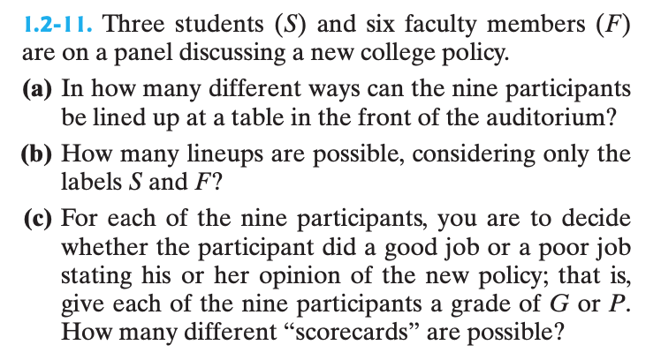
5) In our class, 20% are math majors, 33% are actuary majors, and 47% are econ majors.
  85% of math majors will pass the exam
  73% of actuary majors will pass the exam
  64% of econ majors will pass the exam
a) What is the probability a student will not pass the exam?
b) What is the probability a student is an actuary if we know they passed the exam?
c) What is the probability a student is a math or econ major given they passed the exam?

Slide 3
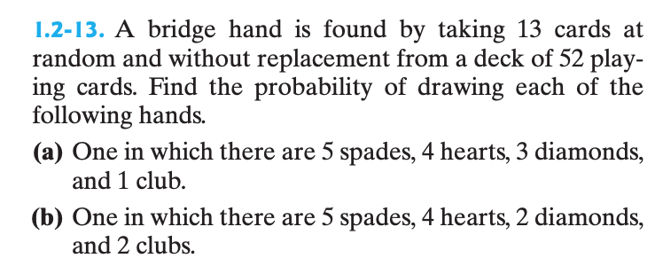
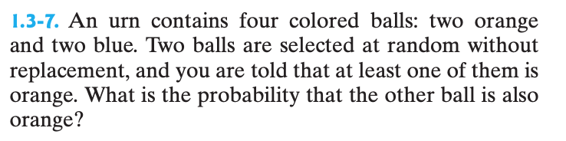
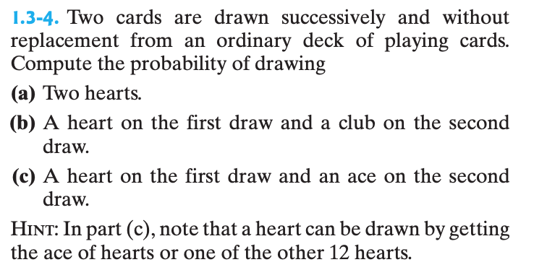
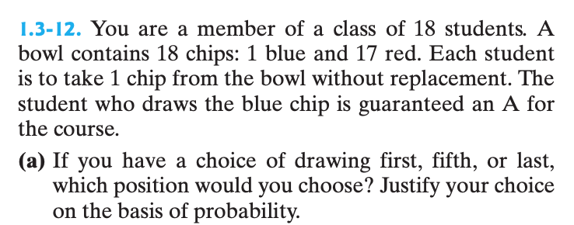

Slide 4
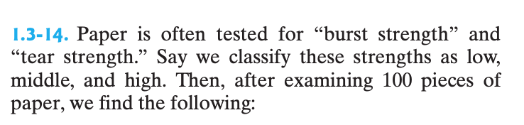
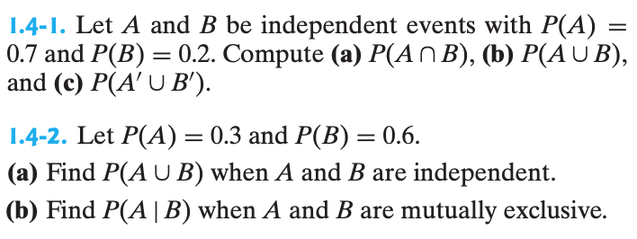
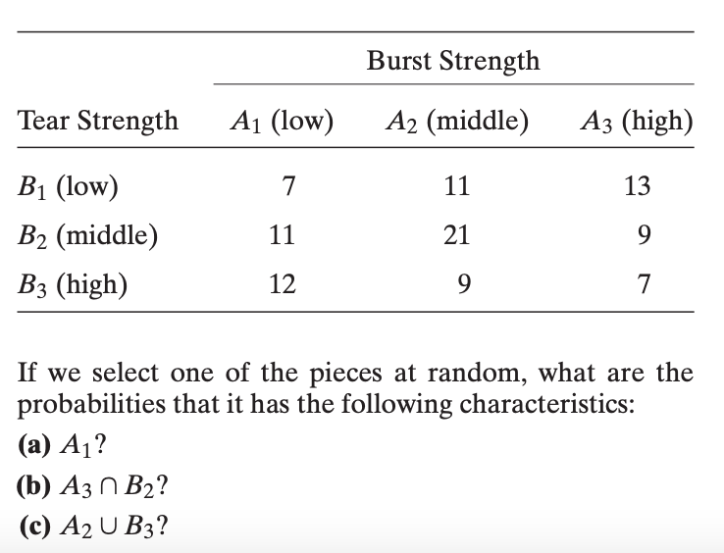
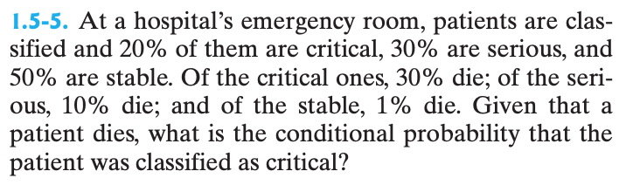
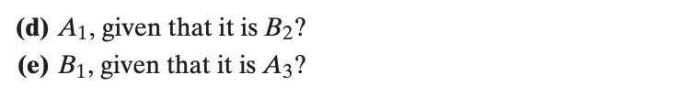

Slide 5
select Answers (rounded to 3 decimals)
2) 0.818
3) Not ind
5) a) 0.288
b) 0.338
c) 0.662
1.1-5) b) 5/6
1.1-6) c) 0.7
1.1-7) 0.63
1.1-8) 0.15
1.2-13) a) 0.005
1.3-4) 0.019
1.3-7) 0.2
1.3-12) all the same prob
1.3-14) c) 0.6
d) 0.268
1.4-1) c) 0.86
1.4-2) 1) 0.72
1.5-5) 0.632

