Slide 1
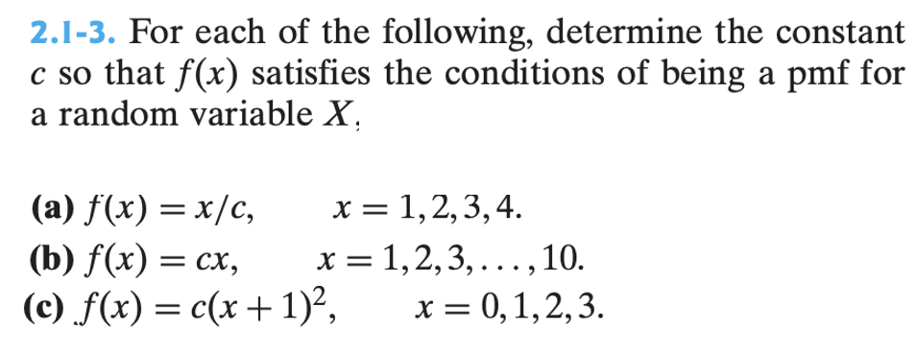

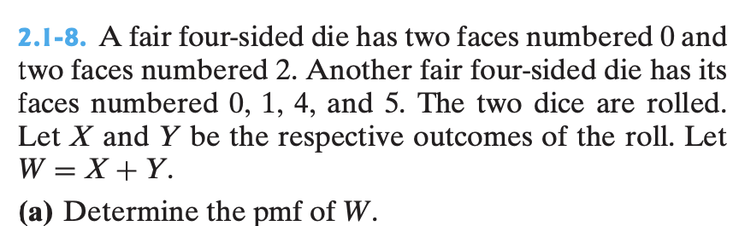
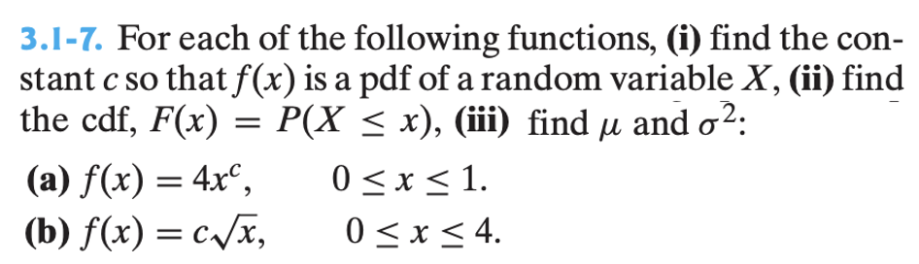
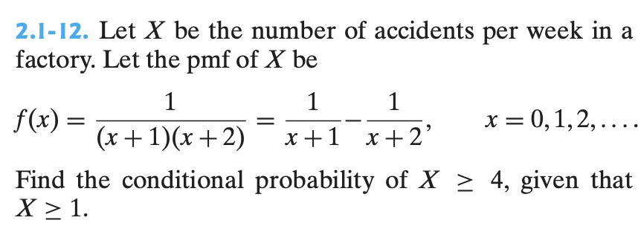
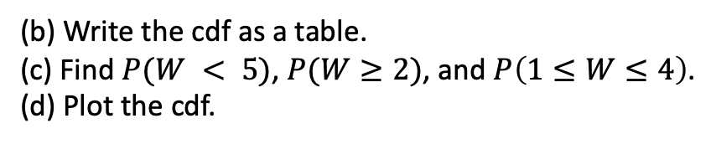
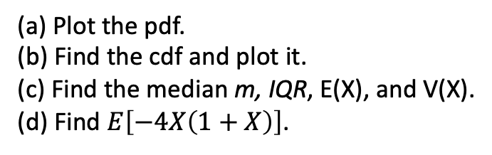
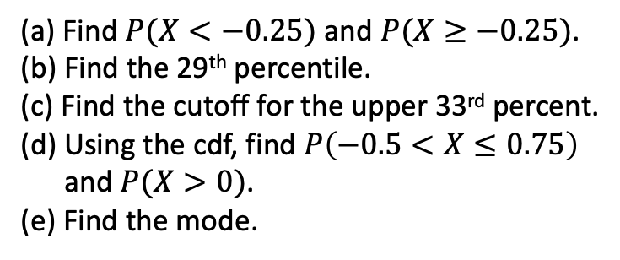
(a) Plot the pdf.
(b) Find the cdf and plot it.
(c) Find the median m, IQR, E(X), and V(X).
(d) Find $E\left[−4X\left(1+X\right)\right]$.
(a) Find $P(X<−0.25)$ and $P(X≥−0.25)$.
(b) Find the 29th percentile.
(c) Find the cutoff for the upper 33rd percent.
(d) Using the cdf, find $P\left(−0.5<X≤0.75\right)$
and $P(X>0)$.
(e) Find the mode.
as a table.
(b) Write the cdf as a table.
(c) Find $P(W < 5)$, $P(W≥2)$, and $P\left(1≤W≤4\right)$.
(d) Plot the cdf.

Slide 2
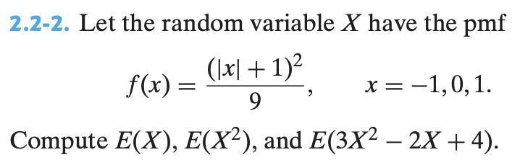
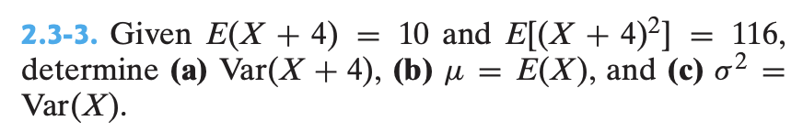
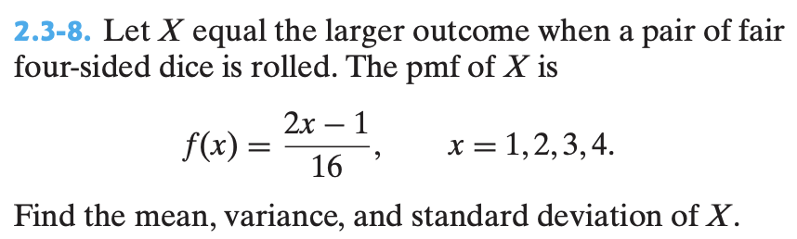
and V(X) by hand.
(a)
using your calculator.
(b) If Y = 2X – 1, find E(Y) and SD(Y).

Slide 3
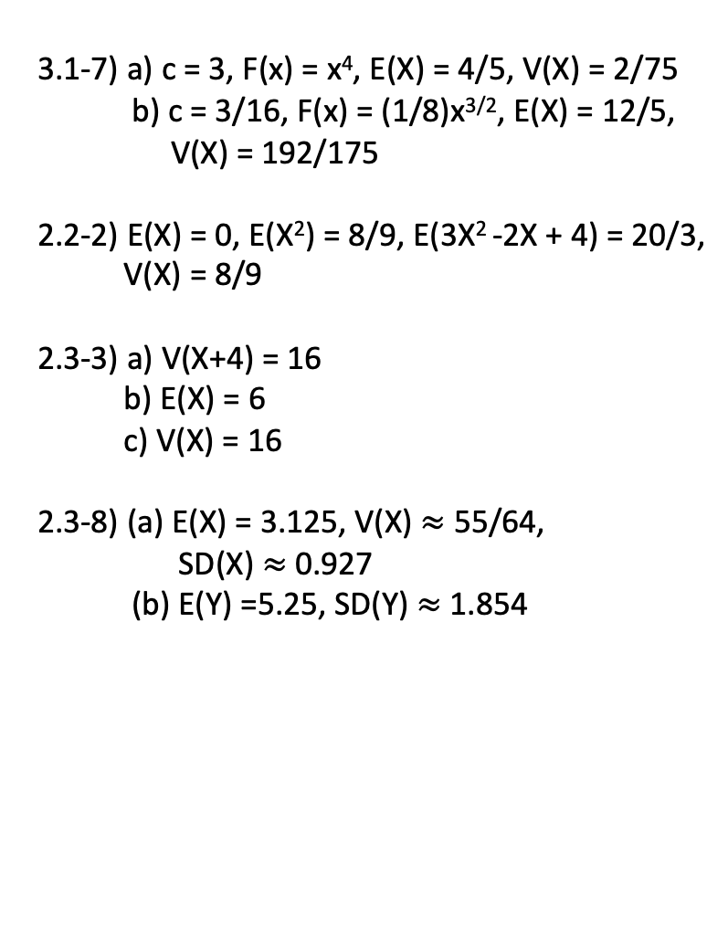
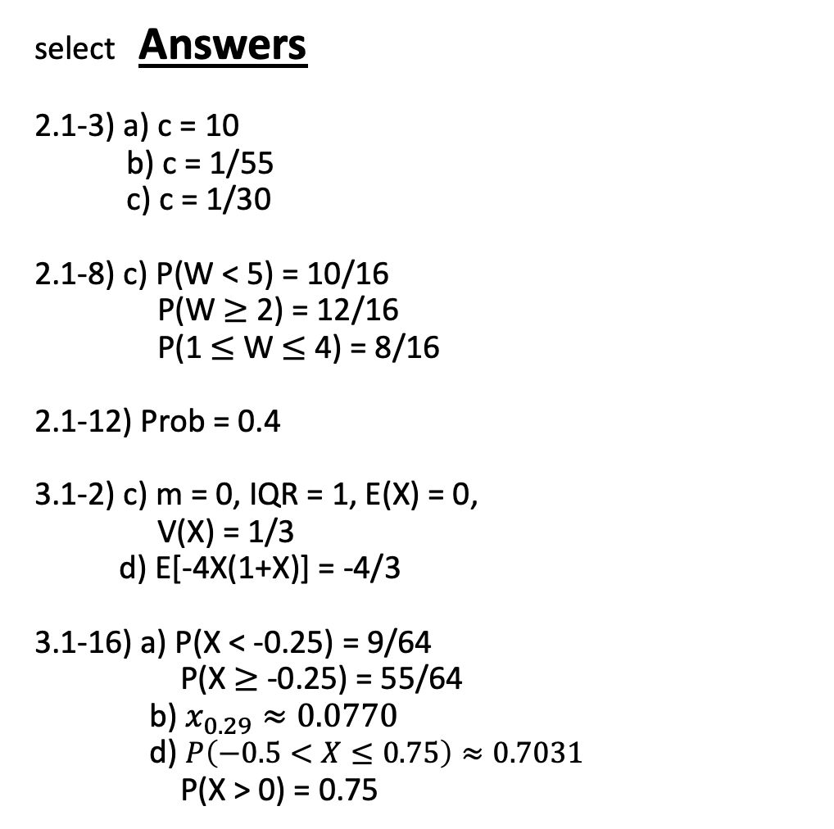
select Answers
2.1-3) a) c = 10
b) c = 1/55
c) c = 1/30
2.1-8) c) P(W < 5) = 10/16
P(W $≥$ 2) = 12/16
P(1 $≤$ W $≤$ 4) = 8/16
2.1-12) Prob = 0.4
3.1-2) c) m = 0, IQR = 1, E(X) = 0,
V(X) = 1/3
d) E[-4X(1+X)] = -4/3
3.1-16) a) P(X < -0.25) = 9/64
P(X $≥$ -0.25) = 55/64
b) $x_{0.29}≈0.0770$
d) $P\left(−0.5<X≤0.75\right)≈0.7031$
P(X > 0) = 0.75
3.1-7) a) c = 3, F(x) = x⁴, E(X) = 4/5, V(X) = 2/75
b) c = 3/16, F(x) = (1/8)x^{3/2}, E(X) = 12/5,
V(X) = 192/175
2.2-2) E(X) = 0, E(X²) = 8/9, E(3X² -2X + 4) = 20/3,
V(X) = 8/9
2.3-3) a) V(X+4) = 16
b) E(X) = 6
c) V(X) = 16
2.3-8) (a) E(X) = 3.125, V(X) $≈$ 55/64,
SD(X) $≈$ 0.927
(b) E(Y) =5.25, SD(Y) $≈$ 1.854

