Slide 1
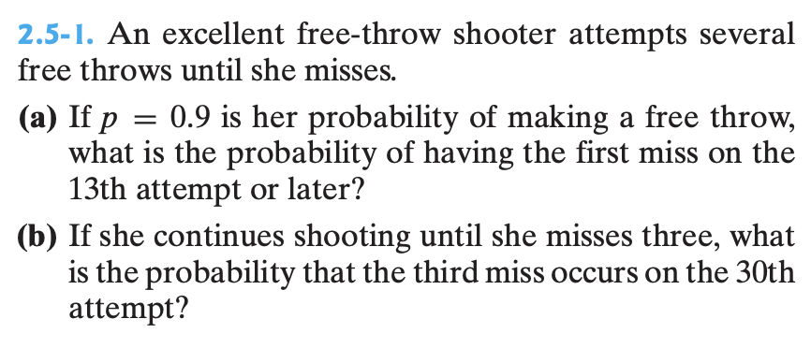
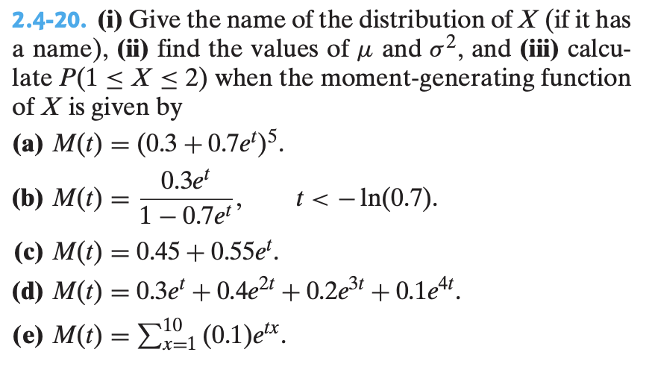
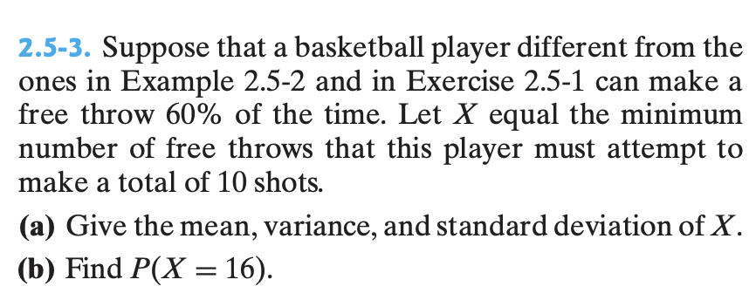
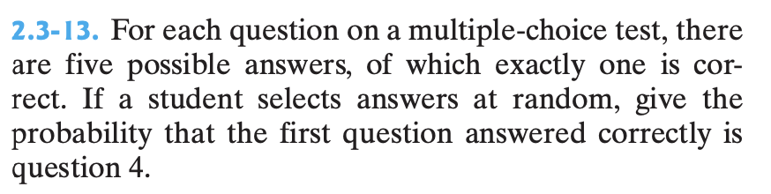
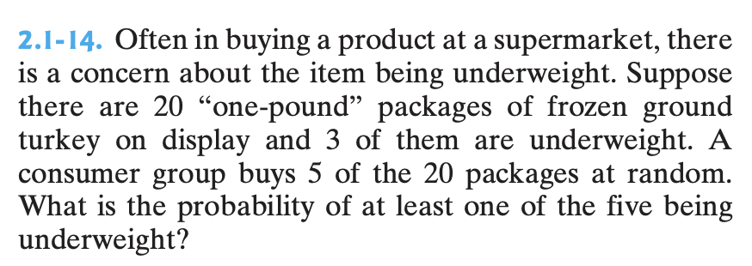
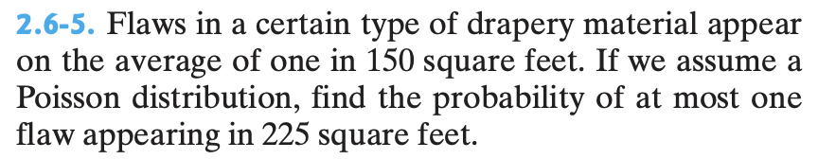

Slide 2
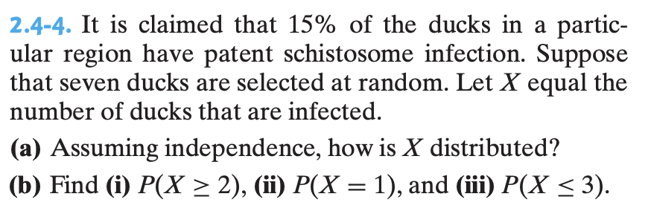
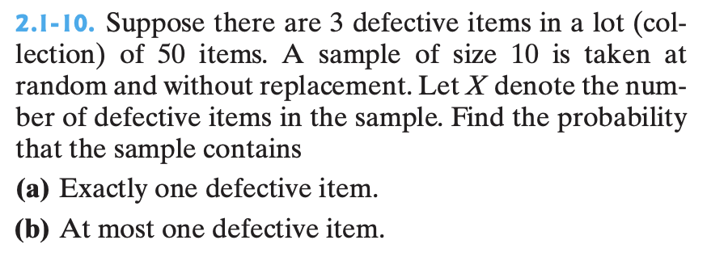
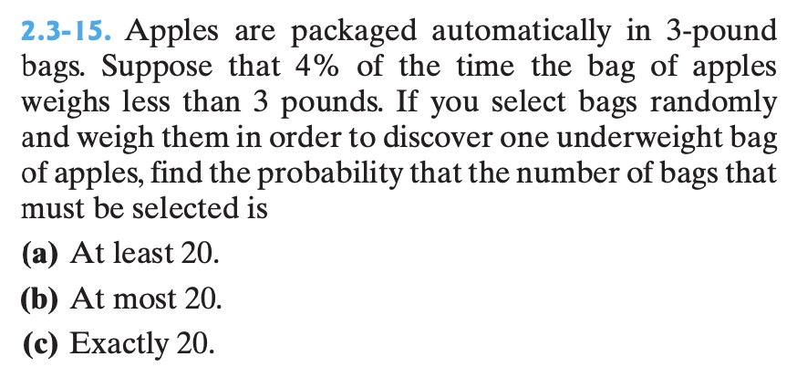
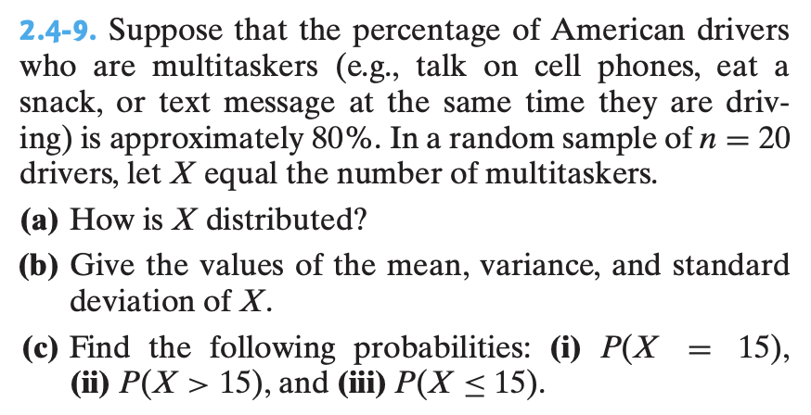
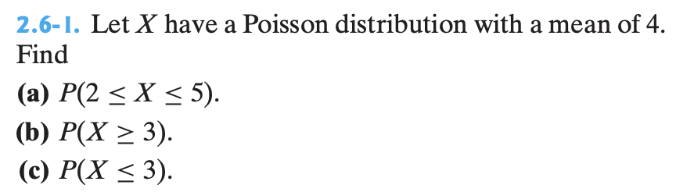

Slide 3
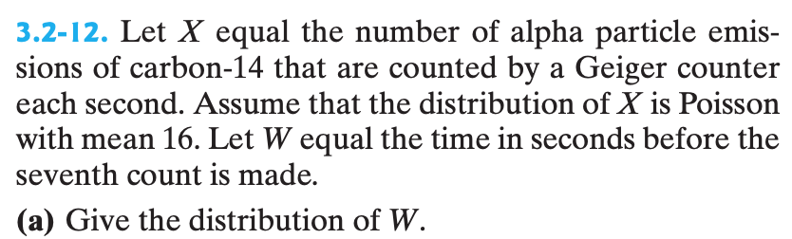
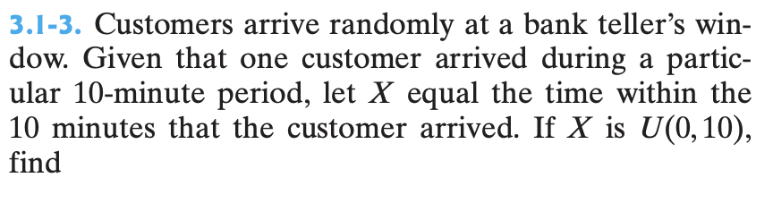
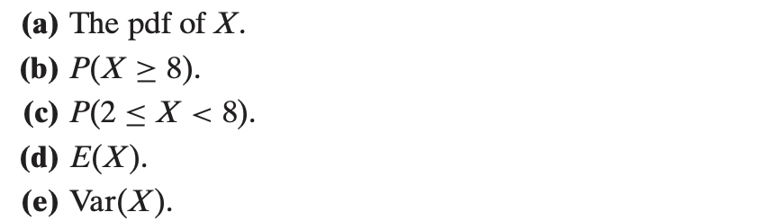
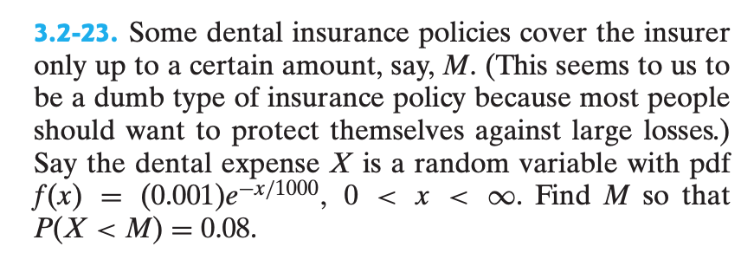
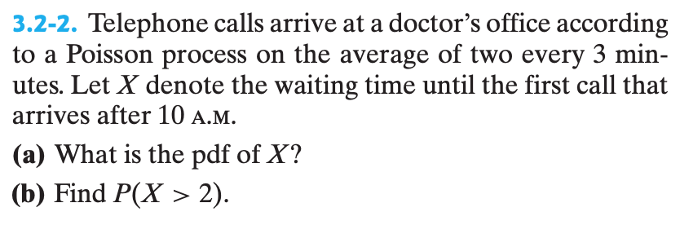
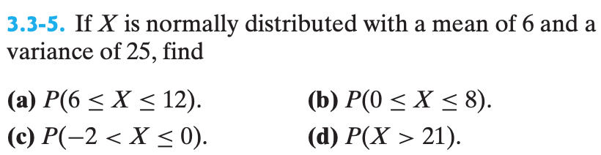
3.2-16. Cars arrive at a toll booth at a mean rate of 5 cars every 50 minutes. Find the following probabilities of waiting for the first customer to arrive.
(a) P(T < 28 min)
(b) P(T > 20 min)
(c) P( 15 < T < 22 min)
(d) Now suppose the toll collector is waiting for the 60th customer. Approximate the probability the total weight time is less than 8 hours and 20 min (totals 500 min)

Slide 4
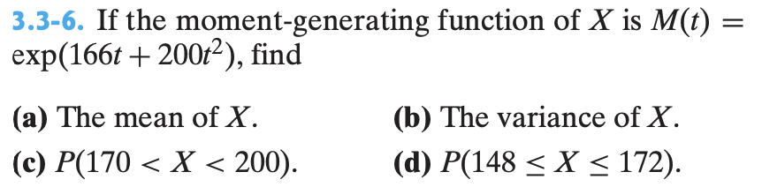
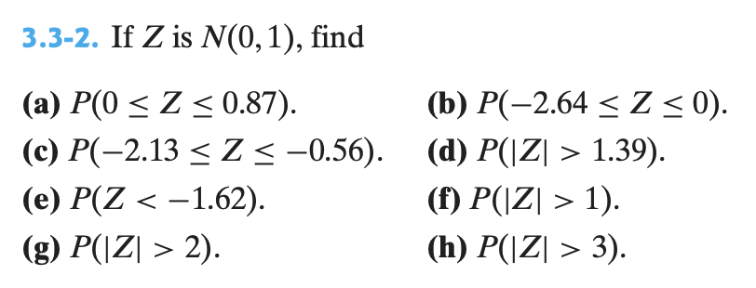
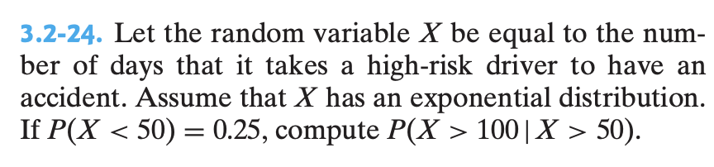

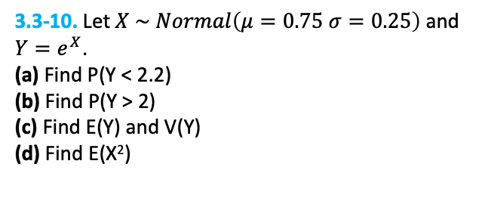
3.3-10. Let $X \sim Normal\left(μ=0.75 σ=0.25\right)$ and $Y=e^{X}$.
(a) Find P(Y < 2.2)
(b) Find P(Y > 2)
(c) Find E(Y) and V(Y)
(d) Find E(X²)
3.3-15. Let $X \sim Beta\left(α=2,β=4\right)$
(a) Find E(X) and V(X)
(b) Find P(X < 0.5)

Slide 5
select Answers
** note all normal probabilities s were found with normalcdf()
so z-table answers will be close
2.5-1) a) Prob ≈ 0.2824
b) Prob ≈ 0.0236
2.5-3) a) E(X) ≈ 16.67, V(X) ≈ 11.11
b) Prob ≈ 0.1240
2.1-14) Prob ≈ 0.60
3.2-23) M ≈ 83.38
3.2-2) b) Prob ≈ 0.2636
3.3-5) a) Prob ≈ 0.3849
b) Prob ≈ 0.5404
c) Prob ≈ 0.0603
d) Prob ≈ 0.0013
2.1-10) a) Prob ≈ 0.3980
b) Prob ≈ 0.9020
2.4-9) b) E(X) =16 , V(X) = 3.2
c) i) Prob ≈ 0.1746
ii) Prob ≈ 0.6296
iii) Prob ≈ 0.3704
3.3-2) a) Prob ≈ 0.3078
b) Prob ≈ 0.4959
c) Prob ≈ 0.2712
d) Prob ≈ 0.1645
e) Prob ≈ 0.0526
3.2-24) Prob = 0.75

Slide 6
2.4-20) a) Prob ≈ 0.1607
b) Prob = 0.51
c) Prob ≈ 0.55
d) Prob ≈ 0.2
2.3-13) Prob = 0.1024
2.6-5) Prob ≈ 0.5578
3.2-16) a) Prob ≈ 0.9392
b) Prob ≈ 0.1353
c) Prob ≈ 0.1123
d) Prob ≈ 0.0984
2.4-4) b) i) Prob ≈ 0.2834
ii) Prob ≈ 0.3960
iii) Prob ≈ 0.9879
2.3-15) a) Prob ≈ 0.4604
b) Prob ≈ 0.5580
c) Prob ≈ 0.0184
2.6-1) a) Prob ≈ 0.6936
b) Prob ≈ 0.7619
c) Prob ≈ 0.4335
3.3-10) a) Prob ≈ 0.5611
b) Prob ≈ 0.5899
c) E(X) ≈ 2.1842, V(X) ≈ 0.3077
d) E(X²) ≈ 5.0784
3.3-15) a) E(X) ≈ 0.3333, V(X) ≈ 0.0317
b) Prob = 0.8125

