Slide 1










Example: $a=2, b=3, a+b=5$
Given survived to $a=2$
Probability survive to $a+b=5$
$$P(T>2+3∣T>2)$$
0
$$a=2$$
$$a+b=5$$
$≈$ shifting starting point
$$P(T>3)$$
0
$$b=3$$
Survive to $b=3$ from start

Slide 2
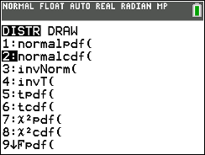
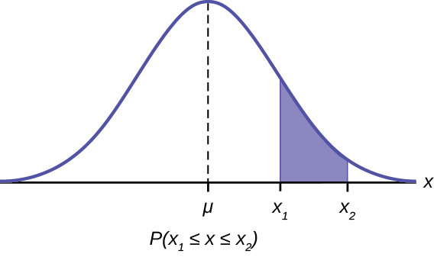
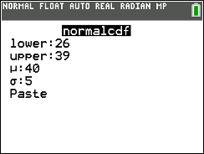
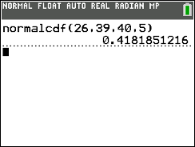
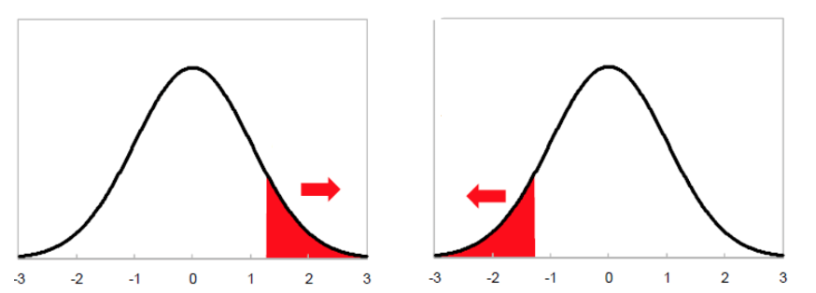

Finding Probabilities
1. Choose correct Dist: 2ND → VARS
  ALWAYS want normalcdf()
2. Enter in information (endpoints and parameters)
  lower = lower boundary
  upper = upper boundary
  μ = Mean
  𝞂 = SD
- If you have TI-83, you would type normalcdf(lower, upper, mean, sd)
*** Special Cases
If finding a left tailed probability, enter lower = -10000 (some really big negative number)
If finding a right tailed probability, enter upper = 10000 or 10^6 (really big positive number)
Ex) If $X \sim Normal\left(μ=40, σ=5\right)$,
$P\left(26 < X < 39\right)$

Slide 3
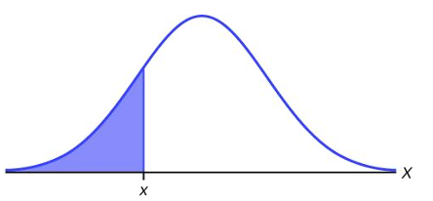
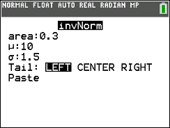
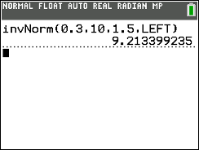



Finding Percentiles
Choose invNorm(): 2ND → VARS
Enter in information (area and parameters)
  area = Probability (LEFT, percentile!)
  μ = Mean
  𝞂 = SD
If you have TI-83, you would type invNorm(area,mean,sd)
*** If you have a right tail (upper probability), you need to rewrite as probability to the left!
$$P\left(X<x_{p}\right)=0.3$$
Ex) If $X \sim Normal\left(μ=10, σ=1.5\right)$,
$x_{0.30}≈9.21$
$$x_{p}= ??$$

Slide 4
