Slide 1
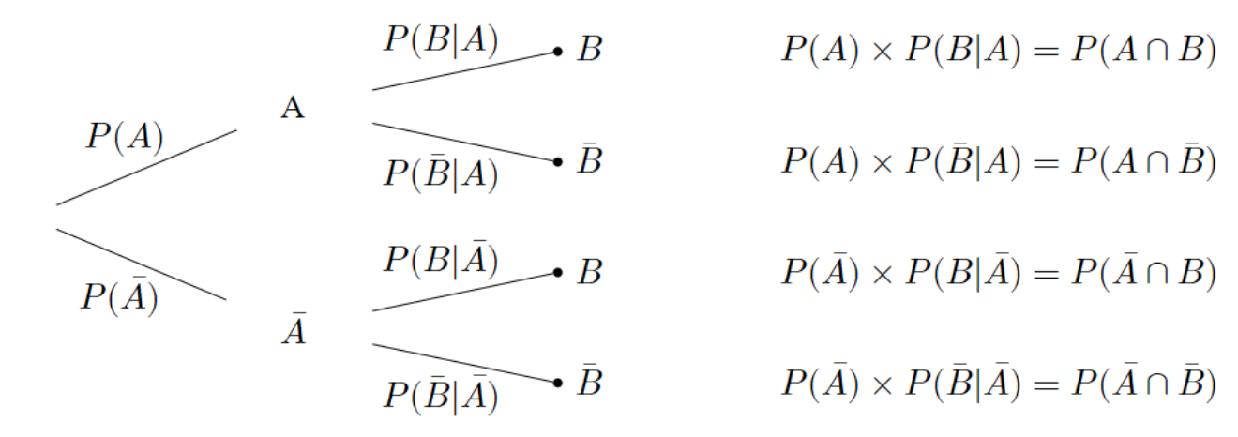
Stage 1
Stage 2
Probability and Outcome

