Slide 1
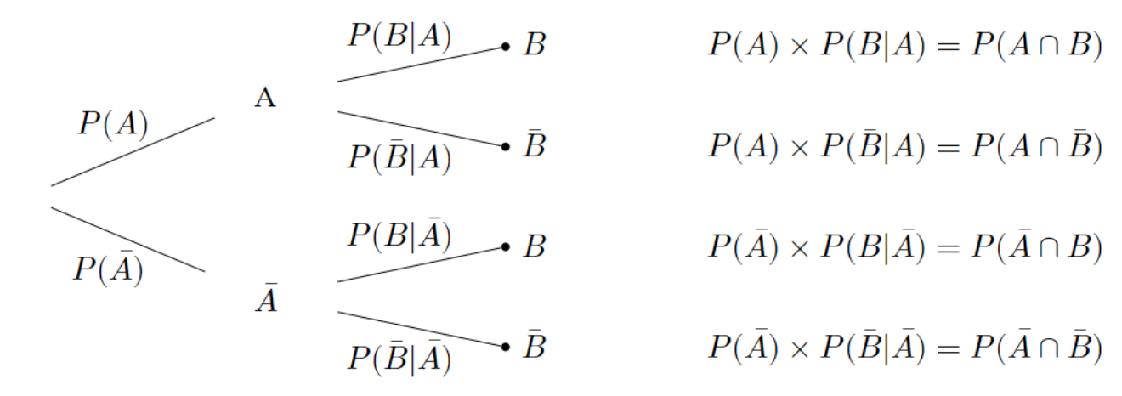
Stage 1
Stage 2
Probability and Outcome
Branch
1
2
3
4

Slide 2
Disease
Test
Outcome / Probability
Branch
Y
(D, Y)
1
D
2
(D, N)
N
Y
3
(~D, Y)
~D
N
4
(~D, N)

