Slide 1
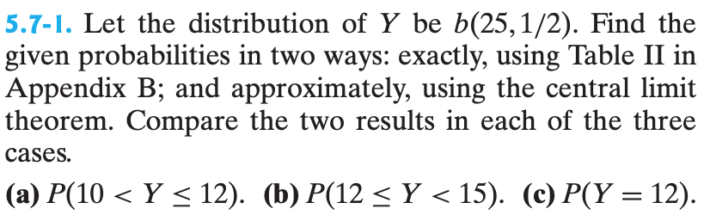
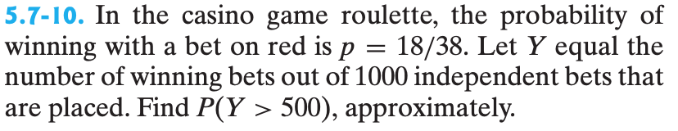
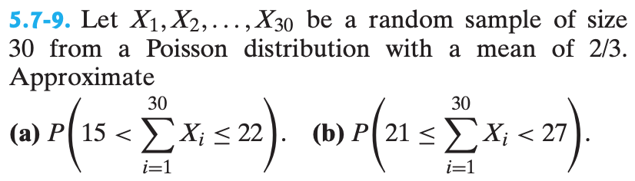

Problem source color codes:
Stat inference
Math stats with apps
Original
Normal approximation to discrete dists
$$Y\sim Bin\left(25,0.5\right).$$
i) Exactly using the binomial distribution
ii) Approximately using normal approximation to the binomial (with continuity correction)

Slide 2
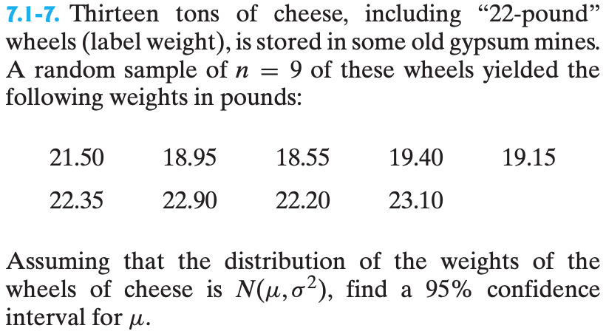
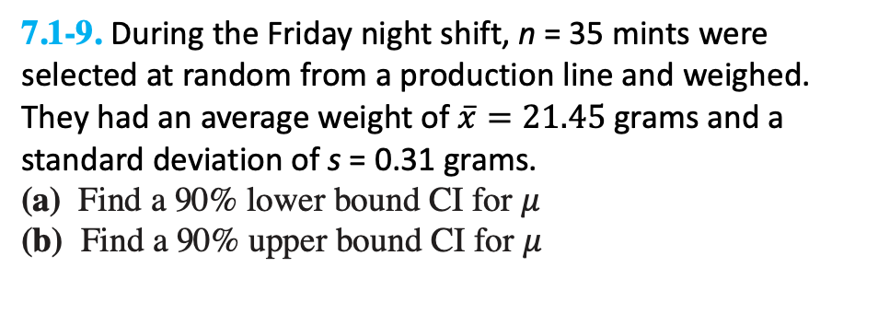
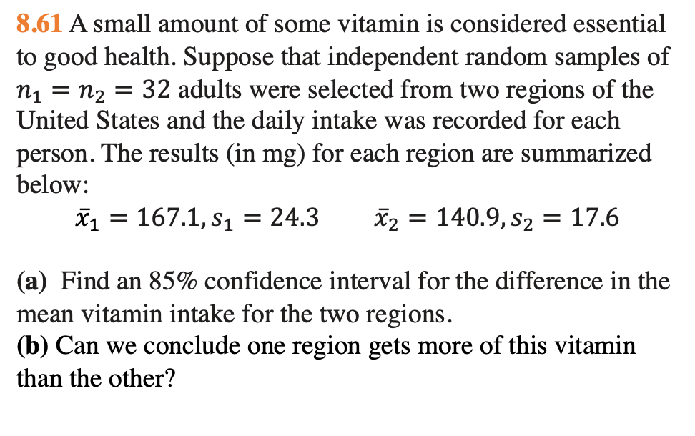
7.1-9. During the Friday night shift, n = 35 mints were selected at random from a production line and weighed. They had an average weight of $\overline{x}=21.45$grams and a standard deviation of s = 0.31 grams.
(a) Find a 90% lower bound CI for 𝜇
(b) Find a 90% upper bound CI for 𝜇
Confidence intervals
8.61 A small amount of some vitamin is considered essential to good health. Suppose that independent random samples of $n_{1}=n_{2}=32$ adults were selected from two regions of the United States and the daily intake was recorded for each person. The results (in mg) for each region are summarized below:
$${\overline{x}}_{1}=167.1, s_{1}=24.3 {\overline{x}}_{2}=140.9, s_{2}=17.6$$
(a) Find an 85% confidence interval for the difference in the mean vitamin intake for the two regions.
(b) Can we conclude one region gets more of this vitamin than the other?
(a) Find a 95% CI for 𝜇
(b) Find a 90% CI for 𝜇
8.56 In a Gallup Poll of n = 800 randomly chosen adults, 45% indicated that movies were getting better.
(a) Find a 98% confidence interval for p, the overall proportion of adults who say that movies are getting better.
(b) Does the interval include the value p = .50? Do you think that a majority of adults say that movies are getting better?

Slide 3
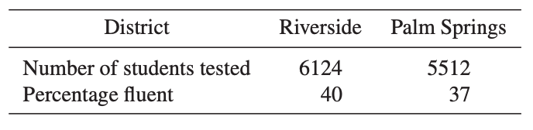
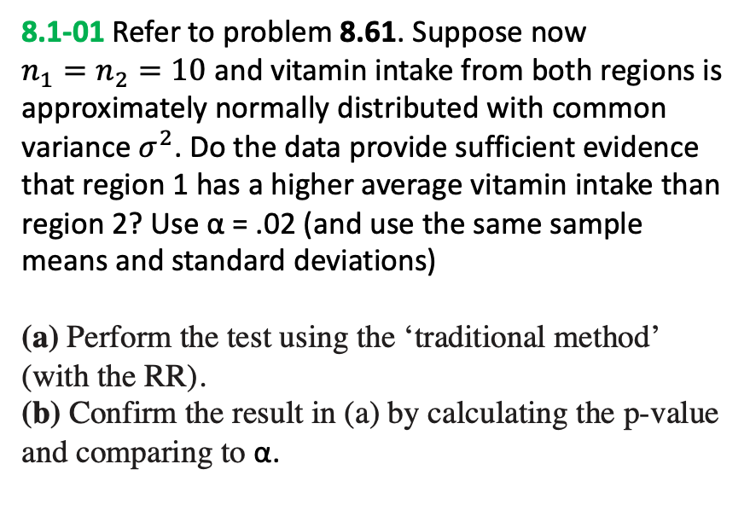
Hypothesis tests
8.1-0 Refer to problem 8.56. Do the data provide sufficient evidence that the true proportion of adults who say movies are getting better is greater than 0.42. Use α = .05.
(a) Perform the test using the ‘traditional method’ (with the RR).
(b) Confirm the result in (a) by calculating the p-value and comparing to α.
10.27 Results for the proportion of non-native English-speaking elementary students who have become fluent in English for two school districts in southern California are shown below.
Do the data indicate a significant difference in the 2003 proportions of students who are fluent in English for the two districts? Use α = .01.
(a) Perform the test using the ‘traditional method’ (with the RR). Can we conclude which region has a higher proportion?
(b) Confirm the result in (a) by calculating the p-value and comparing to α.
8.1-01 Refer to problem 8.61. Suppose now $n_{1}=n_{2}=10$ and vitamin intake from both regions is approximately normally distributed with common variance $σ^{2}$. Do the data provide sufficient evidence that region 1 has a higher average vitamin intake than region 2? Use α = .02 (and use the same sample means and standard deviations)
(a) Perform the test using the ‘traditional method’ (with the RR).
(b) Confirm the result in (a) by calculating the p-value and comparing to α.

Slide 4
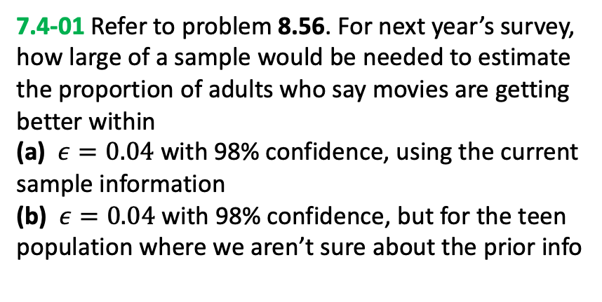
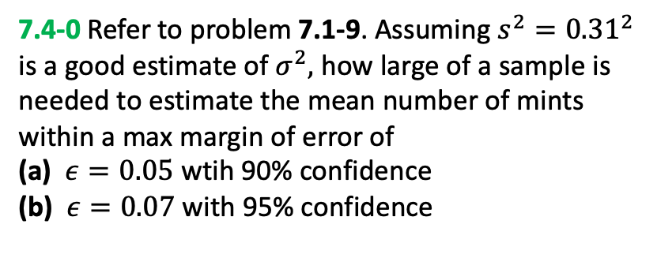
Sample size
7.4-0 Refer to problem 7.1-9. Assuming $s^{2}=0.31^{2}$ is a good estimate of $σ^{2},$ how large of a sample is needed to estimate the mean number of mints within a max margin of error of
(a) $ε=0.05$ wtih 90% confidence
(b) $ε=0.07$ with 95% confidence
7.4-01 Refer to problem 8.56. For next year’s survey, how large of a sample would be needed to estimate the proportion of adults who say movies are getting better within
(a) $ε=0.04$with 98% confidence, using the current sample information
(b) $ε=0.04$ with 98% confidence, but for the teen population where we aren’t sure about the prior info

Slide 5
Answers
5.7-1
(a) Normal: 0.288
Binomial: 0.2878
(b) Normal: 0.4436
Binomial: 0.4428
(c) Normal: 0.1554
Binomial: 0.1550
5.7-10
0.0447
5.7-9
0.5548
0.3824
7.1-7
(a) [19.471, 22.329]
(b) [19.748, 22.052]
8.56
(a) [0.40908, 0.49092]
** answers may vary slightly due to rounding, but should be close
7.1-9
[21.383, infty)
[0, 21.517]
8.61
[18.565, 33.835]
10.27
TS = -0.12
p-value = 0.904
8.1-0
TS = 1.719
p-value = 0.0428
8.1-01
TS = 2.761
p-value = 0.0064
7.4-0
105
76
7.4-01
838
846

