Slide 1


$$Y$$
$$X$$

Slide 2
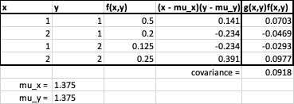

Slide 3
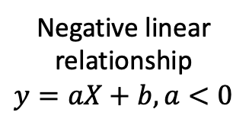
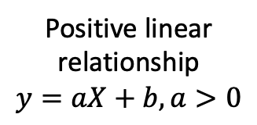
–1
0
1
Negative linear relationship
$$y=aX+b, a<0$$
No linear relationship
Positive linear relationship
$$y=aX+b, a>0$$

Slide 4




$$Y$$
$$X$$
$$Y$$
$$X$$

