Slide 1
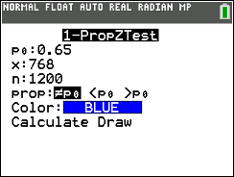
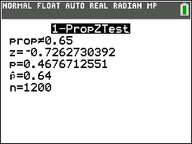
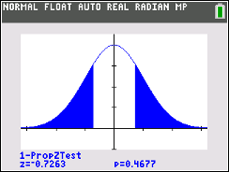
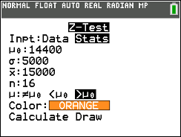
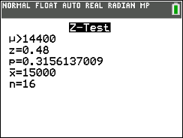
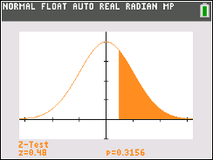


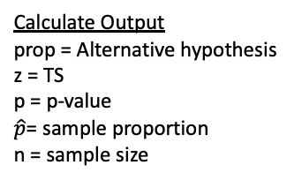

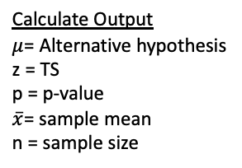
One proportion test: $p$
STAT > TESTS >
Calculate Output
prop = Alternative hypothesis
z = TS
p = p-value
$\hat{p}$= sample proportion
n = sample size
Draw Output
Plot (and displays values) of p = p-value and z = TS on the standard normal curve
H₀: p = 0.65
H_{A}: p ≠ 0.65
*This does NOT give us the Critical Value $z_{α/2}$, we have to figure that out ourselves
One mean test: $μ$
Calculate Output
$μ$= Alternative hypothesis
z = TS
p = p-value
$\overline{x}$= sample mean
n = sample size
H₀: μ = 14,400
H_{A}: μ > 14,400

Slide 2
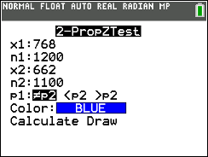
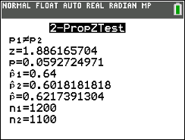
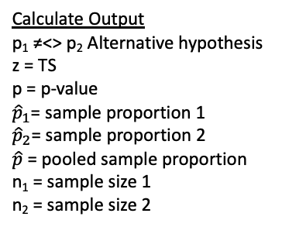
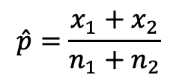

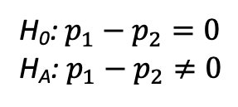
Two proportions test: $p_{1}−p_{2}$
STAT > TESTS >
Calculate Output
p₁ ≠<> p₂ Alternative hypothesis
z = TS
p = p-value
${\hat{p}}_{1}$= sample proportion 1
${\hat{p}}_{2}$= sample proportion 2
$\hat{p}$ = pooled sample proportion
n₁ = sample size 1
n₂ = sample size 2
$$\hat{p}=\frac{x_{1}+x_{2}}{n_{1}+n_{2}}$$
H₀: $p_{1}−p_{2}=0$
H_{A}: $p_{1}−p_{2}≠0$

