Slide 1
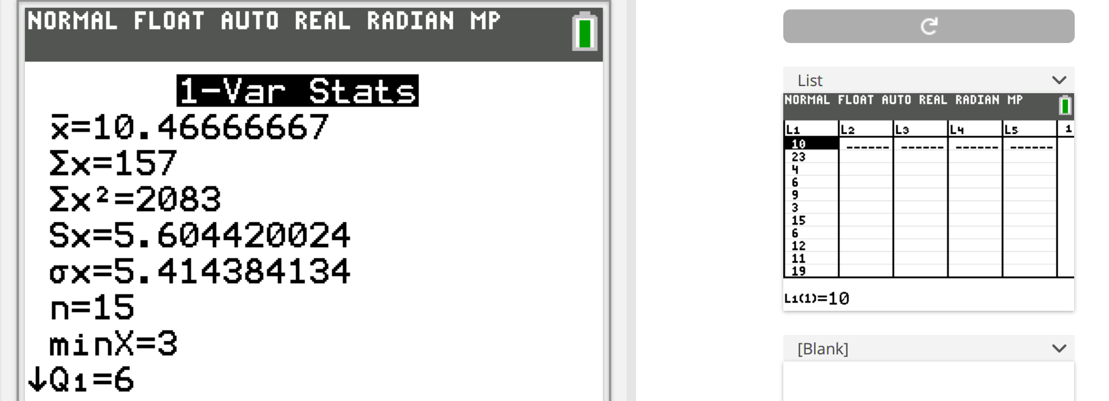
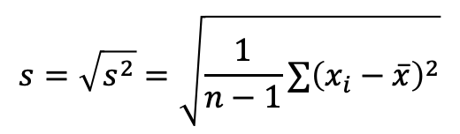
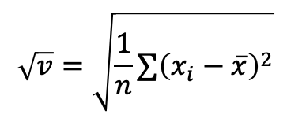
$$s=\sqrt{s^{2}}=\sqrt{\frac{1}{n−1}∑{\left(x_{i}−\overline{x}\right)}^{2}}$$
$$\sqrt{v}=\sqrt{\frac{1}{n}∑{\left(x_{i}−\overline{x}\right)}^{2}}$$

