Slide 1
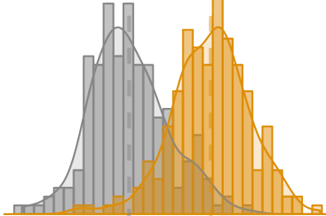


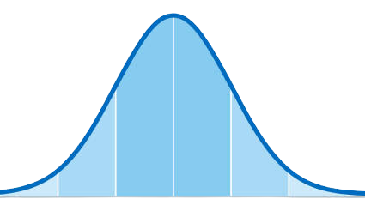




Probability
Mathematical Statistics
CG
Data Visualization
Quantitative Reasoning
Elementary Statistics

Slide 2


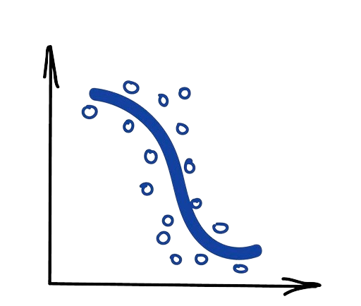
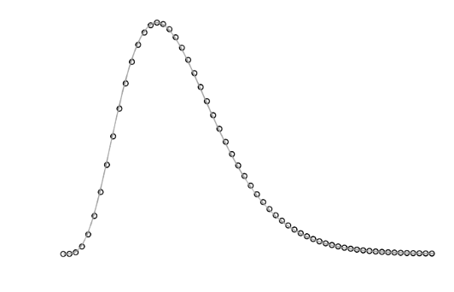
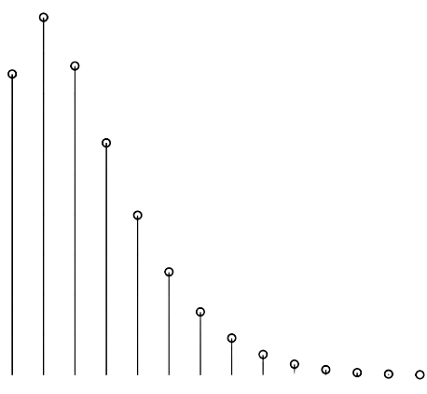


Climate
Data Viz
Gibbs Sampling
Computational Methods
Regression
Master’s
Project
Bayesian
Statistics

