Slide 1
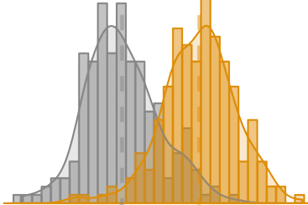


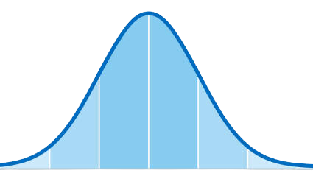




Probability
Mathematical Statistics
CG
Data Visualization
Quantitative Reasoning
Elementary Statistics

