Slide 1
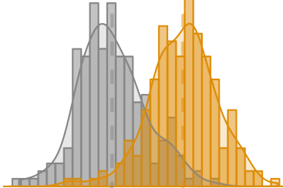


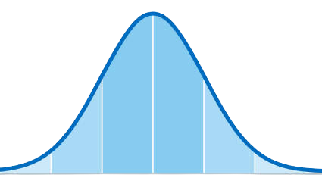




Probability
Mathematical Statistics
CG
Data Visualization
Quantitative Reasoning
Elementary Statistics

Slide 2


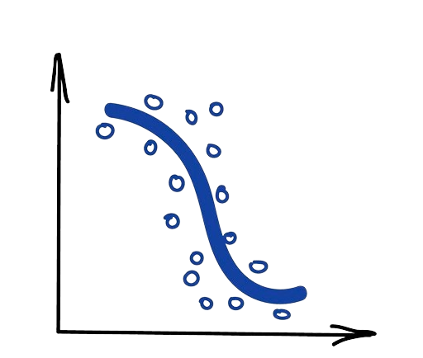
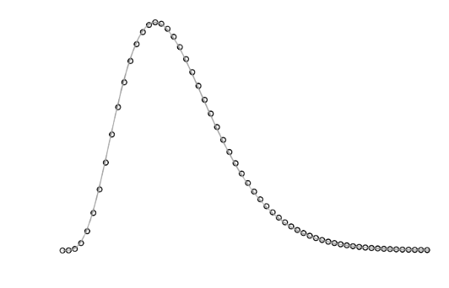
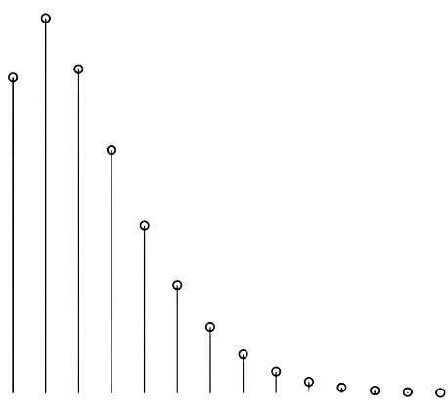



Climate
Data Viz
Gibbs Sampling
Computational Methods
Regression
Master’s
Project
Bayesian
Statistics
MAS I

Slide 3




Exam 5
Work
Learning
python

