Slide 1

Welcome to Pear Blossom Place; a Family Support Community!

Slide 2
Training Agenda
Introductions
Programs & Brief history of FSC
Getting familiar; shelter units, common rooms, laundry, TV, doors…
Privacy, Safety, Confidentiality
Domestic Violence 101
Conflict Resolution
Smoking Policy
Line of Sight Supervision
Lights Out
Storage Area/ Parking
Service Animals
Security Measures
In the event of….
General Policies, Boundaries, Mandated Reporting (*activity)
Coordinated Entry
Answering the Shelter Line, Finding Resources
When We Have Space
On-Call Staff
Volunteer Shifts, Purposeful Overlap
Shelter Website How-to with Volgistics
Staff Contact Information
Questions/feedback at the end! ☺

Slide 3
Tell us who you are!
Name
How did you hear about this volunteer opportunity?
What are you MOST excited for?

Slide 4
Family Support Center Programs
FSC has been in our community since 1992. Our mission is Working Together to Strengthen ALL Families.
We offer a variety of programs and services to families in our community including:
Parent & Child Education providing free evidence based parent education classes, community cafés, family engagement activities, early learning, and on-site childcare for workshops and support groups.
Homeless Family Services / Pear Blossom Place, is the coordinated entry point for ALL homeless families with children in Thurston County, offering the largest 24 hour emergency homeless family shelter in Thurston County, in addition to 7 permanent affordable housing units, and rapid re-housing.
Family Resource Services provides families with access to basic needs including clothing, food, shelter, healthcare, holiday assistance, transportation, diapers, and a kiosk connecting families to mainstream social services benefits

Slide 5
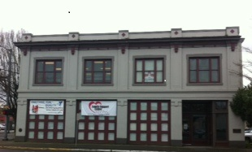
FSC Programs Continued
Thurston County Family Justice Center is the second of its kind in Washington State, providing best practice collaborative and collocated community based and criminal justice services to survivors of domestic violence, sexual assault, and human trafficking. This is in partnership with community agencies and the Thurston County Prosecuting Attorney, Clerk, and Sheriff’s Offices.
Supervised Visitation Foster Child Support provides safe visitation, sibling visits, and transportation.
Our goal is to be a One Stop Shop for families, so they can access a variety of basic needs and support in one location.
Our main office is located at 201 Capitol Way N in downtown. In that location we offer our services and supports to families.

Slide 6
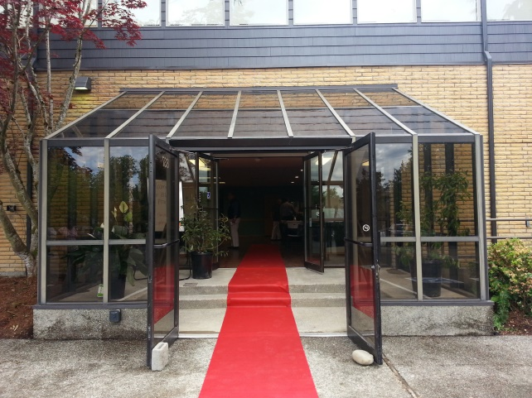
Grounding us in history….
We took on the family shelter on November 1, 2009 because it was a need in our community. We rotated from church to church for a few months, then settled at First Christian Church; shelter used to be 5pm-7am.
We acquired this building, formerly The Smith Building, through a grant process with the City of Olympia. We purchased it for $1 and made a 40 year commitment to provide a family shelter and permanent affordable housing. We raised $2 million for rehabbing and construction.
Over 18 months this building has been transformed to provide a shelter for families with children, in addition to 7 permanent affordable housing apartments-
forever homes- for families, with supportive services on site. We moved here July 1, 2014.

Slide 7
Who Do We Serve?
We serve families with children. Typically mom + children, mom & dad + children, pregnant mom with partner, mom & dad & grandma + children.
We are FLEXIBLE. We accept the family as they present themselves. We work to strengthen the family unit, regardless of it’s makeup.
We work with families from the LGBQT community. It is important to have awareness and understand our own judgments. We serve ALL families with compassion, dignity and respect.
We “screen people” into shelter, completing full criminal background checks and Registered Sex Offender Checks on all adults. We will not allow anyone into shelter with violent offenses or arson. Our directors take close look at all background checks, and always think about the safety of families and volunteers.

Slide 8
Individual Shelter Units
Big step from communal living! Our research tells us that individual shelter units will make life a whole lot better!
All units have their own bathrooms (with the exception of unit 103), cooktop, refrigerator, closets, kitchen table & chairs, bunk beds, highchair, crib, windows.
Unit 103 is wheelchair accessible, and will use the bathrooms in the community room and the communal shower.
Some families will share units. Our capacity is 36, and it will be up to the Property Manager to coordinate the units to make sure we’re making the best use of all available space. We have 30 bunk bed spaces, in addition to 6 playpens.
Volunteers will not be expected to move families or worry about
where to put families after hours. We’ll have a plan!

Slide 9
The Common Bathrooms & Laundry Room
There are two public men’s and women’s bathroom in the common area, in addition to a shower. The shower must be locked at all times.
We ask that you keep an eye on the bathrooms and have an awareness of what’s happening throughout the shelter. We want to make sure children aren’t in there alone (if little), someone isn’t taking in a child that doesn’t belong to them, etc.
Volunteers have access to the laundry room, and can pre-measure laundry soap, which is kept at the reception area. Families can use the stackable laundry machines only.
Families have a specified day to wash their own bedding and clothing.
*Host bedding washed every Monday; hosts recommended to bring their own sleeping bags and pillow cases! ☺

Slide 10
Common Area & Kitchen
Families are welcome to hang out in the common area up until 9PM. We encourage volunteers to engage with the families, help with homework, read books, watch the Seahawks game, etc.
We ask that the computer in the common area is only for job & housing search, resume development, and professional needs. We ask that kids are not playing games on it.
The kitchen in the common area is just for staff and volunteer use. Families can use the oven if they ask, and they should leave it cleaner than they left it!
The dish washer is not for guests! ☺

Slide 11
Television
We have a television in the community room. It has basic cable and may have access to Netflix for movies.
Volunteers and staff have control of this ONLY, and the TV needs to be off by 9pm every night.
When we have Netflix, please do not log into your own account.
Use your judgment- family friendly only. Nothing inappropriate and be firm.
Do not relinquish the remote! Remotes are to be kept in the locking filing cabinet at the reception desk.
Please make sure the TV turns off. The Comcast Remote will not turn it off- use the small TV remote or manually turn it off- bottom left back corner of TV.

Slide 12
Coming & Going
Families are allowed to come and go until 10pm.
We encourage people to go OUT, enjoy the sunshine, job search, take the kids to the park, go to dinner… do things that you and I do on a daily basis.
The main door into shelter (facing the parking lot) is to remain locked at all times. Families must enter/exit through the “After Hours Entrance” on the west side of the building. They will ring the door bell and be let in by staff or volunteers.
When families enter/exit the building, they must sign in/out at the reception desk.
Visitors are not allowed. This includes a grandparent, friend, cousin, etc.

Slide 13
Keys & Doors
Each adult guest/family has a key card that gives them access to their own unit. The key cards are programmable, and staff will be responsible for “turning keys off” if someone leaves shelter and doesn’t return their key.
The property manager and other staff will be responsible for issuing cards to new guests. If you bring someone into shelter at night or someone’s card stops working, you do not need to worry about getting them a key card.
There is one set of “Master” keys for volunteers. They are clearly labeled, and include keys for the shower room, door alarms, offices, and locks for the supply closets. There is also a master key fob attached that gives you access to all rooms, upstairs, bike room and laundry.

Slide 14
Doorbell & Camera
The front doors to shelter (where the FSC logo and "Pear Blossom Place" sign is) must be locked at all times.
Families, staff, and volunteers must enter on the right side of the building, "After Hours Entrance".
There is a door bell there with a camera, which is monitored from the reception desk.
The door is magnetic, so when you “unlock” the door, it releases the magnet. It will automatically reset.
To exit, you can push the green button on the left hand side of the door, and the sensor will release the door.
Please periodically check all doors during your shift to ensure they are locked.

Slide 15
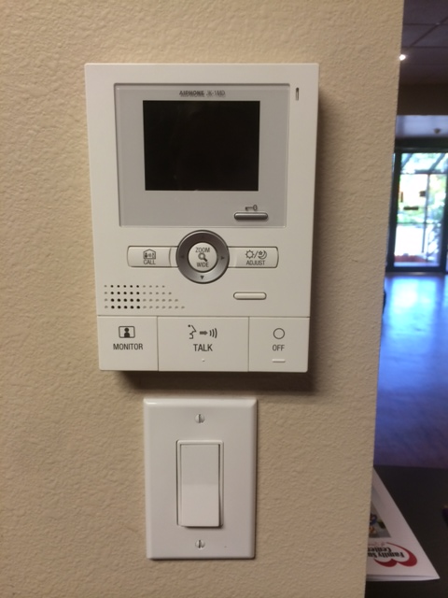
Press this button once to unlock the door and let someone in.
You can press this button to zoom in/out if you’re having a hard time seeing on the screen.
To talk to the person and ask who it is, press and hold the talk button. Release to hear.
This switch is deactivated and doesn’t do anything ☺

Slide 16
Managing Privacy & Safety
We have to find the balance between a family’s right to privacy and dignity to be in their own unit with their family, and the overall safety of families and volunteers.
We ask that all volunteers “knock” before entering a unit. “It’s Katherine- can I come in?” Take it from there.
If you hear yelling, crying, something out of the ordinary, please check.
Follow your gut, ask your co-volunteer. Remember your safety and the safety of the guests and children.
If anything is unsafe, violent, threatening… call 911.
Entering the units should be for emergency situations only. If you and a family are chatting, please do so in the community area.

Slide 17
Confidentiality
We must keep confidentiality 100% of the time!
This includes; not talking to guests about other guests or volunteers.
We cannot release any info via phone, such as who is staying here! When in doubt, take a message and tell the caller you will
pass it to your supervisor.
Child Protective Services, law enforcement or other social service providers cannot enter shelter unless they are approved/expected, and staff are present. The only exception is if you call 911 in the state of an emergency.
Visitors are not allowed; grandparents, friends, partners, etc…

Slide 18
Domestic Violence 101
We are NOT a Domestic Violence shelter—however, many of our clients are impacted by Domestic Violence from their past or current situation.
Why confidentiality is essential; safety is increased when confidentiality is respected. Abusers can be very resourceful…it is our job to keep all families safe!
Every person has the right to privacy. Asking about someone about their history of domestic violence can be triggering and tough. We work to ask as few questions as possible, while gathering the most important information at this moment. Are they safe? Are they fleeing a domestic violence situation? Is someone looking for them?
You can always refer survivors to our main office to meet with an advocate Monday-Friday during normal business hours. Additional resources are in the binder at the front desk.
IF a DV incident occurs at shelter, notify on-call staff IMMEDIATELY and they can walk you through the next steps. If the situation escalates to where safety is jeopardized, call 911.
Please make sure to keep an eye on the shelter website to ensure you
know who is allowed and approved to be at shelter.

Slide 19
Scenario…
You hear the door bell, the camera screen pops up, but you can’t make out the face of the person. He says his name is Tim and he’s here to visit his friend Jenna, who is staying here…Jenna over hears and says to you “Yes, I have a friend named Tim, you can let him in.”
Tim’s name is not listed on the website as an approved guest, staff are not present.
What is the best option? (Discuss with your neighbor)
a.) Unlock the door, let Tim in.
b.) Ask Jenna to see if she recognizes Tim’s voice or clothing through the camera before letting her in.
c.) Tell Tim “I’m sorry, but you can’t visit Jenna right now. You’ll have to wait until staff are here tomorrow during day time hours.”
d.) “I’m sorry, I can’t verify whether or not Jenna is staying here. If you
would like to leave your number, I can have staff call you tomorrow.”

Slide 20
Smoking
Smoking is not allowed anywhere on the property of Pear Blossom Place. This building meets the Evergreen Sustainability Standards, and we cannot have smoking anywhere on the property.
Smokers must leave the property—including Pear St. and the stairs—and smoke on the side walk or on the benches along 8th Avenue.
No one should smoke on the steps going down to Pear St. It’s still our property!
Vapor and E-Cigarettes are not allowed.
We ask that volunteers abstain from smoking while on shift; we need at least 2 people present at shelter at all times.

Slide 21
Line of Sight Supervision
We ask that parents have line of sight supervision on their children at all times. If parents are in their room, kids need to be in the room with them; if kids are in the common areas, parents are in the common areas, etc.
Kids cannot be at shelter without their parent/guardian, and cannot be watched or “babysat” by another family, roommate or volunteer.
If kids arrive at shelter without their parents, please reach out to staff (on-call support listed on website) and we will troubleshoot; how else can we get in touch with the parent? How old is the child? What are the circumstances, etc…

Slide 22
Lights Out Time
Everyone should be settling down in their individual units by 9:00pm.
From time to time parents work late or have an event and will be in after 9pm; this is communicated via the shelter site; staff usually know in advance.
If kids are asleep, parents need to be in the unit. They cannot go out to smoke or hang out in the common area and leave their children alone.
Guests should not be visiting each other in their units (before or after lights out time) they may visit in the common areas.

Slide 23
Bike & Stroller Storage
There is a secure area for guest’s bikes and strollers, volunteers have the master key to open the door.
*This is also where we keep our mats, sleeping bags etc. for Cold Weather shelter.
Bikes and strollers should not be kept in front of the emergency exits!
Parking
Volunteers, shelter guests, and apartment residents are allowed to park in our parking lot.
Please do not approve anyone to park in our lot overnight (ie: someone in an RV etc). Any questions check with your backup.

Slide 24
Service Animals
We do accept all service animals.
Pets are not allowed. Families have to make other arrangements for pets.
Fair housing prohibits you from questioning them about their service animal or their disability. If you have any questions or concerns about it, please speak with staff.

Slide 25
Security Measures
The lights in the common room will stay on at all times. This allows for clear visual in the open space, bathroom entrances, etc.
Guests will be buzzed in all the time.
There are always a minimum of two volunteers, staff or interns.
Hosts are allowed to sleep, but we ask that you keep the door partially opened so you can hear if guests need you, someone buzzes to come in, or the phone rings. Please do not cover the windows.
There are 2 red alarmed emergency exits out of shelter. If the door is opened, an alarm will go off. To turn it off you need to use the Master Key.
If we have to evacuate, our meeting point is: the sidewalk on 7th Avenue.

Slide 26
In the event of….
In the event of an active fire, the sprinkler and alarms will automatically activated. The Fire Department will automatically be called and everyone will need to evacuate out of the closest emergency exist. *Once you leave, DO NOT re-enter the building!
Each shelter unit has an egress window for emergency exit.
Grab the sign in/out book so you know who to account for when evacuating.
In the event of a power outage, all of the key doors and exits are on a battery backup. This will rarely happen as we’re on the city grid! The first to have our power back!
First Aid kits are located throughout the building- 2 in the reception area.
If someone is injured, their parent will need to fill out an incident report that you can find in the filing cabinet top drawer at the reception desk. (Ie: Child hits their head and first aid is administered, a form needs to be completed by the volunteer & parent).
Anytime you have an emergency, notify on-call staff!

Slide 27
General Policies
Always make sure there is another adult present in the room when you are with children.
Limit physical contact with children and guests.
Engage parents in the conversation- “Hey, can I help Johnny with his homework?”
Make your presence known, it makes guests feel safe!
Families & children have to sleep in their own unit.
Children under the age of 6 should not be sleeping on the top bunk. The mattresses are light and can slide under the bottom bunk to trundle if needed.

Slide 28
Boundaries
Personal and professional boundaries with families is crucial. You are an extension of staff, and we ask that you maintain professional boundaries at all times.
Have an “elevator speech”. We want you to be genuine, but do not over-share.
Never give out your personal contact information- phone, email, Facebook etc.
Prepare for transitions and good byes.
If you feel connected with a family or want to know how you can help, talk with staff before you give out any personal information.
Clients are never allowed in your vehicle or your home.

Slide 29
Scenario…
As you volunteer, you start become more attached to one family; they are very nice and respectful, always follow the rules, the kids really like you, etc…one day you run into the mom while you are out and about grocery shopping. She recognizes you, comes up to you and says she’s out of food stamps, and asks you if you would be willing to help her buy some food and give her a ride back to the shelter.
What would you do? (Discuss with your neighbor)
a.) Suggest that she spend her food stamps more carefully and to talk to DSHS.
b.) Gently decline, but inquire about the food pantry at shelter and talk to her about other community resources such as the food bank, as well as the Family Support Center/Pear Blossom Staff.
c.) Tell her “I’ll get you some food and provide a ride, but just this once.”
Because everyone needs a little help.
d.) Ignore her and pretend you don’t recognize her.

Slide 30
Scenario follow up;
*Check your pre-judgements and your ideas; (group discussion, pair in 2s/3s)
Do you think its helpful or harmful to share judgements or advice on lifestyle choices, circumstances or spending habits? Why or why not?
What does it mean to have boundaries? What are some personal boundaries that you have?
What does it mean to be “living in poverty”?

Slide 31
Mandated Reporting
You are ALL mandated reporters of child abuse and neglect. If you see something, say something! If you suspect a child is being abused or neglected, you are required by law to make a report to Child Protective Services.
You are the mandated reporter and have to make the call so that you meet your mandated reporter requirements.
Talk to staff if you have questions or concerns. If you make a report, we need to know. We will never tell the client you made a report, but need it to know when a report was made.
You will also need information from staff before making a call so all of the important information is included.
You have 24 hours to make the report. If making it from shelter, do so in a confidential space (Ie: NOT at the front desk).

Slide 32
Coordinated Entry
The Family Support Center is the Coordinated Entry point for ALL homeless families in Thurston County to access shelter and resources.
It is our responsibility to ensure that all homeless families are provided resources, referrals, and shelter space when available. It is more than “here’s a phone number”- it’s the coordination of services and support.
In Thurston County there are 2 other Coordinated Entry Partners- SideWalk (for homeless individuals without children under age 18) and Community Youth Services (homeless youth under age 24). Together we support the needs of the entire homeless community.
1-844-628-7343 is the coordinated entry hotline for anyone in our community to call 24/7 for support. It is an automated system, and based on 3 options the caller is routed to the appropriate shelter resource. Calls for families are automatically routed to the Family Support Center and Pear Blossom Place.

Slide 33
Answering the Phone…
“Pear Blossom Place, this is _____”.
We receive a variety of calls-
Families looking for shelter
Single individuals looking for shelter
People looking for a staff person
A domestic violence survivor fleeing and looking for shelter
Families calling looking for rental assistance, support…. Resources
The key when answering the phone is to be confident, take a breath, and listen to what the person is asking for.
Ask clarifying questions:
How can I help you today?
Do you have children? **This is key! Helps us determine if we are the proper service agency.
Have you been to our agency before?
Where are you located?
Do you need shelter tonight?

Slide 34
Answering the Phone con’t…
We want to make sure that we support the caller, understand their needs, and give meaningful and helpful referrals.
Sometimes they are looking for shelter and we’re full. It happens a lot, and it’s never fun telling someone we don’t have shelter that night. However, we always have resources. We always have creative minds to think of alternatives.
On nights when we don’t have shelter space…
*Refer them to the office during daytime hours to meet with staff, who will help them complete a vulnerability assessment and get on the waiting list. Let them know they can speak to a staff person between 9am-4pm Monday-Friday at 201 Capitol Way North. Staff will work to identify additional resources.
You can also ask “Do you have anywhere else you can stay tonight?”
Offer other out of county resources. Use the resource binders located at the desk!
If they’re in their vehicle, safe parking lots are often
WalMart, churches, close friend/family etc.

Slide 35
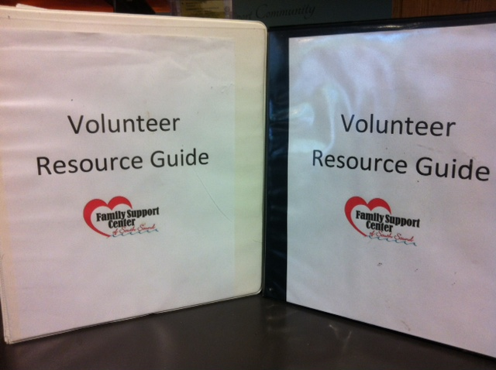
Finding Resources
There are two resource guides at the front desk which have lots of resources and tips for answering the phone, including a script and resources for singles/couples/youth/folks fleeing DV/etc. Don’t hesitate to put the caller on hold to help find the right resource, Google something, or troubleshoot with your other volunteer.
If it’s a question you’re not sure about, don’t hesitate to say “I’m actually not sure…” and ask if you can take a message with their name and good contact number. Let them know staff return in the morning and we’ll work to find the answer to their question.
If its an immediate need you can call your on-call staff and ask for tips and resources, and use your binders!

Slide 36
On-Call Staff
If you have any issues or crises while on your shift, you have a backup staff person available via phone. If it is something that can be addressed when staff arrive in the morning, please leave a note on the website.
If it is an emergency, call your backup!
Staff have an assigned day, and then there is a rotating 2nd backup person each week.
We will keep the shelter website updated with who your primary contact people are for that shift, in addition to having all other staff numbers listed at the shelter in the event you can’t reach your first two people.
*A tip- staff are answering from their homes, sometimes the store, a soccer game, the car. If it is not an emergency, please give them a few minutes to call back before calling the 2nd person. You are also welcome to text staff- that may get a faster response if we’re in a meeting or difficult place
to talk.

Slide 37
Scenario…
The teen daughter of the family in room 106 is out late past curfew; there are rumors that she’s been sneaking out of shelter to go drink with her friends. The father approaches you and asks that if she shows up that you do not let her in; he says she gets belligerent when she’s drunk and doesn’t want her to wake her sisters or other cause a disturbance for other families in shelter, and feels this will teach her a lesson.
How would you respond? What options do you have?
(Discuss with neighbors, report back)

Slide 38
Shelter Volunteer Shifts
Greeters
5-7:30pm *can come @ 5:30PM if needed!
Overnight Hosts
7:00pm-7:00am
*Friday/Saturday hosts stay until 9am
Weekend Hours; 9am-1pm, 1-5pm
*Ask about creating special events!
*There are always at least 2 people per shift.

Slide 39
Purposeful Overlap
Greeters and Hosts are purposefully scheduled to have a 30 minute overlap.
This allows for greeters to update the hosts. Please do! This is SUPER helpful.
It also allows for someone to run 5 minutes late due to traffic or a late meeting.
Please do not leave until there are 2 people to relieve you! *If you’re hosting, make sure you check in with morning staff before you leave.
When greeters arrive to shelter they will be relieving staff. Staff will update the greeters with what’s been happening, if we have shelter space, and any other important updates that will make the shift as smooth as possible.

Slide 40
Enrichment activities/events
*We LOVE when people want to come read with the kids, do an art project, lead a cooking class, offer additional resources to help families…the space and possibilities are open!
*If families don’t attend your event, it is nothing personal. Families at shelter have a lot going on, and sometimes have to balance activities, priorities, and deadlines.
*Please keep coming, and don’t be discouraged! We want your talents and gifts, and appreciate it so much! We know the kids do too…even if one child shows, they are worth that quality time and energy! THANK YOU!
*Please give me advanced notice when you want to start something up, plan an event etc. so we have time to let families know, and see what we can fit into the schedule.
*Think about supplies- what do you need? We will do our best to accommodate what you need with what we have at our office and can put a call
out for donations!

Slide 41
Calling Out
Sick? Stay home! The earlier we know, the better!
Monday-Friday email Katherine ASAP that you’ll be out. If I do not respond within one hour, call shelter directly: 360-628-7343 ext 1
Weekend? Holiday? After 5pm? Call the shelter, let them know!
I do not check my messages after 5pm or on the weekends.
If you’re a regular host and you know you can’t make a shift in two weeks, email me and I’ll take you off the calendar. Not a problem.
If you are at shelter and someone calls out, notify backup staff immediately so they can assist in finding coverage.

Slide 42
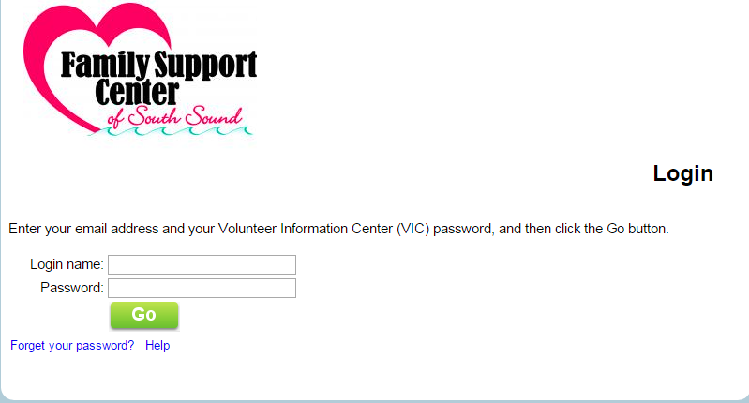
How to use the Volgistics Login Portal
Following this training, I will complete your background checks, grant you access to the portal if everything clears, then send everyone a “congratulations” email with detailed instructions with a temporary password. https://www.volgistics.com/ex/portal.dll/?from=189830

Slide 43
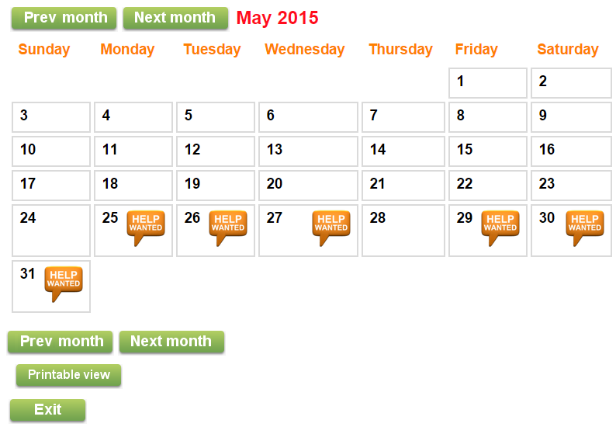
Signing Up for Shifts
I send a weekly email with important updates and openings. Feel free to respond to that email to sign up for shifts. You can also view open shifts in the Volgistics Login Portal anytime from your personal computer, which will look like this:

Slide 44
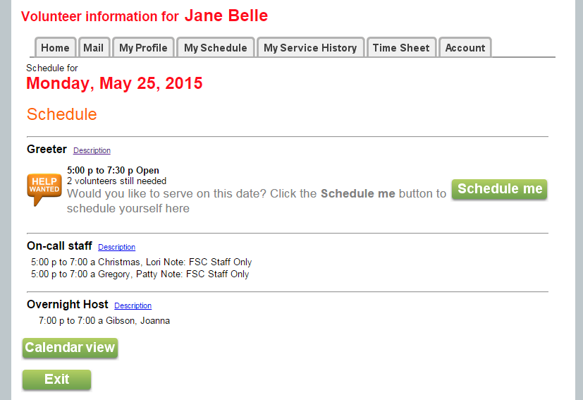
Signing up for shifts con’t…
For self-scheduling;
*Click on the icon that says “Help Wanted” to view details
*It will say specifically “We need 2 greeters” or “we need 1 host” etc…
*Click “Schedule Me” to sign up for the shift

Slide 45
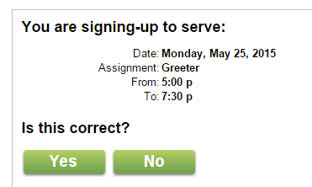
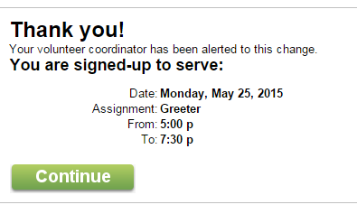
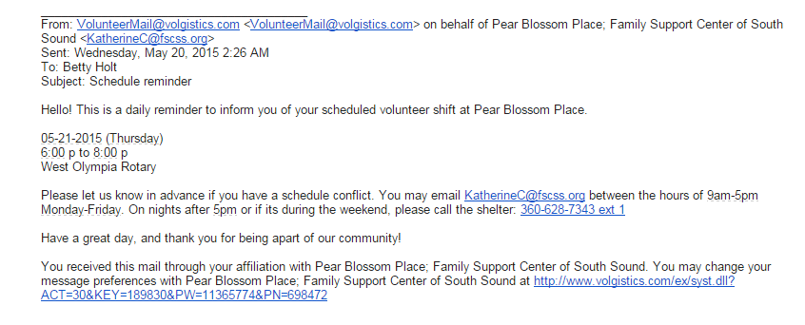
Signing up for shifts con’t…
*It will ask you to confirm by clicking yes or no. Be sure you do this, it won’t save!
*Click “yes” and it will take you to the confirmation page. Click “no” and it won’t save you for that date.
*The day before your shift, you will receive an automatic reminder to your email.

Slide 46
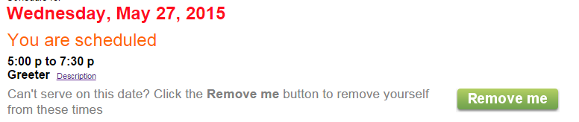
Cancel a shift
*Click on the date of the shift you need to cancel
*Click on the green tab that says “Remove Me”
*It will automatically remove you, and send me an alert message, so I have time to find someone to replace you.
*If it’s less than 24hrs before your shift, the system will not allow you to remove yourself. you must contact me by phone or email and I can cancel it for you.
*If you can’t get ahold of me within an hour, call the shelter directly and let them know: 360-628-7343 x 1

Slide 47
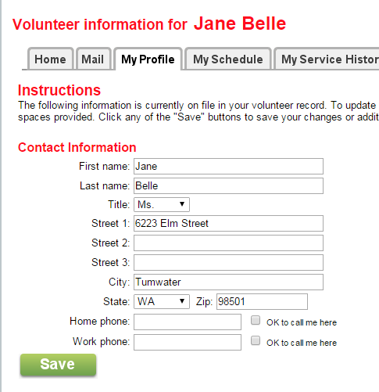
Volgistics- keep it current!
*Click on the “My Profile” tab in your portal, and you can do any of the following;
Update your address
Include a profile picture
Change your schedule availability
Include new skills/interests
…and much more!

Slide 48
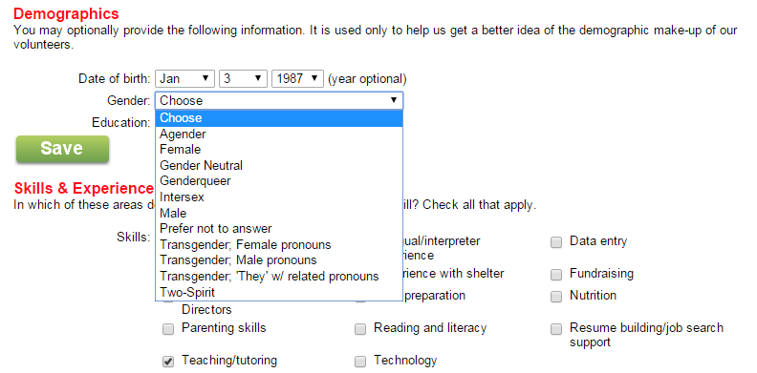
Pronouns & Respect
*There is an option to select your identified gender in the volunteer portal; it is important to us that we are properly and respectfully addressing your preferred pronouns. You are not obligated to answer- we also respect your privacy.
*We also respect that gender is a full spectrum; if you don’t see your specific gender or preferred pronoun, please let me know so I can include that!

Slide 49
“Volgistics is too confusing!!!”
*It takes time to get used to any new software…practice, and I assure you, it will make sense!
*I still have the power to schedule you; if you reply the Monday emails or give me a call with your availability, I can schedule you into the calendar.
*Feel free to drop by my office anytime, or ask me for a video tutorial from the website! I’m happy to help you. ☺
One other tip:
*If you forget your password, just hit the forgot password link on the login portal, and it will automatically generate a new temporary password for you. You will then have the option to change it.

Slide 50
Shelter Website How-To
sites.google.com/site/fscshelter
We create a “new page” for every day of the year, which tells the volunteers and staff who is “screened in” and approved to stay at shelter.
This website is confidential, and will only be available at the front reception desk. The password for the intern login will be located by the computer- this is what you will use to login to the site!
The website is your backbone- it tells you who you can let into shelter, how many people are staying at shelter, who you’re volunteering with, and what’s been happening. Comments are crucial! Please leave them! You’re our eyes and ears.
Do not show it to other guests or anyone else. If you have a copy of the guest list, please shred it after you’re finished with it.

Slide 51
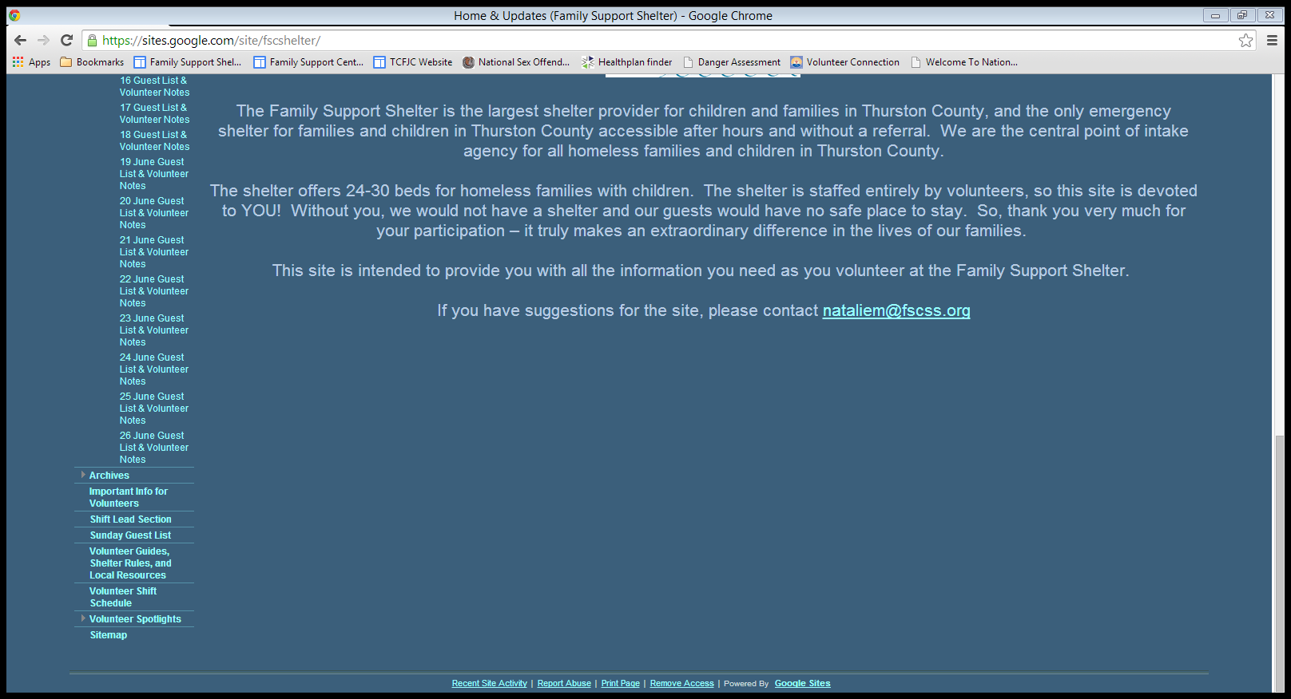
Shelter Website How-To
To view the guest list for the day you’re volunteering, click on the day you’re looking for.
(This page is now called “Key Contact Info for Volunteers”) It has just that! Key contact info!
To view the shift schedule and see what shifts are open, click here

Slide 52
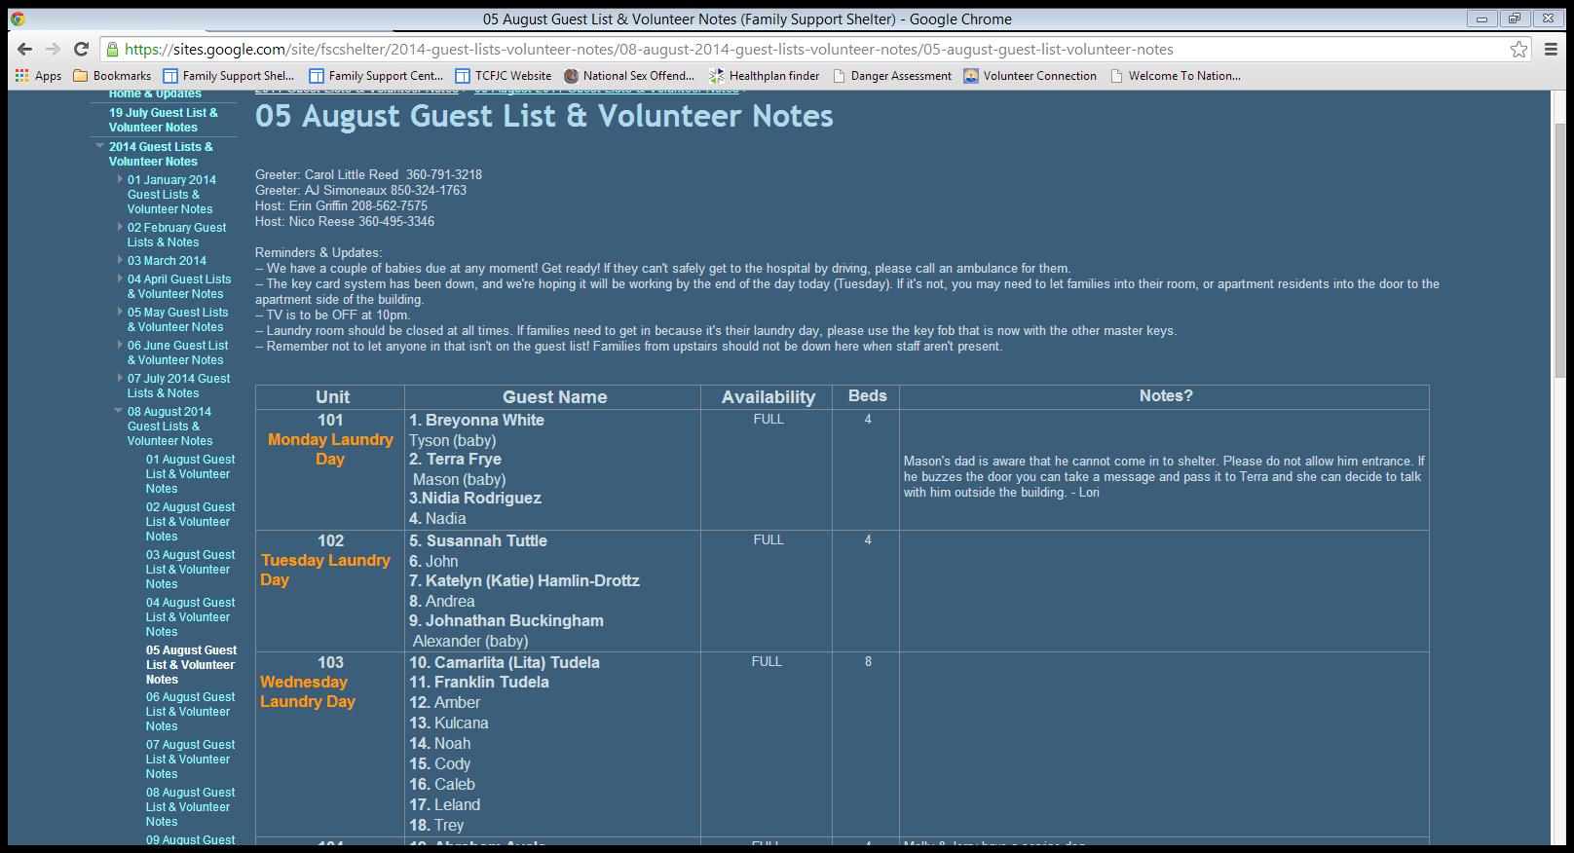
This tells you who you’re volunteering with and their contact #.
Under the day’s volunteers is back up 1 and 2 with our phone numbers.
We will include any updates here so you know of any changes or reminders.
Each room is listed w/ laundry day and residents.
Notes are helpful! We’ll leave you notes, and we love when you leave us notes!
List of each resident. Adults first & bold, kids below. < 1yr not counted in census.
Are we full? If not, we’ll say how many beds are available.

Slide 53
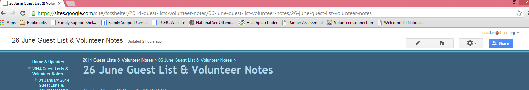
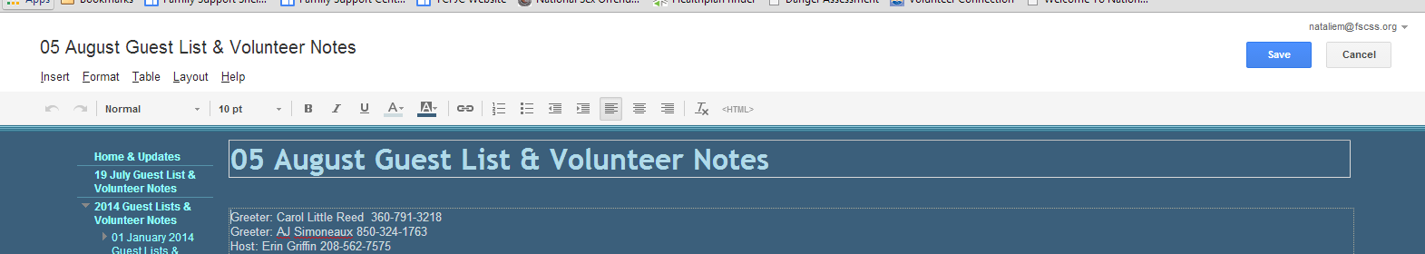
To edit the page and add notes, add a family to the list etc, click the pencil. It will then load the editor.
This is the “editor” view. You can add in your comments or changes. When you’re finished, you MUST click “Save”!

Slide 54
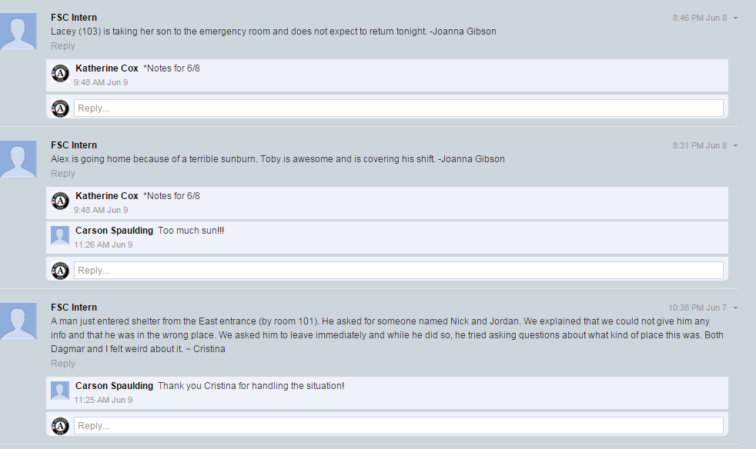
Leave a comment!
We like to see that you made some kind of an entry, even if it’s “all is quiet, no concerns.” If there are folks calling for shelter, get their name and a good call back number. Also, make sure you are signed into the intern account- that’s your key to accessing the shelter guest list! Leave a comment with your name!

Slide 55
Office Space
Lori Christmas, Homeless Family Case Manager is in the far left office. There is a bunk bed in her office.
The middle office is Lindy Fitzgerald’s space; she does retention services. This is also the volunteer office and has a bunk bed for hosts.
Carson Spaulding is our AmeriCorps Youth in Service Member; he works closely with our families and creates the website each day.
Feel free to leave your belongings in the staff offices. You are responsible for them so make sure to lock it behind.
FSC is not responsible for lost, stolen, or damaged items.

Slide 56
Going Forward
Communication will be essential, and so helpful in identifying how we can improve things.
Hang in there- enjoy the ride. Think creatively!
Do not hesitate to ask questions, call your backup, ask your co-volunteer.
Be confident. You’re amazing!

Slide 57
Questions? Concerns? Comments?

Slide 58
Key Contact Information
Pear Blossom Place: A Family Support Community
837 7th Ave SE
Olympia, WA 98501
360-628-7343 x1 for front desk
Katherine Cox- AmeriCorps VISTA
*Volunteer Coordinator Lori Christmas- Homeless Family Case Manager
katherinec@fscss.org 360-628-4585 loric@fscss.org 360-628-7343 x301
Monday-Friday 9am-5pm at main office Works @ PBP Sunday-Wednesday
Mindy Bergen- Affordable Housing Program Manager Keiya Johnson- Homeless Program Manager
mindyb@fscss.org 360-628-7343 x 302 keiyaj@fscss.org 360-628-7343 x 303
Works @ PBP Wednesday-Saturday , part-time *Schedule TBA; oversees volunteering & VISTA
Natalie Moran- Development Director
*Katherine’s supervisor Carson Spaulding, Front Desk Staff/former AmeriCorps
nataliem@fscss.org 360-754-9297x218 Carsons@fscss.org 360-628-7343
Monday-Friday 9am-5PM at main office Monday-Friday 9:30-5:30pm @ PBP
The Staff On-Call Schedule is posted on the website.
When in doubt your backups are:
Patty Gregory - Program Director
pattyg@fscss.org cell: 360-628-7344
Schelli Slaughter – Executive Director
schellis@fscss.org cell: 360-888-0928

Slide 59
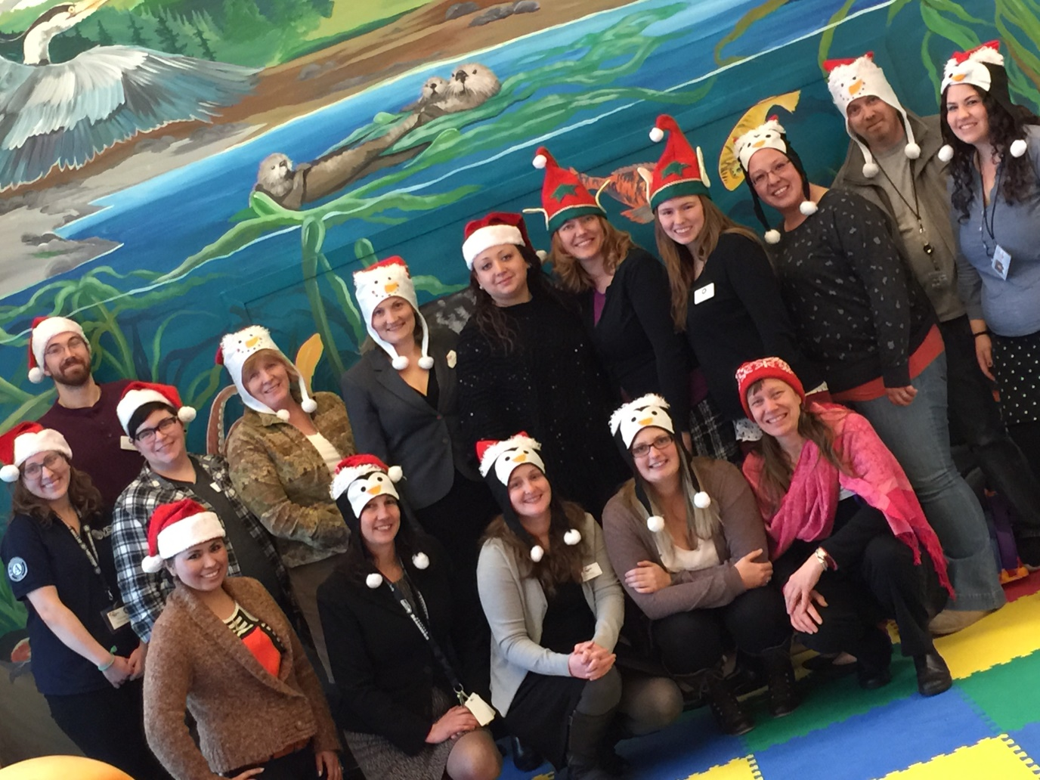
THANK YOU!!!! We couldn’t do all that we do without our amazing volunteers.

