Slide 1
HTML & CSS for the Data Scientist
Derek Lamb, Columbia University Department of Biostatistics
February 10th, 2025

Slide 2
This presentation will cover
Brief overview of HTML syntax
Live coding a webpage, building upon HTML and introducing CSS features
Introduce connections to more complicated websites
Implement HTML and CSS in R Markdown

Slide 3
Do I need to know HTML?
“Of course not, this isn’t 1997 and you’re not putting a website on geocities” - Jeff Goldsmith (2023)
You know R Markdown, or you can use Wix, Weebly, Squarespace, etc.
Why might you want to know HTML?
HTML underlies the entire internet
You like using the internet
A little knowledge goes a long way

Slide 4
How do websites work?
HTML
CSS
Hypertext Markup Language
Webpage content & Metadata
Javascript
Interactivity
Programming-like functions
Cascading Style Sheets
Style and organization

Slide 5
HTML Elements
The most basic component of HTML is the element.
An element is composed of three parts:
A starting tag, <tag>
Whatever content you want to include (this can be other elements)
An ending tag, </tag>
Examples:
<title>My Awesome Website</title>
<p>The most basic component of HTML is the <b>element</b>.</p>

Slide 6
Basic structure of a webpage
1) The !DOCTYPE declaration tells your browser to read HTML
<!DOCTYPE html>
<html>
<head>
<title>Website Title</title>
</head>
<body>
<h1>First Heading</h1>
<p>Additional content here…</p>
</body>
</html>
2) A root <html> element
3) The document head contains the “behind the scenes” info of a document, such as metadata, links to CSS files, or the document title, defined by the <title> tag
4) The document body contains the user-facing content of a document. Examples include text, such as paragraphs, defined with the <p> tag, and headers, defined with <h1>…<h6> tags

Slide 7
Let’s make a website like it’s 1997!

Slide 8
Text formatting
Here are some common elements used for text formatting:
Bold | <b>…</b> | <strong>…</strong>
Italics | <i>…</i> | <em>…</em>
Underline | <u>…</u> | <ins>…</ins>
Strikethrough | <del>…</del>
^{Superscript} | <sup>…</sup>
_{Subscript} | <sub>…</sub>
“Quotes” | <q>…</q>

Slide 9
Elements with attributes
Some tags require additional information, or have additional features that are encoded with attributes.
The general form is <tag attribute=“value”>…</tag>
The anchor tag <a> links content, but needs to know the destination of the link.
href: link destination (value: web address)
target: where to open page (value: _blank, _self)
<a href=“google.com” target=“_blank”>search Google</a>
The image tag <img> embeds an image, but needs to know where the file is.
src: image source (value: file location or web address)
height, width: image size (value: number in pixels)
alt: alternate text (value: text)
<img src=“image.jpg” width=“200”, height=“200”>
Note: the img tag does not require an ending </img> tag!

Slide 10
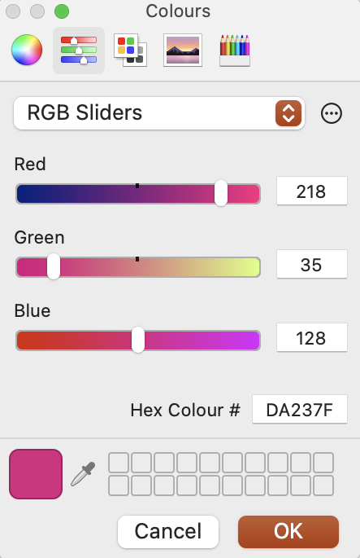
Hexadecimal Color
Hexadecimal has 16 unique digits
Instead of [0:9], hex numbers go [0, 1, 2, 3, 4, 5, 6, 7, 8, 9, A, B, C, D, E, F]
A two-digit hex number has 256 values: [00, …, 9A, …, FF]
A hexadecimal color is a six-digit* hex code, e.g. #DA2374
The first two digits specify the red value (DA: 218/256)
The second two digits specify the green value (23: 35/256)
The third two digits specify the blue value (74: 128/256)
Together, this makes a new color (#DA2374)
There are 2²⁴ hex colors (~16.8 million)

Slide 11
Hexadecimal Color (cont’d)
What colors should you know?
The primary colors
#FF0000 – red
#00FF00 – green
#0000FF – blue
And also:
#000000 – black
#FFFFFF – white
The secondary colors:
#FFFF00 – yellow
#00FFFF – cyan
#FF00FF – magenta

Slide 12
CSS
1) The selector is the element(s) or subsets of elements that you want your style to apply to
selector {
property: value;
property: value;
}
p {
text-align: center;
color: #00FF00;
font-family: arial;
}
2) Every selector has multiple properties, that you assign certain values. Some properties require numeric, color, or specific values

Slide 13
CSS (cont’d)
There are three ways of including CSS in a document.
At the tag level, using the style attribute.
<p style=“color:red;”>
At the page level, using the <style> tag.
<style>p{color:red;}</style>
At the site level, using a .css document linked to the page.
<link rel=“stylesheet” href=“mystyle.css”>

Slide 14
Advanced Selectors
What if you want to only select some of a certain tag? Example: I want certain links to be red!
Give the links of interest the class attribute:
<a class=“redlink” href=“https://www.columbia.edu”>
Then use a period after the element in the CSS to denote the class:
a.redlink {
color: #DB2374;
}
You could also apply the CSS to all elements with a given class, regardless of type:
.fancy {
font-family: Lato;
font-style: italic;
}

Slide 15
Advanced Selectors (cont’d)
Alternatively, if I only want to style links within a <p> element, I add p to the selector:
p a {
color: #DB2374;
}
You can select multiple elements using a comma:
p, h3 {
font-family: monospace;
color: #DB2374;
}

Slide 16
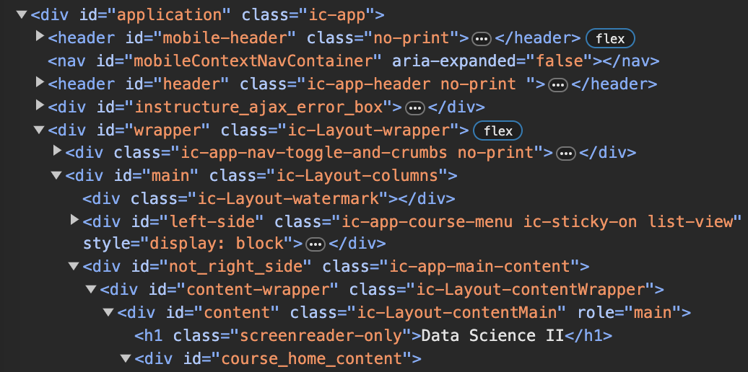
Current Web Design
What’s the same?
All of the components that we have discussed are still there! Content still needs to be in HTML elements, such as <p>, <a>, or <img> tags
So, what’s different?
<div> tags. It’s <div> tags all the way down.
(and sometimes <span> tags too)

Slide 17
Current Web Design (cont’d)
While every tag discussed so far has a clear function, with <div> tags it’s a bit more complex.
A <div> tag does nothing on its own, it serves as a bucket that you can style however you want.
Example: A text block with a special background
<div class=“block-bgd”>
<h3>Block Header</h3>
<p>Block content</p>
</div>

Slide 18
Current Web Design (cont’d)
While every tag discussed so far has a clear function, with <div> tags it’s a bit more complex.
A <div> tag does nothing on its own, it serves as a bucket that you can style however you want.
Example: A website navbar
<div class=“1”> First division: background color
<div class=“2”> Second division: font and text formatting
<div class=“3”> Third division: padding
<div class=“4”> First division: list alignment
<ul> Content (list)
You might think about this as the difference between one function that does five things, and five functions that do one thing each.

Slide 19
Conclusion
At its core, every webpage is an HTML document, and all of the content in webpages is contained within HTML elements
Current web design (HTML 5) makes heavy use of CSS in combination with <div> tags to create the feel of the modern website
Raw HTML and CSS can often be used to supplement websites made through other platforms such as R Markdown, Wix, or Blogger
A little knowledge of HTML goes a long way in understanding the organization and information stored within webpages

Slide 20
Additional Elements
Tables are an element defined with <table>…</table>
Tables have three elements, the header, body, and footer
<thead>…</thead>, <tbody>…</tbody>, <tfoot>…</tfoot>
Each row is its own element defined with <tr>…</tr>
The cells of a header <th>…</th>
All other cells are defined with <td>…</td>
Lists are either ordered (numbers, letters) or unordered (bullet points, dashes)
Each list has a parent element <ol>…</ol> or <ul>…</ul>
Each list item is its own element <li>…</li>
Special characters are entities and are defined &entity; or &#entity;
Examples: &lt;, &nbsp;, &#163;
Comments in HTML are written <!-- comment goes here -->

