Slide 1
Things about Git
Columbia university digital center Data CLUB
18 Feb

Slide 2
WHY DO WE NEED GIT?
Multiple collaborators in one project.
Share code, files, watch other collaborators’ process
Version control. --- What is this?
You lost all your code when upgrading your os/ found a previous version is correct but you have already deleted them/ wanted to check what was done in a previous version.
Version control helps keeping your work history, all your files and code. You can always look at what is done in your previous versions.

Slide 3
GIT AND GITHUB
Git is a distributed version control system.
GitHub is a web-based Git repository hosting service. It is based on Git and provides service to users. Instead of using GitHub, you can build your Git server.
Github allows you to:
Share your repositories with others.
Access other user's repositories.
Store remote copies of your repositories (github servers) as backup of your local copies.

Slide 4
LET’S START
First step is installation. Follow this link: https://git-scm.com/downloads
Do some configuration:
$ git config --global user.name "John Doe"
$ git config --global user.email johndoe@example.com

Slide 5
COMMANDS
Our Data Club ‘intro to Data’ GitHub link is:
https://github.com/columbia-university-libraries-data-club/intro-to-data
First command is learn is ‘git clone’
Git clone helps create a local repository and clone the whole remote repository to your local repository.
To get the whole repository of ‘intro to data’
$ git clone https://github.com/columbia-university-libraries-data-club/intro-to-data.git

Slide 6
COMMANDS
The command ‘git clone’ is enough for you to get all files.
But how to get updated files after you do ‘git clone’?
‘git pull’ can help update your local files!
Open a terminal and navigate into your repository folder.
Type in ‘git pull’ and see the changes.
New files, content change and file deletion.

Slide 7
COMMANDS
If you want to upload files or update some change to files.
‘git add’, ‘git commit’ and ‘git push’.
‘git add’ lets Git track your local changes and indexes them.
‘git commit’ commits your change to the local repository.
‘git push’ uploads local repository content to a remote repository.

Slide 8
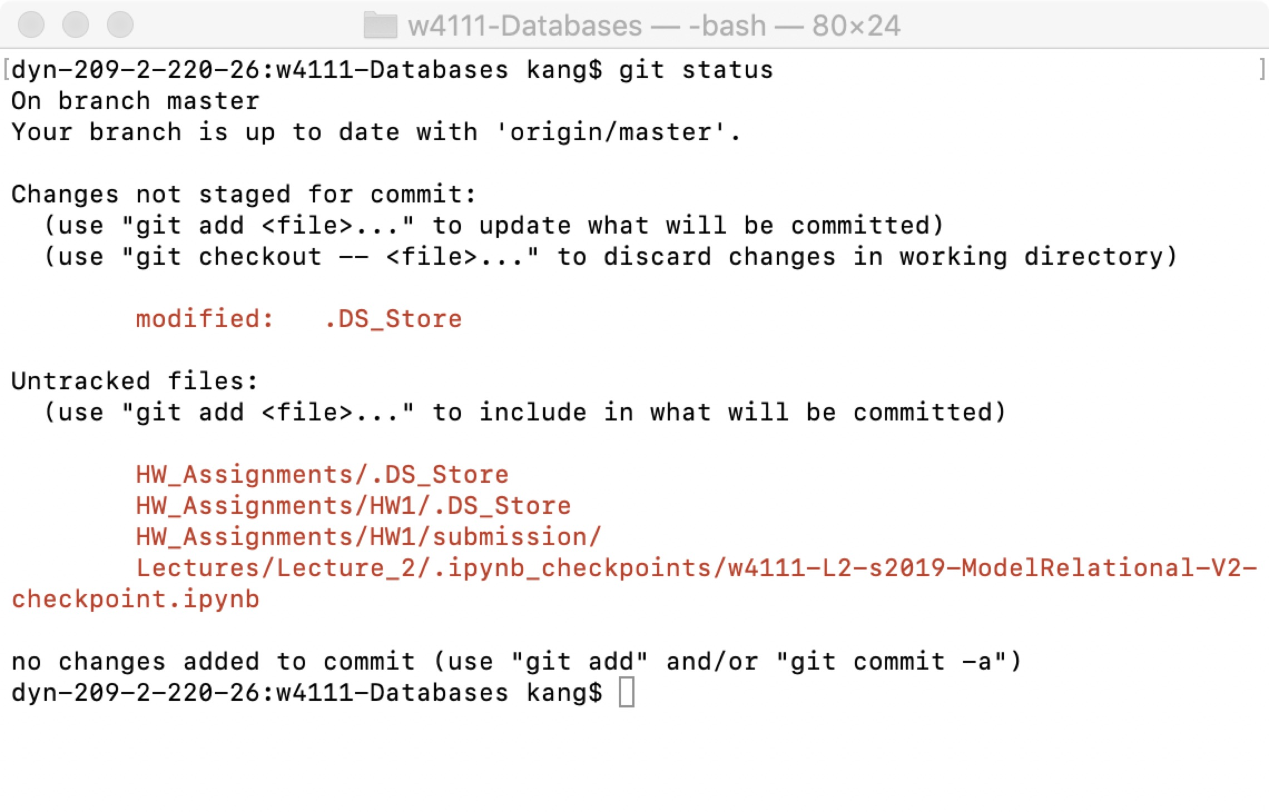
COMMANDS
A very useful command is ‘git status’. It helps you see your current status.

Slide 9
COMMANDS
‘git add’
$ git add some_file
The add some_file to the Git staging area. The files in staging area are prepared for the commit.
$git add .
This helps add all changes(new files, changes, deletions) we made to the staging area.

Slide 10
COMMANDS
'git commit’
$ git commit –m “your comment”
This helps you commit your local change to your local repository.
You can write comment about this commit after ‘-m’, this can reminds you of the purpose of this commit in the future.

Slide 11

diagram

Slide 12
COMMANDS
We have not touched the remote repository on GitHub yet, which means our collaborator can not see our update.
$ git push origin master
‘git push’ / ‘git push origin master’ helps us upload changes on our local repo to GitHub repo.
They are the same thing if you are just working on only one remote repository.

Slide 13
Git is hard
If you are uncomfortable with the complicated commands and just want to get the up-to-date slides and materials. Just knowing ‘git clone xxx’ and ‘git pull’ is enough.
If you really hate every git command, you can always go to our GitHub webpage to download a zip pack of all files.

Slide 14
CREDIT
https://www.atlassian.com/git/tutorials/comparing-workflows
https://git-scm.com/book/en/v1/Getting-Started-Git-Basics

