Slide 1
Interpretable Machine Learning!
Data Club Meeting
Yiming Tan

Slide 2
Why we need interpretability?
Human desire to find the meaning of the world
Safety measures
Detecting bias (Considering the protected social groups)
Social acceptance and interactions (trust and belief)

Slide 3
Interpretable ML Methods
Partial Dependence Plots
Accumulated Local Effects (ALE) Plot
Feature Importance
Global Surrogate Model
Lime (Local interpretable model-agnostic explanations)
Shapley Values

Slide 4


Partial Dependence Plot (PDP)
The marginal effect one or two features have on the predicted outcome of a model

Slide 5
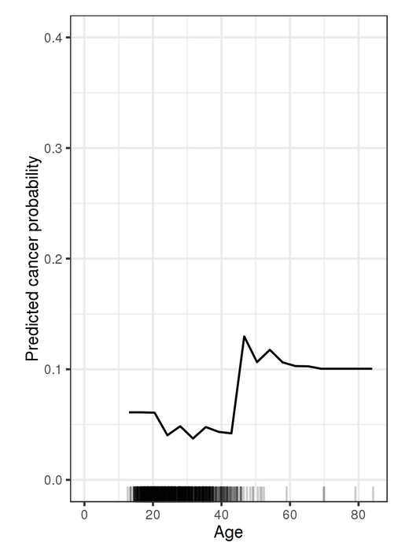
Advantages
Intuitive computation
Clear interpretation
Easy implementation
Disadvantages
Assumption of independence
Maximum #features: no more than 2
Without considering the distribution

Slide 6
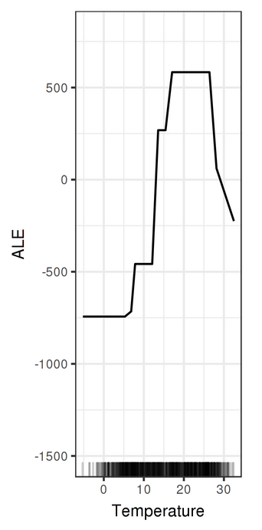
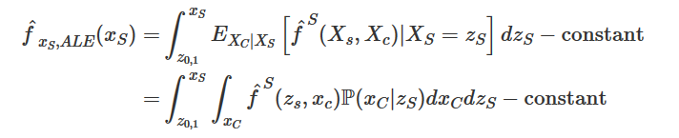

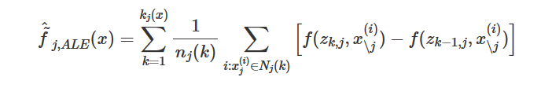
Accumulated Local Effects (ALE) Plot
How features influence the prediction of a machine learning model on average
A faster and unbiased alternative to PDPs

Slide 7
Advantages
Unbiased, even with correlated features
O(n), faster than PDPs(#grid points * n)
Clear interpretations
Disadvantages
A bit shaky, no perfect solution to decide the number of intervals
Complex implementation (compared to PDPs)
Still hard to interpret when features highly correlated
(change together)

Slide 8
Feature Importance
(Different from feature importance in tree-based models)
The increase in the prediction error of the model after permuting the feature’s values (feature’s information is destroyed)

Slide 9
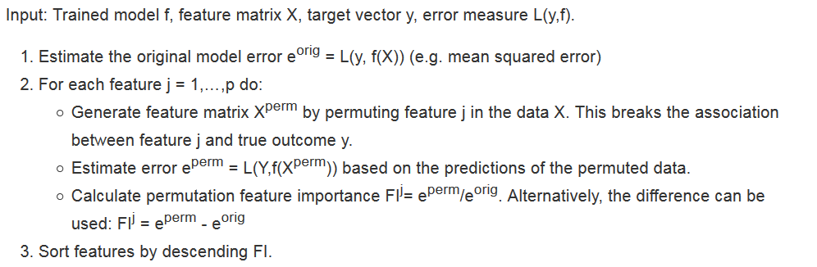
The permutation algorithm (Fisher, Rudin, and Dominici (2018))

Slide 10
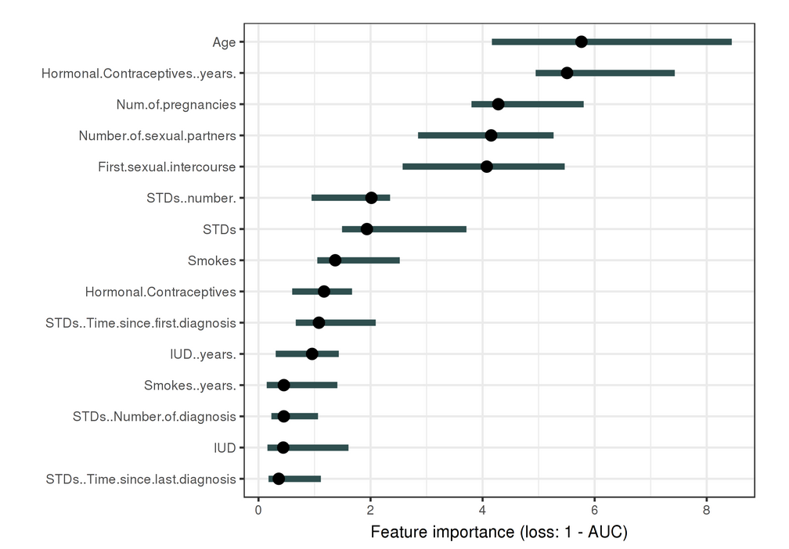
Advantages
Nice interpretation
Highly compressed, global insight
Comparable across problems
Retraining the model not required

Slide 11
Disadvantages
Unclear whether training or test data?
Error/performance, do people care?
Access to the true outcomes?
Results might vary among different permutations

Slide 12
Global Surrogate Model
An interpretable model trained to approximate the predictions of a black box model (as accurate as possible and interpretable)
Linear models
Trees
Additive models
…
Also used in engineering:
Use a cheap and fast surrogate model of the outcome instead of an expensive, time-consuming one.

Slide 13
Select a dataset X. (Training or new)
For the selected dataset X, get the predictions of the black box model.
Select an interpretable model type (linear model, decision tree, …).
Train the interpretable model on the dataset X and its predictions.
Congratulations! You now have a surrogate model.
Measure how well the surrogate model replicates the predictions of the black box model.
Interpret the surrogate model.

Slide 14
Advantages
Flexible (Any interpretable model)
Intuitive and straightforward
R-squared can be used to measure how good the fit is
Disadvantages
No information from data
(the surrogate model never sees the real data)
Best cut-off for R-squared?
Dependence on the dataset X

Slide 15
Other interpretable ML methods
Lime (Local interpretable model-agnostic explanations)
Train local surrogate models to explain individual predictions
Shapley Values
The contribution of a feature value to the difference between the actual prediction and the mean prediction
For more information, check this!
https://christophm.github.io/interpretable-ml-book/

Slide 16
Problems with interpretable ML
Many interpretable ML methods give us approximations
How people interpret the results? (Misinterpretations)
Balance between interpretations and the model performance.

