Slide 1
Using Diversity to Harden Multithreaded Programs Against Exploitation
David M. Tagatac
Michalis Polychronakis
Salvatore J. Stolfo
HPSC 4/9/2016

Slide 2
Outline
Concurrency Bugs
Example Attack
Software Diversity
Time Randomization
Results

Slide 3
I. Concurrency Bugs

Slide 4
Concurrency Bugs: What are they?
Concurrency Bug: code which produces incorrect output nondeterministically as a result of an unexpected thread interleaving.

Slide 5
Concurrency Bugs: Classifications
[Lu, S., Park, S., Seo, E., & Zhou, Y. Learning from mistakes - A Comprehensive Study on Real World Concurrency Bug Characteristics. ASPLOS’08.]
Bug classification along three dimensions:
Bug pattern
Atomicity violation
Order violation
Other
Bug manifestation
Manifestation condition
# of threads involved
# of variables involved
# of accesses involved
Fix strategy

Slide 6
Concurrency Bugs: Mitigations
Detection
Lockset based [Serebryany WBIA’09][Savage TOCS’97]
Happens-before based [O’Callahan PPoPP’03]
Testing [Burckhardt ASPLOS’10][Fonseca OSDI’14]
Language Design
Systems [Cui SOSP’13][Lu PPoPP’14]

Slide 7
II. Example Attack

Slide 8
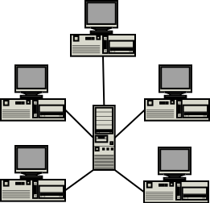
Example Attack: scenario

Slide 9
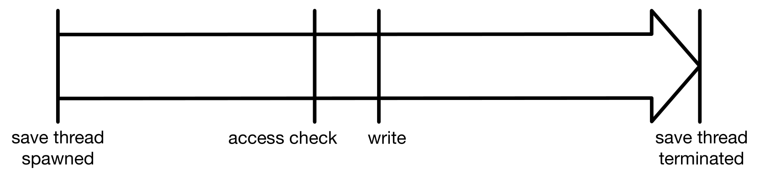
Example Attack: save operation

Slide 10
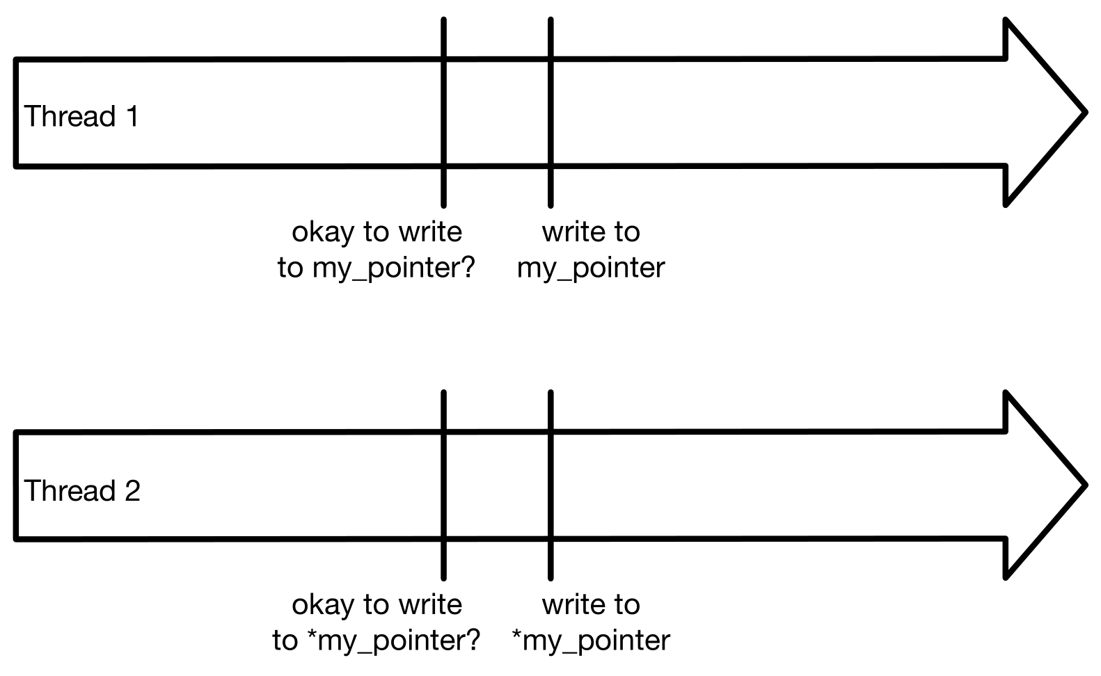
Example Attack: two threads

Slide 11
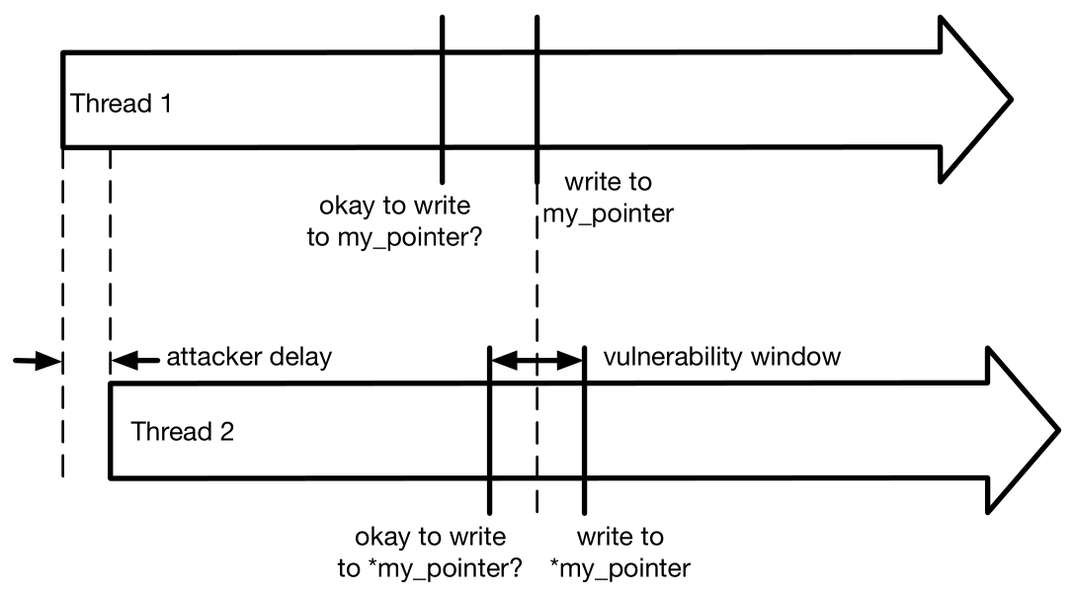
Example Attack: attack

Slide 12
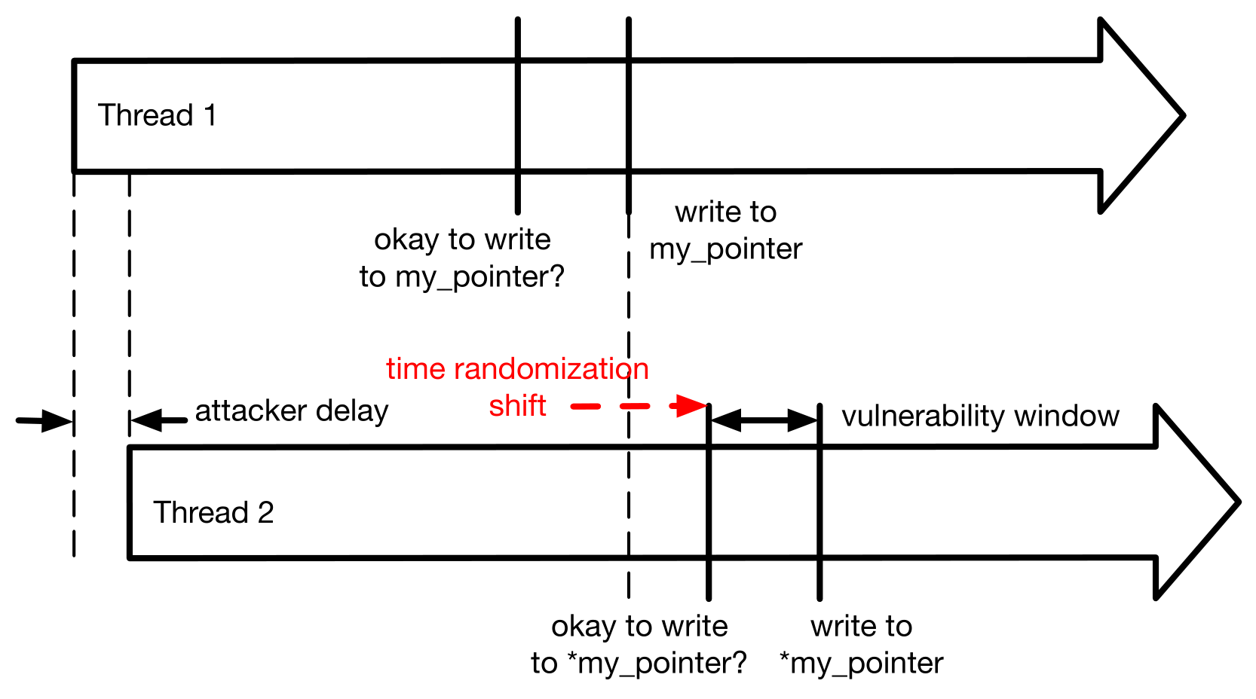
Example Attack: thwarted

Slide 13
III. Software Diversity

Slide 14
Software Diversity: dangers of a monoculture
[GEER , D., BACE , R., GUTMANN , P., METZGER , P., PFLEEGER , C., QUARTERMAN , J., AND SCHNEIER , B. Cyber insecurity: The cost of monopoly. CCIA’03.]
“[Lack of software diversity is a threat to society.]”

Slide 15
Software Diversity: taxonomy
[LARSEN , P., HOMESCU , A., BRUNTHALER , S., AND FRANZ, M. SoK : Automated Software Diversity. IEEE S&P (2014).]
Instruction level
Basic block level
Loop level
Function level
e.g. stack layout randomization
Program level
e.g. ASLR
System level
e.g. system call mapping randomization

Slide 16
Software Diversity: taxonomy for concurrency
Add delays to a thread or threads
Reorder something such that thread interleaving is affected

Slide 17
IV. Time Randomization

Slide 18
Time Randomization: library interposition
program
dynamic library
foo()
foo()
{
…
}

Slide 19
Time Randomization: library interposition (continued)
program
dynamic library
foo()
foo()
{
…
}
interposition code
foo()
{
<random-length NOP loop>
real_foo()
}

Slide 20
Time Randomization: three transformations
T1: all dynamic library functions
T2: library functions before syncs
T3: library functions after syncs
All three can be considered instruction-level transformations which add delays to threads.

Slide 21
V. Results

Slide 22
Results: summary
Bug | Tranformation Applied | Time Randomization Effective?
Libsafe | T1 (all) | Yes
Libsafe | T2 (before syncs) | No
Libsafe | T3 (after syncs) | Yes
Libvirt | T1 (all) | No
Libvirt | T2 (before syncs) | No
Libvirt | T3 (after syncs) | Yes

Slide 23
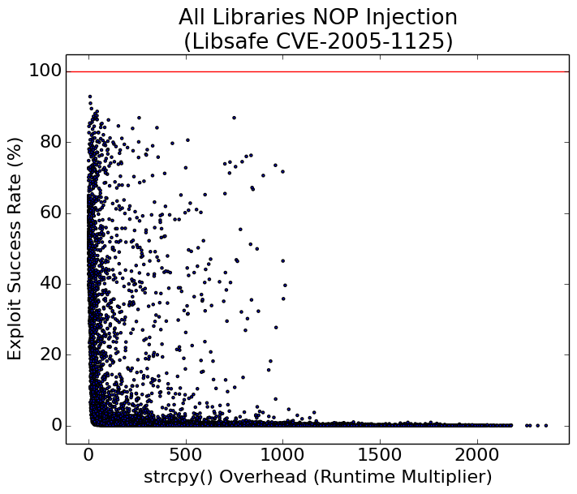
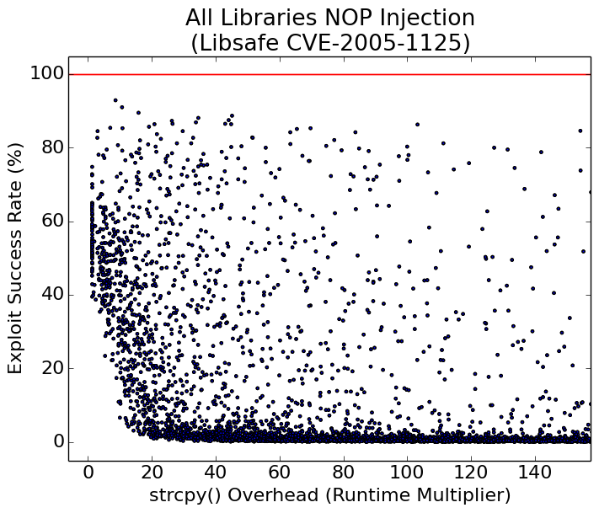
Results: T1 applied to Libsafe bug

Slide 24
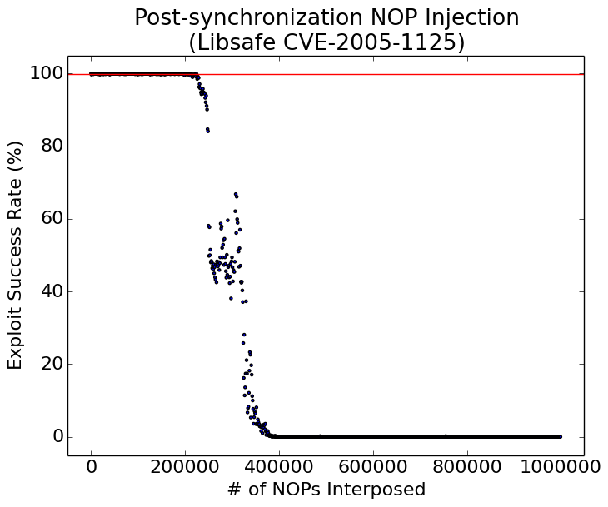
Results: T3 applied to Libsafe bug

Slide 25
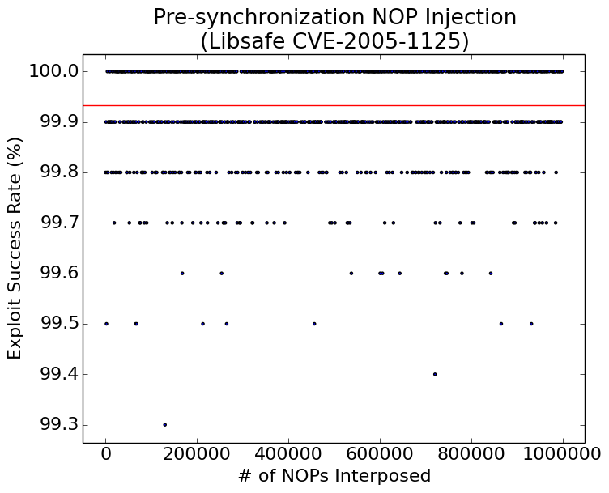
Results: T2 applied to Libsafe bug

Slide 26
Future Directions
Randomization in the scheduler
Use empirical results for NOP insertion decisions
E.g. measure relative thread timing and/or runtime overhead after randomization

Slide 27
Summary
Concurrency bugs
Example concurrency attack
Automated Software Diversity
Time randomization:
Increase the cost of exploitation
Future Directions

Slide 28
Please ask questions :)
Thanks!

Slide 32
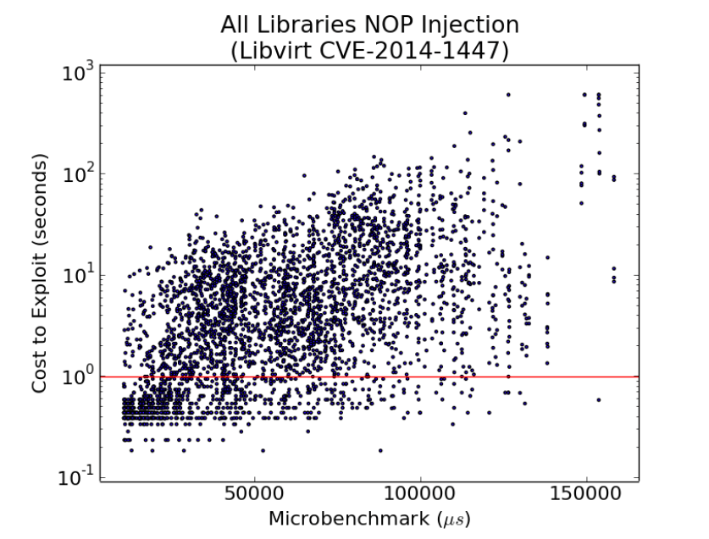
T1 applied to Libvirt bug

Slide 33
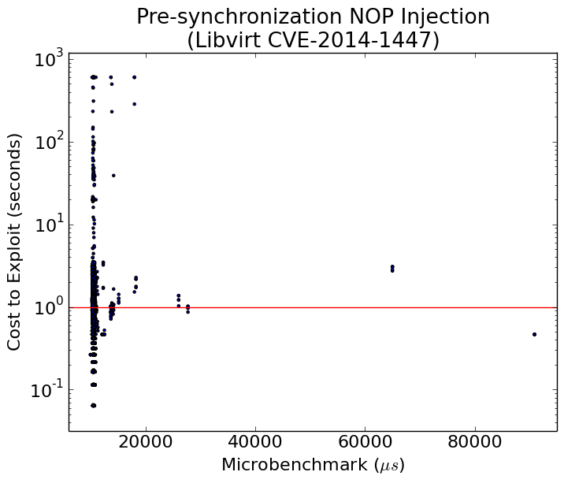
T2 applied to Libvirt bug

Slide 34
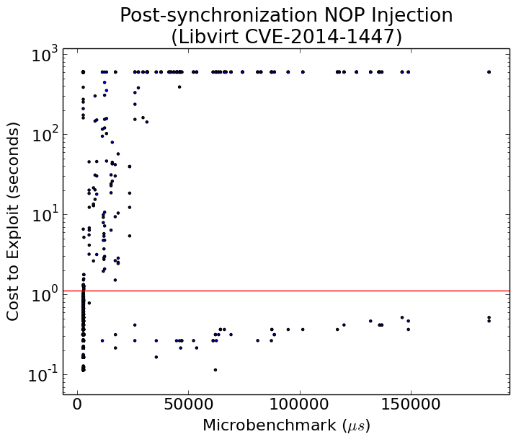
T3 applied to Libvirt bug

Slide 35
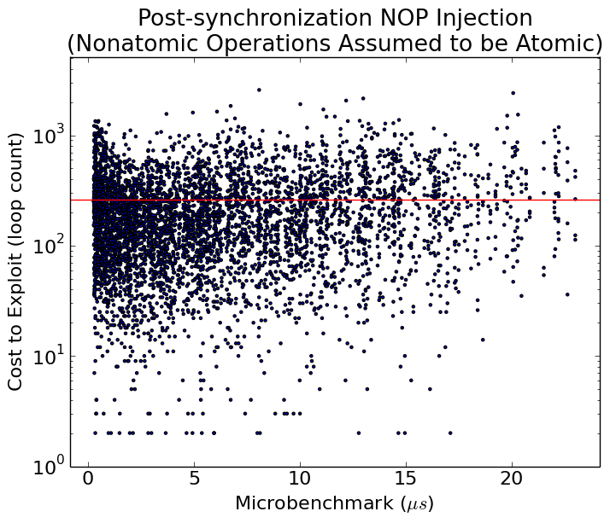
T3 applied to canonical atomicity violation bug

