Slide 1
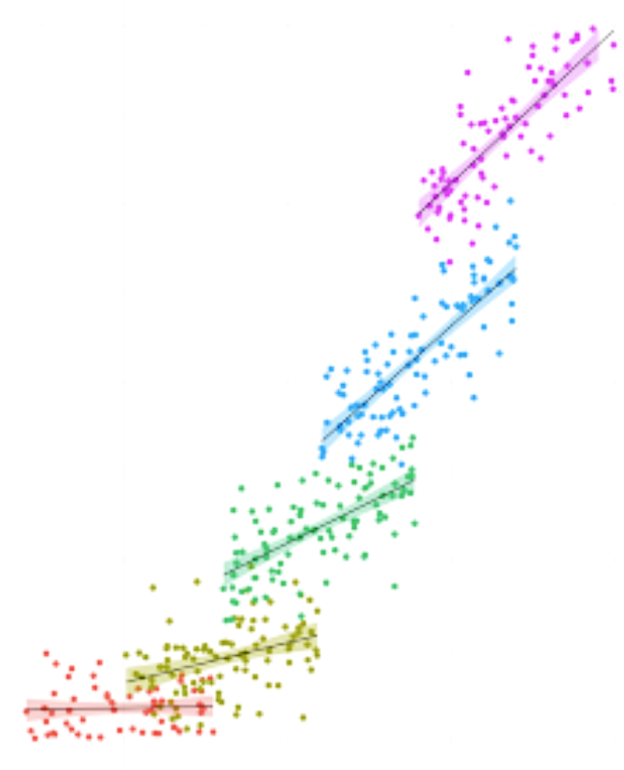
Multilevel Modeling: When to use and Why
Ana DiGiovanni SIPPS 2021

Slide 2
Email list sign-up
Google form to sign-up for our email list!
https://forms.gle/Wk9wMaxKJd28JTLr6

Slide 3
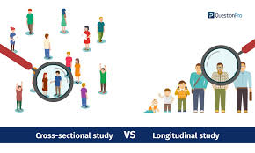
Cross-sectional vs. longitudinal data
Cross-sectional
Measure variables at ONE time-point.
Longitudinal (repeated measures)
Measure participants’ responses OVER TIME
OR
Same person responds to Multiple trials/stimuli in behavioral data

Slide 4

Time-course data: Exploring happiness over time
Possible question of interest: How does happiness change over the life-span?

Slide 5
Within-person processes: What predicts increases in happiness for individuals?
Cross-sectionally
Recruit a large sample of participants and compare happiness of individuals with high levels of social support to happiness of individuals with low levels of social support.

Slide 6
Within-person processes: What predicts increases in happiness for individuals?
Cross-sectionally
Recruit a large sample of participants and compare happiness of individuals with high levels of social support to happiness of individuals with low levels of social support.
A BETWEEN-SUBJECT analysis
Analyzing differences between people
I.e., people who have high levels of social support on average compared to people who have low levels of social support on average should report different happiness

Slide 7
Within-person processes: What predicts increases in happiness for individuals?
Longitudinally
Recruit a sample of individuals and measure the amount of perceived social support and levels of happiness at multiple time-points

Slide 8
Within-person processes: What predicts increases in happiness for individuals?
Longitudinally
Recruit a sample of individuals and measure the amount of perceived social support and levels of happiness at multiple time-points
A WITHIN-SUBJECT analysis
Examine processes that unfold within the individual -- at times when individuals report having more social support than normal (e.g., compared to their OWN average perceptions of social support), do they also report increased happiness?

Slide 9
Multiple Trials: Experimental data
What are the differences between negative and neutral emotion conditions on cognitive control behavior (as measured by accuracy during STOP signal in a go/no-go task)
Each participant completes 200 task trials where the stimulus content is negative in 50% of trials and neutral in 50% of trails
Is there a difference in their performance based on the emotional content of the trial?

Slide 10
Data wrangling for repeated-measures projects
Why do we need a special lesson on how to clean and wrangle data for repeated-measures design?

Slide 11
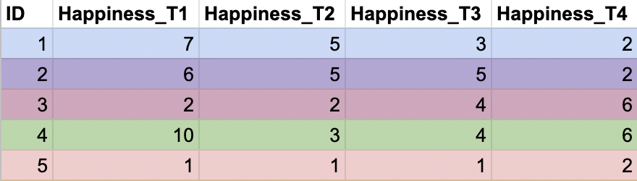
Data wrangling for repeated-measures projects
Why do we need a special lesson on how to clean and wrangle data for repeated-measures design?
Data is normally in wide format ….

Slide 12
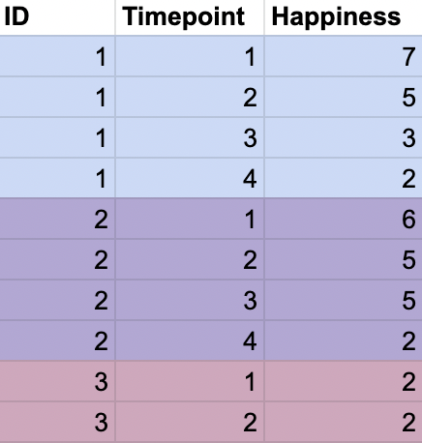
Data wrangling for repeated-measures projects
Why do we need a special lesson on how to clean and wrangle data for repeated-measures design?
Data is normally in wide format ….
But we need to get the data in long format so that we can properly (1) visualize the data and (2) analyze the data

Slide 13
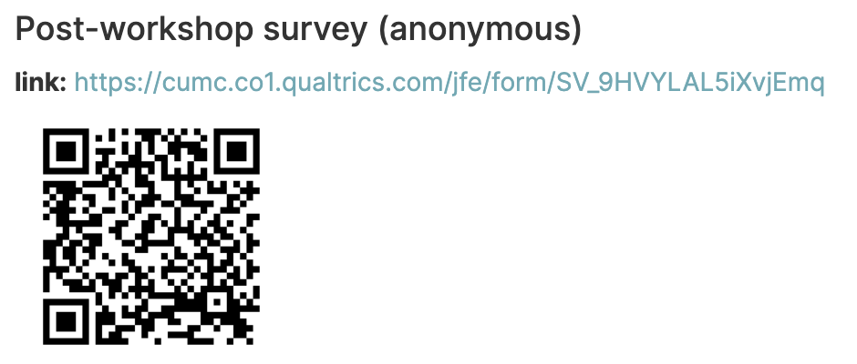
SIPPS post-workshop survey access
(~1 minute survey)

Slide 14
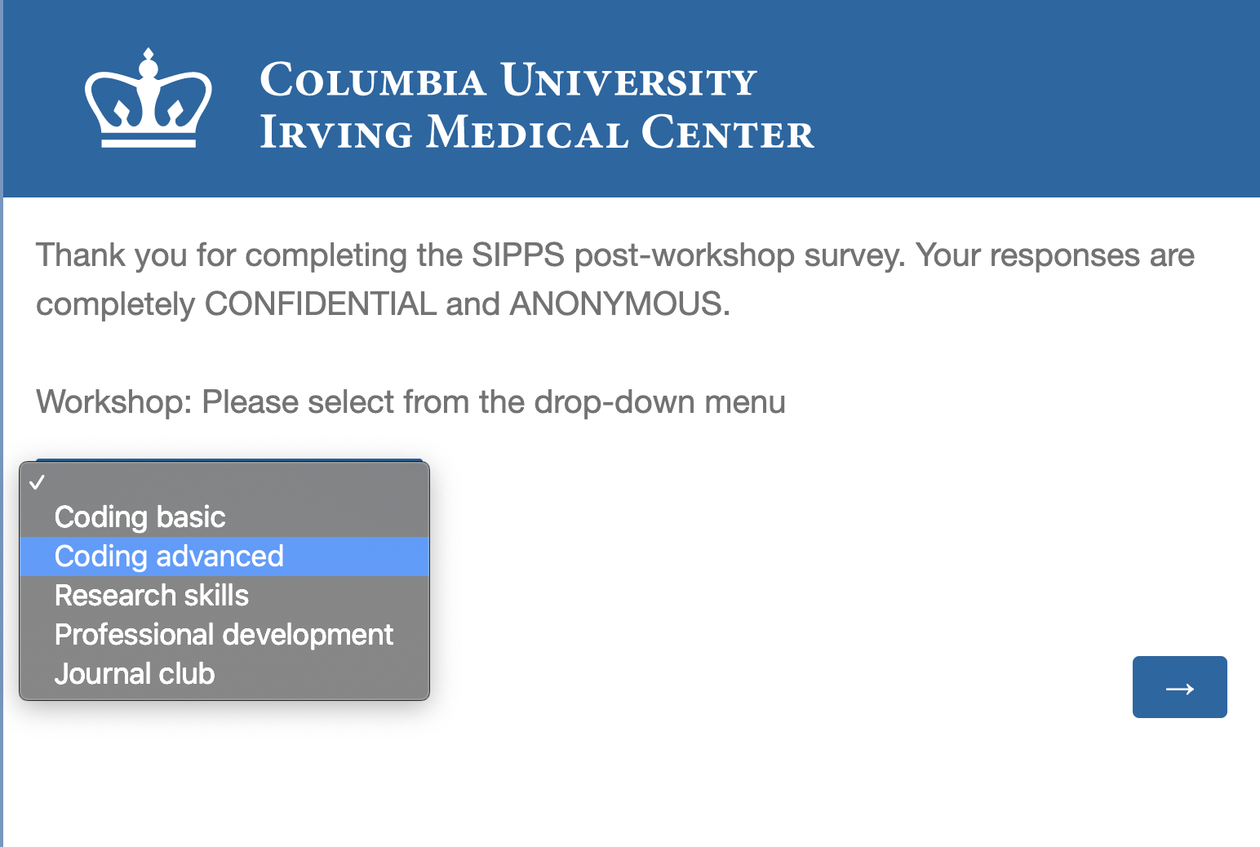
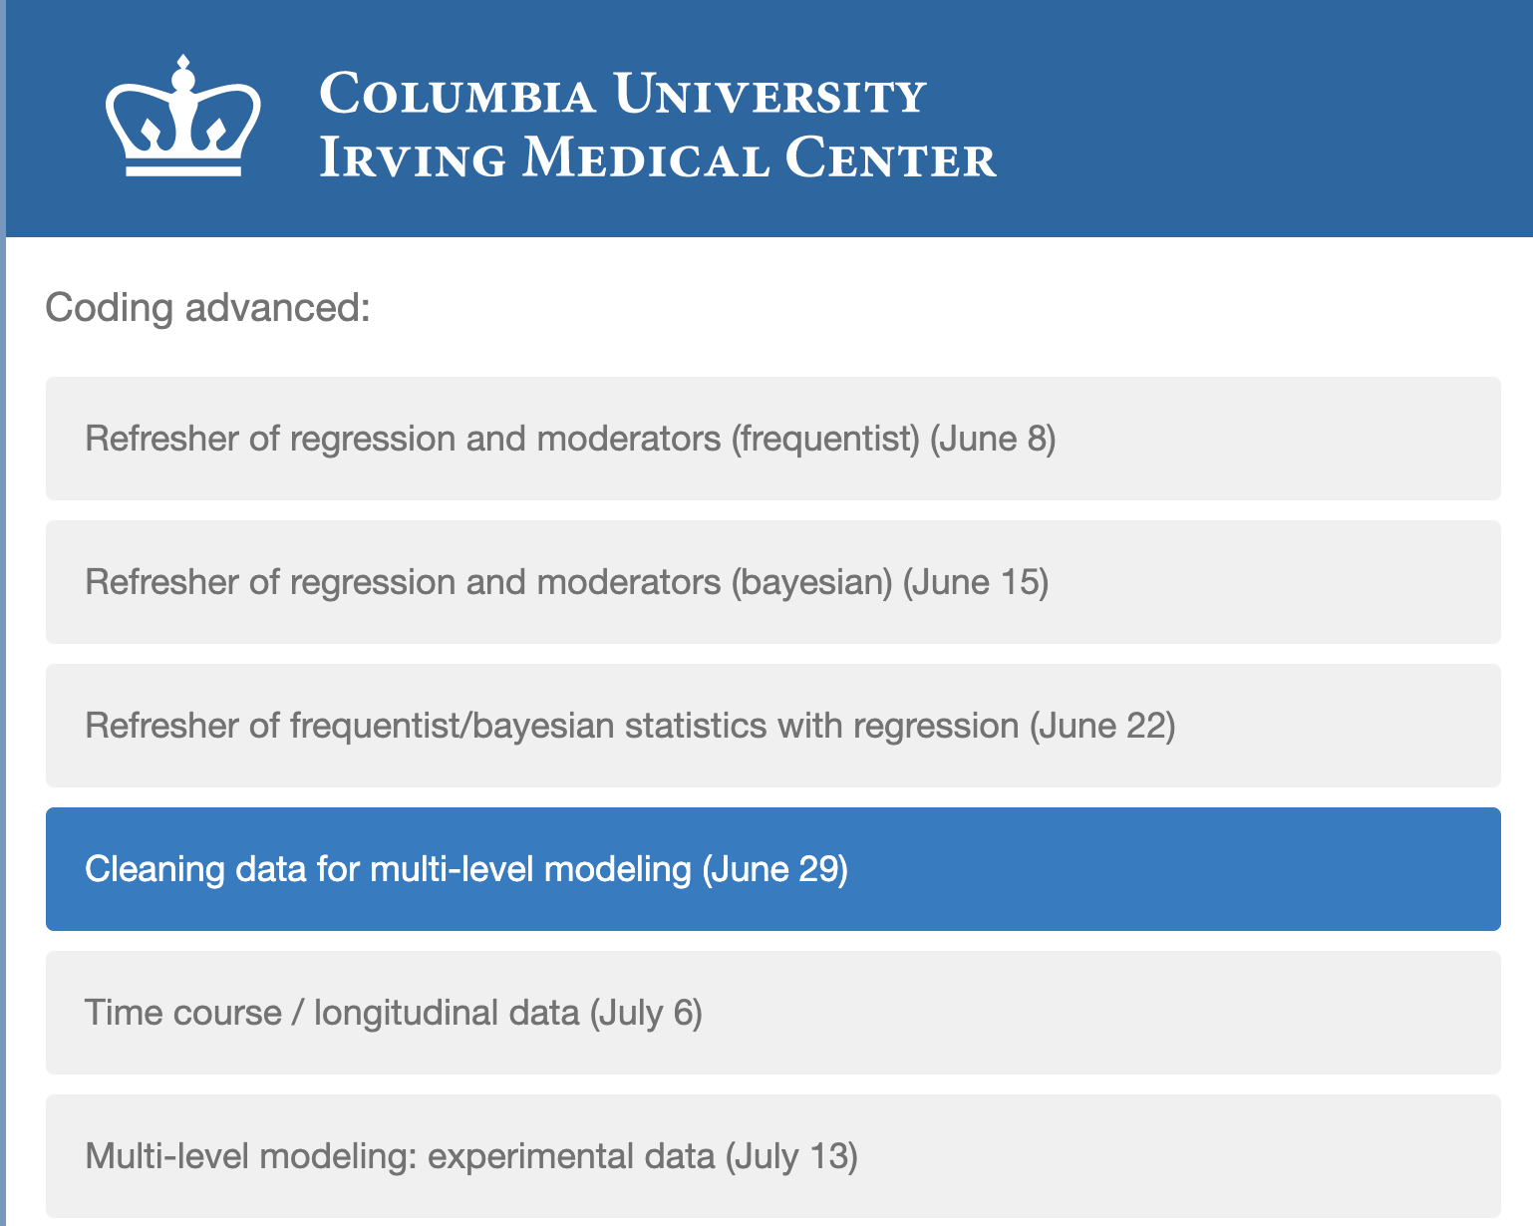
Cleaning data for multilevel modeling (June 29)
Select “Coding advanced” and press arrow
2. Select “Cleaning data for multi-level modeling
(June 29)” and press arrow

