Slide 1

Careers Inside and Outside of Academia
SIPPS 2021

Slide 2
The Goal: Discuss Career Trajectories and Opportunities and How Training in Psychology Can Prepare You

Slide 3
Have an open discussion about different options both inside and outside academia, and the pros & cons of each Consider what you enjoy about your education, and what you want to get more experience with after you graduate

Slide 4



Slide 5
Roadmap for Today
My path and where I fit within the “psychological science ecosystem”
Describe some of the options out there
Explore how psychological science can help you
Takeaways and tips
Share some resources
Participate, Ask Questions, Have Fun!

Slide 6

What Careers Come to Mind? What Questions or Concerns Do You Have?

Slide 7





About Me
UX Research Intern
Summer 2019
BA, 2014
MA, 2016
PhD, 2021
Teaching Postdoc
The Bottomline:
I was all over the place!
Some view this as a negative, I view it as a strength
Notes:
BA, Temple University, 2014
Psychology and Jewish Studies
Photojournalism? Social Work? Clinical Psychology?
Thesis: Nightmares and Socioaffective Outcomes in Preadolescence
MA, Wake Forest University, 2016
General Psychology
Photojournalism? Clinical Psychology? Social Psychology?
Thesis: Regret as a Self-Regulatory System
PhD, New York University, 2021
Social Psychology
Minor in Quantitative Methods
Internship: User Experience (UX) Research Intern at Facebook
Dissertation: Persistence in Romantic Relationship Pursuit
Incoming Harvard College Fellow
The Bottomline:
I was all over the place!
Some view this as a negative, I view it as a strength

Slide 8
Let’s Zoom Out for a Minute

Slide 9
I have training in Psychology…now what?
What areas can I work in?
Schools and Universities
Mental Health Centers
Social service and Government agencies
Healthcare organizations
Corporations, Businesses, and Big Tech
Community Agencies and Nonprofits
What positions are out there?
Professor (research- or teaching-focused)
Educational consultant
Forensic psychologist
Policy Analyst
User Experience Researcher
Private practice psychologist
Staff psychologist in a Hospital
Human resource manager
Educational psychologist
Marketing director
University administrator

Slide 10
The Academic Path: A PhD in Psychology
If you are interested in committing your life to RESEARCH for minimum 5 years (likely more)
To become a professor, you need a PhD
Some professors mostly teach (liberal arts and teaching colleges; like Williams College or Smith College)
Some professors mostly research (“R1”; like Columbia or NYU)
Some professors do both (“R2” or elite liberal arts colleges; like Williams College or Smith College)
And some professor are working clinical psychologists (Hospitals or large Research Institutions)
Some Clinical PhD programs require less research than others, but PhD = Research.
More on this later!
These programs are usually funded: Stipend, Health Benefits, etc.
Don’t pay for a PhD program. Ever.
Check out this site for a list of open PhD positions to apply to when you are ready

Slide 11
The Academic Path: A PhD in Psychology
If you are interested in a PhD but need more research experience, you might think about the following options:
Post-baccalaureate training program
In some special cases, a master’s program (funded only; don’t bother paying!)
Lab Manager
Research technician
Research Coordinator
Research Associate
Academic twitter is a good place to look for these positions!
If you work with a grad student, ask them if they know of any positions—unofficial networks make these positions less visible to so-called “outsiders”
See here, here, and here for a list of possible positions.
Research within hospitals (these are often higher paying)

Slide 12
An unpleasant reality
Academic job market is far from ideal
With an excellent silver lining
People with training in the behavioral sciences are in an especially good position

Slide 13
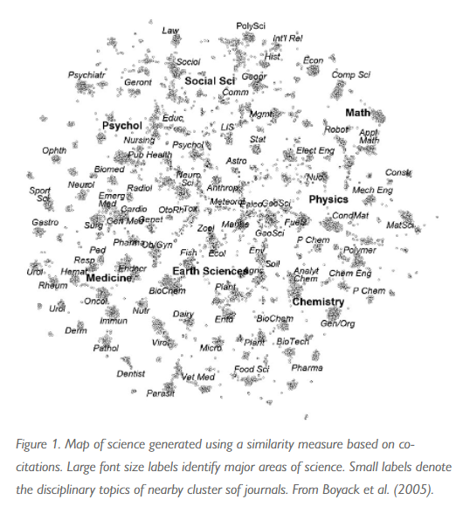
Psychology is a Hub Science!
Notes:
https://www.psychologicalscience.org/observer/psychology-is-a-hub-science
https://www.psychologicalscience.org/observer/the-structure-of-psychology
https://www.psychologicalscience.org/observer/better-interdisciplinary-research-through-psychological-science

Slide 14
Adjacent Fields Offer Abundant Opportunities
Other Arts, Sciences, and Humanities
Statistics and Applied Mathematics, Neuroscience, Biology, Computer Science, Economics,
Sociology, Communications, History, Political Science,
Anthropology, History, Philosophy, Medi Studies, Religion, Literature, Women’s Studies, Black Studies,
Therapy, Clinical Psychology, Psychiatry, Social Work
Business, Industrial/Organizational, Marketing
Big Tech, Data Science, Computer Science
Public Health, Nursing, Medicine, Epidemiology
Government, Politics, Law
Criminology, Criminal Justice, and Forensics

Slide 15
The Academic Path: A PhD Elsewhere?
If you like research but don't like psychology for one reason or another, there are graduate programs in other similar fields:
Don’t like Data?
Explore qualitative methods and non-empirical research
Women’s Studies, Black Studies, Philosophy, Literary Criticism
Don’t like Theory?
Applied Statistics, Data Science
Don’t like the Individual as a primary unit of analysis?
Sociology, Communications, Political Science, Public Policy, Public Health Epidemiology

Slide 16
The Clinical/Applied Path
Therapy, Clinical Psychology, Psychiatry, Social Work
If you want to be involved in therapy and other forms of "practice" (counseling, clinical work in a hospital, therapy, etc.) you don't necessarily need a PhD
In fact, a PhD may be opposite of your goals
Some possibilities:
Masters in Social Work (to become a licensed clinical social worker and practice)
A PsyD (a Doctor of Psychology)
Counseling Degrees (Masters in Education for child populations, PhD in Counseling)
An MD, get involved in psychiatry
Master’s programs (in marriage and family therapy; related programs)
Unlike PhDs, most of these programs are fairly costly, so think carefully!

Slide 17
Business, Industrial/Organizational, and Marketing
PhDs in Business Schools offer an alternative academic path that can open up doors in the private sector as well. These fields tends to be cushier ($$), less competitive, relatively friendly to psychology backgrounds, albeit more conservative
Management,
Marketing,
Organizational Behavior
Pursuing an MBA is also possible if you brush up on some of math skills and develop some connections to land an industry internship.
Knowledge on persuasion, motivation, emotions, situational + contextual factors are all immensely valuable in the advertising, marketing, and management worlds
Linkedin is a great place for non-academic advertising and marketing roles
Association of Management and American Marketing Association have lots of resources

Slide 18
Big Tech, Data Science, Computer Science
If you like psychology and data/numbers/statistics but want to move more quickly and work on applied problems, the private sector may be of interest
Lots of psychology graduate students go on to User Experience Research and Data Science
Possible to work for companies like Facebook, Google, Amazon, or Dating Apps if you have some additional education/hard skills like:
Statistical training, basics of data science
Familiarity with human-centered design
Don’t neglect mixed method and/or qualitative research methods for UX research careers!
One advantage of this industry is a friendliness towards non-traditional paths and training.
Bootcamps and other supplementary training can be an effective way to get into this field

Slide 19
Public Health, Nursing, Medicine, Epidemiology
Masters in Public Health and MDs are a great way to apply your knowledge of psychology.
Having a "psychologist's perspective" on the field of medicine can give you an interesting approach to working in that area
The social, cultural, and contextual factors that determine medicine are going to become even more important in the future
Don't be surprised if you see more people talking about this connection between psychology and medicine in the future
Social determinants of health are the next big thing!
If there’s a topic in psychology that appeals to you, most likely there are medical researchers working on an adjacent topic

Slide 20
Government, Politics, Law
Plenty of psychologists go on to study law!
If this is of interest to you, if may be a good idea to get a position at a law firm after graduation to see if you like this work, while also taking time to study for the LSAT.
A good LSAT+GPA is good enough to get you into the best law schools (whereas PhDs require lots of specific training experience)
Criminology, Criminal Justice, and Forensics

Slide 21
What Skills from Psychology Can I Use?
Long Answer:
Competency with Data
Familiarity with the Scientific Method
Comfort with engaging critically with Theory
**Ability to integrate theory, scientific method, and data skills**
Psychology as a hub science is an advantage in and of itself
Short Answer:
All of them!
You’ve probably had a unique experience
Combining the breadth and depth of your training is the best thing you can do

Slide 22
Takeaways and Tips
Seek out the people who are interesting to you
[People are almost always more friendly than you imagine!]
Adjacent fields offer opportunities
[don’t fear interdisciplinary pursuits, even if it means more work]
Ask yourself what is it that you like about psychology so far and double down on those interests
[let the hub-like nature work for you]
You can make your major work for you, regardless of where you head next
Statistical skills will ALWAYS be a big advantage on the job market
Don’t sleep on qualitative skills though!
Understanding the complexities of human behavior is a big advantage
Psychology majors have the unique mix in quantitative skills, scientific method, and critical thinking
Become conversant in the basic principles and terminology of the field you’re considering
[Rely on your immediate network of support to help you identify resources, connections, and information]

Slide 23
Resources for Careers Inside Academia
https://mitch.web.unc.edu/wp-content/uploads/sites/4922/2017/02/MitchGradSchoolAdvice.pdf
https://www.psychresearchlist.com/
https://docs.google.com/spreadsheets/d/e/2PACX-1vSVD3l1IaXI1gggRlUjpRd7EwLtZeIL_zLHwgVafCrPunBg3Vgf9rR7-kIraWv3DU_i43Cdak_Ia6ar/pubhtml?urp=gmail_link&gxids=7628
https://sites.google.com/g.harvard.edu/p-prep/resources
https://drive.google.com/drive/folders/1OR0gSKMFeHm1ij8_SB1eGLxTx0c9OiKc

Slide 24
Resources for Careers Outside Academia
https://www.psychologicalscience.org/observer/considering-life-on-the-other-side
https://www.psychologicalscience.org/webinars
https://www.psychologicalscience.org/observer/careers-outside-academia-webinar
https://www.psychologicalscience.org/observer/the-many-shapes-of-applied-psychological-science
https://www.youtube.com/watch?v=CC4ndQovtVw
https://socialsciences.nature.com/posts/55118-the-path-to-professorship-by-the-numbers-and-why-mentorship-matters

Slide 25
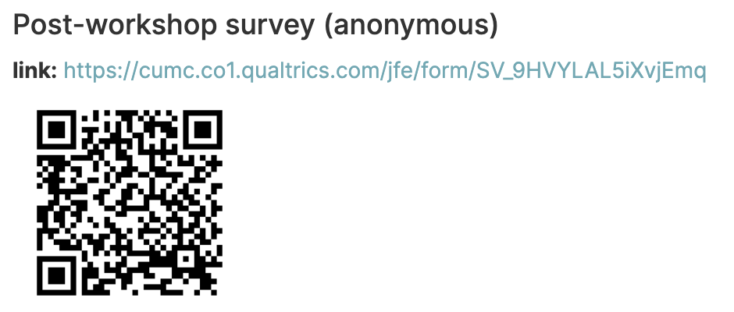
Notes:
https://cumc.co1.qualtrics.com/jfe/form/SV_9HVYLAL5iXvjEmq

Slide 26
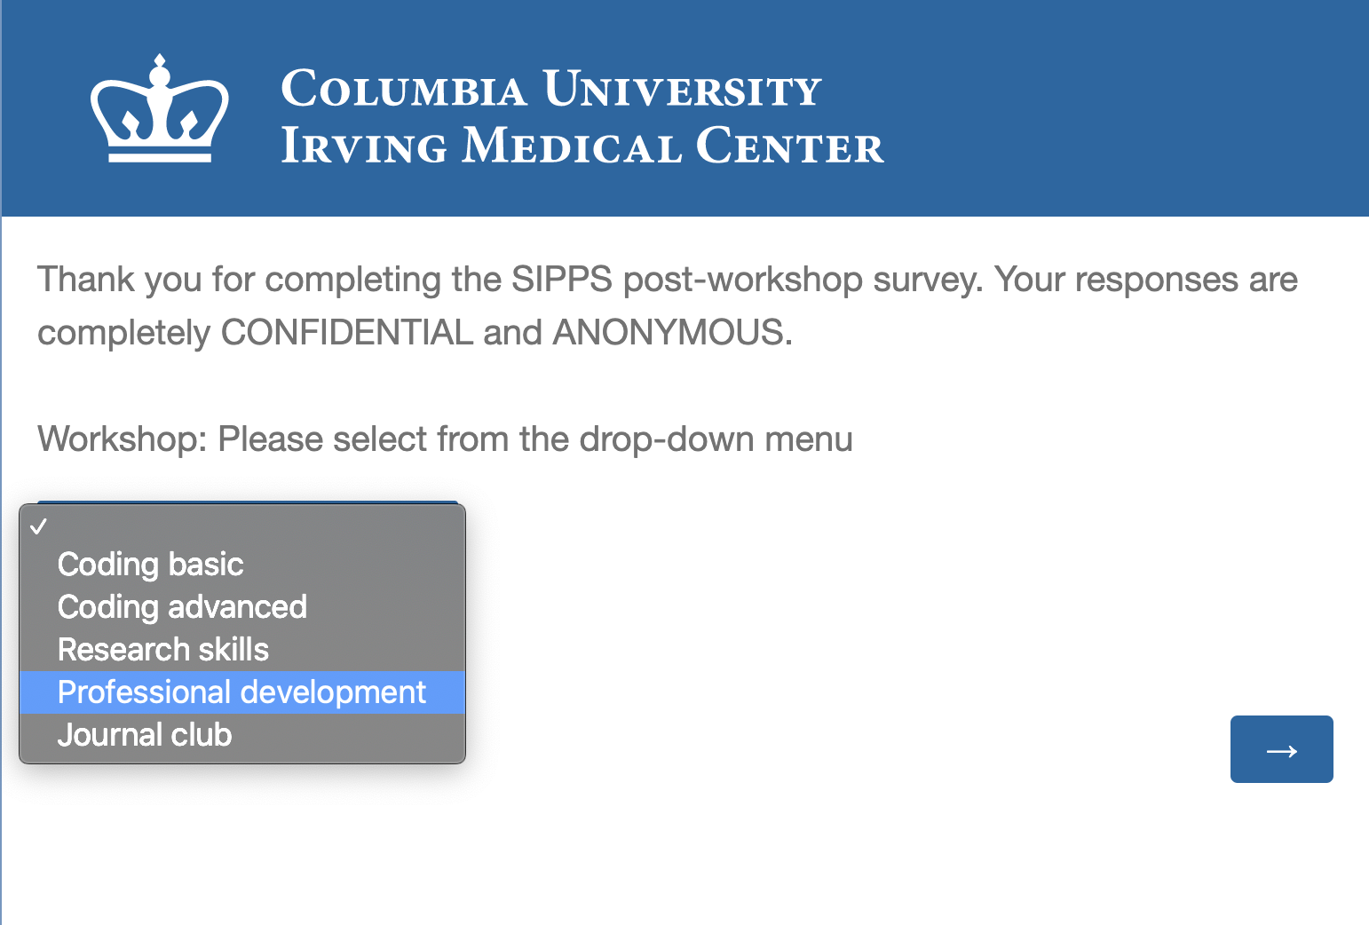
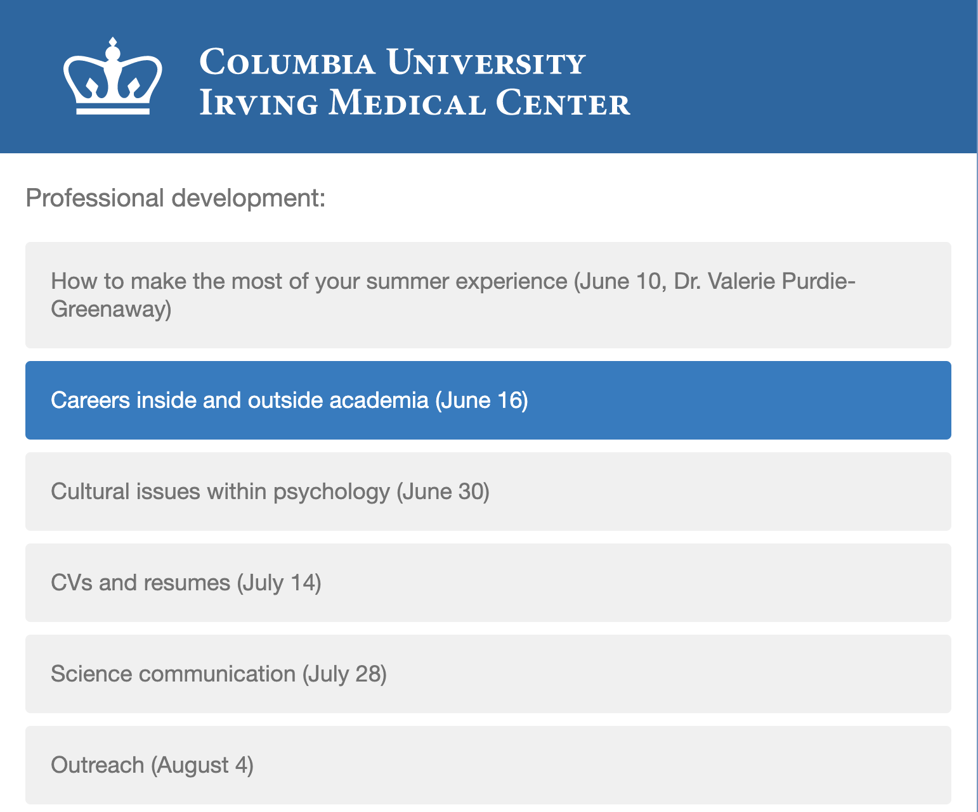
SIPPS post-workshop survey instructions
Careers inside and outside academia
Select “Professional Development”
2. Select “Careers inside and outside academia (June 16)”
Notes:
https://cumc.co1.qualtrics.com/jfe/form/SV_9HVYLAL5iXvjEmq

Slide 27
What did I do at Facebook?
Enterprise Engineering
Recruiting Products
Manager Hiring Team
Product Manager, Engineering Manager, Sr Software Engineer, Data Engineer, Data Scientist, UX Researcher, Content Strategist, and a cast of other adjacent people
Not a front-facing team
I worked with recruiters, sourcers, and hiring managers
Helped design a new tool to optimize the most challenging hiring pipelines at Facebook
Our tool was in Alpha testing, transitioning to Beta testing
My job was to facilitate expansion of this tool from a relatively small set of user needs up to global scale
Almost entirely qualitative work (conducted extensive interviews)
I worked with cross-functional team (with managers, directors, and even briefly VP of recruiting at FB) to implement a quarterly quantitative survey on recruiting

