Slide 1
A Quick Guide to Bayesian vs. Frequentist Estimation
Collecting questions from last time! Put them in the chat or ask
Dummy coding and effect coding – why?
“Confidence intervals” or ”Posterior Intervals”
When to use regression? When to use covariates?
Understanding regression outputs

Slide 2
Fixed vs. Random variables
Fixed = a specific value
Random = there is variability, it is bound by constraints, but it can be anything

Slide 3
When we collect data ….
We have a sample that represents the population, these are our data
We are trying to estimate a population parameter from the sample
Does it make more sense to you that the data would be fixed (we collected the data, and that is what is “true”/what we have) or the parameter would be fixed (there is ONE TRUE population parameter)?

Slide 4
At the core of the debate ….
Frequentist thinking treats the parameters as fixed and the data as random, viewing there to be ONE true parameter value that we look to estimate.
Bayesian estimation views the data as fixed and the parameters as random, and says that ALL parameters have a distribution or a range of possible values.

Slide 5
95% Confidence intervals -- Frequentist
Confidence interval interpretation: If we were to repeat the same study 100 times, 95% of the intervals that you get from all your different studies would contain the true population value in it
Probabilities are NOT attached to hypotheses and parameters
Probabilites represent long-run frequencies
We have confidence in the procedure, not in the data itself

Slide 6
95% Credibility intervals -- Bayesian
Credibility interval (or posterior interval) interpretation: Given our observed data, there is a 95% probability that the true value falls within the range of X and Y. We can be 95% certain that the true value is contained within the given interval.
Probabilities ARE attached to hypotheses and values
A more intuitive interpretation of credibility intervals -- what we WANT to say (and often, how people DO interpret these effects!)

Slide 7
Frequentist approach
What you may be used to seeing in most papers (especially older ones)
Based on p values and Null Hypothesis Significance Tests (NHST)
Parameters that you model are point estimates (there is one value)

Slide 8
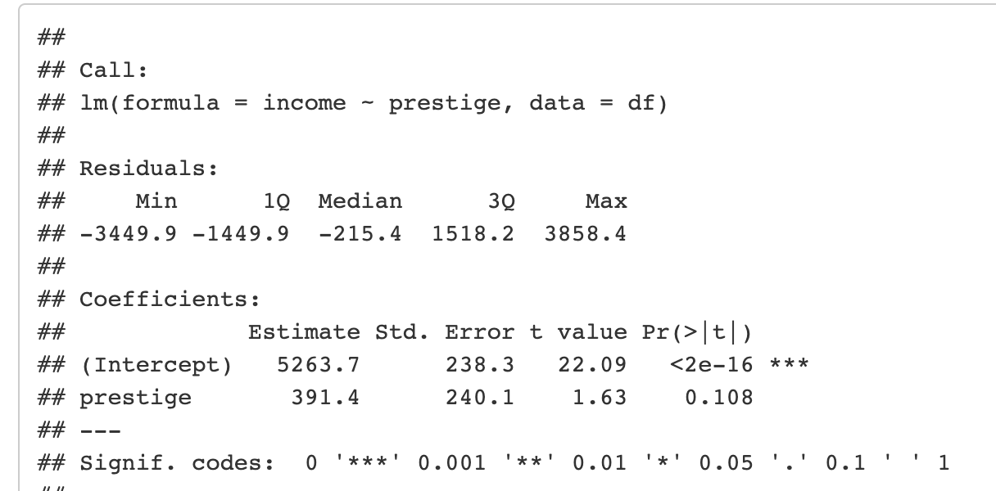
Frequentist approach – lm()

Slide 9
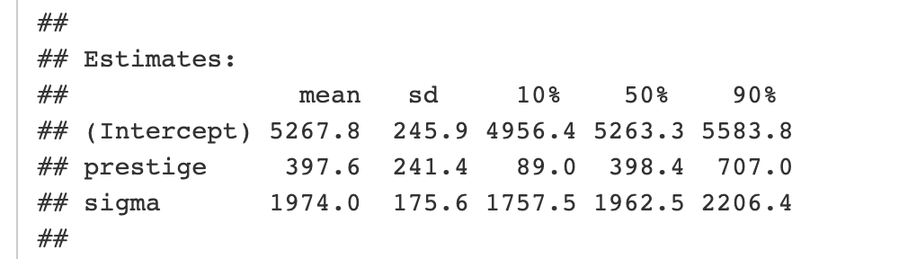
The Bayesian approach
No p values, instead talk about posteriors and posterior intervals
You get the whole distribution for what you are trying to estimate
You can decide for yourself what to do with that distribution

Slide 10
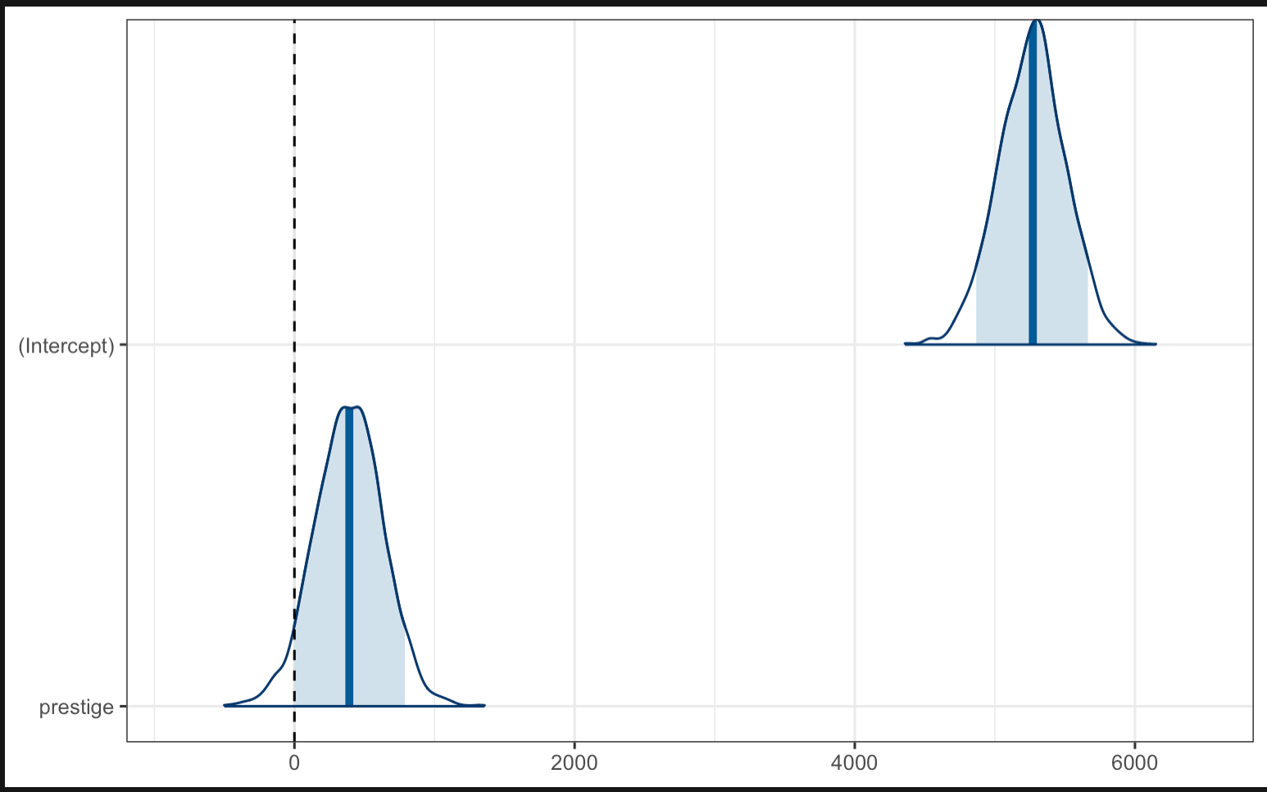
The Bayesian approach – rstanarm::stan_glm()
Posterior distribution for what the model thinks is the average income when prestige == 0 (the average prestige)

Slide 11
The Bayesian approach – rstanarm::stan_glm()
Posterior distribution for what the model thinks is the difference in income associated with a 1-unite change in prestige

Slide 12
No p-values?! How will we make decisions?
With posterior intervals!
With Bayesian models, one way we can set decision thresholds is by asking if posterior intervals include 0
If a posterior interval contains only values of one sign (i.e. all positive, or all negative), we could be more confident that the parameter is in that direction (i.e. the ‘effect’ is positive)
The estimated mean difference was 0.12 (95% PI [0.05, 0.18])

Slide 13
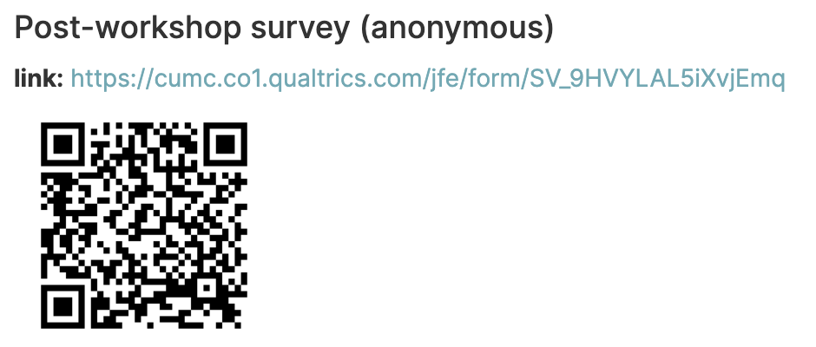
SIPPS post-workshop survey access
(~1 minute survey)
https://cumc.co1.qualtrics.com/jfe/form/SV_9HVYLAL5iXvjEmq

Slide 14
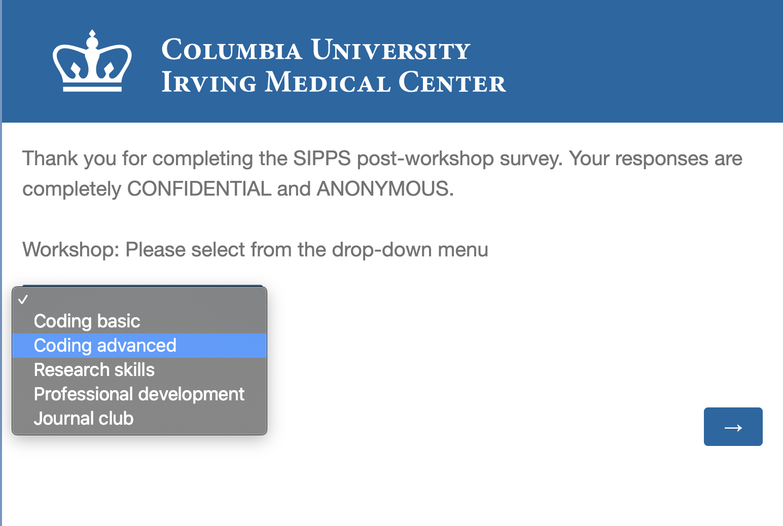
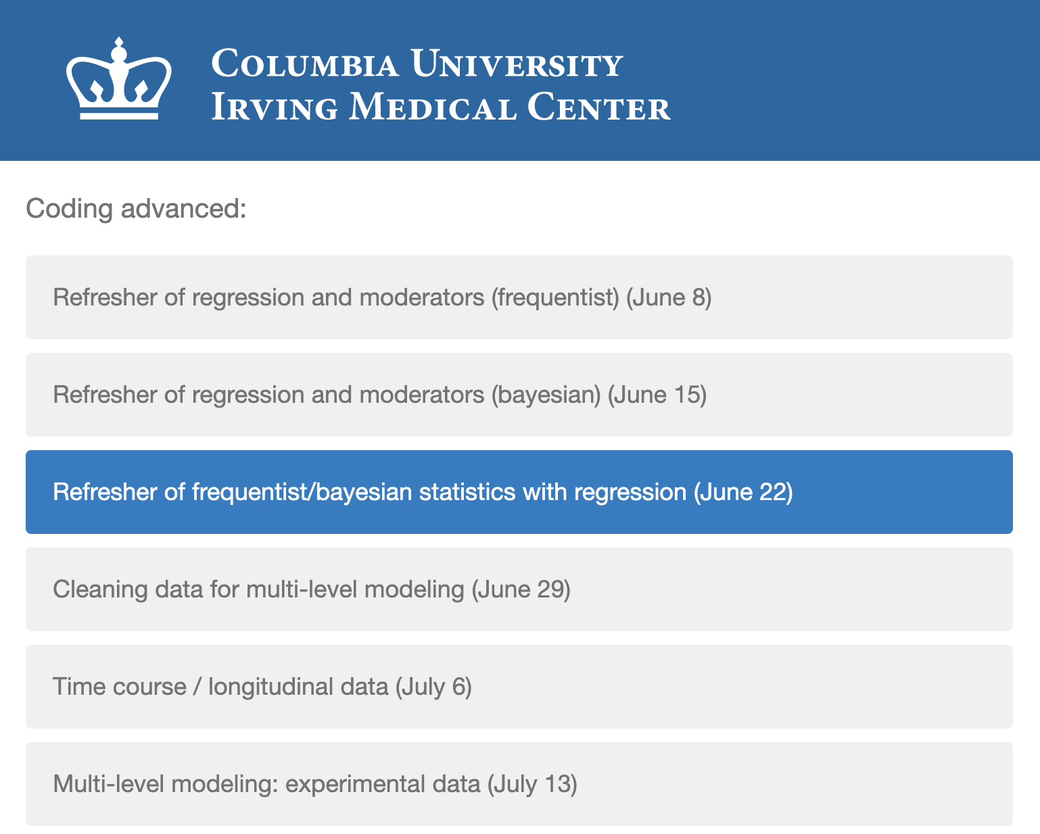
SIPPS post-workshop survey instructions
Advanced Coding Track: Refresher part 3 (June 22)
Select “Coding advanced” and press arrow
2. Select “Refresher of frequentist/bayesian statistics with regression (June 22)” and press arrow

