Slide 1
Before we begin
Download and install git via the instructions sent out by email earlier this week
Sign up for an account on github.com
Let a TA know if you need help

Slide 2


Intro to Git
SIPPS Workshop 2021
John Thorp

Slide 3
Before we begin
Download and install git via the instructions sent out by email earlier this week
Sign up for an account on github.com
Let a TA know if you need help

Slide 4
Why programming?
Replication
Automation
Documentation
Code Sharing
Iteration
Data Management

Slide 5
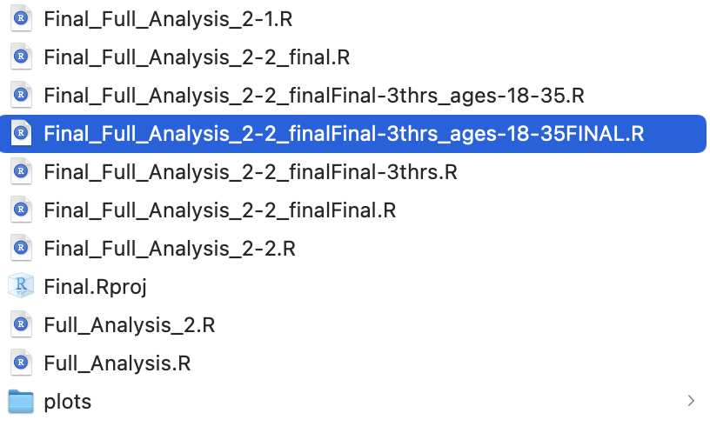
Why programming?
Replication
Documentation?
Documentation
Code Sharing

Slide 6
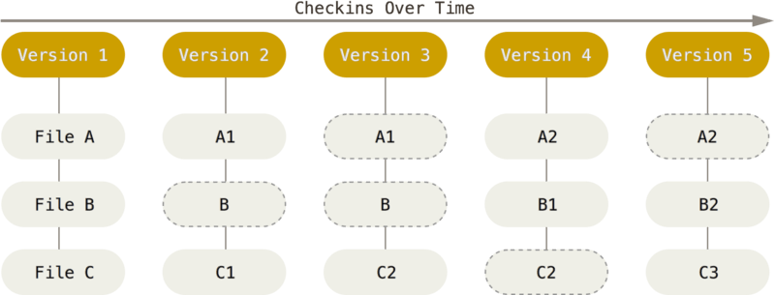
What is Git?
Git is a version control system
What is this useful for?
Storytellers have “it was all a dream”;
Monopoly has “get out of jail free”;
Marty McFly has a DeLorean;
Programmers have Git
Versions have names
(called commits)

Slide 7
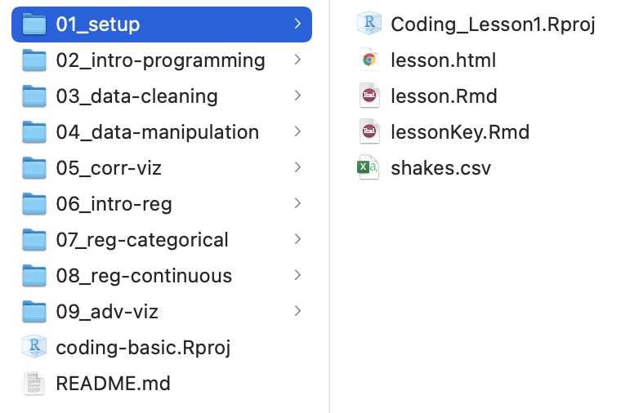
Why programming?
Replication
Code Sharing?
Documentation
Code Sharing

Slide 8
What is Github?
Github is an online database of git repositories
What is this useful for?
Storing your own code in a safe location
Sharing your own code with collaborators
Downloading other scientist’s code for your own project
Show granularity_analysis

Slide 9
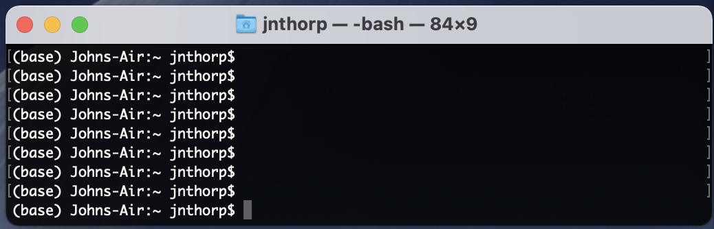
How do I use git?
Open Terminal (on Mac) or PowerShell (on Windows)

Slide 10
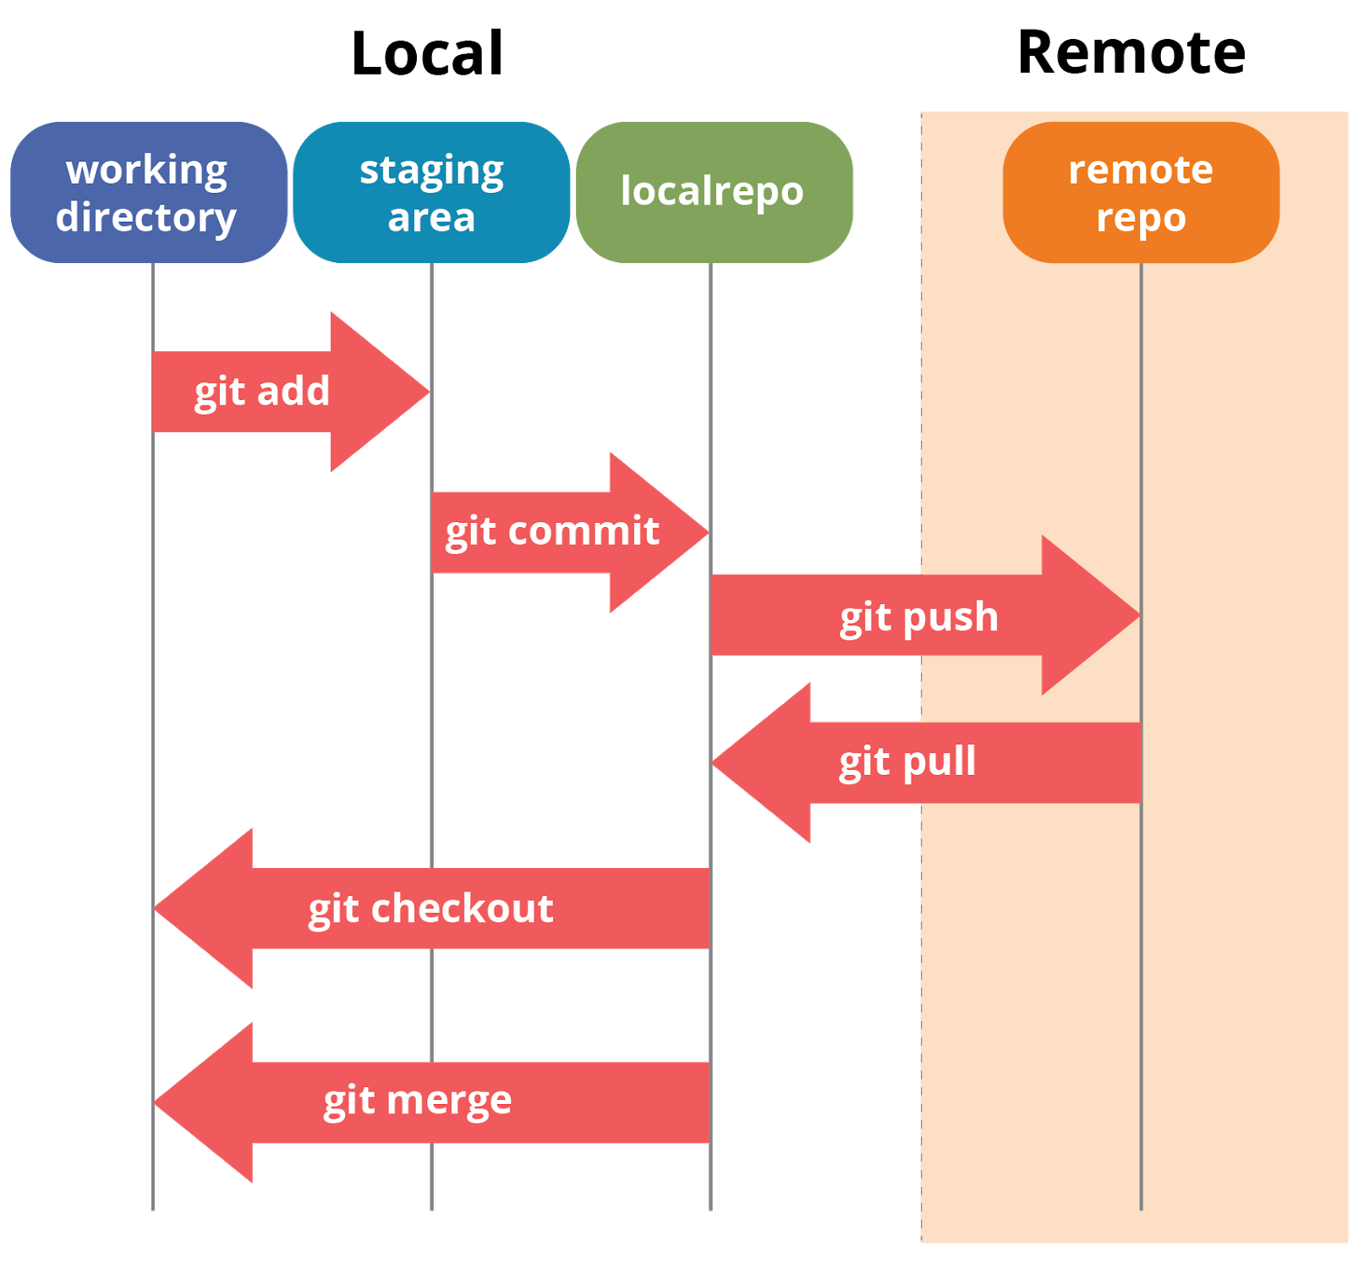
Git Terminology
Working directory:
Anything you change lives here
Staging area:
Where you add files ready to commit
Localrepo:
Your own documented / committed files
Remote repo
Files on github that should be synced with localrepo
git fetch
Fetches remote differences
git status
check status of all areas and commits

Slide 11
Uploading to Github
https://docs.github.com/en/github/importing-your-projects-to-github/importing-source-code-to-github/adding-an-existing-project-to-github-using-the-command-line
Set up an SSH key!
https://docs.github.com/en/github/authenticating-to-github/connecting-to-github-with-ssh

Slide 12
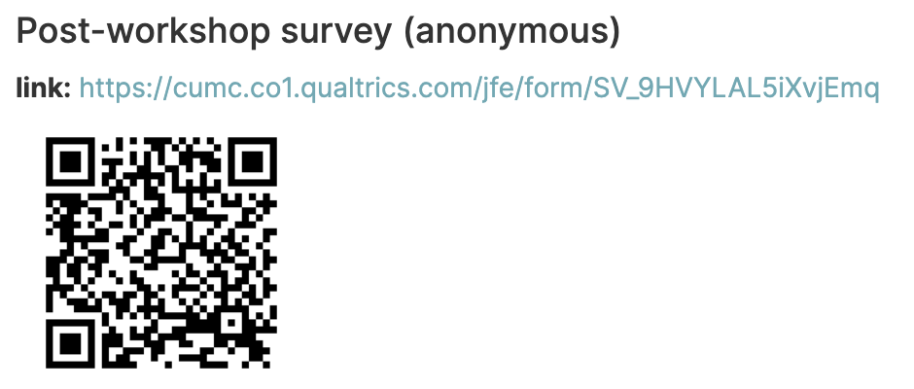

Slide 13
