Slide 1
Components of a clear research question
Summer Internship in Psychological Science
Slides taken from The How-Tos of Research and Ben Silver from SIPPS 2021

Slide 2
A good research question
Builds on prior theory or prior research
Reflects a real-world phenomenon or something you have observed
Something personally relevant/important to you
Fills a gap in the literature: is novel and hasn’t been done (novelty can mean an improvement on methods or testing in a new sample!)

Slide 3
The iterative process
S
Research topic of interest
Narrow down literature review
Begin literature review
Refine/concretize research question

Slide 4
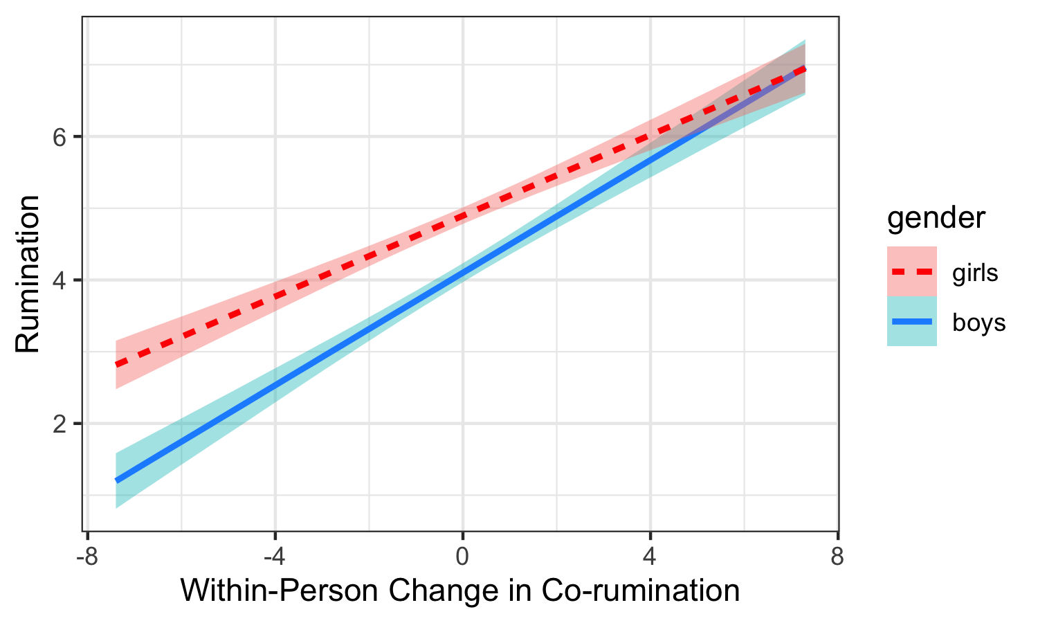
Structure of a research Q
Research is all about effects: What is the effect of X on Y?
What is the effect of social support on well-being?
X = independent variable (IV)
what you manipulate or what is varying
Y = dependent variable (DV)
what you measure or what the outcome is
DV
(y-axis)
IV (x-axis)

Slide 5
Structure of a research Q
Research is all about effects: What is the effect of X on Y?
What is the effect of social support on well-being?
X = independent variable
what you manipulate or what is varying
Y = dependent variable
what you measure or what the outcome is
Does X have an effect on Y, or is it simply related to (or associated with) Y?
How can we determine causality in research?

Slide 6



variable operationalization
There are always countless ways to measure what we are interested in, but we have to be explicit in how we decide to measure variables → a research question is only as good as your operationalization of variables!
How would you measure social support?
Amount of social support/number of close friends?
Quality of social support?
Self-reported? Other-reported (e.g., ask a friend if they PROVIDED SS? Observationally coded (RAs code support behaviors in the lab)?

Slide 7




Specifying your sample
Our findings may vary based on the sample we are studying
Our findings usually can’t generalize to all populations
We have to specify what our sample is:
Are we studying adolescents? Adults? Clinical populations?
Are we studying people in the united states? Or a different country?
Country? Continent?
City? Rural?

Slide 8
What are covariates?
A type of “control variable” in non-experimental work (a related, but distinct, concept to confounding variables in experimental work)
X may be associated with Y… but there is a third variable that also affects Y that we want to adjust for
To make sure that we are measuring the true association between X and Y, we want to “control for” or “adjust for” other variables

Slide 9
What are covariates?
A type of “control variable” in non-experimental work (a related, but distinct, concept to confounding variables in experimental work)
X may be associated with Y… but there is a third variable that also affects Y that we want to adjust for
To make sure that we are measuring the true association between X and Y, we want to “control for” or “adjust for” other variables
Covariates are normally not included in research questions, but are something to think about as you design your study

Slide 10
Example of a covariate
Some research indicates that visible or overt forms of social support lead to INCREASED negative affect.
However, experiencing more stressors may also be related to increased negative affect

Slide 11
Example of a covariate
Some research indicates that visible or overt forms of social support lead to INCREASED negative affect.
However, experiencing more stressors may also be related to increased negative affect
Stressors = covariate
Measure this in your study so that you can “adjust for” this effect

Slide 12

What are interactions?
Sometimes we don’t think a relationship will be the same across all conditions or across all people
A moderator / interaction variable affects (or modifies) the strength of the relationship between X and Y
A moderator can strengthen or weaken a relationship → acts as a dimmer switch

Slide 13
What are interactions?
When you think of a moderation, think of the phrase “it depends”
Does salary increase with years of work experience? The strength of that relationship depends on your gender

Slide 14
Example of an interaction
Increases in co-rumination are associated with heightened rumination at a given timepoint for all adolescents
HOWEVER, the strength of this association is STRONGER for boys than it is for girls
DV
(y-axis)
IV (x-axis)

Slide 15
Activity
INDIVIDUALLY: Come up with two research questions → It should be clear what the IV and DV is, whether this is correlational or causal, whether there is a moderating variable, and who the sample is
IN PAIRS:
Share your research questions with one another
Choose 1 question that you want to focus on
Make any improvements to the question, if needed
Start brainstorming how you would know whether this is a good research question based on the things we talked about today

Slide 16
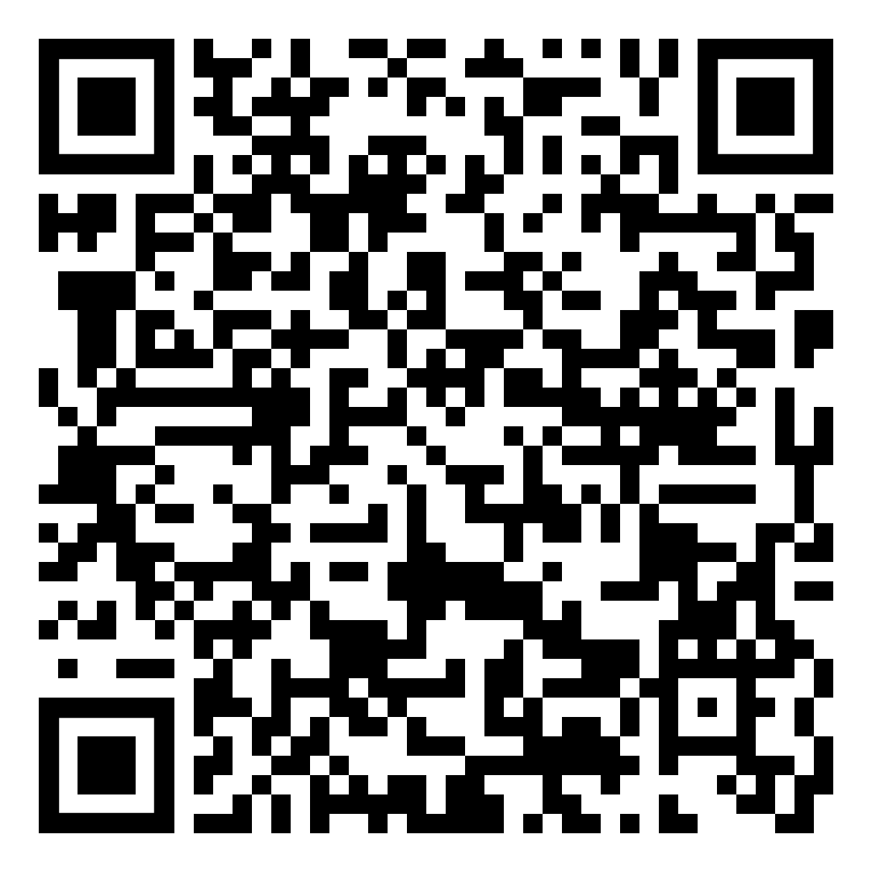
Exit Ticket
https://docs.google.com/forms/d/e/1FAIpQLSfXQYejYNHPafF3AoaTSHLErGzyF62IeBieMzg-cZDMB4Y3vA/viewform

