Slide 1
Week 6 Performance I

Slide 2
Administrivia
Feedback for proposals sent out
Poster session shared with Intro to Vis class? Tues 4/28 6-8PM

Slide 3
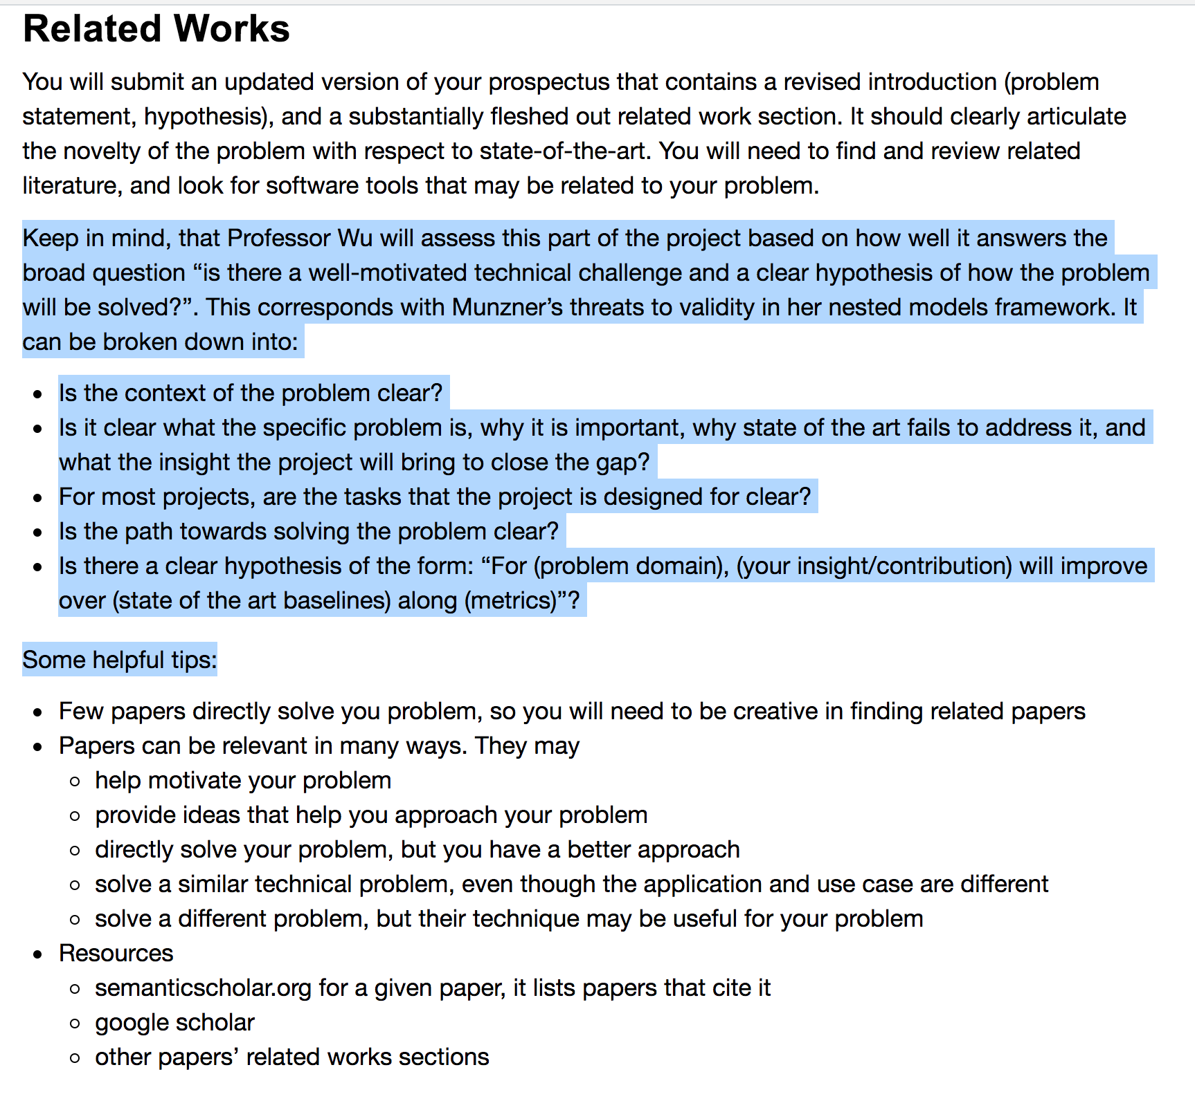

Slide 4
Administrivia
Immens
Presenter: Haneen
Scribe: Yiru Chen
Kyrix
Presenter: Yiru Chen
Scribe: Haneen

Slide 5
Immens Discussion

Slide 6
Contrast with Tableau
What was tableau’s vis-db architecture?
User interaction → SQL query → backend DB
How is immens different?
Precompute: know all interactions → SQL query → cubes
User interaction → cube lookup/compute

Slide 7
The writing
Who was the audience?
How did that affect what the paper focuses on?

Slide 8
Expressiveness
What class of SQL queries does Immens fundamentally express?
SELECT a1, [a2], count(*)
WHERE a3=? GROUP BY a1, [a2]

Slide 9
Core contribution
What “visualization level constraints” does immens use to motivate their use of data cubes?
binned visualizations
interaction dimensionality
plenty of “setup” time, visualization designs fixed
When are these constraints reasonable? not reasonable?

Slide 10
Applicability
When are the techniques (binning, cubing) not applicable?
arbitrary brushes
combinations of filters
arbitrary aggregates
zoom?
scatterplots with transparency (why?)
higher dimensionality interactions
b = 50 bins for each dimension
1d x 2d chart?
2d x 2d chart?

Slide 11
Space partitioning
Immens uses equi-width bins. Why? What’s an alternative?
sparse vs dense representations
lookups fast
sensitive to outliers in attribute values?

Slide 12
Kyrix Discussion

Slide 13
Expressiveness
What class of SQL queries does Kyrix fundamentally express?
SELECT * WHERE point WITHIN viewport
How general is this “zoomable UI” class of interfaces?
Why not Tableau?

Slide 14
Core contribution
“I have a big (legacy) DB, I have a design in mind. Help!”
Task oriented programming API for XUI
Minimum needed to “do the rest”
Layer only needs
SELECT * condition
how to position an item
how to render an item

Slide 15
Contrast with Immens
Immens: specific optimization. still need to build the app
Kyrix: task-specific API that handles the rest

