Slide 1
Modalities:
Voice and Natural Language
Presented by Carlos Eguiluz Rosas

Slide 2
Definitions
Voice: modality for communicating information between User and System
Natural Language: type of language similar to human speech
Notes:
Voice is a modality of communicating information between user and system. It involves using speech as a means of requesting or responding.
Natural Language on the other hand is a type of language reminiscent of human speech which can be structured using syntax grammar rules etc or unstructured with interruptions slang etc. The goal in most works is being able to decipher information from the language. Now in natural language, information can be expressed using written-text or voice.
For this presentation, we will look specifically at the intersection between voice and natural language, focusing particularly on how natural language expressed via voice can be a means of querying for information.

Slide 3
Natural Language Interfaces (NLI)
To generate outputs (whether visual or voice) from natural language queries, NLIs first model the input query in terms of data attributes and low-level analytic tasks (e.g., filter, correlation, trend).
Using this information, these systems can determine which type of output (e.g. text, visualization, speech) is best suited as a response to the input query.
Advantage: NLI affords users the ability to pose data-related questions in natural language to remove the “coding” (e.g. SQL, NLP) barrier of entry.
Disadvantage: Depending
Large search space
Output can be slow
Infer context from input
Output depends on how well user spoke/wrote query and ability of system to interpret

Slide 4


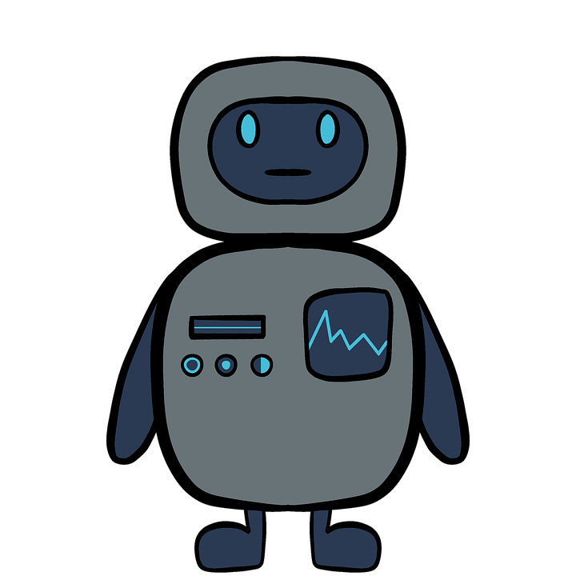

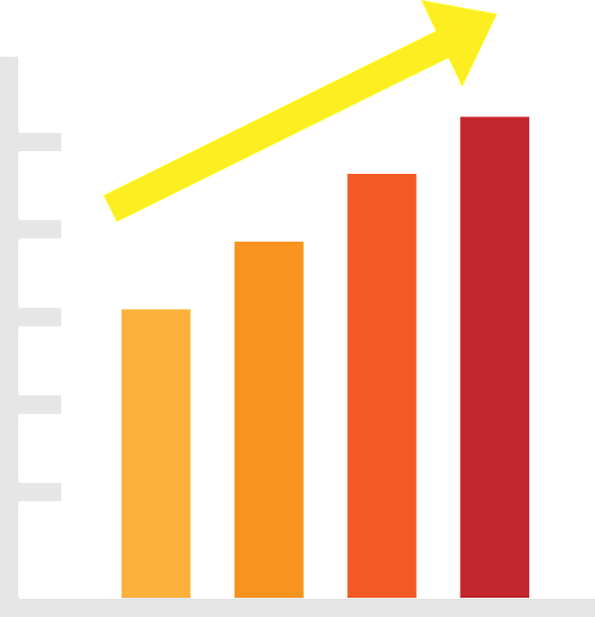


Continuum (based on related work)
1. User gives request in natural language via text or voice
2. System interprets and parses request for attributes/operations. Consults database when needed
3. System returns query result (response) as either text, visualization or voice
Notes:
From surveying a list of related, I was able to develop a continuum for how the information flow would work. In all interfaces, a user first give …..
Afterwards, the system would parse the request …
Finally, the system returns …
From the two readings, we see that users can use their natural language to obtain visualizations or voice. For the purpose of this presentation, we will focus on the CiceroDB paper as it deals more with the topic at hand and offer some discussion questions on the first paper.

Slide 5
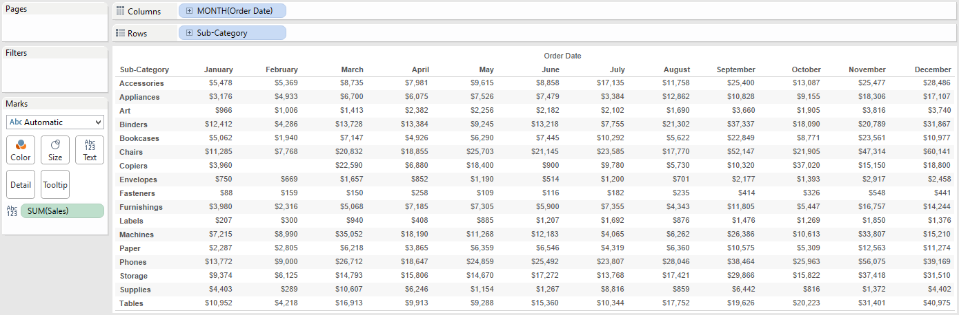


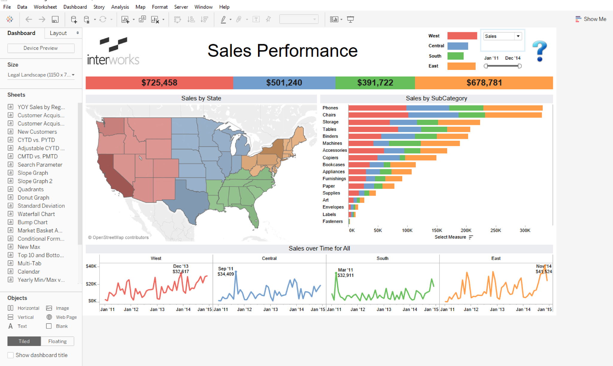
Before we begin...
How is data analysis typically generated and presented to users?
Notes:
Before we begin, let’s talk about how ….
On the top, we have a sales performance table that a data analyst would analyze using a variety of tools. In this case, they’re using tableau and within the application, they’re able view the data directly, make transformations, and generate insights using a variety of mechanisms such as pivot tables. Once they generate the analysis, the analyst would construct a presentation. in this stage, the analyst would present their findings using different types of visualizations such as geographic plots, time series graphs, and bar charts. As a reader, this information is neatly presented, color coded, summarized and divided into sections so that our focus can shift from one section to another. We can spend as much time as we want to look at this dashboard and generate our own observations about the data.
Now that sounds all fine and dandy but what if

Slide 6


But what if ...
The analyst was visually-impaired , inexperienced, and/or needed takeaway as soon as possible?
Notes:
…. the data analyst (or any one of us) was visually impaired, inexperienced at analyzing data, or needed the key takeaway as soon as possible. Regarding the first constraint, tools that leverage visual outputs such as ultorg or tableau will be inaccessible since we can’t view the information well enough for us to perform a task. Regarding the second constraint, sometimes the information we desire can be hard to produce if we don’t know how to express it in a given language or tool. Regarding the third constraint, getting the right information in an understandable manner that would allow us to take some form of action is of crucial importance. A surgeon or a CEO can’t spend too much time looking at visualizations or low-level details for them to make a conclusion. Therefore these three constraints make it harder for one to generate and present an analysis, or so we think...

Slide 7
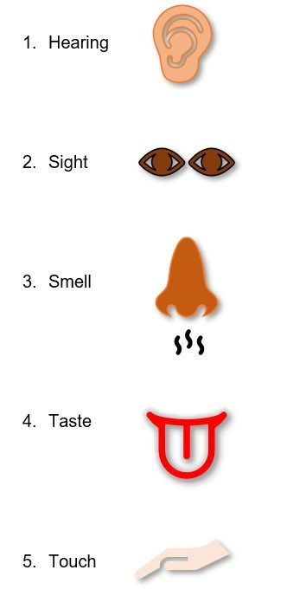

The chosen one...
So far we’ve discussed the use of visual outputs to perform a task.
Given the fact that humans have 5 senses, there are 4 other senses that can address our constraints.
Notes:
So far …
And given the fact that….
As you might’ve guessed, SMELL and TASTE are not practical for generating and understanding analysis. Maybe in the future who knows. And since this presentation is on voice and natural language, we will forgo TOUCH for another day and focus our attention on leveraging HEARING as a way to understand data. If you’re interested in learning how TOUCH can help you understand data, I would suggest researching VR papers that use the haptics for sensing data spaces and objects.

Slide 8
How would it work?
What was the highest temperature reading last summer?
Assume the user is querying a relational database.
In a hypothetical scenario,
User sends request using natural language
System gets request, understands what User wants, and translate it to a query
System queries database which sends result
System presents result to User via voice
(1)
(4)
Last summer, the highest reading was 100*F
(2)
SELECT MAX(temp)
FROM temps WHERE 06/01/21 <= date <= 08/31/21
(3) 100
Notes:
With that in mind, let’s look into how this process would work. In the following hypothetical scenario, let’s assume that the user is querying a relational database.
Starting off at the top, …..
This sounds pretty straightforward, right? You can probably hack this project in a week or two using existing APIs that converts sentences into queries and translates voice to text and vice versa.

Slide 9
The End
Thank you for your time!
Notes:
So we’re done. Or are we?

Slide 10

Yes and No….
We technically addressed the first two by leveraging natural language and voice output as an accessible medium of communicating .
However, we didn’t quite answer the third part to the best of our ability.
ACCESSIBILITY B+
NO-CODE A-
ANALYSIS
SUMMARIZATION C-
Notes:
Looking back at our constraints, ...

Slide 11
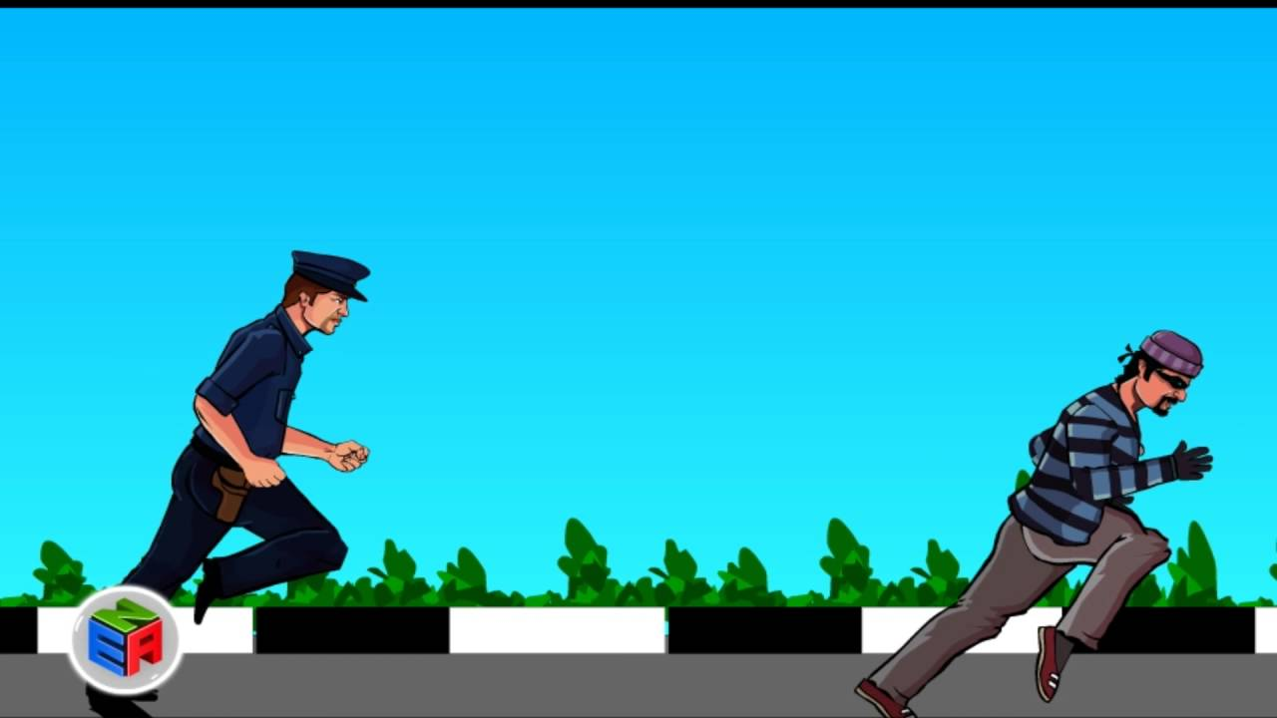
How So?
Me:
Output:
Voice output is fleeting. Output will only exist for a limited amount of time and user will have to rush themselves to process and remember it.
Notes:
More specifically, …
In the case of a highly dense output, this cannot be done by everyone. When it comes to listening, human generally have a short-term memory and unlike reading, there’s no reliable method of skimming for key information since skimming requires knowing the full output in advance to strategically parse. You have to wait and pay attention to every word being uttered so that you can process and remember every detail which is undesirable in the third constraint. If you’re visually-impaired and voice outputs are your only means of understanding information, then you’re going to have a hard time with all this being thrown at you. This leads us to the ultimate question: what can we do?

Slide 12
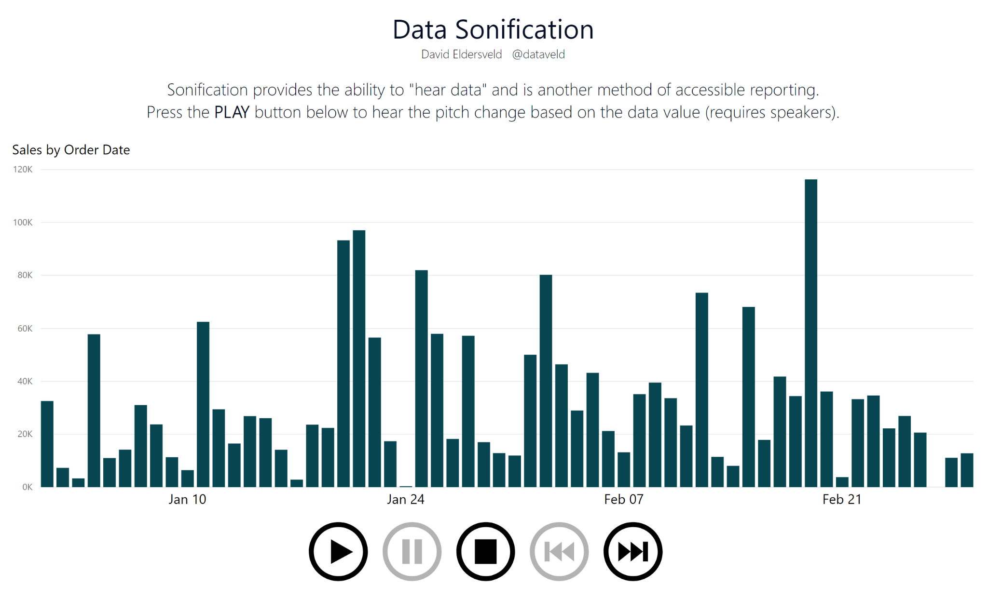
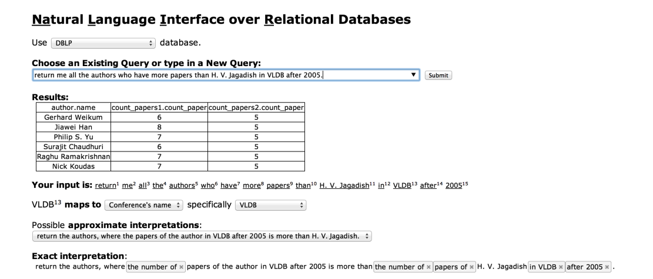
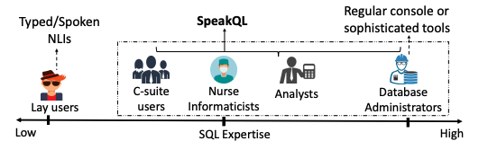
Previous Work
Notes:
To answer this question, it’s important that we look at prior work in the realms of natural language interfaces and audio summarizations.
Starting from the left, we have NALIR which is an interface where users can write in natural language to query a relational database. The system outputs the desired result in tabular form along with alternative interpretations of the request.
Over on the bottom right, we have SpeakQL that acts as a mediator tool for slightly-proficient individuals who want to translate vocally expressed sql-ish queries into full SQL queries as a method of improving their understanding of the language.
In both interfaces, we have a semi-accessible way to query data using natural language however the results aren’t vocally expressed and summarized to best fit our comprehension. Not only that both interfaces are not well suited for analysis of large data sets which is the typical work for analysts.
Now a previous work that can effectively communicate large and complex data via audio is called data sonification. In brief, data sonification involves encoding numerical data with musical tunes so that user can auditorily understand and engage with their composition. The drawbacks of this approach is that (1) it only works with numerical data (2) it’s mainly for entertainment purposes, and (3) there’s no accessible method of querying the data via voice.

Slide 13
So what now?
Notes:
Up to now, we’ve learned that prior work has not been successful at addressing the three constraints we mentioned. Please keep in mind that all three constraints aren’t randomly pulled from a hat, rather they’re all interconnected and when properly addressed, they can impact the way a user perceives information outputted via voice. Before we move onto a potential solution, I would like to dedicate this time to answer any questions.

Slide 14
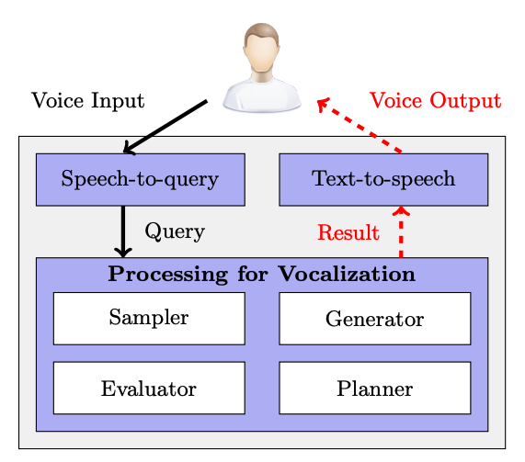
Hello, CiceroDB!
Database system that summarizes query results via voice output
Goal: “Educate” users about their query result in an non-interruptible, low-latent, and concise manner.
Notes:
Awesome, with that in mind, we can introduce CiceroDB which is a database system ....
It is not a system designed specifically for the translation of voice input into SQL queries, as that has already been done.
Its goal is to ….We can dissect those three terms into the following

Slide 15
How does this mean?
non-interruptible: system processes queries and crafts vocal descriptions in background while talking so that information-flow is not interrupted
low-latent: system processes request, plans a strategy for merging query results and vocal descriptions in short span of time, and outputs it
concise: vocal descriptions are pruned for high-level insights so that user can well understand and remember information
Notes:
Essentially, non-interruptible means that the system queries the backend while reading an output to reduce the lag in between results. Low latent means that information is delivered in short span of time. And concise means that all the low-level detail and filler words are removed to optimize user’s retention of information.

Slide 16
How does it work?
Assume User sends OLAP-related request to system using natural language
System translates voice input into query using speech-to-query mechanism
System generates voice description that contains query results within a well-written and summarized sentence that gives System time to process any remaining queries via the vocalization processing pipeline.
Generator: creates candidate speech fragments → ____ ____ ____
Sampler: creates samples of queries → A B C
Evaluator: updates quality estimates of speech fragments based on samples → A+ ____ = Good
Planner: controls query evaluation process → __A__ __B__ ...
System voices description to User via text-to-speech mechanism.
(Holistic Vocalization)
Notes:
Now looking into how things work, we can split this entire process into 3 tasks. The first and third are pretty straightforward as it’s essentially a translation of request and response which related work has shown.
The core of the system is step 2 in which the system ….
Now this sounds straightforward but it’s missing one last thing which is the key to how it generates the voice output and that’s the HOLISTIC VOCALIZATION metric. This metric allows for the system to determine which voice output (i.e. speech) minimizes the distance between the query results and user’s belief. The user’s belief being what they believe the query result is after listening to the speech. In one paper that the author co-wrote, he and his team developed the algorithm for obtaining minimal distance and validated this approach with a experiment involving Amazon Turk participants comparing the approach to others. In another paper that the author co-wrote, he and his team concluded that voice-output optimization is NP-hard, meaning that it’s pretty complex and hard to solve in nondeterministic polynomial time. So the vocalization pipelining method that the author investigated is a viable greedy algorithm solution to reduce the complexity to polynomial time and outputs the desired speech. Therefore we can assure ourselves that this second task has been studied.

Slide 17
Example
blah blah blah
Assume I’ve queried the system before
Hi Cicero, how cold does it get in NYC and, for those dates when it snows, how thick does the snow usually get?
Vocalization processing pipeline
Generator: On average, The mean, around, usually
Sampler: 50*F, 45*F, 5”, 3” (may not be truths)
Evaluator: On average + 50*F → Good, The mean + 50*F → Ehh
Planner: On average NYC is 50*F …. usually 3” thick
On average NYC is 50*F and, for snowy days, snow is usually 4” thick.
(1)
Query given in speech/natural language and translated to query
(3)
Voice description generated from pipeline and translated to speech
(2) Query validation pipeline
Notes:
Here’s an example of how the query would work….
As you might guess, the query is non-interruptible since it gives the system ample time to process and refine other queries in the background. We can assume low latency since this operation involves aggregating twice on conditionals. Finally, we can say it’s concise since we found the optimal phrasing of speech fragments that’s best captures the query results and which the user can believe. It’s important to note that the sampled query results may not be ground truths but that doesn’t matter since the system’s aim is to provide a quick answer to what the user could believe to be true. With all this in mind, we have two variables worth testing in order to validate the system’s performance.

Slide 18
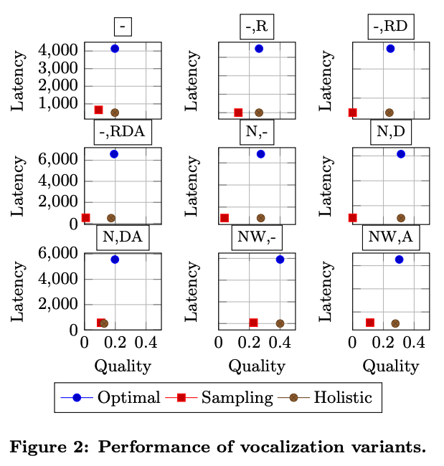
Evaluation
Notes:
To evaluate the performance of the system, the authors ran a study on a large dataset to see how well the system performs given it’s Holistic Vocalization metric. They ran queries on their own system and measured the latency and speech quality (which is a measure of how well the speech approximates the actual query result).
Based on these results, the authors determined that the Holistic metric is low latent in nature like Sampling metric, and achieves similar quality to Optimal metric. In conjunction to their secondary study on user’s preference of vocalization method, it’s clear that CiceroDB is the preferred choice for vocalizing large query results.
While this sounds impressive, I believe a study that investigates user belief is worth doing in addition to this. As I’ve mentioned before, the system gives the users a query result that approximately the ground truth, based on the samples. I would be curious to see how users would react after listening to the ground truth and if that affects their belief in any way.

Slide 19
So Now What?
So now that we validated the system, are we done? Not quite but this is a good starting point.
DB Operations: CiceroDB currently supports simple SQL queries with equality predicates, grouping, and aggregation. The system could be expanded to include other operations (e.g. joins)
Tweening for Vocalization: User issues multiple, related queries in a sequence and system describe difference between consecutive query results. Instead of outputting each query results 1-by-1, focus on the “delta” to prevent overwhelming the user.
Exact Data Vocalization: CiceroDB samples data to approximate results, however there are cases where the exact result is needed. In those cases, processing and voice output need to be aligned for further optimization (e.g. minimize latency and avoid interruptions until voice output starts)
Notes:
So now… The field is fairly new and there’s a lot of interesting work that can be done to add more value to the system, more specifically supporting additional db operations, outputting similar and sequential querying results, and providing exact measures while minimizing the system. With that being said, I rest my time and open the floor to any questions y’all might have.

Slide 20
The End
Thank you for your time!
Notes:
So we’re done. Or are we?

Slide 21
Time to Discuss!
Would you use CiceroDB or NL4DV in your future work?
Besides the aforementioned limitations, what are other visual outputs (e.g. records values, pivot tables, data-vizs) that cannot be vocally communicated using either tool?
What does CiceroDB or NL4DV assume about the user when voicing their request and listening to the results?
Are there any drawbacks to using natural language speech when querying a database? How does one minimize those drawbacks?
In what cases would low-level detail be favored as opposed to summarization?
Is approximation of query results a practical method of communicating information?

