Slide 1
Trust, but Verify
Optimistic Visualizations of
Approximate Queries for Exploring Big Data

Slide 2
Big Data Visualization
 | Pros | Cons
Distributed System | General query Precise | Network latency Costly
Data Cube | Fast Precise | Precompute Limited query
Sampling | Fast General query | Not precise

Slide 3
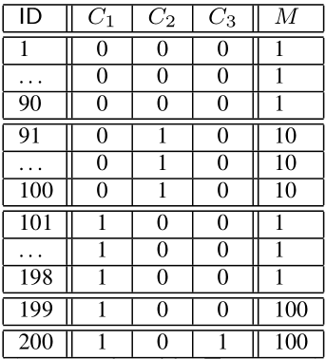
Sample + Seek
SELECT C1 , SUM(M) FROM T GROUP BY C1
When C1 = 0.
SUM(M) = 1*90 + 10*10 = 190
When C1 = 1
SUM(M) = 1*98 + 2*100 = 298

Slide 4
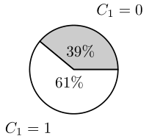
Sample + Seek
SELECT C1 , SUM(M) FROM T GROUP BY C1
<190/488,298/488> = <0.39,0.61>

Slide 5
Sample + Seek
Uniform sampling 20 records:
High chance
For C = 0
9 rows from rows 1-90 M = 1
1 row from rows 91-100 M = 10
For C = 1
Case 1: one of 199, 200 sampled
Case 2: neither sampled

Slide 6
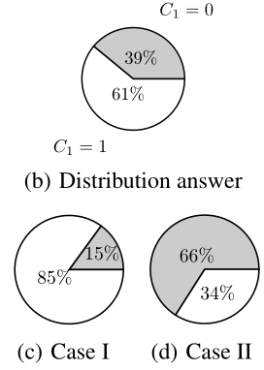
Sample + Seek
SELECT C1 , SUM(M) FROM T GROUP BY C1

Slide 7
Sample + Seek
Measure-biased sampling
Pick a row with probability proportional to its value on the measure attribute.

Slide 8
Sample + Seek
Measure-biased sampling
1 26 51 76 92 94 96 98 111 136 161 186 199(four times) 200(four times)
<8/20,12/20> = <0.40,0.60>

Slide 9
Optimistic Data Visualization
Trust: Assume that approximation is right in most of the cases.
But not done yet...

Slide 10
Optimistic Data Visualization
Trust: Assume that approximation is right in most of the cases.
Verify: Run the query in the background

Slide 11
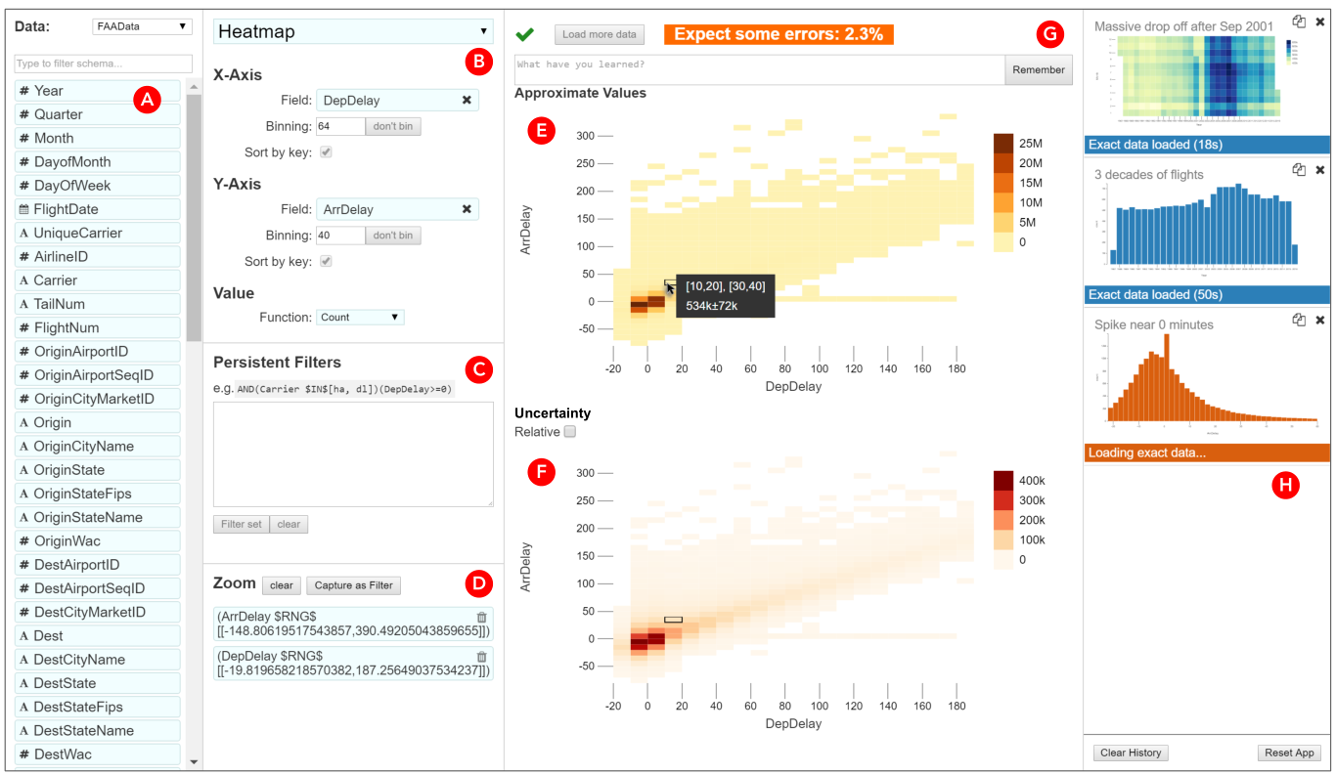
a list of fields (A), chart specification forms (B), a textfield for filters (C), zoom specification (D), approximate visualization (E), visualization of the uncertainty (F), field for annotations and “remember” button (G), a list of views in the history (H)

Slide 12
Evaluation
Three case studies:
David and Software Crashes: 200MB/day
Madhu and Search Terms: 994 million rows of data
Faraz and Social Computing

Slide 13
Evaluation
Takeaways
AQP works “ excited that Pangloss could let him get to know the shape of his full dataset. In the past, he had not felt like he could explore his data: queries took too long, and so he would focus only on specific questions that he needed to answer”
Optimism works: “I was think what to do next - and I saw that it had loaded, so I went back and checked… very nice for not interrupting workflow.”
Draft query: “ He began to use the ap­proximate query as a draft, less concerned about the answer it showed and more concerned about whether it showed that he had the right query … When he accidentally formed a view with a bad filter, he quickly noticed the approximate view was incorrect and adjusted the query”

Slide 14
Discussion

Slide 15
Wander Join: Online aggregation via Random Walks
Xupeng Li
3/4/2020

Slide 16




Overview
Join operation of relational database
Join is common, but expensive
$$1000000000000$$
$$×$$
$$×$$
$$→$$
$$10000$$

Slide 17

Overview
If only for Aggregation (sum)
$$Σ$$
$$1000000000000$$
$$×$$
$$×$$
$$→$$
$$10000$$

Slide 18
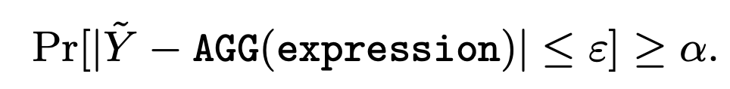

Overview
If only for Aggregation (sum)
Can do approximation
fast: hours (full) $→$ seconds (approximate)
with certain confidence
$$Σ$$
$$1000000000000$$
$$×$$
$$×$$
$$→$$
$$10000$$

Slide 19



Overview
$$Σ$$
$$\frac{1}{10}$$
$$5$$
Approximate by random sampling
$$1000000000000$$
$$×$$
$$×$$
$$→$$
$$10000$$
$approximation: sum= 5÷\frac{1}{10}$

Slide 20


Overview
$$Σ$$
Approximate by random sampling
$$1000000000000$$
$$×$$
$$×$$
$$→$$
$$10000$$
$$\frac{1}{20}$$
$$3$$
$approximation: sum=(5÷\frac{1}{10}+3÷\frac{1}{20})/2$

Slide 21


Overview
$$Σ$$
Approximate by random sampling
$$\frac{1}{10}$$
$$9$$
$$1000000000000$$
$$×$$
$$×$$
$$→$$
$$10000$$
$approximation: sum=(5÷\frac{1}{10}+3÷\frac{1}{20}+9÷\frac{1}{10})/3$

Slide 22
Algorithms for random sampling
Ripple Join v.s. Wander Join

Slide 23
Algorithms for random sampling
Ripple Join v.s. Wander Join
Sampling
Table A
Table B
Table A
Table B
Join
$$×$$

Slide 24
Algorithms for random sampling
Ripple Join v.s. Wander Join
Sampling
Table A
Table B
Table A
Table B
Join
$$×$$

Slide 25
Algorithms for random sampling
Ripple Join v.s. Wander Join
Sampling
Table A
Table B
Table A
Table B
Join
$$×$$

Slide 26
Algorithms for random sampling
Ripple Join v.s. Wander Join
Sampling
Table A
Table B
Table A
Table B
Join
$$×$$

Slide 27
Algorithms for random sampling
Ripple Join v.s. Wander Join
Sampling
Table A
Table B
Table A
Table B
Join
$$×$$

Slide 28
Algorithms for random sampling
Ripple Join v.s. Wander Join
Sampling
Table A
Table B
Table A
Table B
Join
$$×$$

Slide 29

Algorithms for random sampling
Ripple Join v.s. Wander Join
Dependent
Uniform
Sampling
Table A
Table B
Join
Table A
Table B
$$×$$

Slide 30
Algorithms for random sampling
Ripple Join v.s. Wander Join
Independent
Non-uniform

Slide 31







Algorithms for random sampling
Ripple Join v.s. Wander Join
Table A
Table B
Table C
$$3$$
$$5$$
$$5$$
$$3$$
$$×$$
$$3$$
$$×$$
$$5$$
$$5$$
WHERE A.x = B.x and B.y = C.y

Slide 32

Algorithms for random sampling
Ripple Join v.s. Wander Join
Table A
Table B
Table C
$$3$$
$$5$$
$$5$$
$$\frac{1}{|A|}$$
$$3$$
$$×$$
$$3$$
$$×$$
$$5$$
$$5$$
WHERE A.x = B.x and B.y = C.y

Slide 33

Algorithms for random sampling
Ripple Join v.s. Wander Join
Table A
Table B
Table C
$$\frac{1}{2}$$
$$3$$
$$5$$
$$5$$
$$\frac{1}{|A|}$$
$$3$$
$$×$$
$$3$$
$$×$$
$$5$$
$$5$$
WHERE A.x = B.x and B.y = C.y

Slide 34

Algorithms for random sampling
Ripple Join v.s. Wander Join
Table A
Table B
Table C
$$\frac{1}{2}$$
$$3$$
$$5$$
$$5$$
$$\frac{1}{|A|}$$
$$3$$
$$\frac{1}{3}$$
$$×$$
$$3$$
$$×$$
$$5$$
$$5$$
WHERE A.x = B.x and B.y = C.y

Slide 35
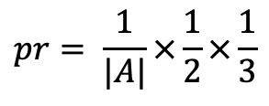
Algorithms for random sampling
Ripple Join v.s. Wander Join
Table A
Table B
Table C
$$\frac{1}{2}$$
$$3$$
$$5$$
$$5$$
$$\frac{1}{|A|}$$
$$3$$
$$\frac{1}{3}$$
Random walk
$$×$$
$$3$$
$$×$$
$$pr= \frac{1}{|A|}×\frac{1}{2}×\frac{1}{3}$$
$$5$$
$$5$$
WHERE A.x = B.x and B.y = C.y

Slide 36
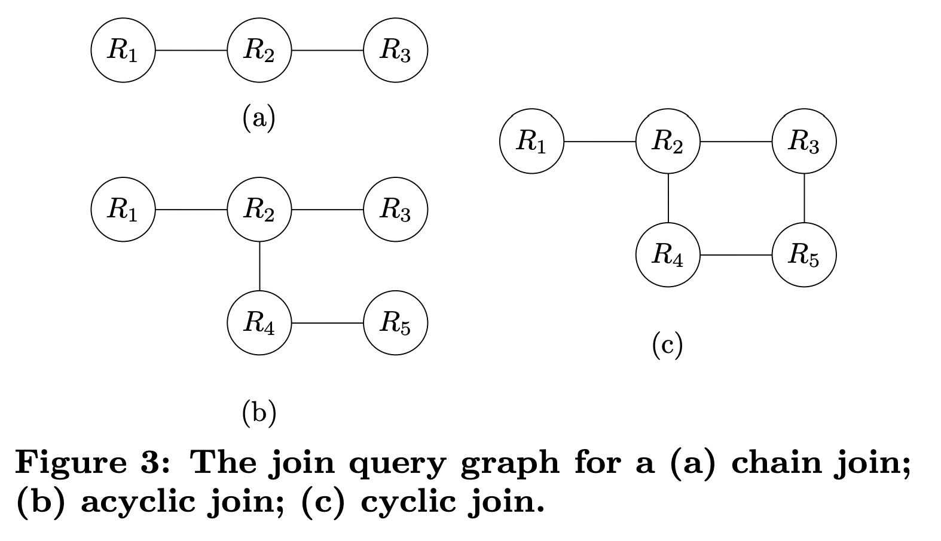
Wander Join
More complicated cases
Acyclic
Cyclic

Slide 37
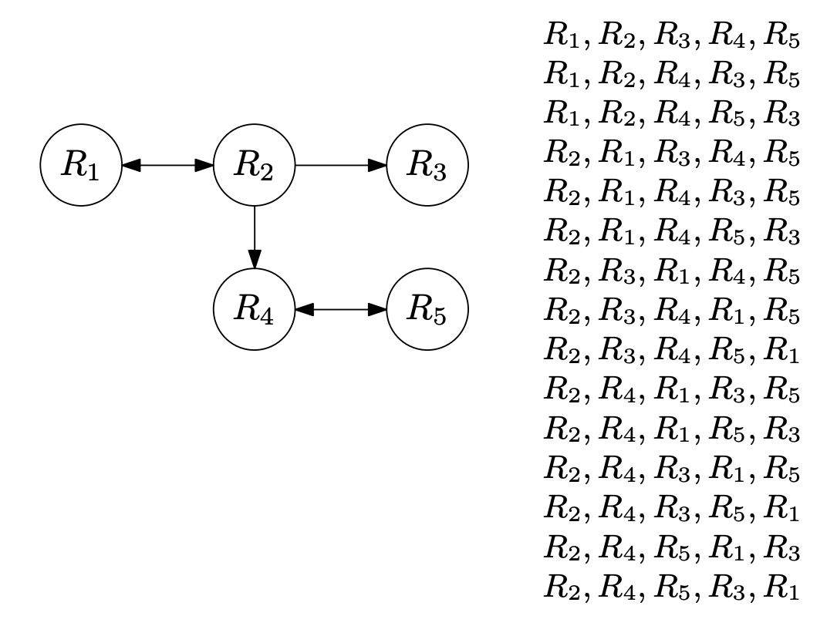
Wander Join
Acyclic
Finding an optimal walk path
Do trail runs

Slide 38
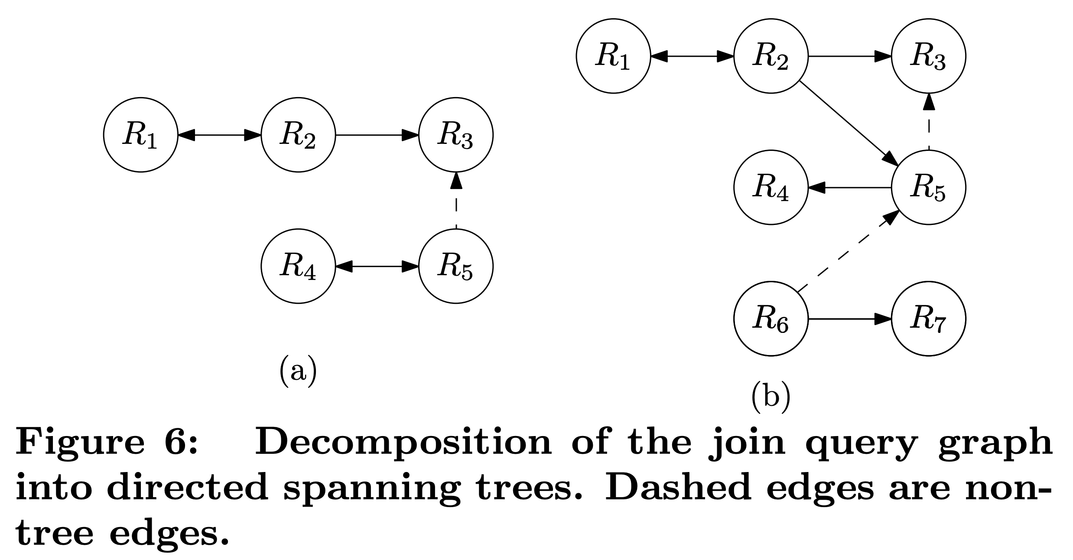
Wander Join
Cyclic
Compute tree decomposition
Random walk on trees
Check for non-tree edges at the end

Slide 39
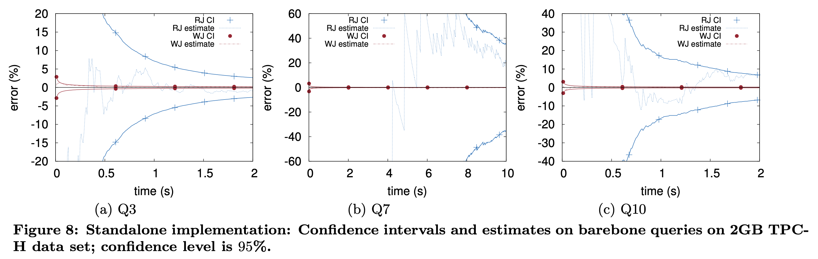
Experiments

Slide 40
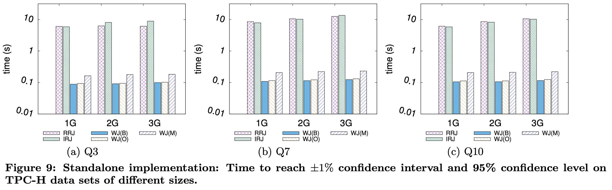
Experiments

Slide 41
Discussion

