Slide 1
Textual Human Data Interfaces
Week 11

Slide 2
Welcome Back!
What’s one thing awesome you did since our last class?

Slide 3
Administrivia
Check-ins
A3 due yesterday
A4 due Apr 6th
Guest lecture next week

Slide 4
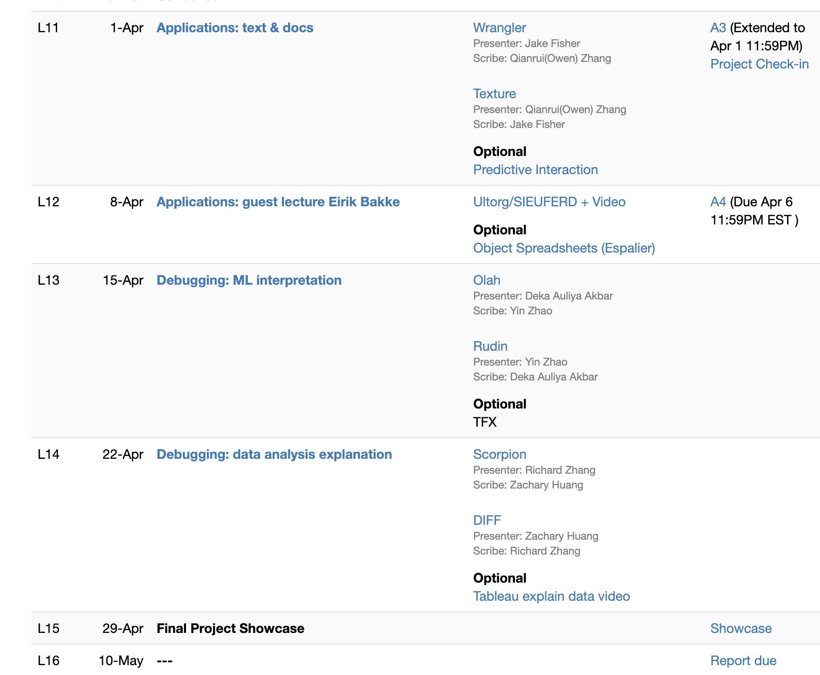
Today

Slide 5
Wrangler
Presenter: Jake Fisher
Scribe: Qianrui (Owen) Zhang
Texture
Presenter: Qianrui (Owen) Zhang
Scribe: Jake Fisher

Slide 6
Wrangler Discussion

Slide 7
Wrangler thoughts
Strengths compared to programming, excel?
Weaknesses/Concerns?
Overall, when is programming by example appropriate?

Slide 8
Wrangler thoughts
Strengths compared to programming, excel?
Easier to select what you want to extract than to write code
Previews of options
Weaknesses/Concerns?
Overall, when is programming by example appropriate?

Slide 9
Wrangler thoughts
Strengths compared to programming, excel?
Easier to select what you want to extract than to write code
Previews of options
Weaknesses/Concerns?
Doesn’t do everything well, but not integrated with e.g., notebooks
In-place previews relies on low latency
Scalability
Overall, when is programming by example appropriate?

Slide 10
Texture Discussion

Slide 11
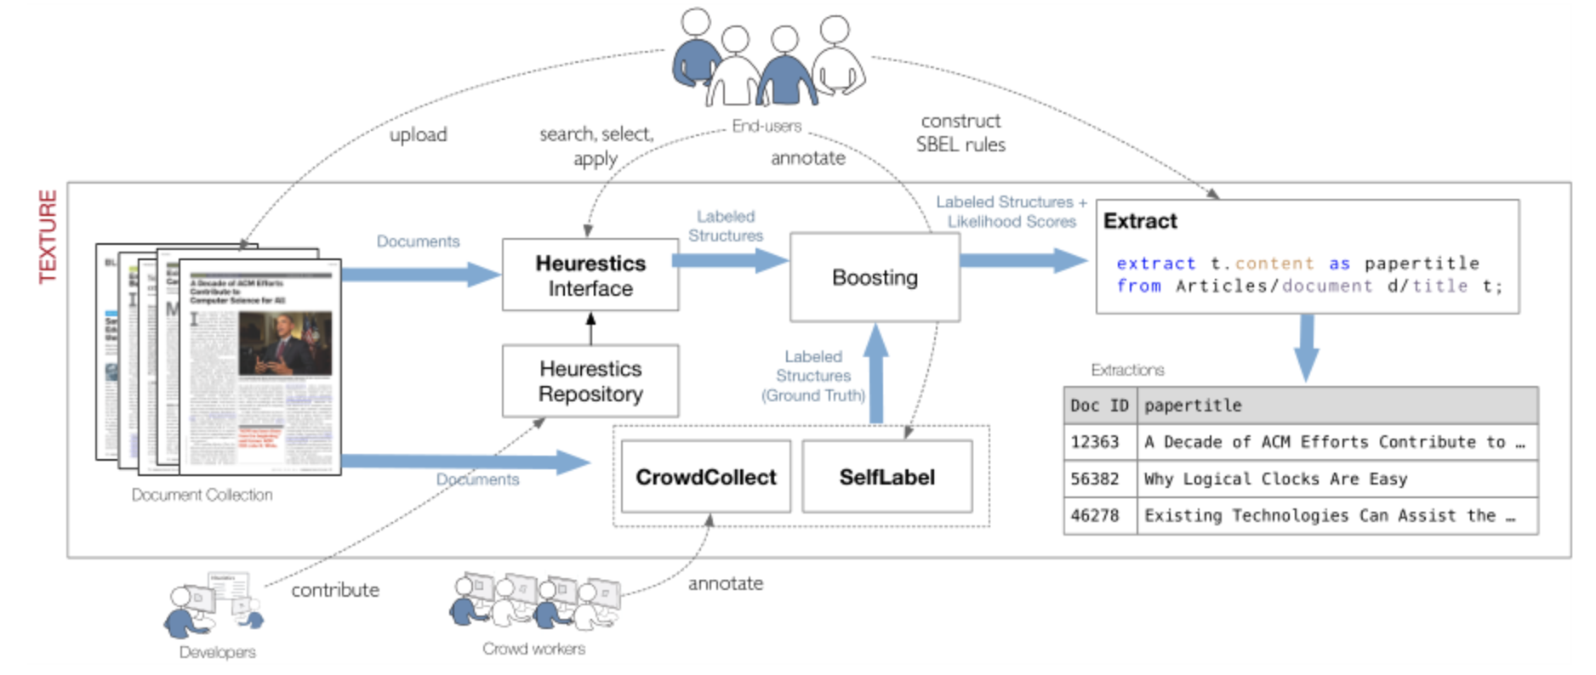
Real use case for Texture?

Slide 12

Real use case for Texture?
Query-ers
Tables
Query Plan
Extract Boxes
Query Executor
Heuristics/UDFs
Function Implementers

Slide 13
Real use case for Texture?
Examples of…
Documents
End Users
Developers
Notes:
covid

Slide 14
General Discussion

Slide 15
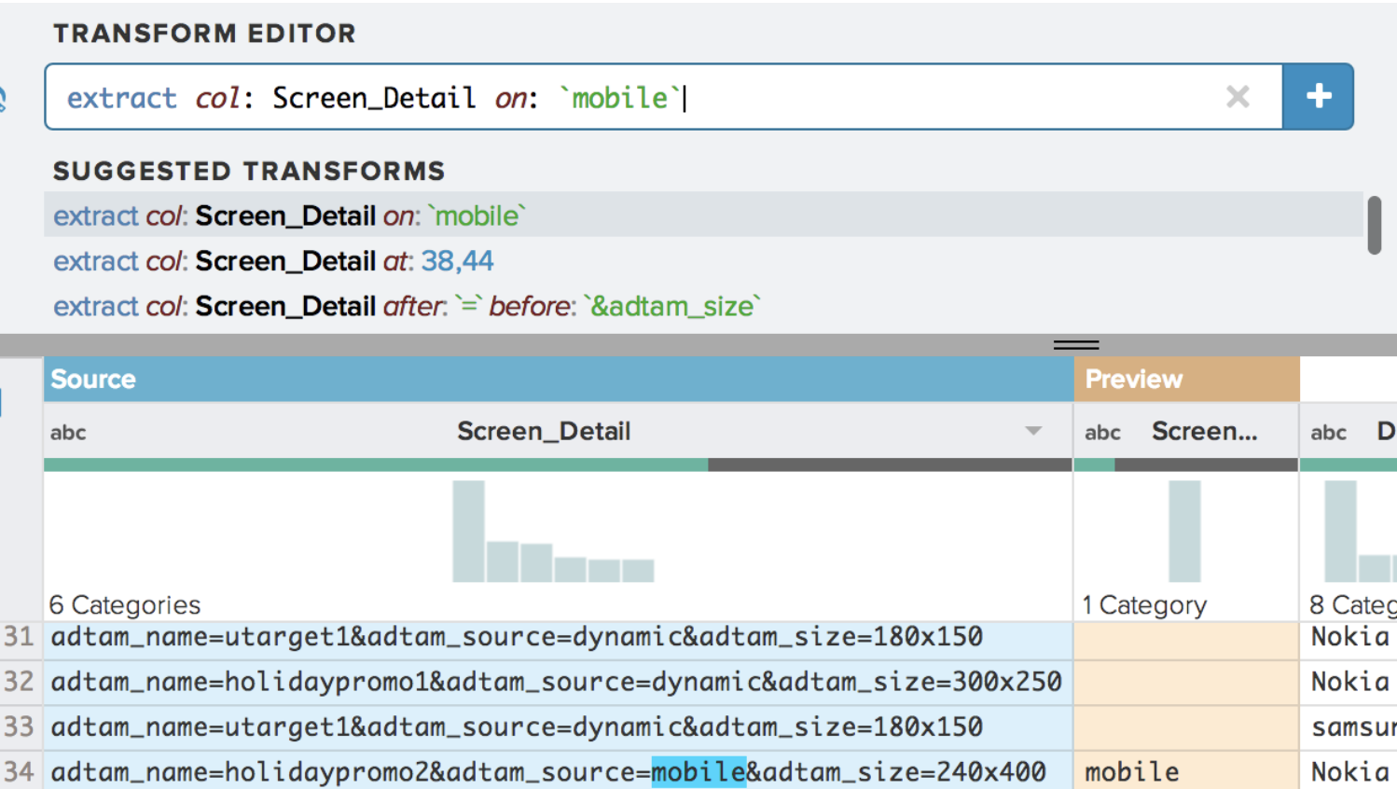
Predictive Interaction (Heer, Hellerstein, Kandel 15)
Ranked
Suggestions
1…
2…
3…
User
Interaction
Rendered Results
(could be sample)
choose
visualize
compile
Data
Write Code
Results

Slide 16
Predictive Interaction (Heer, Hellerstein, Kandel 15)
User Visualization/Interface Space
visualize
compile
Data
Write Code
Results

Slide 17
Predictive Interaction (Heer, Hellerstein, Kandel 15)
User Visualization/Interface Space
Domain Specific Language
visualize
compile
Data + Code Space

Slide 18
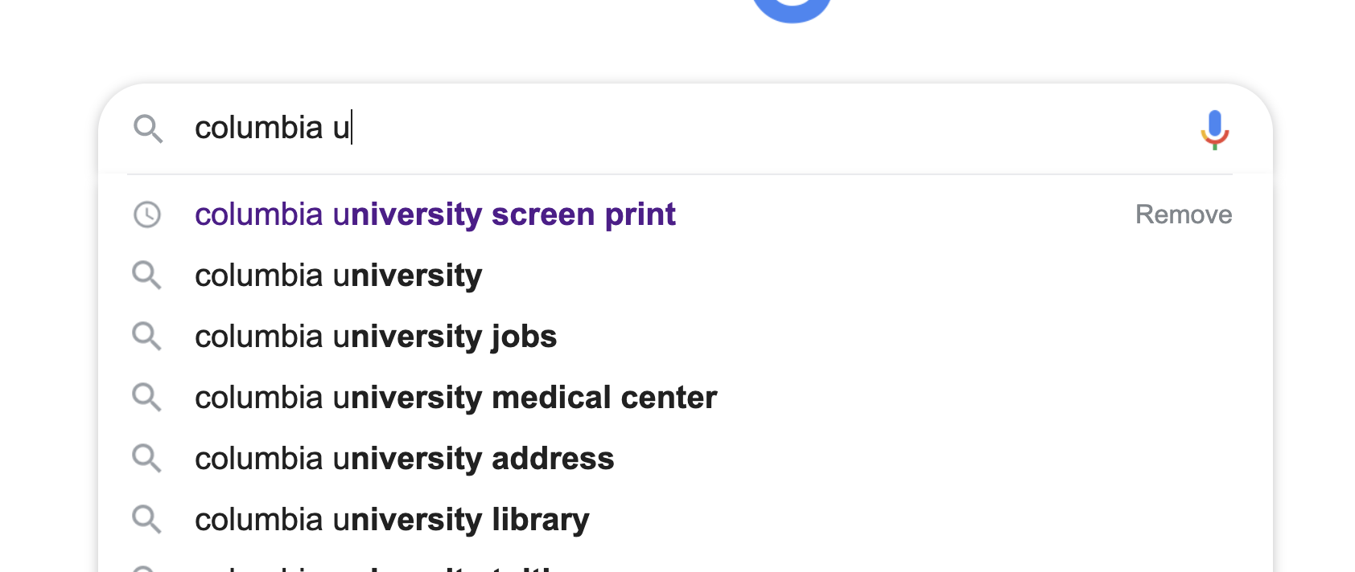
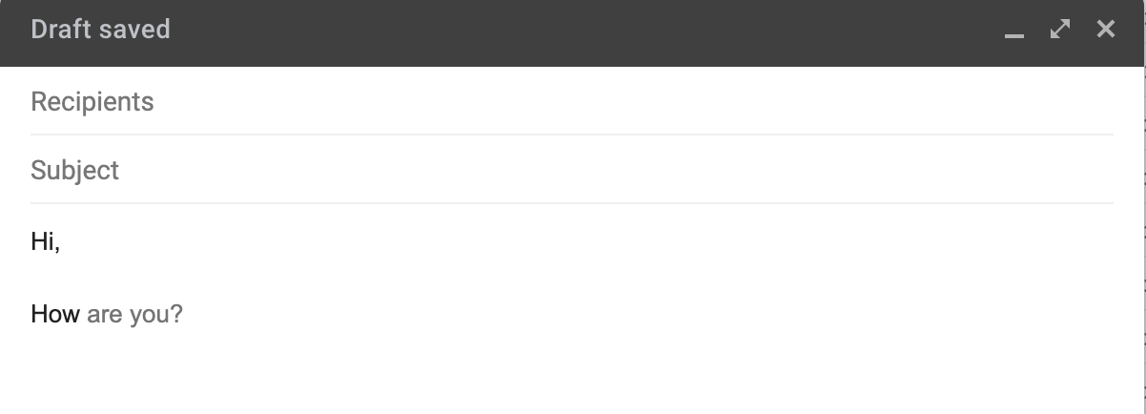
How best to combine HDIs and AI?
Provide shared representation: DSL
AI: generate and rank suggestions in DSL
Users: review, select, edit, ignore suggestions

Slide 19
How best to combine HDIs and AI?
Provide shared representation: DSL
AI: generate and rank suggestions in DSL
Users: review, select, edit, ignore suggestions
Examples of DSLs
Tableau:
Voyager:
Wrangler:
Texture:

Slide 20
How best to combine HDIs and AI?
Provide shared representation: DSL
AI: generate and rank suggestions in DSL
Users: review, select, edit, ignore suggestions
Examples of DSLs
Tableau: VisQL
Voyager: vega-lite
Wrangler: wrangler transforms
Texture: SBEL extraction rule

Slide 21
How best to combine HDIs and AI?
Provide shared representation: DSL
AI: generate and rank suggestions in DSL
Users: review, select, edit, ignore suggestions
Principles
Positive value (for user tasks)
Low overhead: augment, not replace, user interaction
Doesn’t decrease value
Better over time

Slide 22
Why Combine HDIs and AI anyways?
Data tasks are ill-formed. User iteratively identifies the task
Data science, cleaning, exploration, creativity
Big design + action (programs) space
Big and unknown task (goals) space
Imperfect AI

Slide 23
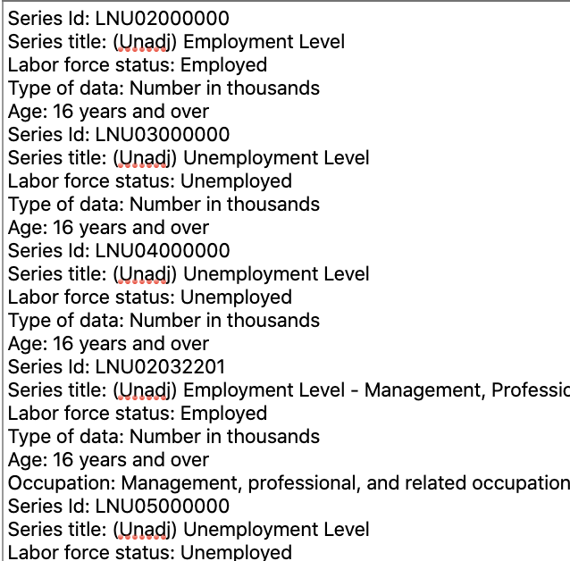
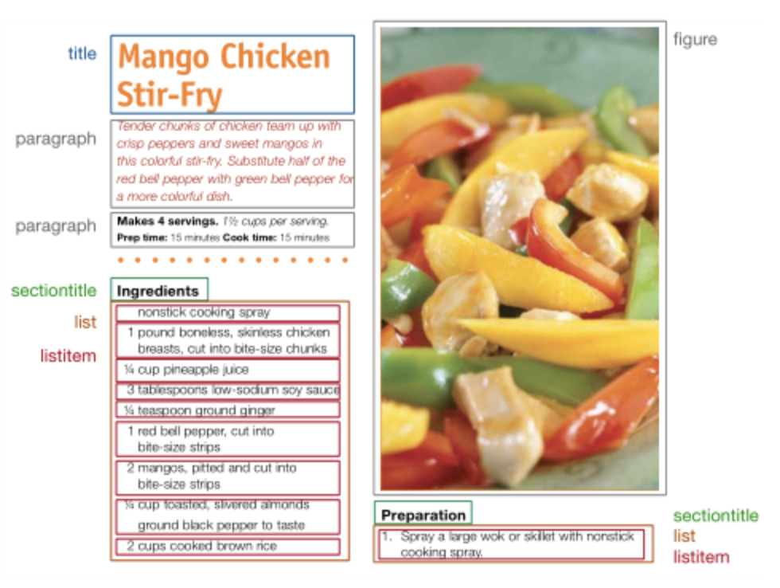
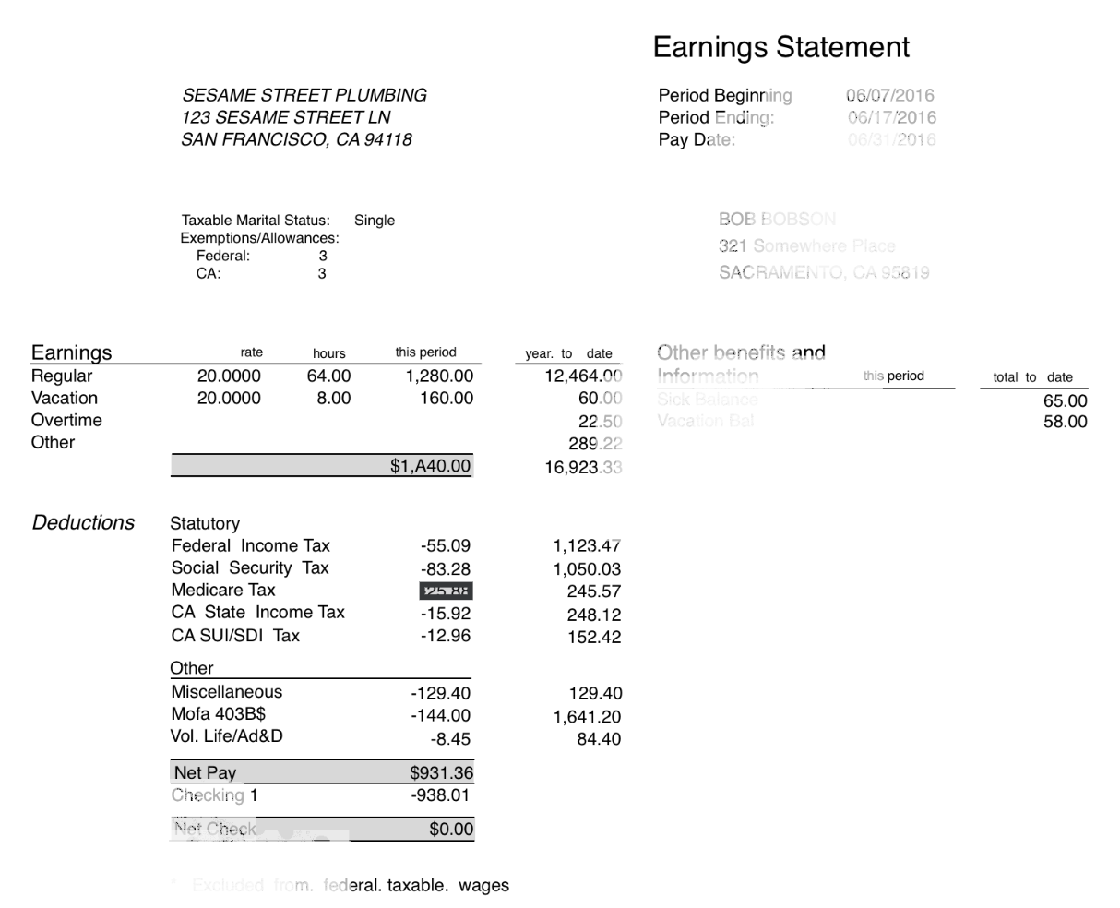
Contrast between the three systems
Wrangler
csv/text
Texture
Print docs
Instabase
structured docs

Slide 24
Compare: Problems They Tackle
Wrangler
Texture
Instabase
Extracting from text is hard
Extraction is self contained to a single cell
Documents have similar types of data (titles, paragraphs)
Lots of design variation in docs
Low design variation
Extraction is contextual

Slide 25
Compare: Assumptions About Setting/Users
Wrangler
Texture
Instabase
Individual user
Novices, not programmers
Prioritize learnability
Hide programming API
Full service running in a company, with developer staff
2 types of users
Developers can write extraction heuristics
End users have documents and want to extract text from docs
End users not progremmers
Organization with valuable document data
Deeply understand their docs
Programmers

Slide 26
Compare: How They Model the Problem
Wrangler
Texture
Instabase
Data model
Language
User Interaction
Data model
Developer Interaction
User Interaction
Data model
Language
User Interaction

Slide 27
Compare: How They Model the Problem
Wrangler
Texture
Instabase
Data model
Table of text attributes
Language
Filter, project operators + fold/unfold
User Interaction
Select text to extract
Choose & refine suggestions
Data model
Developer Interaction
User Interaction
Data model
Language
User Interaction

Slide 28
Compare: How They Model the Problem
Wrangler
Texture
Instabase
Data model
Table of text attributes
Language
Filter, project operators + fold/unfold
User Interaction
Select text to extract
Choose & refine suggestions
Data model
Typed bounding boxes (title, list)
Boxes have metadata
Doc = hierarchy of boxes
Developer Interaction
Write bounding boxes detectors and labelers in Java
Heuristics populate the “database”
User Interaction
Write extraction “queries” over “database” of boxes
Data model
Language
User Interaction

Slide 29
Compare: How They Model the Problem
Wrangler
Texture
Instabase
Data model
Table of text attributes
Language
Filter, project operators + fold/unfold
User Interaction
Select text to extract
Choose & refine suggestions
Data model
Typed bounding boxes (title, list)
Boxes have metadata
Doc = hierarchy of boxes
Developer Interaction
Write bounding boxes detectors and labelers in Java
Heuristics populate the “database”
User Interaction
Write extraction “queries” over “database” of boxes
Data model
Document image
OCR that preserves spatial struct.
Language
Extract relative to anchors
Anchors based on visual+text
User Interaction
Manually write functions
Shows extracted bounding boxes in doc & text

Slide 30
Compare: Errors & Verifying that “It Worked”
Wrangler
Texture
Instabase
User sees previews
Edit transform if it’s only slightly wrong
User can get stuck if suggestions are all bad
Manually choose transform
Heuristic could be wrong?
Manual labels as ground truth
Crowd could be wrong?
Ask 5 workers
User chooses wrong heuristic? Preview boxes in documents
”Database” is not populated correctly or not fully populated?
“Query” doesn’t work for many documents?
Function was wrong?
Render bounding boxes
Function doesn’t work for many documents?
Assumes docs have same structure.

Slide 31
Compare: Why Focus on HDI?
Wrangler
Texture
Instabase
Selecting desired text is easier than writing regex
Seeing previews is good
Documents have similar types of data (titles, paragraphs)
Lots of design variation in docs
Less data variation
Low design variation
Element to extract is hard

Slide 32
Why Do They Focus on Interaction?
Wrangler
Same Goals: extract tables for text documents/inputs
Why not just build better ML models?
What users want extracted depends on the user
Lack of labels for each task
Shared building blocks across tasks, but different compositions
Point and select content
Box detection, visual features (positioning, size)
User interaction
Language to solve task
Interface and interactions to help use the language
Texture
Instabase
Notes:
Similar to SQL

