Slide 1
Week 8 Modalities

Slide 2
Administrivia

Slide 3
GestureQuery Discussion

Slide 4
Student Questions
What gestures does Gesture Query start with?
Are they intuitive?
What do they assume about users that use GestureQuery?
Notes:
understand SQL query operators.

Slide 5
Issues with GestureQuery
When do gestures make querying harder?
Bigger schemas, larger tables.
Modal inputs better for values/params
Complex queries
Advanced users liked visual query builder

Slide 6
Experiments
What questions do you wish they answered?
Discoverability
Ease to compose queries

Slide 7
SpeakQL

Slide 8
The SpeakQL argument
People
know SQL. May even be experts
want to write SQL on-the-go
have a phone/tablet
Thus speech interface is best

Slide 9
Use Cases
DBA debugging system while on the road
Nurse accesses patient record away from his desk
Analyst answers customer sales question in a meeting

Slide 10
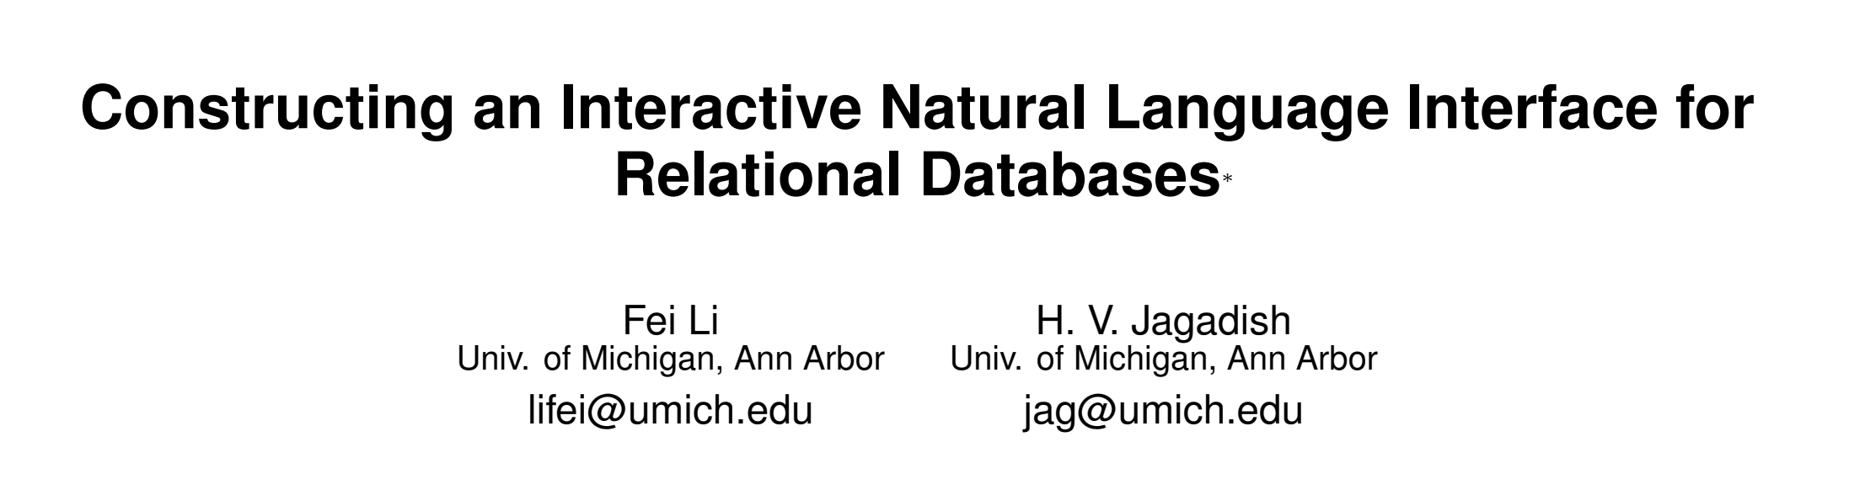
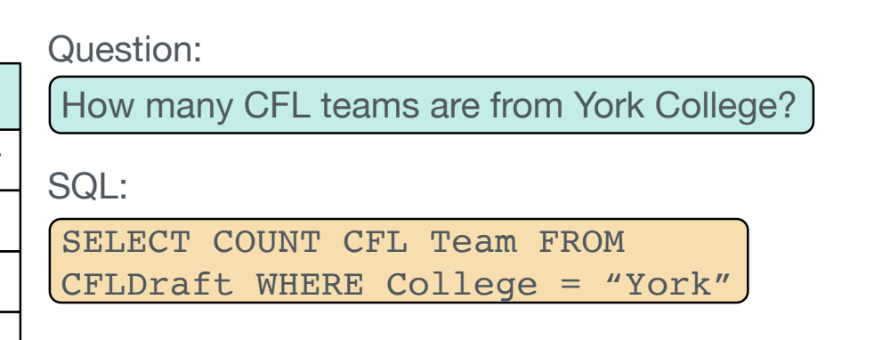
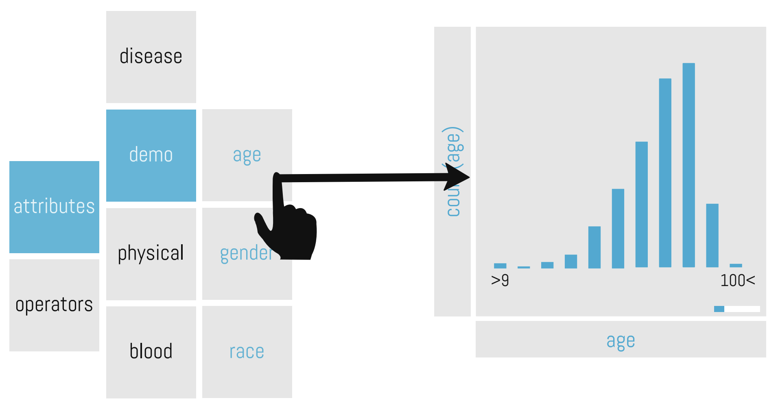
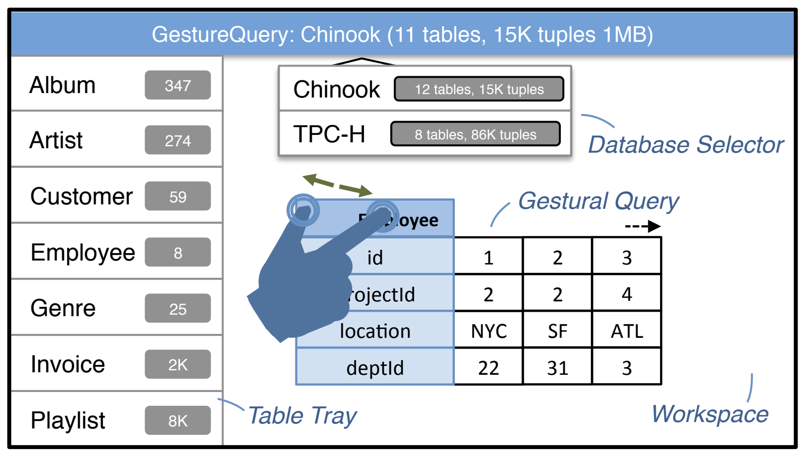
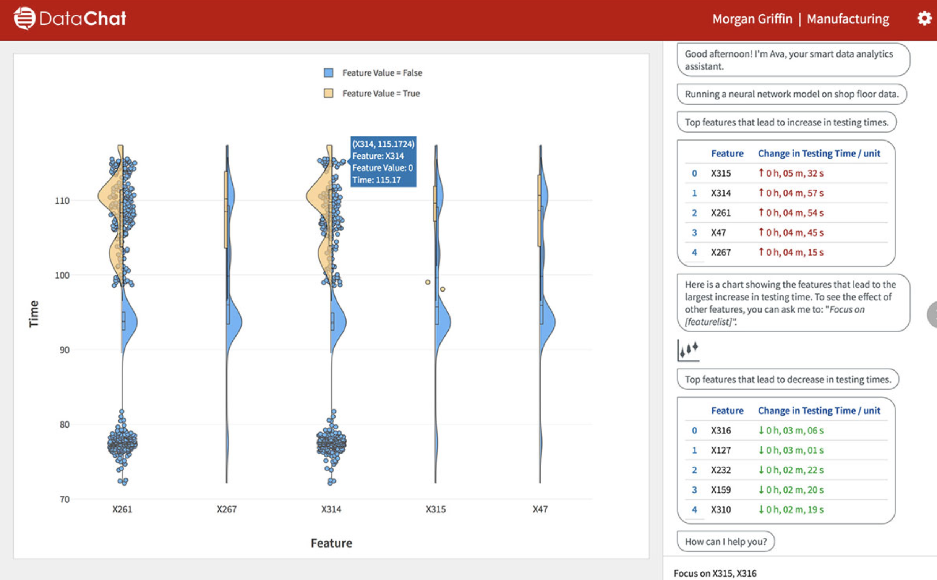
Why Not Existing Approaches?
Natural Language Interfaces (NLI)
User speech → ASR → NLI → SQL → result
Errors propagate in each step
Touch interfaces
Paper argues they “obviate” SQL
Template-based Interfaces
Seq2SQL
vizdom
gesturequery
DataChat

Slide 11
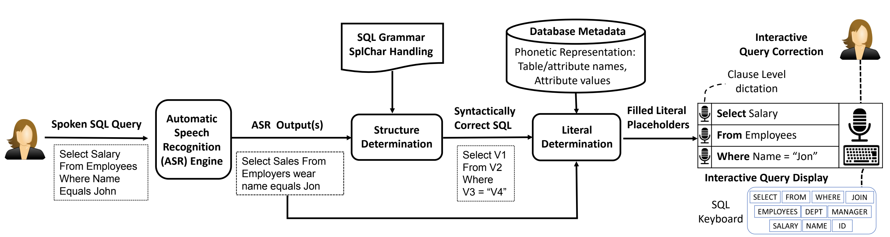
Approach Overview
Match speech tokens to SQL template (struct determination)
Fill in literals, address homophones (literal determination)

Slide 12
Structure Determination
Goal: find matching query template
Offline: build index of all possible query templates
Online: find minimum edit distance query template

Slide 13
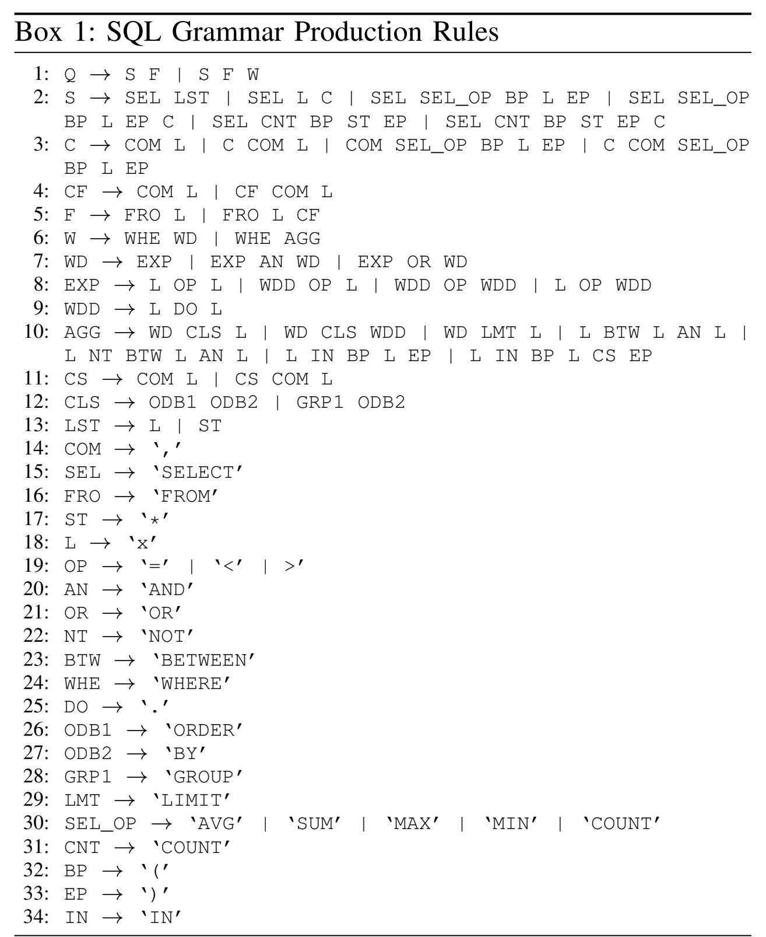
Offline
Generate all queries <=50 tokens
Build trie for queries of same length

Slide 14
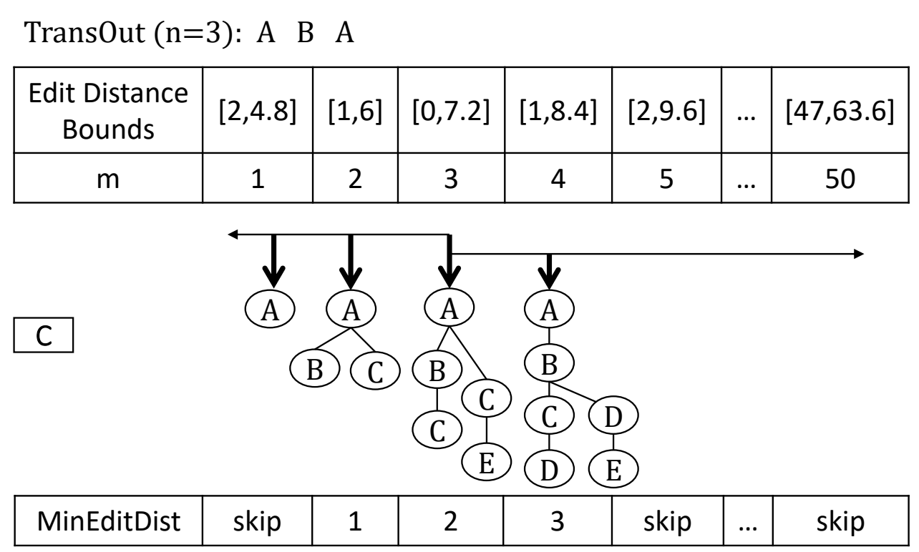
Online
Find template that matches
“select first name from employers wear col one two equal jon”
to
SELECT v1 FROM v2 WHERE v3 = v4
Match by edit distance
Bound & prune trick to speed up

Slide 15
Literal Determination
Fill in variables in query template based on sounds-like-ness
“select first name from employers wear col one two equal jon”
SELECT v1 FROM v2 WHERE v3 = v4
Ideas
Translate all tokens & values into phonemes. Employees → EMPLYS
Infer variable types from grammar. v1 is attr, v2 is table
Know tokens to variable mappings. “first name” → v1

Slide 16
Literal Determination
Tricky part: picking the attribute name/values
“first name” → “firstname”
“col one two” → “col_12”
What SpeakQL does
Enumerate all concatenations of tokens: ”first” “name” “firstname”
Compute phoneme distance with attributes “firstname”, “forestname”
All tokens get a “vote”
Thoughts on their method?

Slide 17
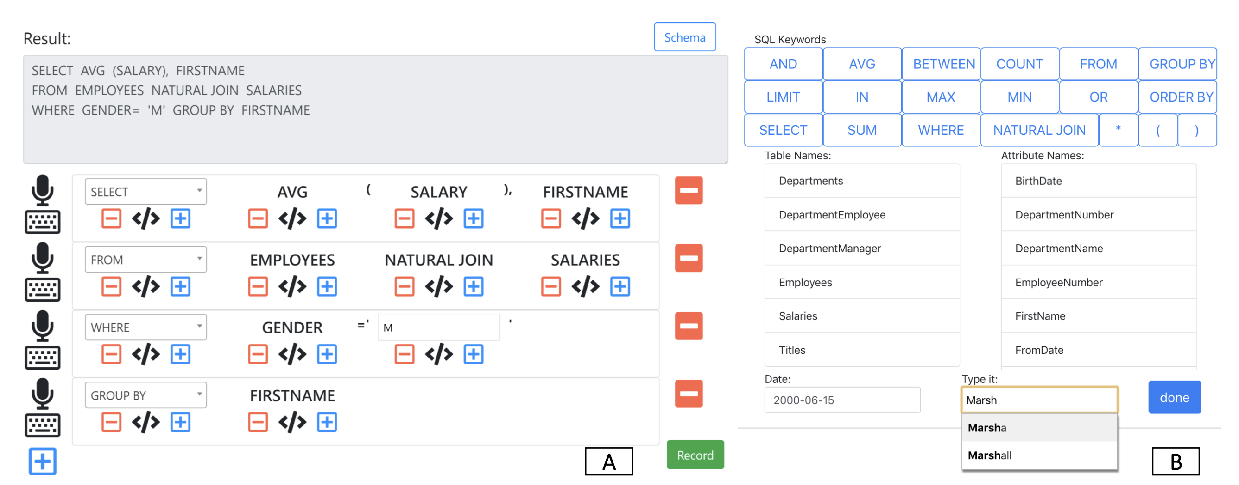
Experiments
Metrics
How accurate?
Did it get the tokens right?
Token edit distance
Easy to use?
Token edit distance
Time

Slide 18
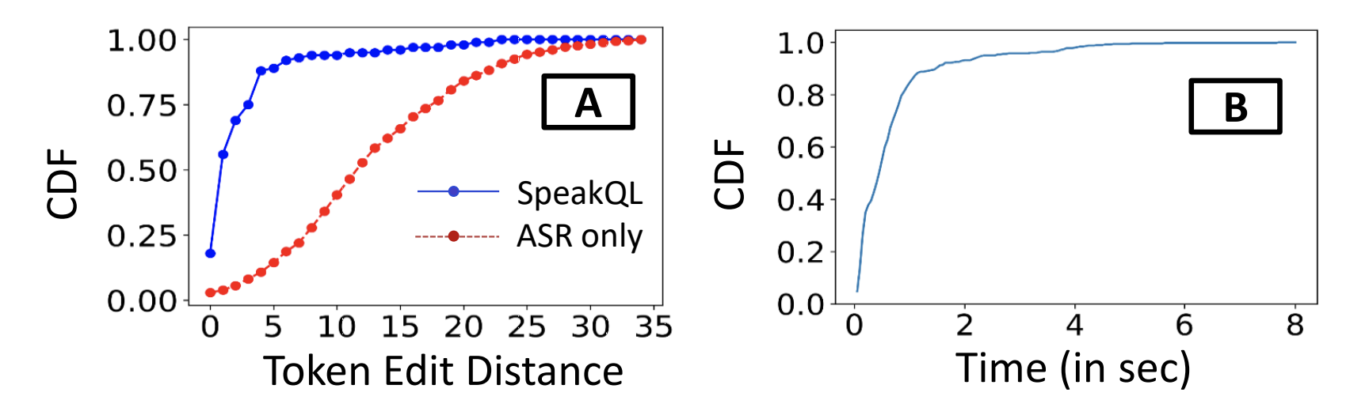
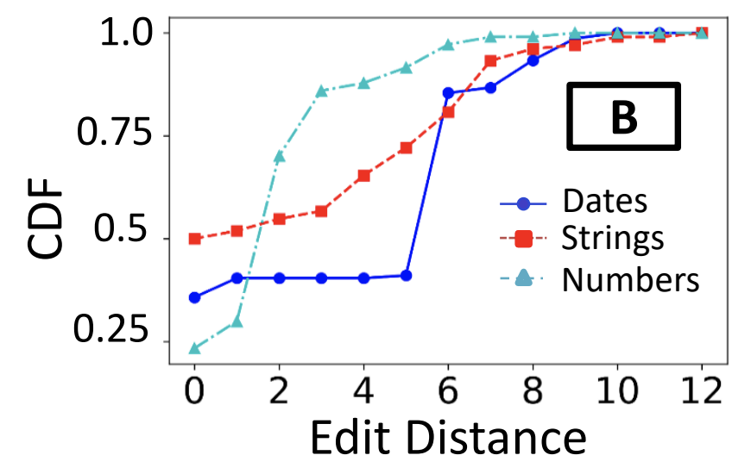
Synthetic Speech
Most within 5 tokens away from truth. Some within 25-30.
How complex are the queries? Does that matter?

Slide 19
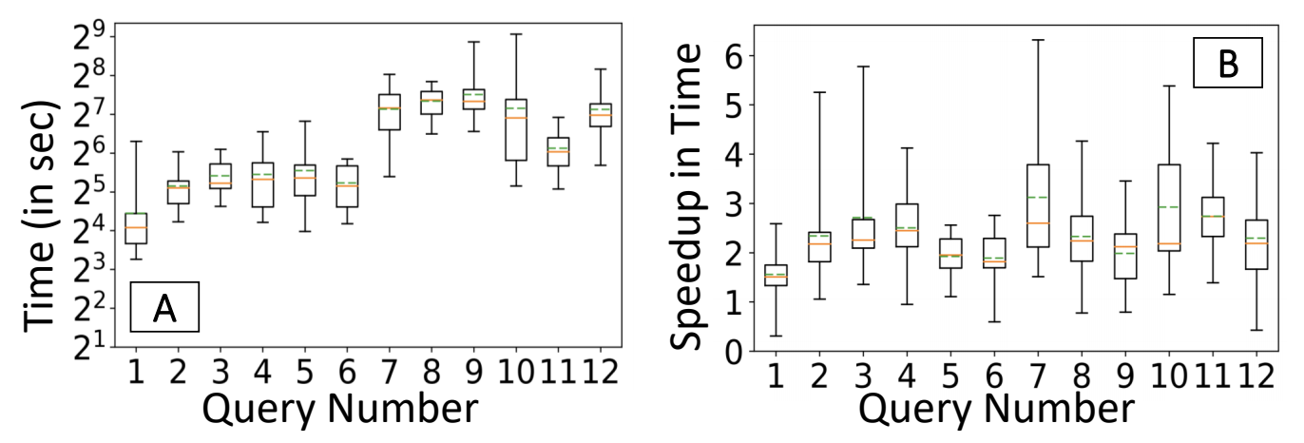
User Study
12 queries per user. 15 users
Simple: <20 token query
Complex: >= 20
Methods
SpeakQL
Mobile typing

Slide 20
Conclusions
SpeakQL works
Hard to compose entire query at once. Users think in “clauses”
Hard to disambiguate values – esp numbers and dates
Better than mobile keyboard typing.

Slide 21
SpeakQL Discussion

Slide 22
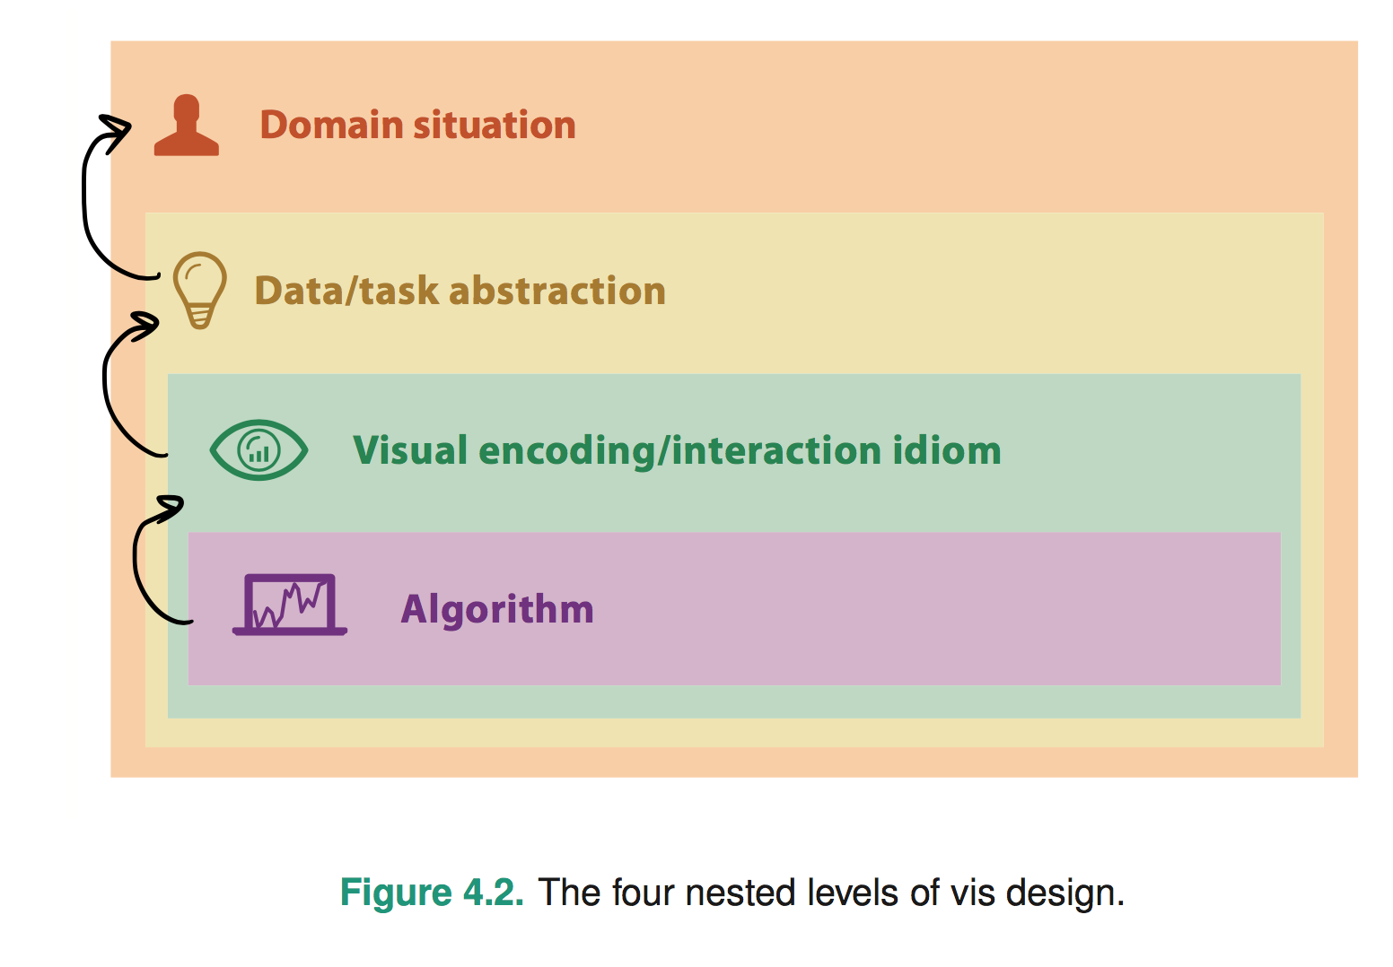
4 classes of questions
Wrong problem. Misunderstood user needs
Wrong abstraction. Showing the wrong thing
The way to show data is ineffective
Code is slow/buggy
Notes:
* early webvis papers soled "lost in hyperspace" by rendering the web's hyperlink topological structures. Not useful, and no idiom/algorithm could solve it, since it only added to user cognitive load

Slide 23
Thoughts on problem & abstraction?
Use case:
what do people want when querying data on-the-go?
Is speaking SQL the best way to query on-the-go?
Improvements/Alternatives?
Mobile-friendly SQL keyboard?
Custom app/visual analytics

Slide 24
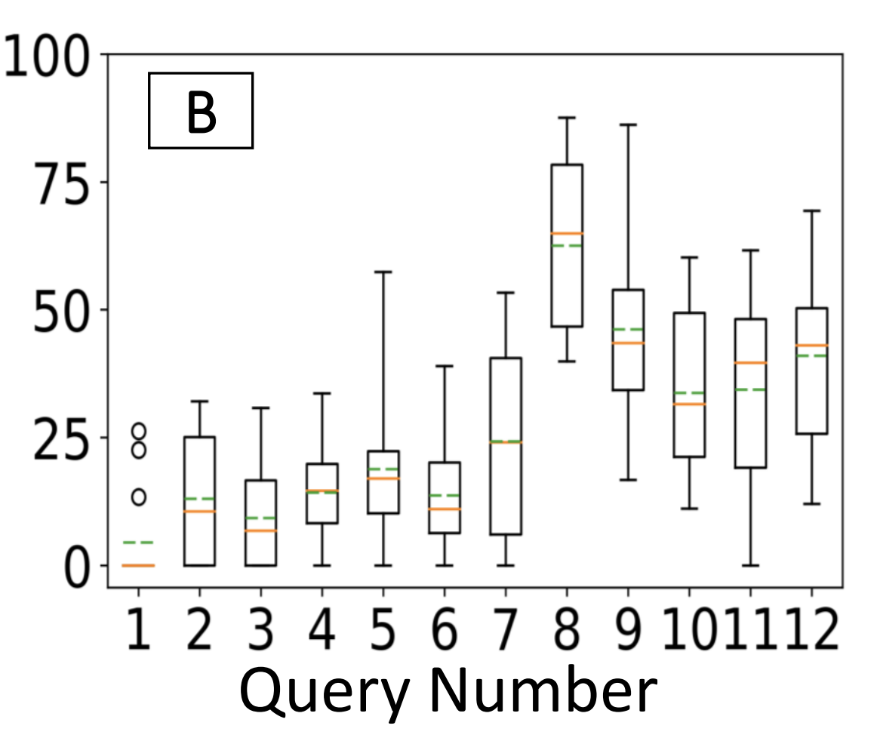
Issues with SpeakQL
Expressiveness
Select-Project-Join-Aggregate (up to 50 tokens)
Challenges if richer language?
debugging query structure harder if nesting is wrong
Intuitiveness
Easy to “debug” query?
Need to say “comma” in “SELECT a, b”
% time spent using keyboard

Slide 25
Experiments
Were the experiments “fair”?
Ran a pilot study – good idea!
Not clear what queries/tasks are evaluated
Type SQL using phone keyboard (hard!)

Slide 26
Comparing the Two Papers
GestureQuery: novices on tablets
SpeakQL: experts on phones
What are other users & settings ripe for interface development?
Users: SQL novices, SQL experts, ...?
Settings: exploration, adhoc queries, ...?

Slide 27
Comparing the Two Papers
Compare with Tableau
Tableau good at visual analytics and filter/aggregation
Less good at joins, selection
Compare with Excel
Excel good at projection, simple filters, sort
Less good at Joins, complex predicates, aggregation

