Slide 1
Week 6 Tasks

Slide 2
Administrivia
Proposals due tonight
A1, A2 grades are out. 100% if we saw good faith effort
Thoughts on an assignment for sampling?

Slide 3
Munzner Chapter 1 Discussion

Slide 4
Munzner Chapter 1
Tasks
Effectiveness & the design search space
Validation
What-Why-How

Slide 5
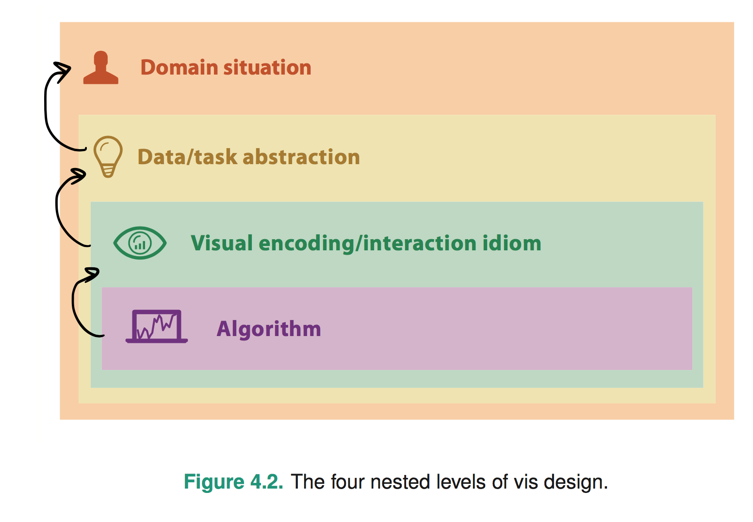
Chapter 4: The Nested Model
Politics, Genomics, Network monitoring, etc
What’s the goal? What data is needed? Talk to users!
Word tree, statistical graphic, etc
Considers perceptual/design issues for task
Computation and performance
Notes:
* early webvis papers soled "lost in hyperspace" by rendering the web's hyperlink topological structures. Not useful, and no idiom/algorithm could solve it, since it only added to user cognitive load

Slide 6
Chapter 4: The Nested Model
Wrong problem. Misunderstood user needs
Wrong abstraction. Showing the wrong thing
The way to show data is ineffective
Code is slow/buggy
Notes:
* early webvis papers soled "lost in hyperspace" by rendering the web's hyperlink topological structures. Not useful, and no idiom/algorithm could solve it, since it only added to user cognitive load

Slide 7
Comparison Paper Discussion

Slide 8
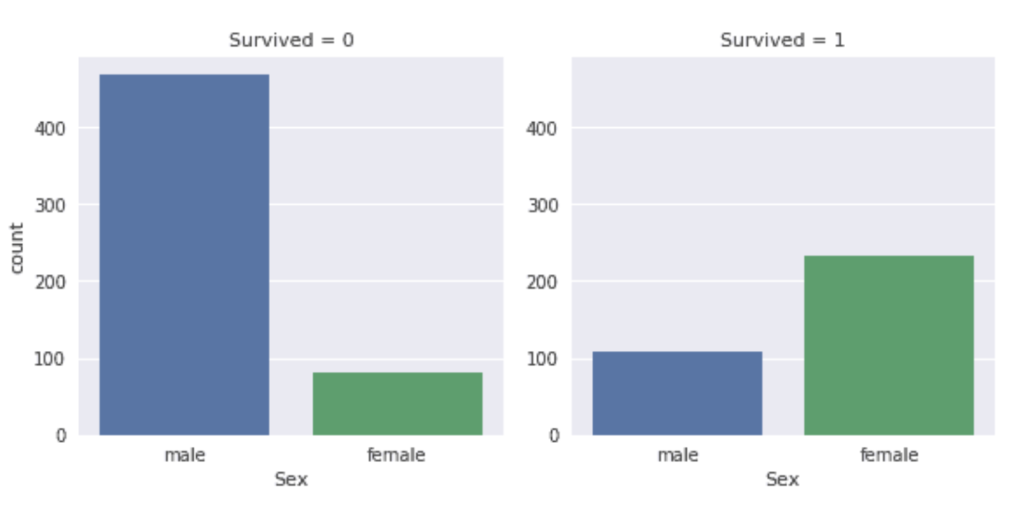
Targets?
Actions?
Naming?

Slide 9
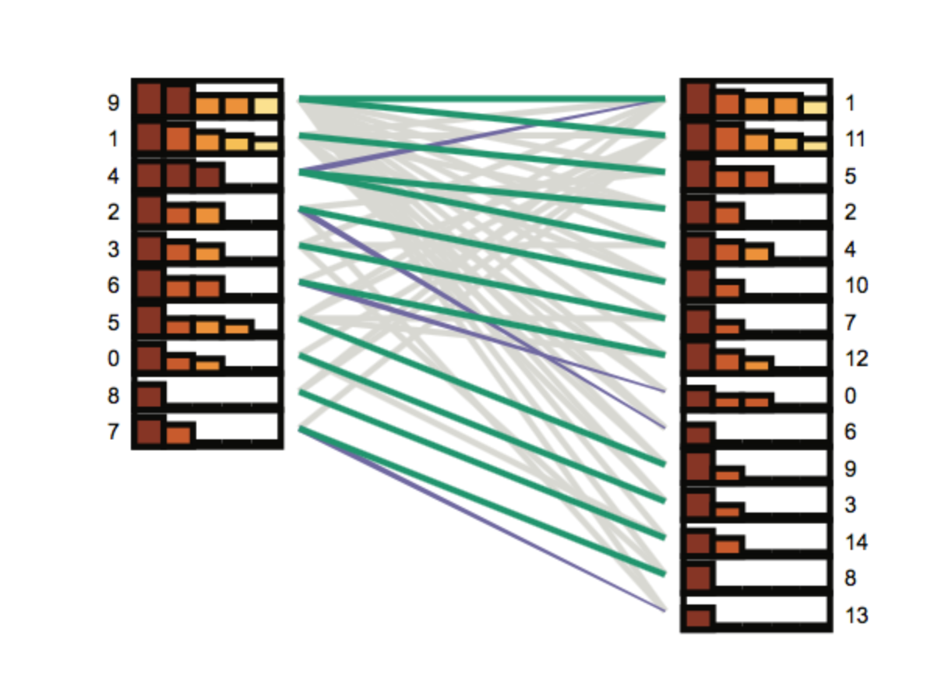

Slide 10
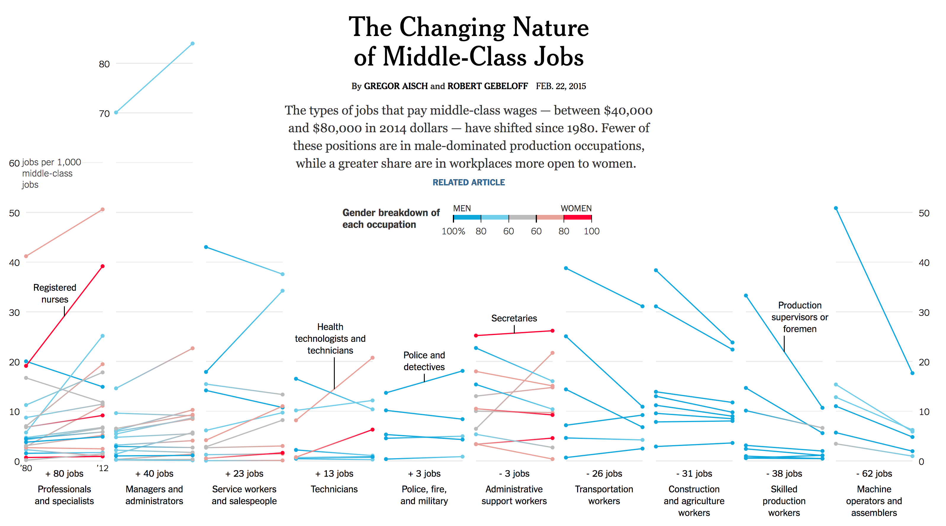
Notes:
https://www.nytimes.com/interactive/2015/02/23/business/economy/the-changing-nature-of-middle-class-jobs.html

Slide 11
Why was this paper written?
What purpose does it serve?

Slide 12
Are comparisons composed of target, action, & naming?
Are there other forms of challenges beyond scalability?
Strategies and Designs
Where does interaction play a role?

