Slide 1
Week 12 Spreadsheet Interfaces

Slide 2
Administrivia
A4 was due on Monday
Showcase in 3 weeks. Details will be out this weekend.

Slide 3
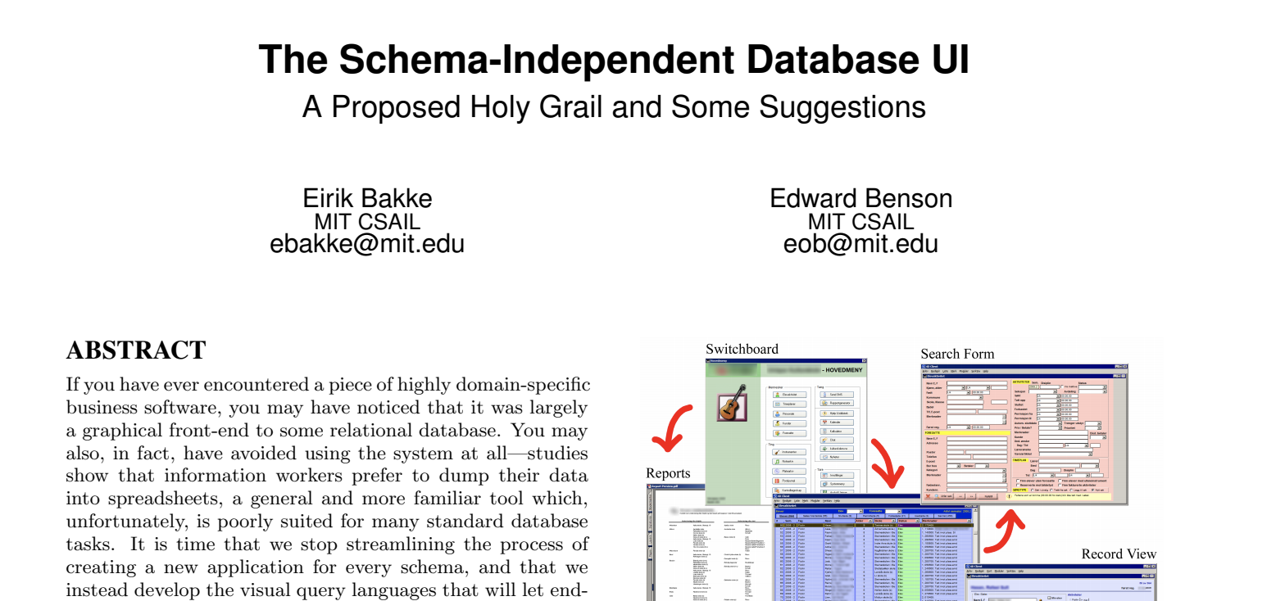

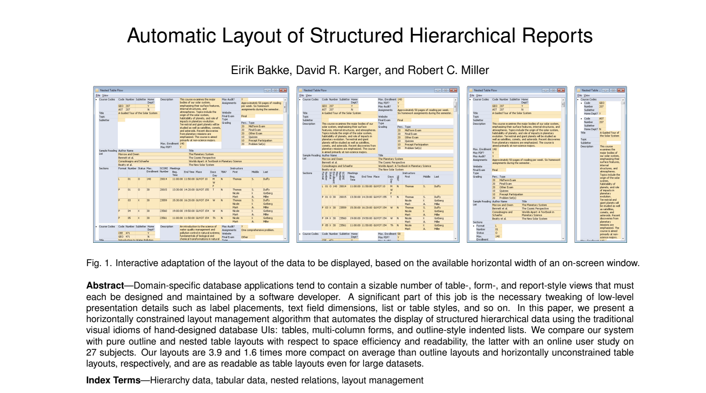

Eirik Bakke
PhD MIT 2016
Lord of Spreadsheets

