Slide 1
Textual Human Data Interfaces
Week 11

Slide 2
Welcome Back!
What’s one thing awesome you did since our last class?

Slide 3
Administrivia
Check-ins
A3 due yesterday
A4 due Apr 6th
Guest lecture next week

Slide 4
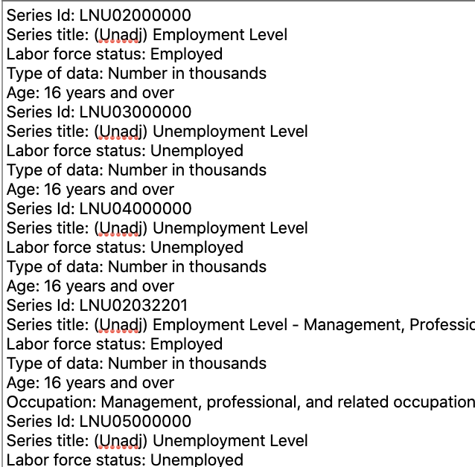
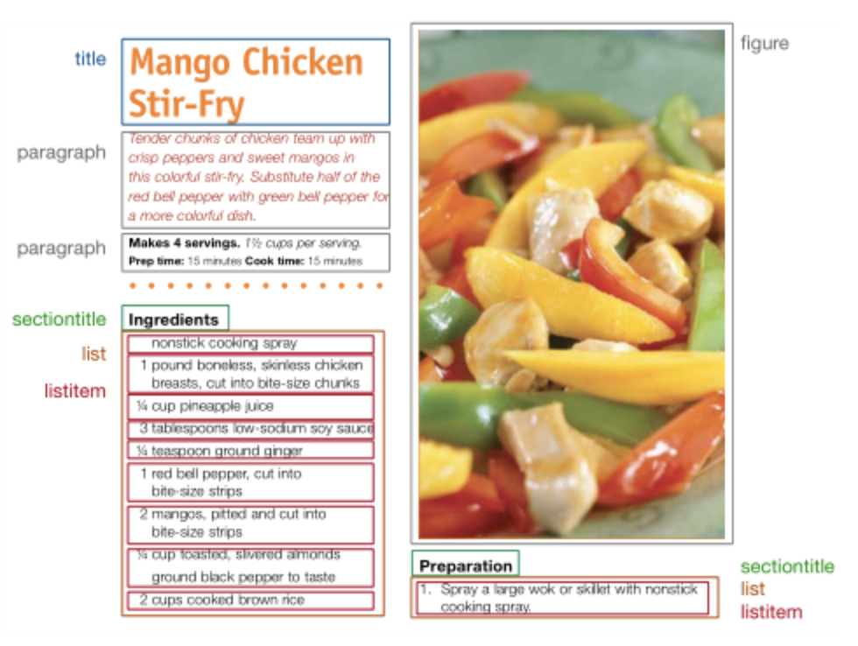
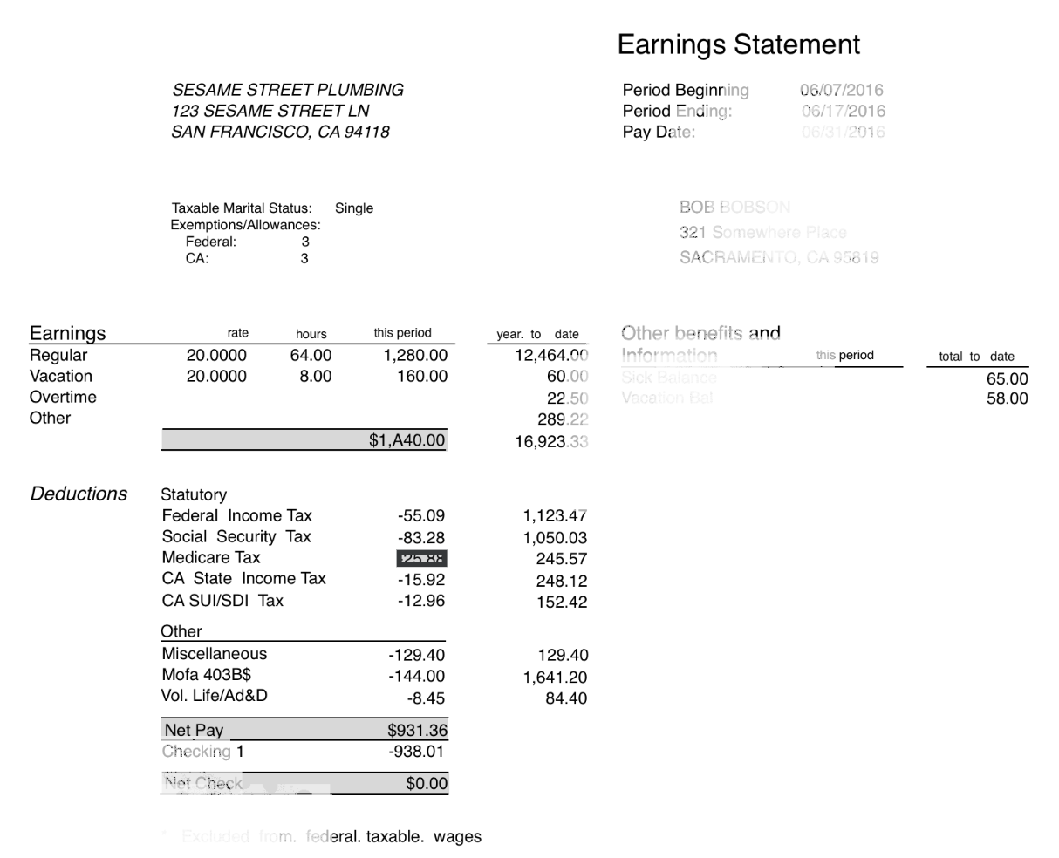
Three separate systems!!
Wrangler
csv/text
Texture
Print docs
Instabase
structured docs

Slide 5
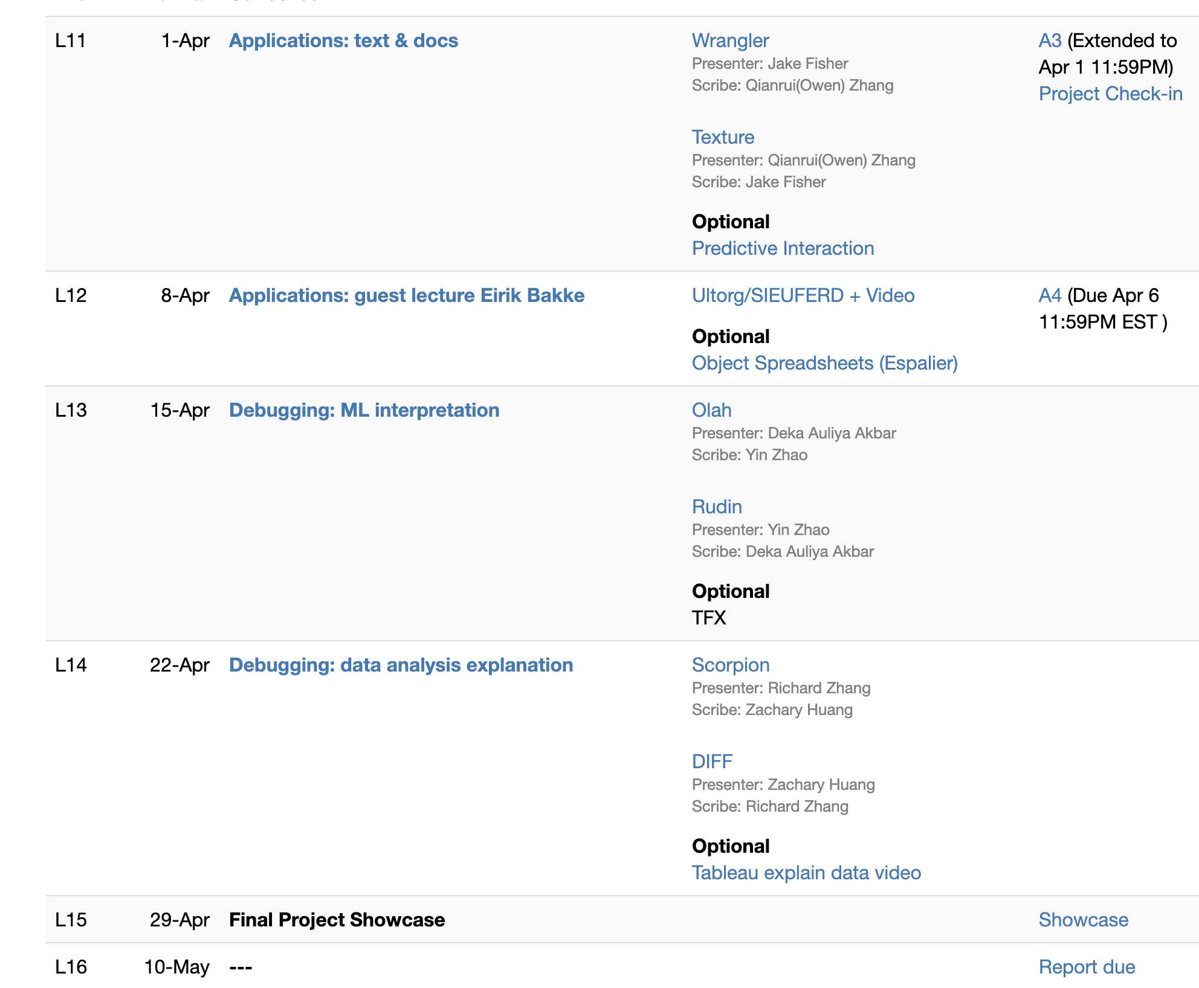
Today

Slide 6
Wrangler
Presenter: Jake Fisher
Scribe: Qianrui (Owen) Zhang
Texture
Presenter: Qianrui (Owen) Zhang
Scribe: Jake Fisher

Slide 7
Wrangler Discussion

Slide 8
Wrangler thoughts
Strengths compared to programming, excel?
Weaknesses/Concerns?
Overall, when is programming by example appropriate?

Slide 9
Wrangler thoughts
Strengths compared to programming, excel?
Easier to select what you want to extract than to write code
Previews of options
Weaknesses/Concerns?
Overall, when is programming by example appropriate?

Slide 10
Wrangler thoughts
Strengths compared to programming, excel?
Easier to select what you want to extract than to write code
Previews of options
Weaknesses/Concerns?
Doesn’t do everything well, but not integrated with e.g., notebooks
In-place previews relies on low latency
Scalability
Overall, when is programming by example appropriate?

Slide 11
Texture Discussion

Slide 12
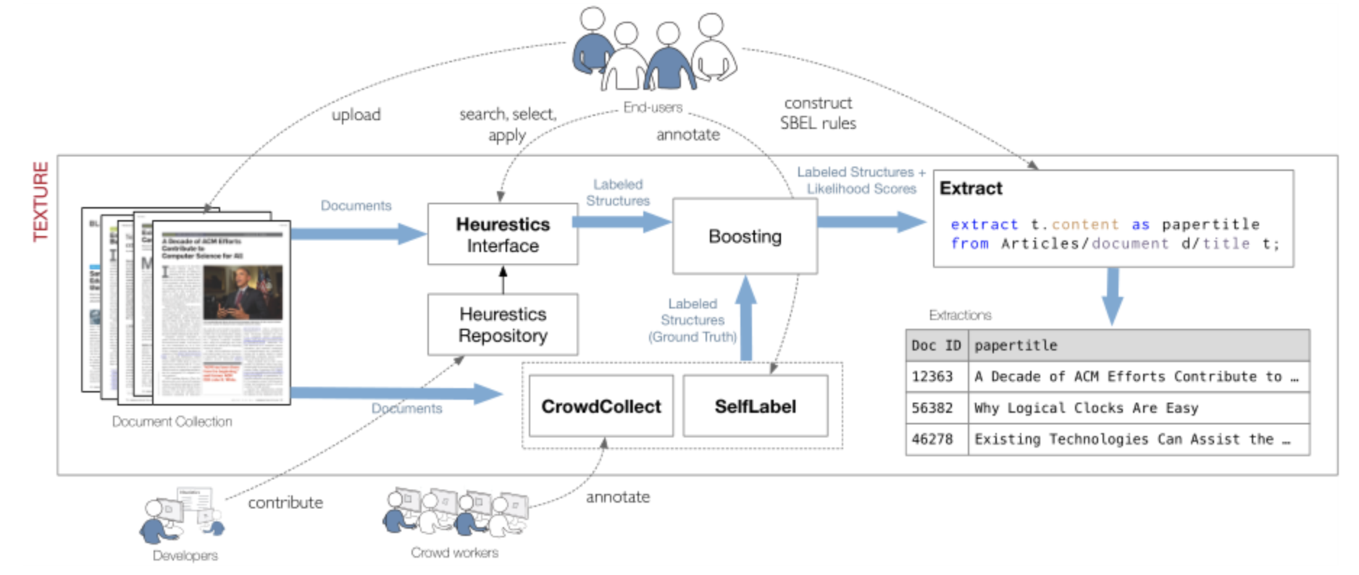
Real use case for Texture?

Slide 13
Real use case for Texture?
Examples of…
Documents
End Users
Developers
Notes:
covid

Slide 14
General Discussion

Slide 15
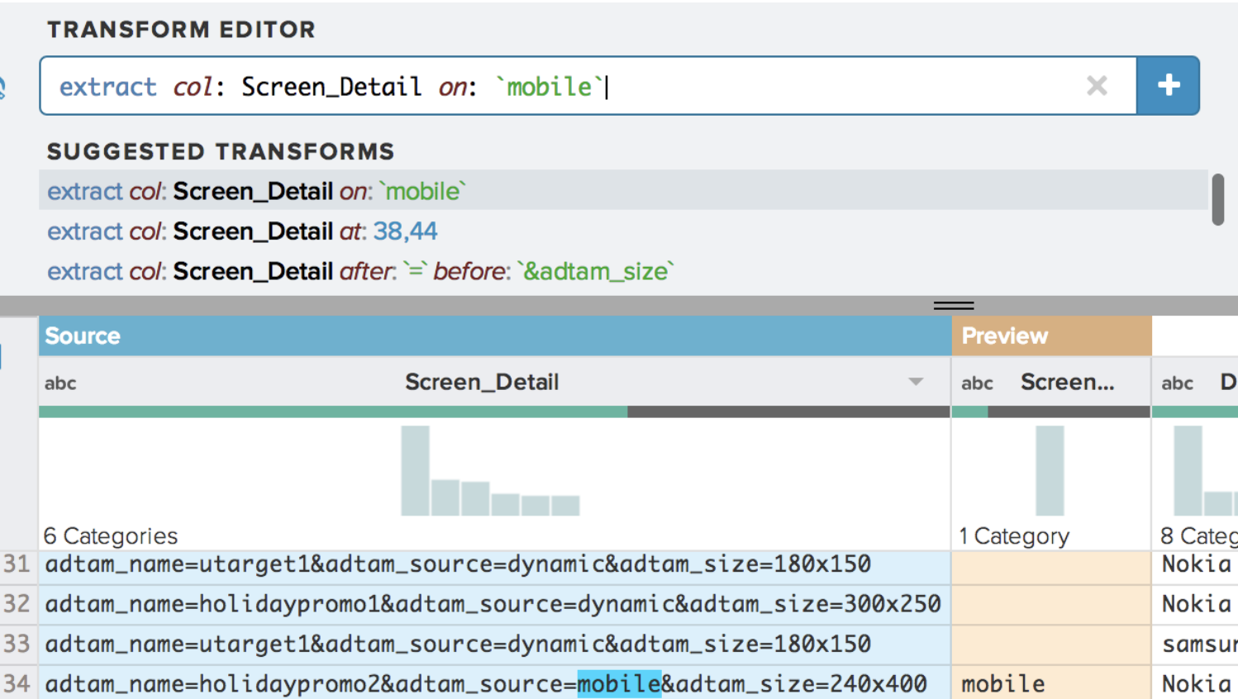
Predictive Interaction (Heer, Hellerstein, Kandel 15)
Ranked
Suggestions
1…
2…
3…
User
Interaction
Rendered Results
(could be sample)
choose
visualize
compile
Data
Write Code
Results

Slide 16
Predictive Interaction (Heer, Hellerstein, Kandel 15)
User Visualization/Interface Space
visualize
compile
Data
Write Code
Results

Slide 17
Predictive Interaction (Heer, Hellerstein, Kandel 15)
User Visualization/Interface Space
Domain Specific Language
visualize
compile
Data + Code Space

Slide 18
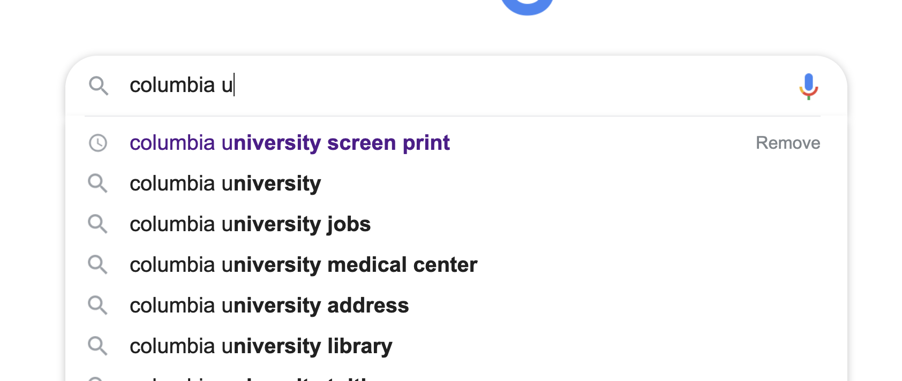
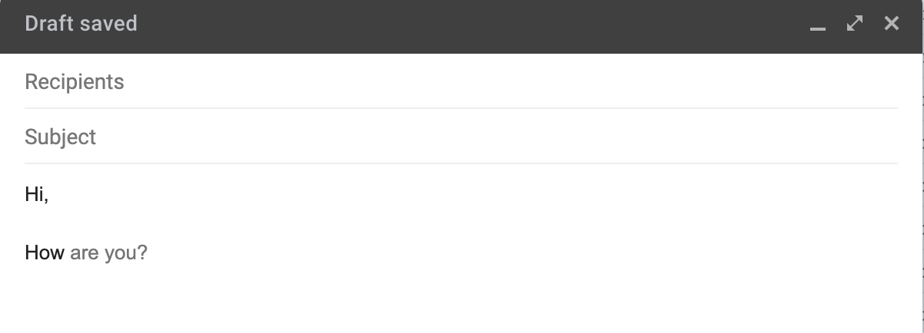
How best to combine HDIs and AI?
Provide shared representation: DSL
AI: generate and rank suggestions in DSL
Users: review, select, edit, ignore suggestions

Slide 19
How best to combine HDIs and AI?
Provide shared representation: DSL
AI: generate and rank suggestions in DSL
Users: review, select, edit, ignore suggestions
Examples of DSLs
Tableau:
Voyager:
Wrangler:
Texture:

Slide 20
How best to combine HDIs and AI?
Provide shared representation: DSL
AI: generate and rank suggestions in DSL
Users: review, select, edit, ignore suggestions
Examples of DSLs
Tableau: VisQL
Voyager: vega-lite
Wrangler: wrangler transforms
Texture: SBEL extraction rule

Slide 21
How best to combine HDIs and AI?
Provide shared representation: DSL
AI: generate and rank suggestions in DSL
Users: review, select, edit, ignore suggestions
Principles
Positive value (for user tasks)
Low overhead: augment, not replace, user interaction
Doesn’t decrease value
Better over time

Slide 22
Why Combine HDIs and AI anyways?
Data tasks are ill-formed. User iteratively identifies the task
Data science, cleaning, exploration, creativity
Big design + action (programs) space
Big and unknown task (goals) space
Imperfect AI

Slide 23
Contrast between the three systems
Wrangler
csv/text
Texture
Print docs
Instabase
structured docs

Slide 24
Why Do They Focus on Interaction?
Wrangler
Same Goals: extract tables for text documents/inputs
Why not just build better ML models?
What users want extracted depends on the user
Lack of labels for each task
Shared building blocks across tasks, but different compositions
Point and select content
Box detection, visual features (positioning, size)
User interaction
Language to solve task
Interface and interactions to help use the language
Texture
Instabase
Notes:
Similar to SQL

Slide 25
Modeling the Problem: Wrangler
Wrangler
Data model
table of text attributes
Language
sequence of str extraction/transforms
filter, project operators + fold/unfold
User Interaction
select text to extract
choose and refine suggestions
Texture
Instabase

Slide 26
Modeling the Problem: Texture
Wrangler
Two types of users: developers and end users
Data model
Typed bounding boxes (paragraph box, title box, etc)
Boxes contain text, annotated with labels (font, etc)
Hierarchy based on box containment
Developer Interaction
Write bounding boxes detectors and labelers in Java
Heuristics populate the “database”
User Interaction
Write extraction “queries” over boxes
Texture
Instabase

Slide 27
Modeling the Problem: Instabase
Wrangler
Data model
Document image
Text of doc, w/ spacing to preserve spatial structure
Language
Extraction relative to anchors
Assumes anchors are realistic due to doc structure
User Interaction
Manually write functions
Shows extracted bounding boxes in doc & text
Texture
Instabase

