Slide 1
Week 8 Modalities

Slide 2
Administrivia

Slide 3
GestureQuery Discussion

Slide 4
SpeakQL Discussion

Slide 5
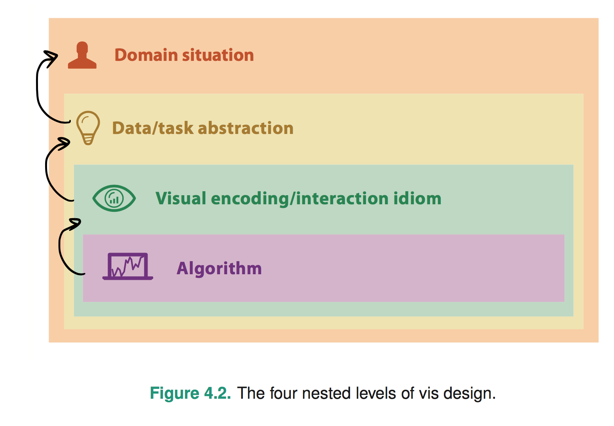
Chapter 4: The Nested Model
Wrong problem. Misunderstood user needs
Wrong abstraction. Showing the wrong thing
The way to show data is ineffective
Code is slow/buggy
Notes:
* early webvis papers soled "lost in hyperspace" by rendering the web's hyperlink topological structures. Not useful, and no idiom/algorithm could solve it, since it only added to user cognitive load

