Slide 1
Week 14 Query Explanations

Slide 2
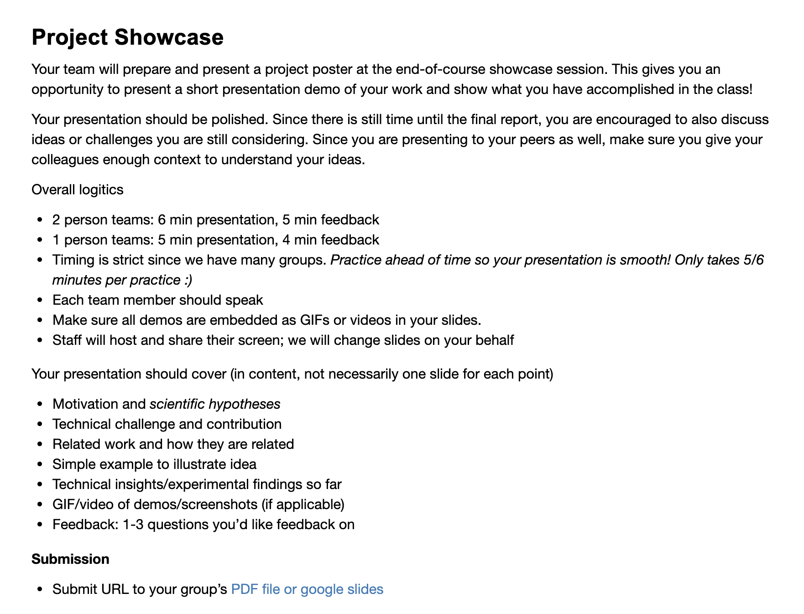
Administrivia
Thank you for the insightful reviews this semester!
Showcase in 1 week

Slide 3
Showcase Logistics
9 groups
2 person teams: 6 min presentation, 5 min feedback
1 person teams: 5 min presentation, 4 min feedback
Timing is strict, so practice!
Every team member should speak
Submit slides by Monday night before showcase
Staff will share & control screen for all presentations

Slide 4
Showcase Details
Presentation should contain (in substance, not necessary slides)
Motivation and hypotheses
Technical challenge and contribution
Related work and how they are related
Simple example to illustrate idea
Technical insights/experimental findings so far
GIF/video of demos/screenshots (if applicable)
Feedback: 1-3 questions you’d like feedback on

Slide 5
Recall
If project is a perceptual/user study
Focus is on the task that the study will better illuminate
Show: new understanding of users
If project is a system/tool/interaction design
Focus is on the task that is improved
Show: novelty, performance, ease of use
If project is an algorithm
Focus is an existing or new task
Show: novelty, correctness, scalability

Slide 6
Topics in Database Research w6113.github.io
DATABASES
HOW DO THEY WORK?
(learn in 6113!)

Slide 7
Scorpion: Explaining Away Outliers in Aggregate Queries
Presenter: Richard Zhang
Scribe: Zachary Huang
DIFF: A Relational Interface for Large-Scale Data Explanation
Presenter: Zachary Huang
Scribe: Richard Zhang

Slide 8
DIFF
A Relational Interface
for Large-Scale Data Explanation

Slide 9
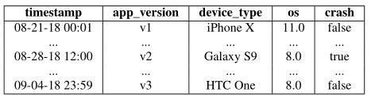
DIFF problem example - What caused the crash?
Given high-volume, high-dimensional data sources, users want to explore what caused the “crash”?

Slide 10
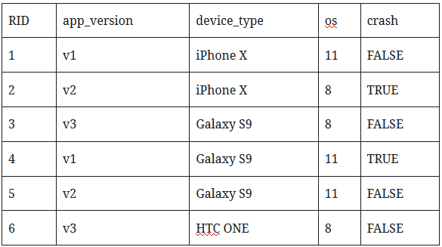
DIFF
Explanation (Predicate):
a set of attribute values: A∗ = {A1 = a1 , ..., Ak = ak }
For example, is crash caused by {os = 8}?
1

Slide 11

MacroBase
Data volumes are quickly outpacing human abilities to process them. Today, Twitter, LinkedIn, and Facebook each record over 12M events per second.
However, human attention remains limited.
Data analytics engine that prioritizes end-user attention in high-volume fast data streams.
Use classifier to automatically detect outliers, and explain these outliers.

Slide 12
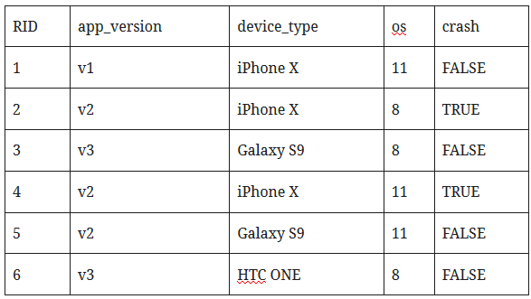

MacroBase
Explanation: combinations of attribute values that are relatively common in outliers. For example, app_version = v2, device_type = iPhoneX.
Risk ratio is a standard diagnostic measure used in epidemiology, and is used to determine potential causes for disease.
Given an attribute combination appearing ao times in the outliers and ai times in the inliers, where there are bo other outliers and bi other inliers, the risk ratio is defined as

Slide 13
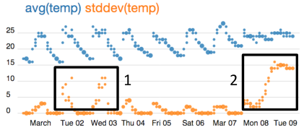
Scorpion
Exploratory Analysis: where users try to understand trends and general patterns by fitting models or aggregating data.
Such analyses will often reveal outliers aggregate values, or subgroups of points that behave differently than others.
Conduct why-analysis: describing the common properties of the input data points or tuples that caused the outlier outputs

Slide 14
Scorpion
Sensitivity: how the uncertainty in the output of a mathematical model or system (numerical or otherwise) can be divided and allocated to different sources of uncertainty in its inputs.
COUNT(crash=FALSE) is too high.
Given an explanation (combinations of attribute values), if we remove these values, whether the count of crash will be lower, and the count of non-crash won’t be affected?

Slide 15
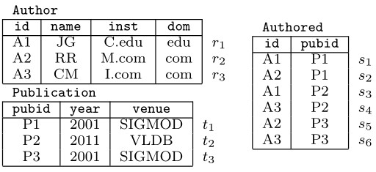
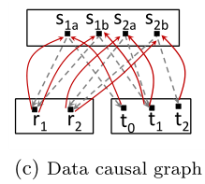
RSExplain
An explanation is a predicate with the property that, when we remove from the database all tuples satisfying that predicate, then we affect significantly the outcome that we want to explain.
Extended explanations with a formal framework that handles complex SQL queries and database schemas involving multiple relations and functional dependencies.
Use foreign keys to model causal paths.

Slide 16
Data X-Ray
Explanation engine that diagnoses systematic errors in large-scale datasets.
For each explanation, define the cost.
Find a set of explanations with the least cumulative total cost that explains all errors in the data.
For example, first explanation could be {version = v1, device_type = Galaxy S9}
Second explanation could be {version = v2, device_type = iPhone X}

Slide 17
Interoperability
Current explanation engines are usually standalone tools, and so the Interoperability piece is actually pretty hard to navigate.
If you're a data analyst, having an explanation is really handy but chances are it's going to exist as some part of larger workflow.
Solution: capture the semantics of these engines via our DIFF operator, which is parameterized by difference metrics and can generalize to application domains.
Incorporate the DIFF operator into a relational query engine.

Slide 18
DIFF
First specify two groups of records:
For example:
Q1: (SELECT * FROM logs WHERE crash = true) crash _ logs
Q2: (SELECT * FROM logs WHERE crash = false) success _ logs
After run the queries, get a set of records.

Slide 19
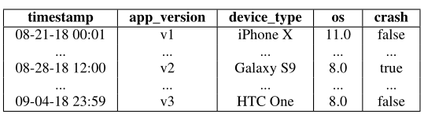
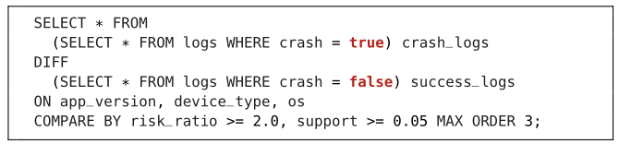

DIFF Operator

Slide 20
DIFF
First define two sets to compare (crash and non-crash)
Here, crash records R = {2,4} and non-crash records S = {1,3,5,6}.

Slide 21
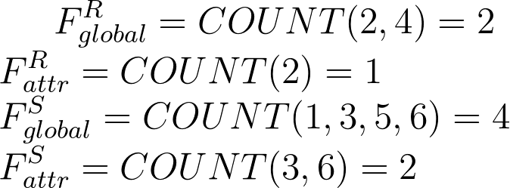
DIFF
R = {2,4}, S = {1,3,5,6}. Explan = {os = 8}.
Global is all records in R/S. Attr is records matching explanation.

Slide 22

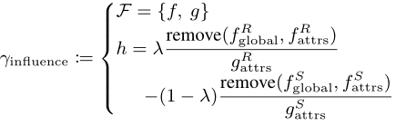
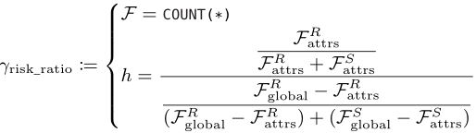


DIFF
Different metrics to evaluate the explanations:

Slide 23
Logical Optimizations For DIFF
DIFF-JOIN Predicate Pushdown: Joining tables together could be costly. Evaluating the DIFF on the foreign keys first.
Exploit functional dependencies: For instance, an explanation containing state = "CA" is equivalent another explanation one containing state = "CA", country = "USA" .

Slide 24
Physical Optimizations For DIFF
Prune low support attributes (for support metric) and dictionary-encode remaining values.
For low-cardinality columns, use bitmap-encoded.
Encoded data stored in columnar format for cache locality.

Slide 25
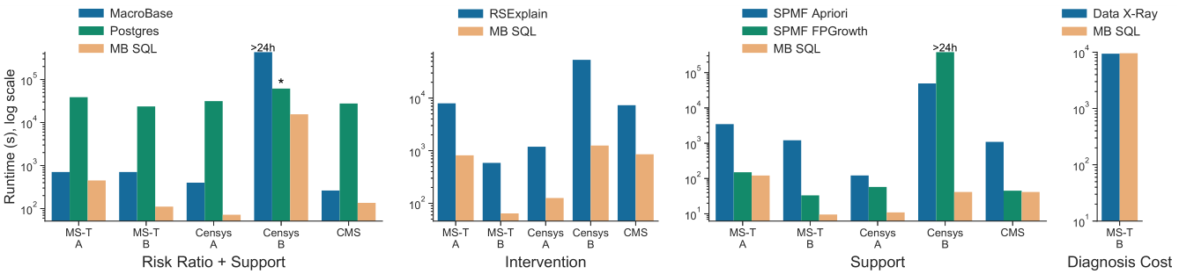
Evaluation: End-to-end Benchmarks

Slide 26
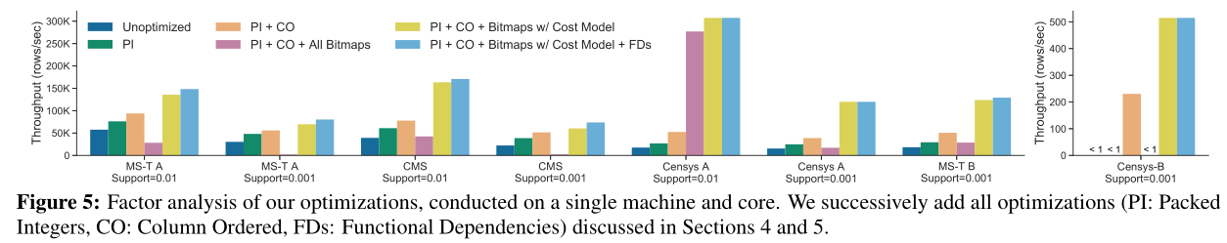
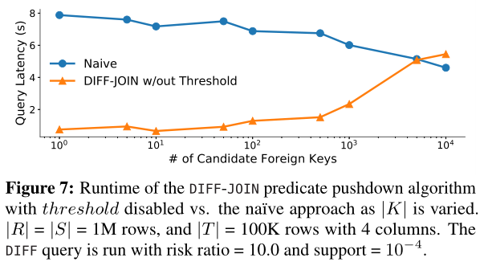
Evaluation: Factor analysis of our optimizations

Slide 27
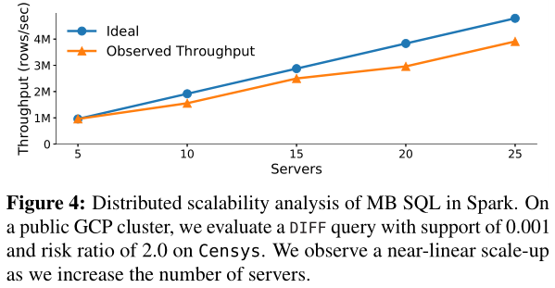
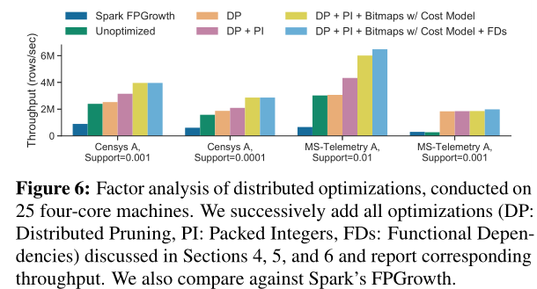
Evaluation: Scalability

Slide 28
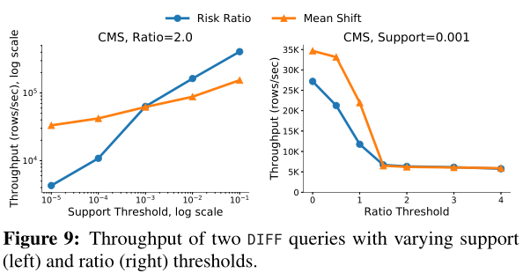
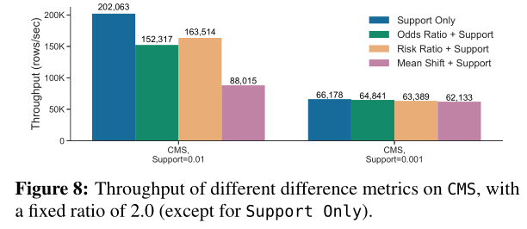
Evaluation: Different Metrics and Parameters

Slide 29
Scorpion: Explaining Away Outliers in Aggregate Queries

Slide 30
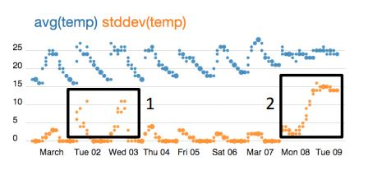
Sample Problem for Scorpion
Say we have the following visualization
of some Intel Sensor data:
Problem: How can we explain these outliers in the stdev(temp) given our initial dataset?

Slide 31
Why Why-Analysis is Hard
Determining why a model’s outputs are outliers is difficult for the following reasons:
Stated by the paper:
Backwards Provenance - It’s difficult to track an arbitrary subset of inputs that are used to compute outliers
Responsible subset - How can a system determine which subset of inputs is “responsible” for each outlier group? The naive solution of enumerating all input combinations is extremely costly
Predicate generation - How can a system construct a boolean predicate to filter out responsible inputs? It is not sufficient to merely enumerate the inputs, as this doesn’t “explain” to the user anything

Slide 32
Scorpion and Why-Analysis
Scorpion attempts to explain outliers for queries of the type:
“SELECT aggregate_function(attr_b) FROM table GROUP BY attribute_b”
Questions being asked:
Which attributes in the data influence outliers and to what degree?
How can we contrast between our normal incidental data and our outliers?

Slide 33




Simplified Formalization of Why-Analysis in the case of Scorpion
We have relation with attributes in our aggregate query over
We aim to produce some boolean predicates over attributes in that do not contain the
aggregate or group-by attributes that have the most influence on computing our outliers. These
predicates are conjunction of range clauses over continuous attributes and subset clauses of
discrete values for discrete attributes

Slide 34
How Scorpion Aimed to Improve Upon Past Related Work
Probabilistic provenance wanted to formalize and compute the notion of influence regarding individual
tuples in a dataset. Scorpion improves on this by computing a predicate over the attributes in an
attempt to provide explanation rather than simply enumerating tuples.
Previous work also had limited use cases, such as searching for predicates over user attributes to explain
movie ratings. Scorpion aims to be a system to be used for explaining specifically outliers optimized for
various (and very common) aggregate queries (such as SUM, COUNT, AVG).

Slide 35



Notion of Predicate Influence (Important!!)
Our aggregate query’s result tuples:
Basic Definition of Predicate Influence:
Suppose we have our aggregate function agg(), input tuples g_o, and result o. We have the following formula for the difference in aggregation when applying predicate p to our input g_o (removing all inputs that are filtered out by the predicate):
Thus Scorpion determines a predicate’s influence by the following:

Slide 36
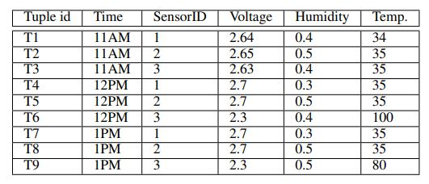

Example and Additional Notation
Suppose we have the following table:
And we have the inputs a = {T1, T2, T6}. We determine the influence of {T2} on avg(a, {T2}) = (56.6-67.5)/1 = -10.8. On the other hand, the influence of {T6} is 21.6. This seems to be reflected by the table at initial glance.
Error vector:

Slide 37
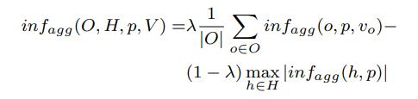
Additional Notation (2)
The user selects some results tuples to be considered outliers, and some results tuples to be explicitly not be considered outliers. The explicit non-outliers make up the Holdout Set. We have the following notion of influence based on Holdout set H and Outlier set O when multiple results to be included in H and O:

Slide 38
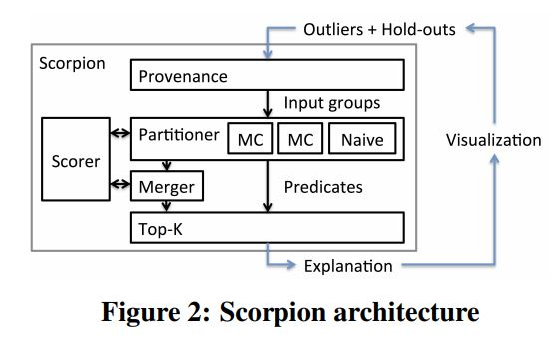
Scorpion Architecture

Slide 39
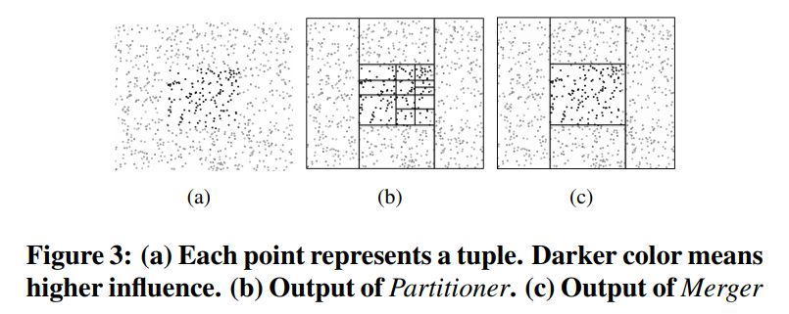
Scorpion Architecture (2)

Slide 40
Problems of Naive Merger
Predicates merged by computing minimum bounding box for continuous attributes and union of discrete values for discrete attributes
If we do not optimize for certain aggregate functions, a merger may only be able to merge upon one attribute at a time and thus is extremely costly.

Slide 41
Aggregate Properties
Incrementally Removable — some aggregate properties are incrementally removable and we can optimize by storing a cached value
Independent — sets of tuples can be determined not to influence any other set of tuples.
Anti-monotonic — in our case, the influence of a predicate is greater than or equal to the influence of any subset of given predicate

Slide 42
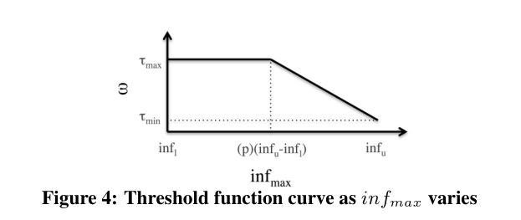
Optimizing for Regression Tree Partitioning (DT)
Splits attribute space of outlier and holdout groups
Basically, the idea is to use a regression tree to minimize variance over a set of input tuples. Intuitively makes sense: partitions should contain tuples with similar levels of influence
To further optimize, we don’t have to compute the influence over all the tuples within a partition. Rather, we can score them by sampling and extrapolating influence from our sample.

Slide 43
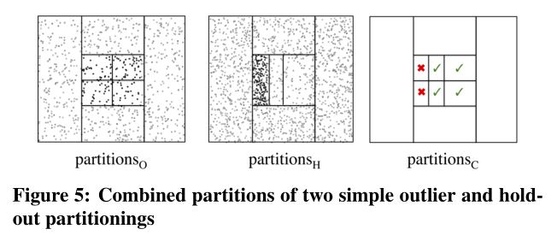
Holdout with DT

Slide 44
Bottom-Up Partitioner (MC)
This partitioner applies to non-monotonic and independent tuples to prune out certain tuples. It partitions based on the density of the input tuples and expands its partitions until the merged predicate is not as influential as the most influential predicate discovered so far.
Begins with most granular predicates and moves up, terminating when the influence of the predicate

Slide 45
Experiments on Synthetic Datasets
Proved DT and MC to be much faster than Naive, and have similar accuracies.
Showed reasonable results on real world data

Slide 46
Some Questions
Does the amount of user input have an influence on the usability of Scorpion?
How would you design an experiment for Scorpion?

