Slide 2
Class 3
Languages

Slide 3
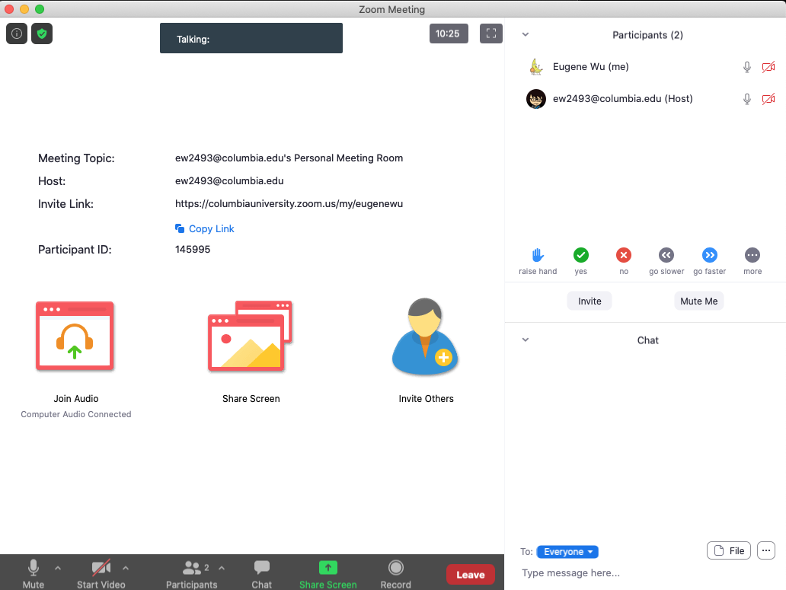

Turn video on,
enable mic & say:
“Hi, this is _(name)_,
I usually eat ________ for lunch”
Click when done
Participants
Chat

Slide 4
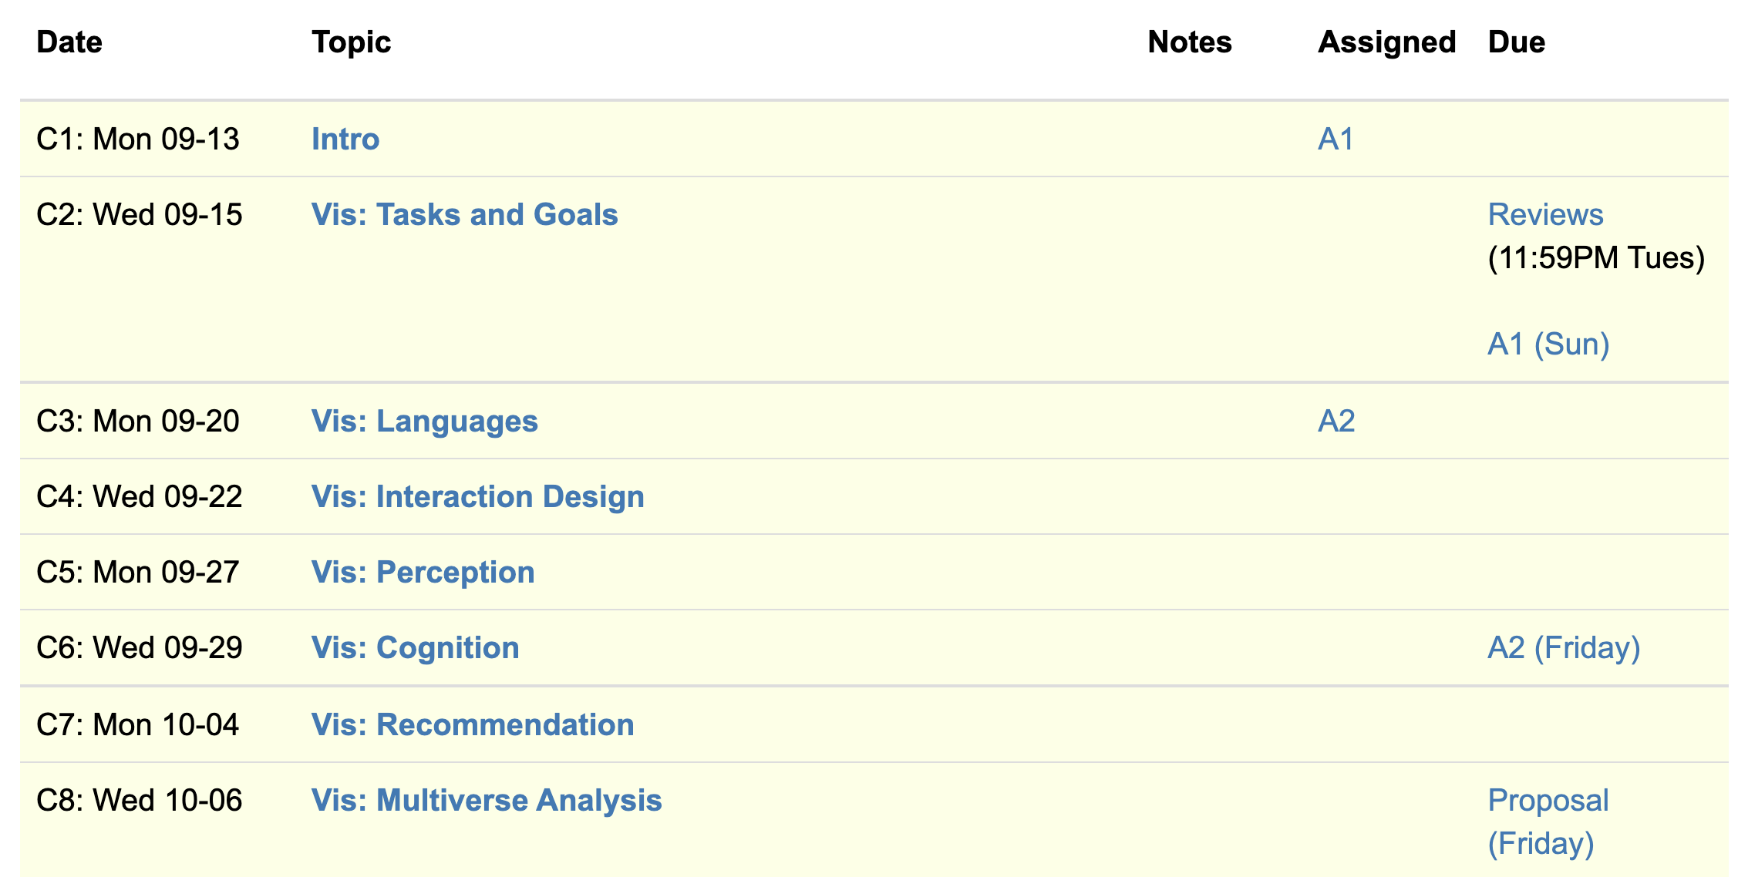
Logistics
A1 was due last night
A2 released.

Slide 5
Each group assigns notetaker
G1 and 2: What criteria makes a HDI language good? Put the criteria into action: pick a domain/task and make up a language.
G3 and 4: discuss the strengths and weaknesses of how the paper is communicated. Share the top strength and top weakness.
Notetaker shares what you came up with and the process.
Notes:
How did you pick the other vis language?

Slide 6
Support your colleagues
for speaking up
A quick thanks or follow up
is great

Slide 7
Each group assigns notetaker
G1 and 2: What criteria makes a HDI language good? Pick a domain/task and come up with a language.
G3 and 4: discuss the strengths and weaknesses of how the paper is communicated. Share the top strength and top weakness.
Notetaker shares what you came up with and the process.

Slide 8
Technique
Is it correct?
Does it make sense?
Is it as simple as possible?
Are decisions unnecessarily complex?

Slide 9
Comunication
What is the appropriate audience?
How well do they justify
Design decisions?
Technical approach?
The problem itself?

Slide 10
Experiments
What SHOULD have been done?
How should it be measured?

Slide 11
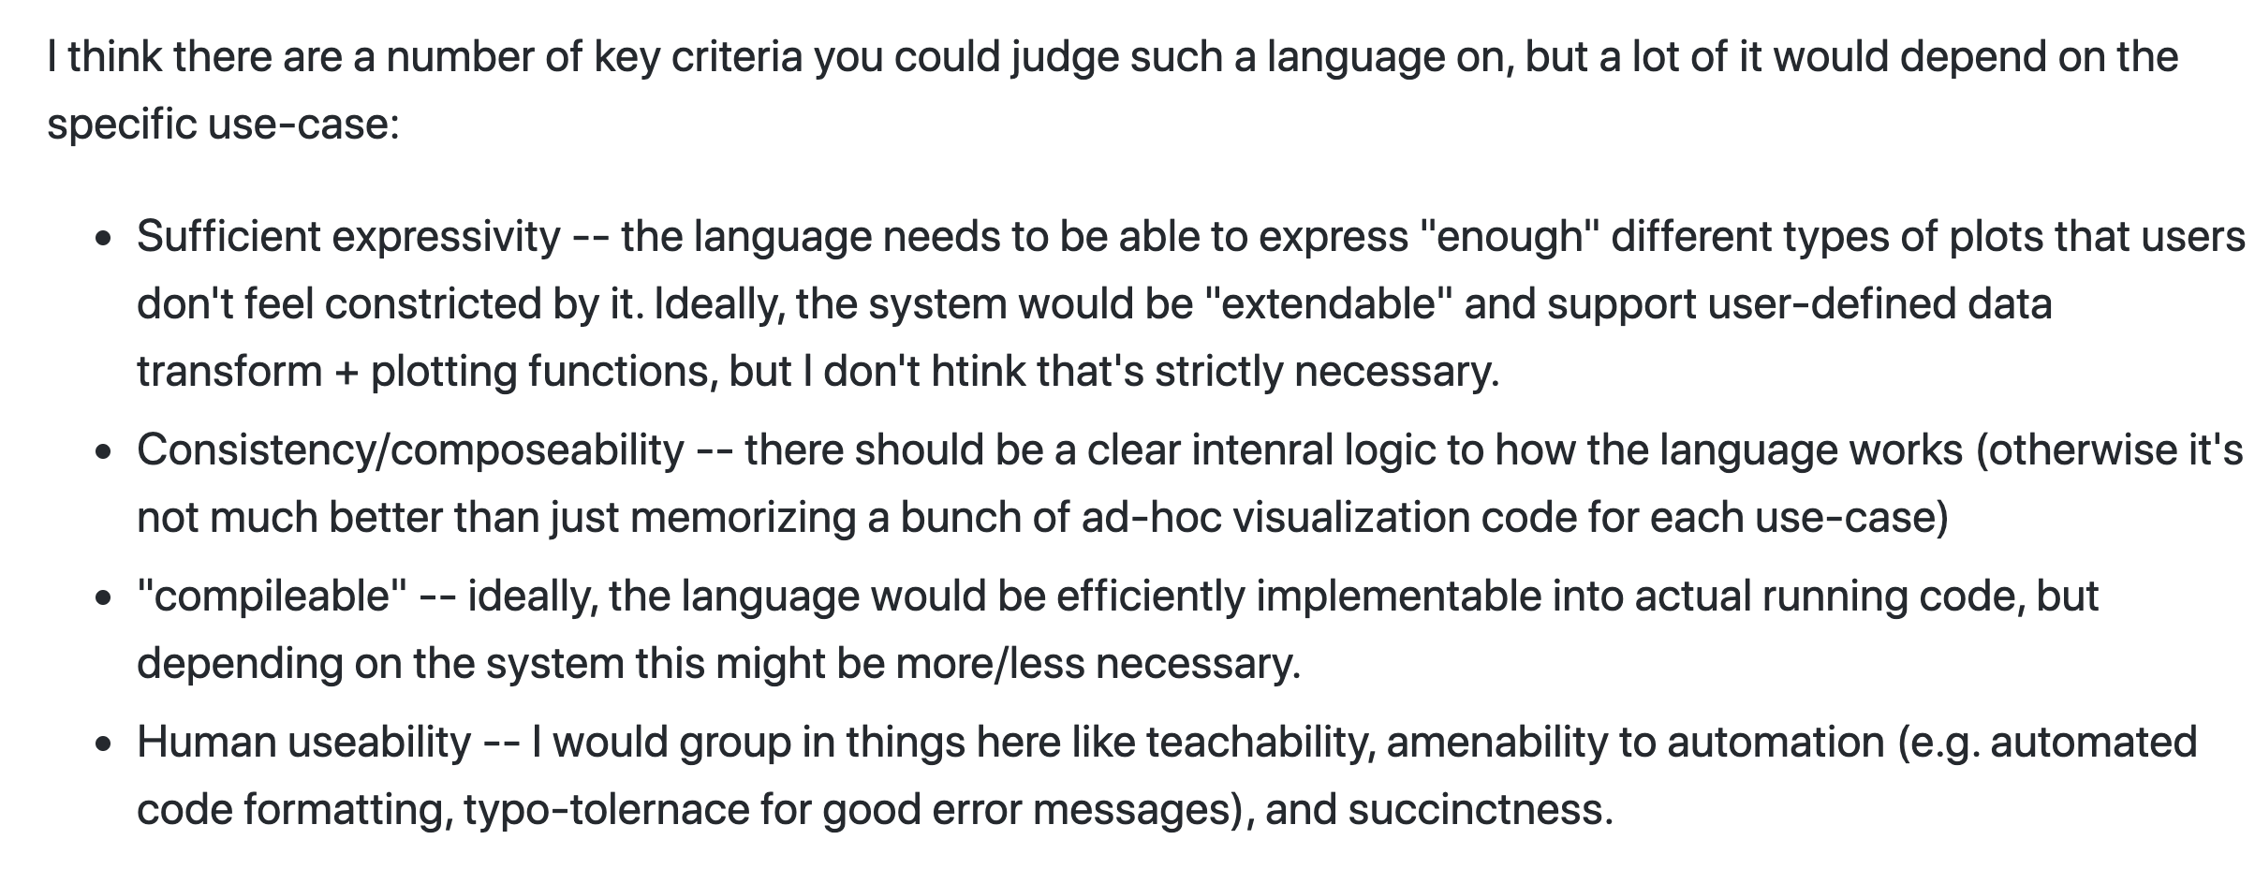

Slide 12
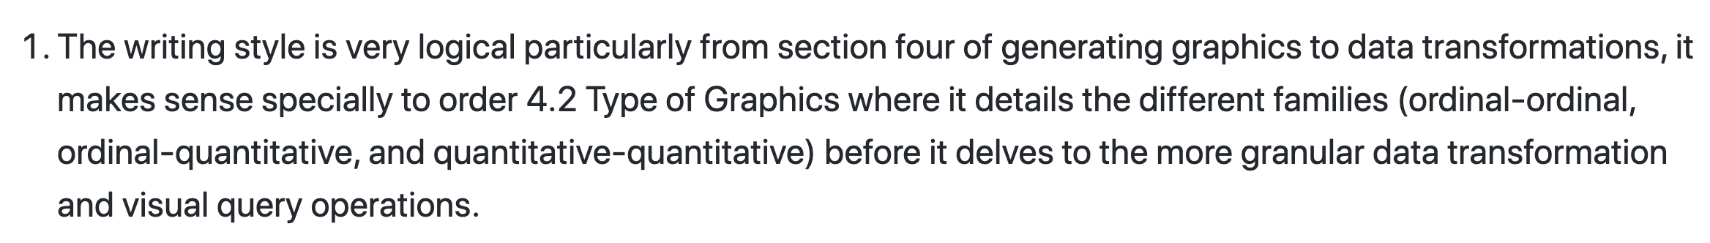

Slide 13
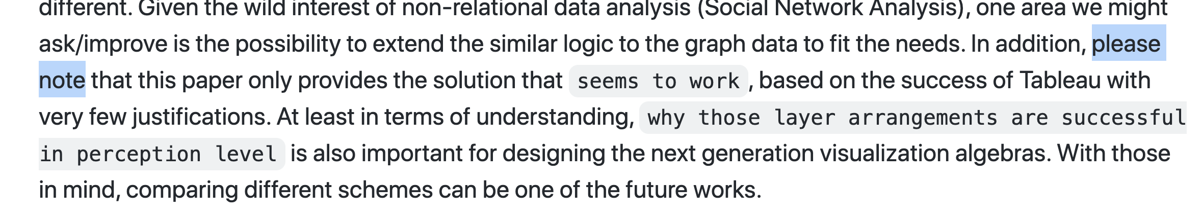

Slide 14
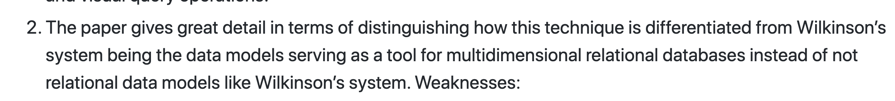

Slide 15
Class 2
Tasks

Slide 16
Discussion prompt:
Recent book that you find memorable

Slide 17


Slide 18
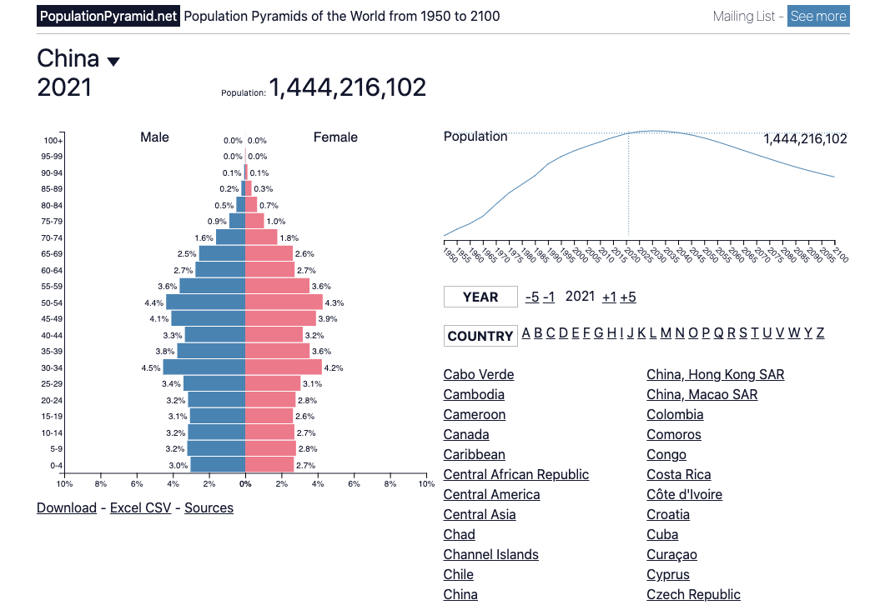

Slide 19
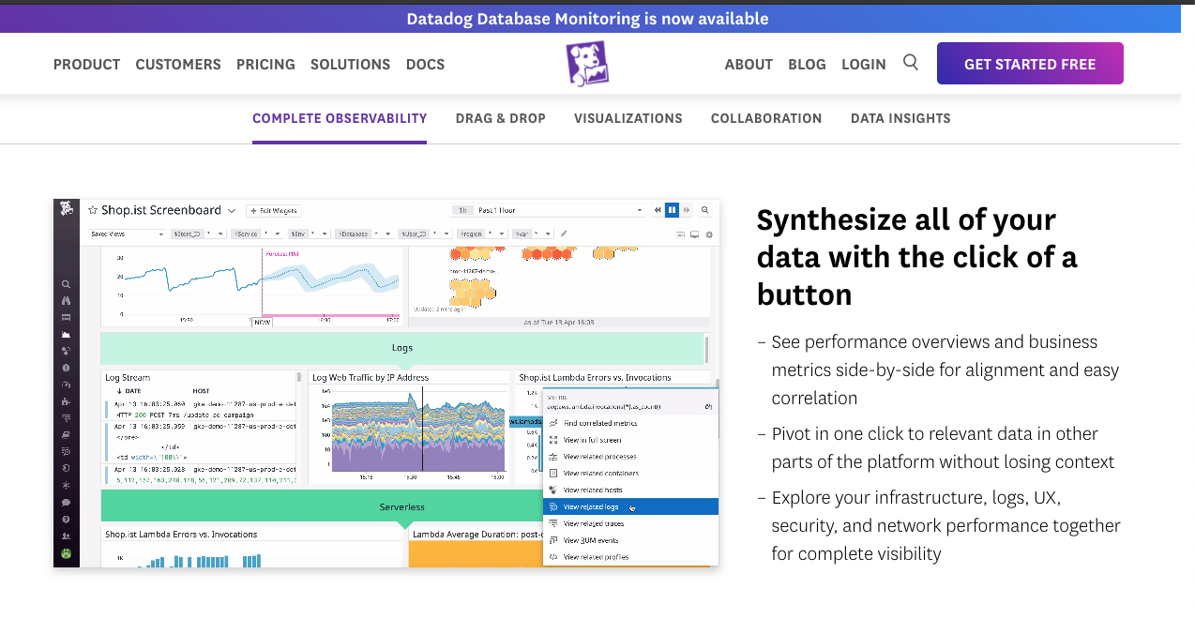

Slide 20
Each group assigns notetaker
Groups of 4:
You back-fitted task descriptions from a visualization. Discuss your process, what made it easy/difficult, and reflect on the applicability of the task typology.
Bonus, choose a visualization and task to share with the class. (connect to zoom, share screen)

Slide 21
Support your colleagues
for speaking up
A quick thanks or follow up
is great

Slide 22
Each group assigns notetaker
Groups of 4:
Discuss and share the visualization and task description you created in the review.
Choose one that notetaker will share with the class
(connect to zoom, share screen)

Slide 23
TODOs
A1!!

