Slide 1
Week 7 Approximation

Slide 2
Administrivia
Related Works due today midnight
extended to Friday midnight

Slide 3
Today’s topic
Pangloss: Zachary Huang
Scribe: Xupeng Li
Wander join: Xupeng Li
Scribe: Zachary Huang

Slide 4
Trust, but Verify
Optimistic Visualizations of
Approximate Queries for Exploring Big Data

Slide 5
Big Data Visualization
 | Pros | Cons
Distributed System | General query Precise | Network latency Costly
Data Cube | Fast Precise | Precompute Limited query
Sampling | Fast General query | Not precise

Slide 6
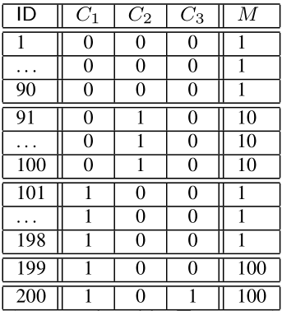
Sample + Seek
SELECT C1 , SUM(M) FROM T GROUP BY C1
When C1 = 0.
SUM(M) = 1*90 + 10*10 = 190
When C1 = 1
SUM(M) = 1*98 + 2*100 = 298

Slide 7
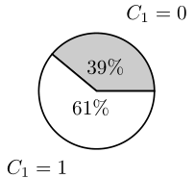
Sample + Seek
SELECT C1 , SUM(M) FROM T GROUP BY C1
<190/488,298/488> = <0.39,0.61>

Slide 8
Sample + Seek
Uniform sampling 20 records:
High chance
For C = 0
9 rows from rows 1-90 M = 1
1 row from rows 91-100 M = 10
For C = 1
Case 1: one of 199, 200 sampled
Case 2: neither sampled

Slide 9
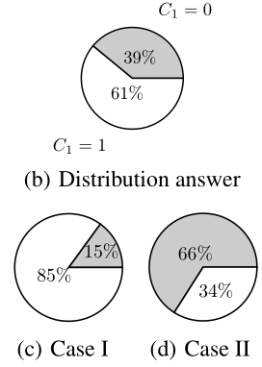
Sample + Seek
SELECT C1 , SUM(M) FROM T GROUP BY C1

Slide 10
Sample + Seek
Measure-biased sampling
Pick a row with probability proportional to its value on the measure attribute.

Slide 11
Sample + Seek
Measure-biased sampling
1 26 51 76 92 94 96 98 111 136 161 186 199(four times) 200(four times)
<8/20,12/20> = <0.40,0.60>

Slide 12
Optimistic Data Visualization
Trust: Assume that approximation is right in most of the cases.
But not done yet...

Slide 13
Optimistic Data Visualization
Trust: Assume that approximation is right in most of the cases.
Verify: Run the query in the background

Slide 14
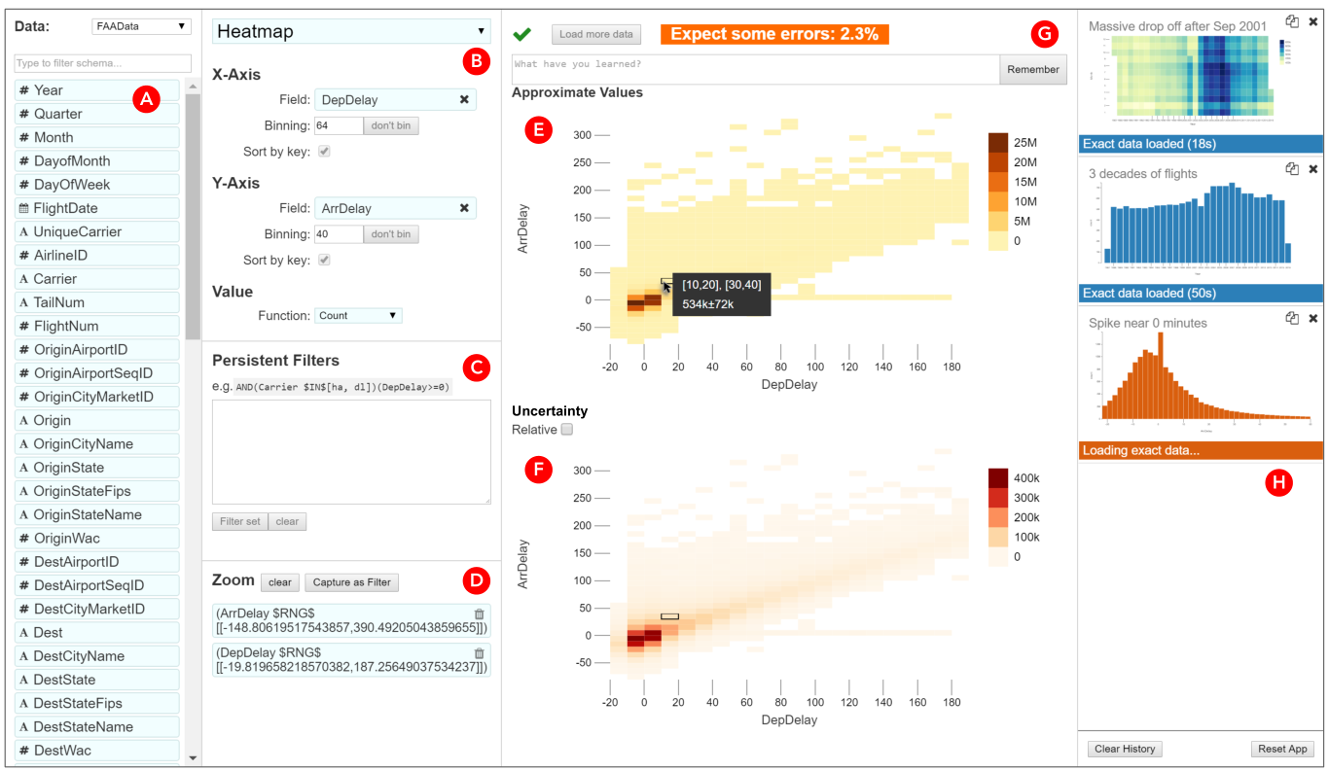
a list of fields (A), chart specification forms (B), a textfield for filters (C), zoom specification (D), approximate visualization (E), visualization of the uncertainty (F), field for annotations and “remember” button (G), a list of views in the history (H)

Slide 15
Evaluation
Three case studies:
David and Software Crashes: 200MB/day
Madhu and Search Terms: 994 million rows of data
Faraz and Social Computing

Slide 16
Evaluation
Takeaways
AQP works “ excited that Pangloss could let him get to know the shape of his full dataset. In the past, he had not felt like he could explore his data: queries took too long, and so he would focus only on specific questions that he needed to answer”
Optimism works: “I was think what to do next - and I saw that it had loaded, so I went back and checked… very nice for not interrupting workflow.”
Draft query: “ He began to use the ap­proximate query as a draft, less concerned about the answer it showed and more concerned about whether it showed that he had the right query … When he accidentally formed a view with a bad filter, he quickly noticed the approximate view was incorrect and adjusted the query”

Slide 17
Discussion

Slide 18
Sample+Seek
Measure-biased samples for SUM(val): proportional to val
100 rows
val
1
..
1
100
p_{naive}
1/100
..
1/100
1/100
p_{s+s}
1/199
..
1/199
100/199
sampled val
100/(1/100)
= 10,000
100/(100/199)
= 199
Estimate
Addresses err bound’s Data Dependency
Notes:
if you were unlucky and picked v=100, you think the SUM is 100 * 100 = 10,000
in S+S, you would estimate as 100 / 100 * 199 = 199
Addressing data dependency bounds the number of samples needed.
Combined with clever in-memory and on-disk data structures to draw enough samples to meet error bounds

Slide 19
Sample+Seek
Sample probability based on value
result = Q(in-memory sample)
if enough samples: return result
if very low selectivity:
lookup rows directly
else:
use measure-augmented index to
draw sample biased by b
Q = SELECT a, SUM(b)
WHERE c=1 ...
GROUPBY b
In-mem
Samples
Notes:
Low means < sqrt(n)
Both these approaches require fundamental changes to the query engine.

Slide 20
Discussion
Pangloss limits the types of analysis to make the research tractable.
How feasible to extend for ”full-featured” analysis?
How to support other visualizations?

Slide 21
Discussion
How do you think approximation is used in analyses today?
How should approximation be integrated into analysis flows?

Slide 22
Discussion
Users need to manually validate “remembered” charts
Do you think users are fundamentally needed to validate?
How to extract observations/insights?

Slide 23
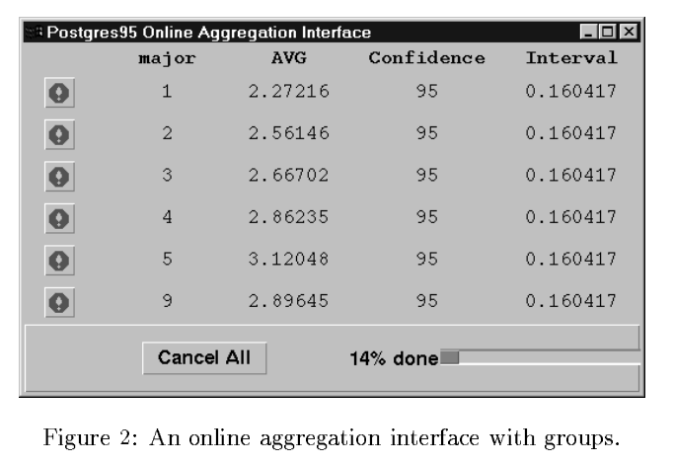
Hellerstein et al Online Aggregation SIGMOD 97

Slide 24
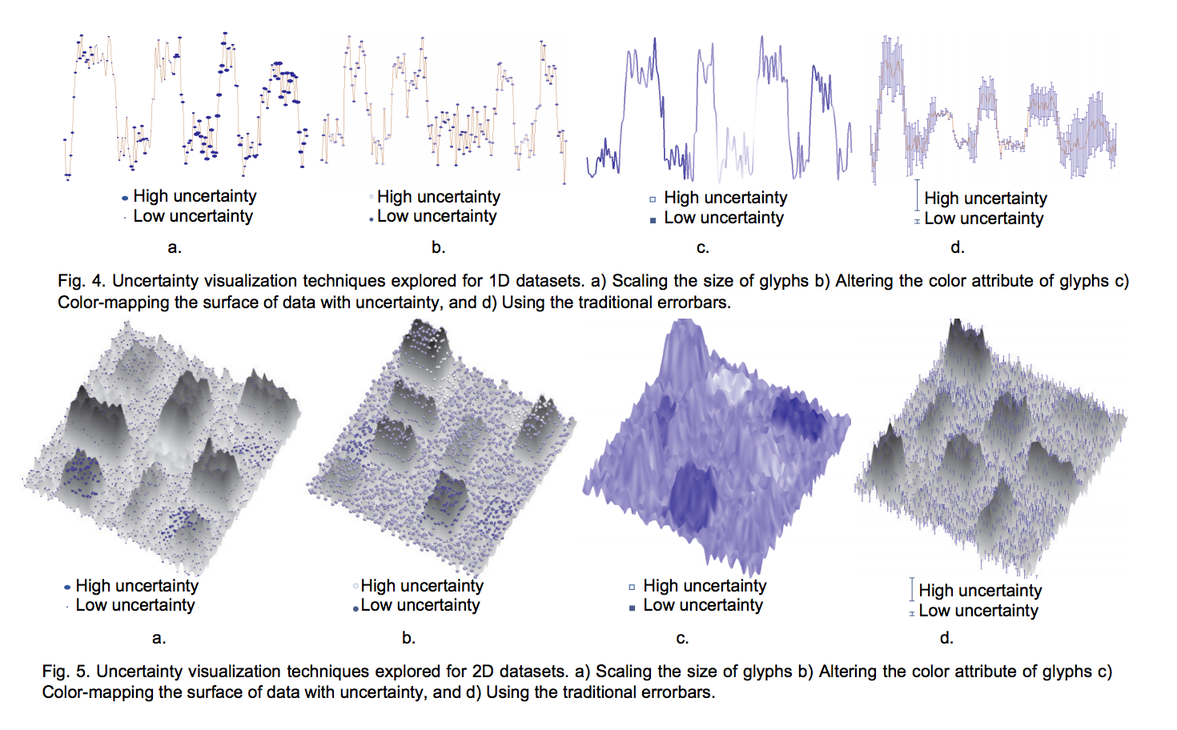

Slide 25
Wander Join: Online aggregation via Random Walks
Xupeng Li
3/4/2020

Slide 26




Overview
Join operation of relational database
Join is common, but expensive
$$1000000000000$$
$$×$$
$$×$$
$$→$$
$$10000$$

Slide 27

Overview
If only for Aggregation (sum)
$$Σ$$
$$1000000000000$$
$$×$$
$$×$$
$$→$$
$$10000$$

Slide 28
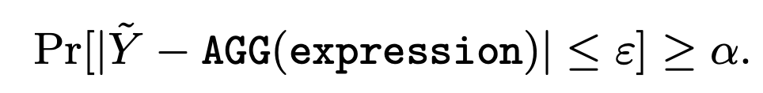

Overview
If only for Aggregation (sum)
Can do approximation
fast: hours (full) $→$ seconds (approximate)
with certain confidence
$$Σ$$
$$1000000000000$$
$$×$$
$$×$$
$$→$$
$$10000$$

Slide 29



Overview
$$Σ$$
$$\frac{1}{10}$$
$$5$$
Approximate by random sampling
$$1000000000000$$
$$×$$
$$×$$
$$→$$
$$10000$$
$approximation: sum= 5÷\frac{1}{10}$

Slide 30


Overview
$$Σ$$
Approximate by random sampling
$$1000000000000$$
$$×$$
$$×$$
$$→$$
$$10000$$
$$\frac{1}{20}$$
$$3$$
$approximation: sum=(5÷\frac{1}{10}+3÷\frac{1}{20})/2$

Slide 31


Overview
$$Σ$$
Approximate by random sampling
$$\frac{1}{10}$$
$$9$$
$$1000000000000$$
$$×$$
$$×$$
$$→$$
$$10000$$
$approximation: sum=(5÷\frac{1}{10}+3÷\frac{1}{20}+9÷\frac{1}{10})/3$

Slide 32
Algorithms for random sampling
Ripple Join v.s. Wander Join

Slide 33
Algorithms for random sampling
Ripple Join v.s. Wander Join
Sampling
Table A
Table B
Table A
Table B
Join
$$×$$

Slide 34
Algorithms for random sampling
Ripple Join v.s. Wander Join
Sampling
Table A
Table B
Table A
Table B
Join
$$×$$

Slide 35
Algorithms for random sampling
Ripple Join v.s. Wander Join
Sampling
Table A
Table B
Table A
Table B
Join
$$×$$

Slide 36
Algorithms for random sampling
Ripple Join v.s. Wander Join
Sampling
Table A
Table B
Table A
Table B
Join
$$×$$

Slide 37
Algorithms for random sampling
Ripple Join v.s. Wander Join
Sampling
Table A
Table B
Table A
Table B
Join
$$×$$

Slide 38
Algorithms for random sampling
Ripple Join v.s. Wander Join
Sampling
Table A
Table B
Table A
Table B
Join
$$×$$

Slide 39

Algorithms for random sampling
Ripple Join v.s. Wander Join
Dependent
Uniform
Sampling
Table A
Table B
Join
Table A
Table B
$$×$$

Slide 40
Algorithms for random sampling
Ripple Join v.s. Wander Join
Independent
Non-uniform

Slide 41







Algorithms for random sampling
Ripple Join v.s. Wander Join
Table A
Table B
Table C
$$3$$
$$5$$
$$5$$
$$3$$
$$×$$
$$3$$
$$×$$
$$5$$
$$5$$
WHERE A.x = B.x and B.y = C.y

Slide 42

Algorithms for random sampling
Ripple Join v.s. Wander Join
Table A
Table B
Table C
$$3$$
$$5$$
$$5$$
$$\frac{1}{|A|}$$
$$3$$
$$×$$
$$3$$
$$×$$
$$5$$
$$5$$
WHERE A.x = B.x and B.y = C.y

Slide 43

Algorithms for random sampling
Ripple Join v.s. Wander Join
Table A
Table B
Table C
$$\frac{1}{2}$$
$$3$$
$$5$$
$$5$$
$$\frac{1}{|A|}$$
$$3$$
$$×$$
$$3$$
$$×$$
$$5$$
$$5$$
WHERE A.x = B.x and B.y = C.y

Slide 44

Algorithms for random sampling
Ripple Join v.s. Wander Join
Table A
Table B
Table C
$$\frac{1}{2}$$
$$3$$
$$5$$
$$5$$
$$\frac{1}{|A|}$$
$$3$$
$$\frac{1}{3}$$
$$×$$
$$3$$
$$×$$
$$5$$
$$5$$
WHERE A.x = B.x and B.y = C.y

Slide 45
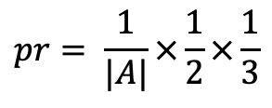
Algorithms for random sampling
Ripple Join v.s. Wander Join
Table A
Table B
Table C
$$\frac{1}{2}$$
$$3$$
$$5$$
$$5$$
$$\frac{1}{|A|}$$
$$3$$
$$\frac{1}{3}$$
Random walk
$$×$$
$$3$$
$$×$$
$$pr= \frac{1}{|A|}×\frac{1}{2}×\frac{1}{3}$$
$$5$$
$$5$$
WHERE A.x = B.x and B.y = C.y

Slide 46
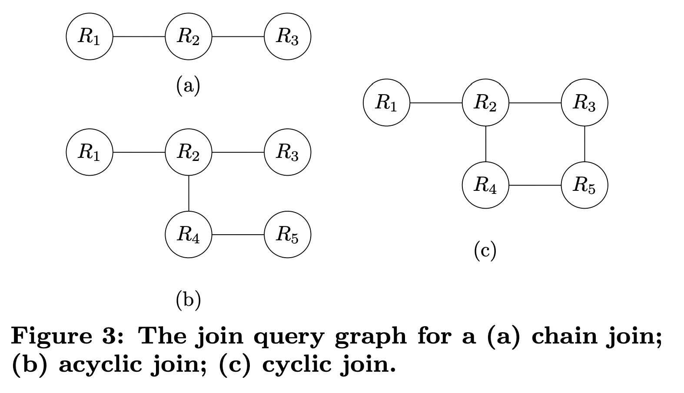
Wander Join
More complicated cases
Acyclic
Cyclic

Slide 47
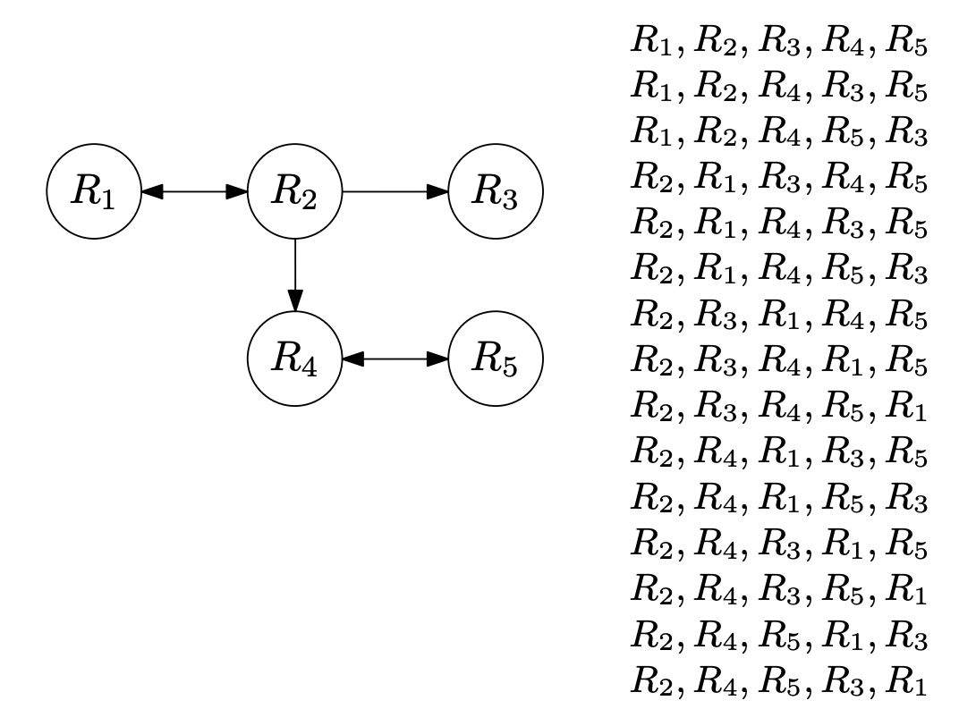
Wander Join
Acyclic
Finding an optimal walk path
Do trail runs

Slide 48
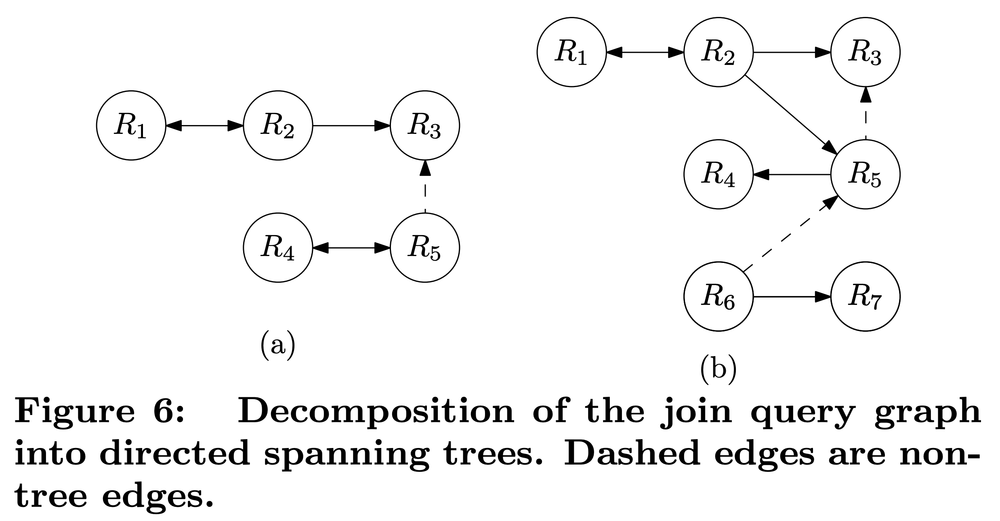
Wander Join
Cyclic
Compute tree decomposition
Random walk on trees
Check for non-tree edges at the end

Slide 49
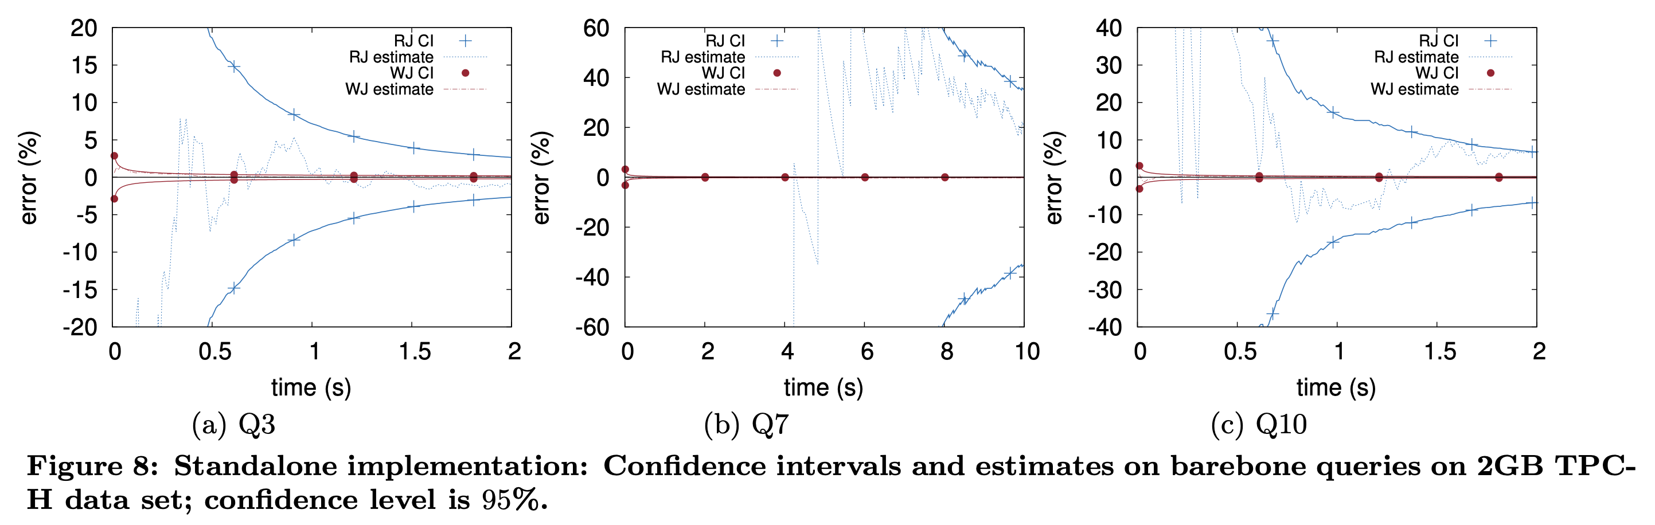
Experiments

Slide 50
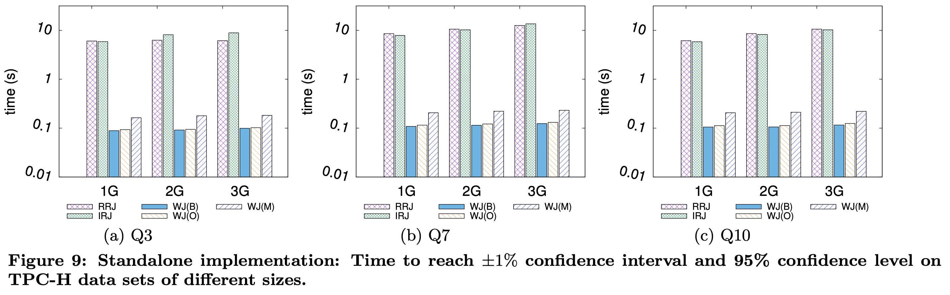
Experiments

Slide 51
Discussion
Writing
Presentation Style
Technical Details
Experiments?

Slide 52
Discussion: Offline vs Online AQP
What are the pros and cons of each type of method?
Are they different?
Sample+Seek is offline
Know queries ahead of time
Special schemes for classes of queries (S+S on joins?)
WanderJoin is online
Random sampling is expensive
Disk: 20 random seeks / sec vs 300MB read / sec
Data structures to accelerate

