Slide 1
Tasks Week 5

Slide 2
Administrivia
Related Work project milestone
at least 15 relevant papers
convince reader (staff) that you understand state of the art
Few papers directly solve you problem (good thing!) Need to be creative
Papers can be relevant by problem, technique, application.
They may
motivate problem
provide ideas to approach your problem
directly solve problem, but you can do better
solve similar problem, different application
solve different problem, but useful technique

Slide 3
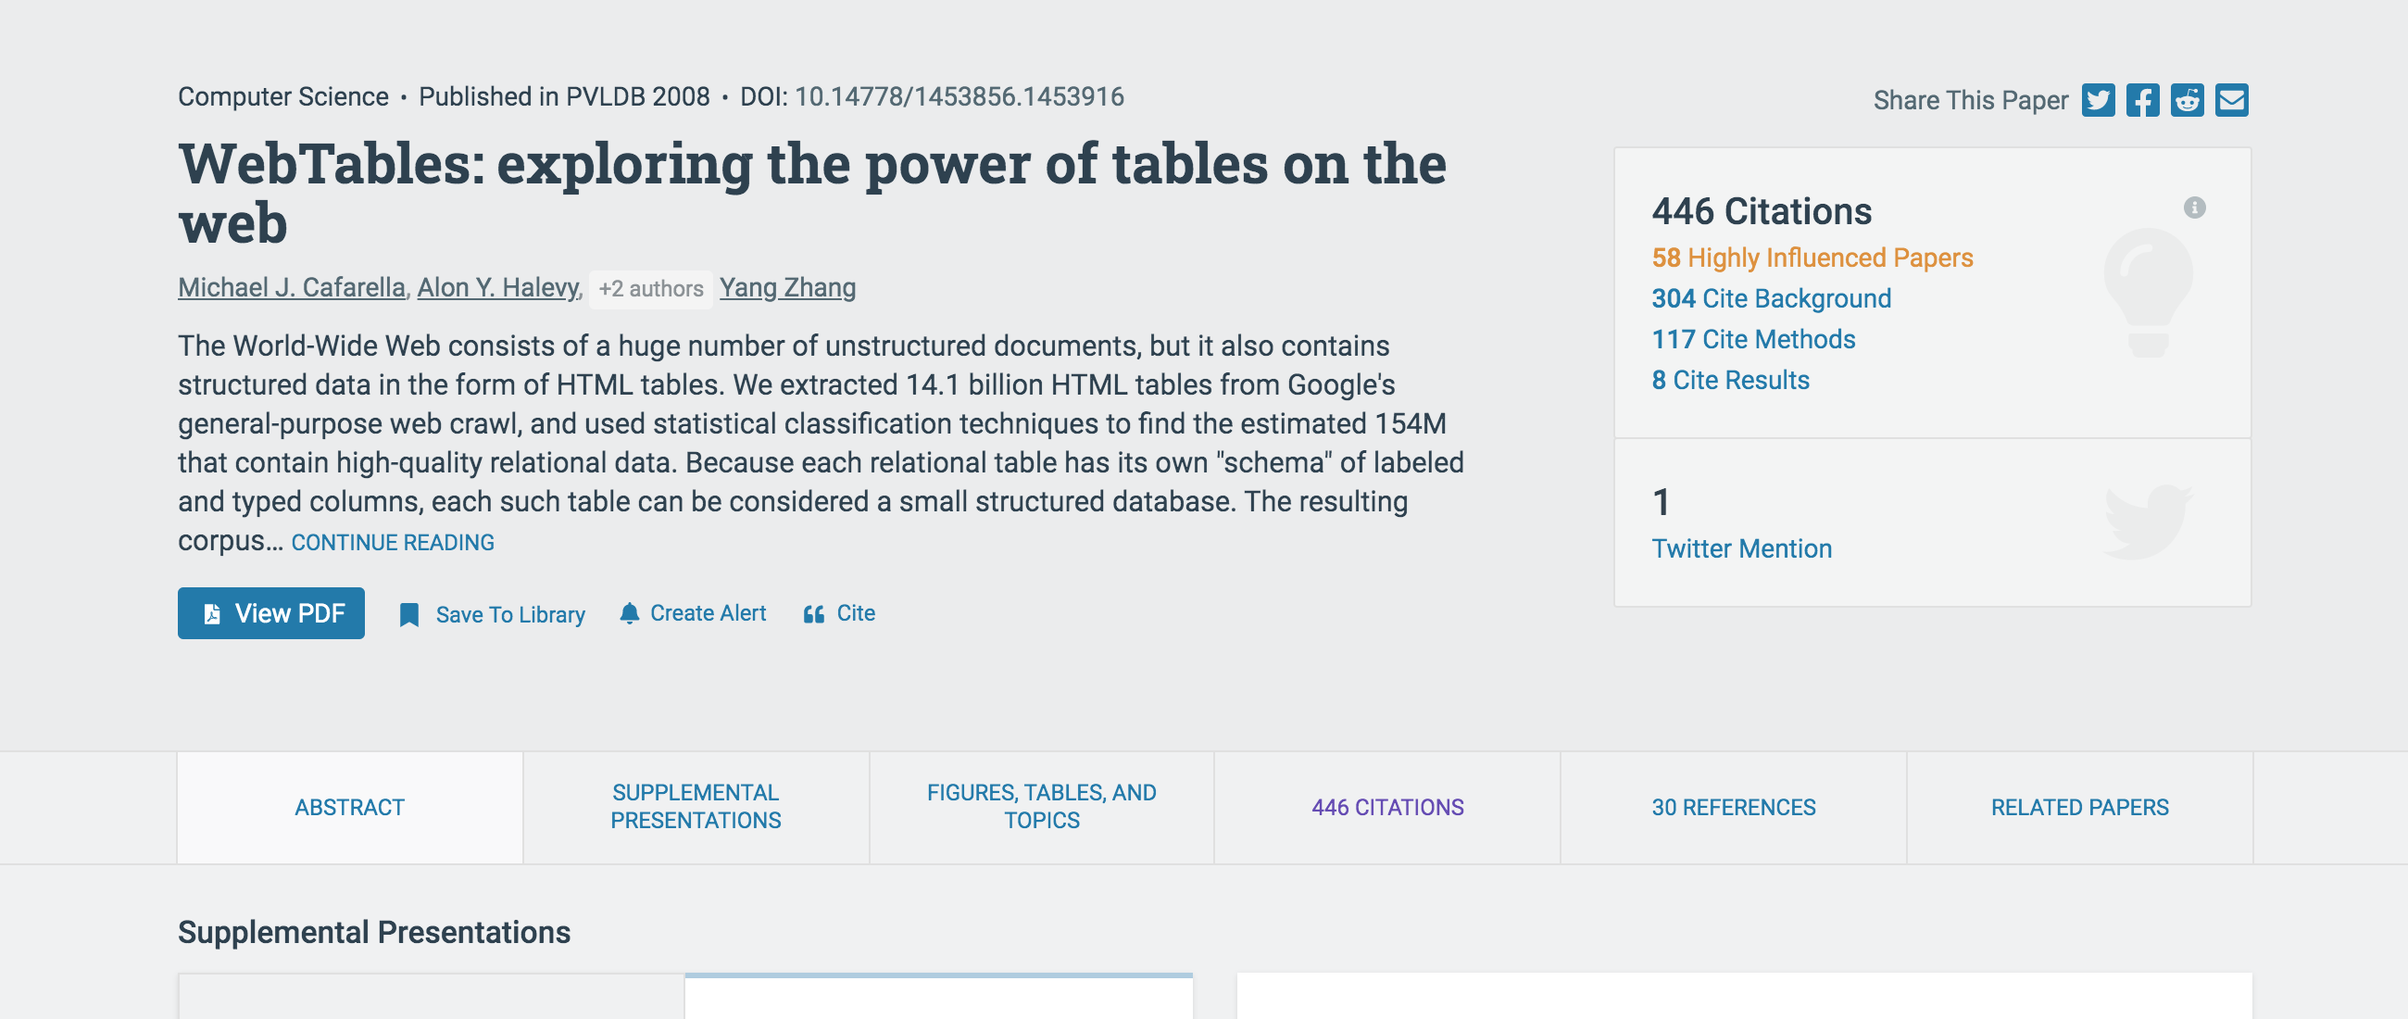
Administrivia
Resources
semanticscholar.org

Slide 4
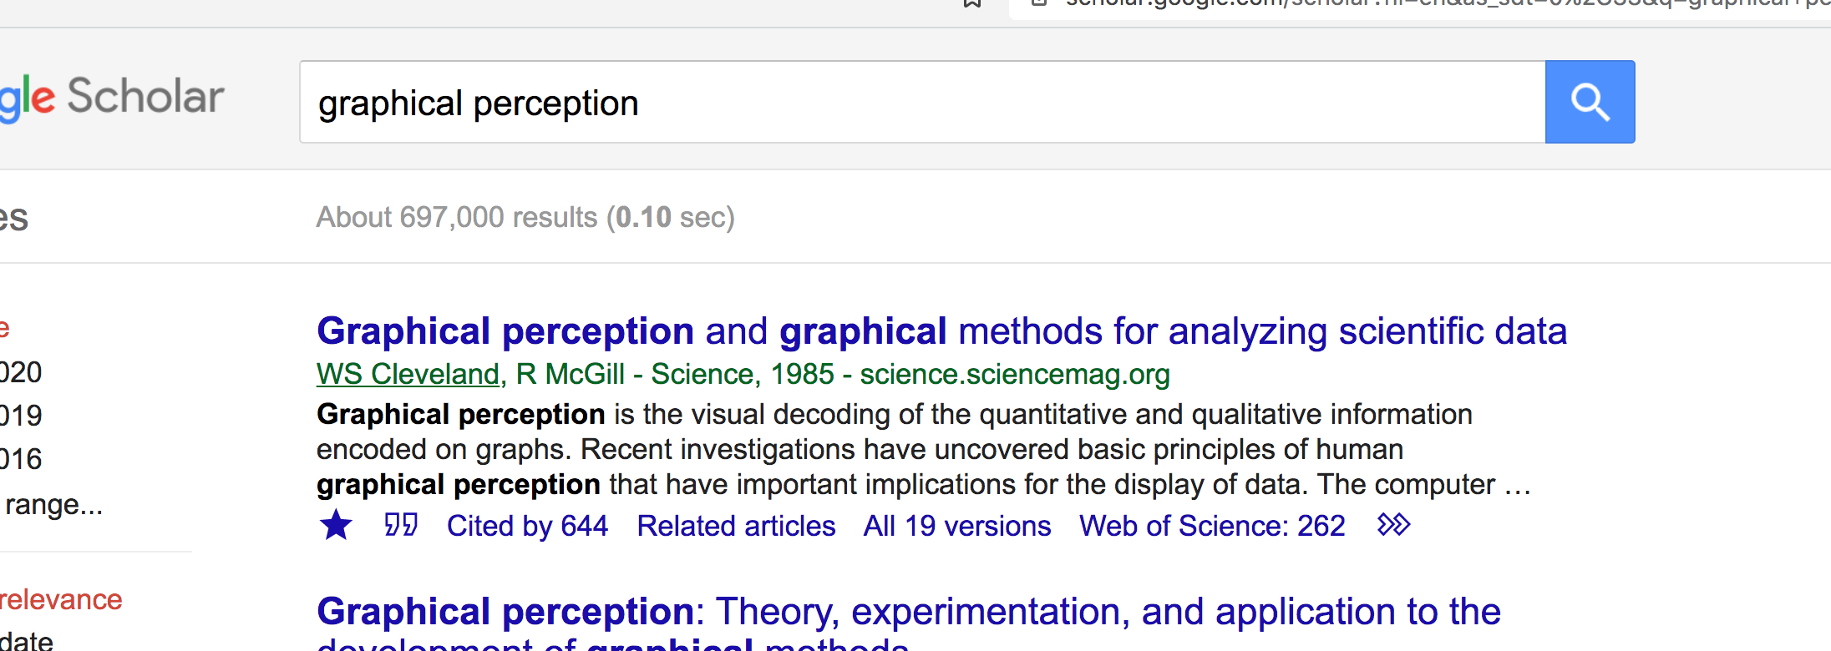
Administrivia
Resources
google scholar recs

Slide 5
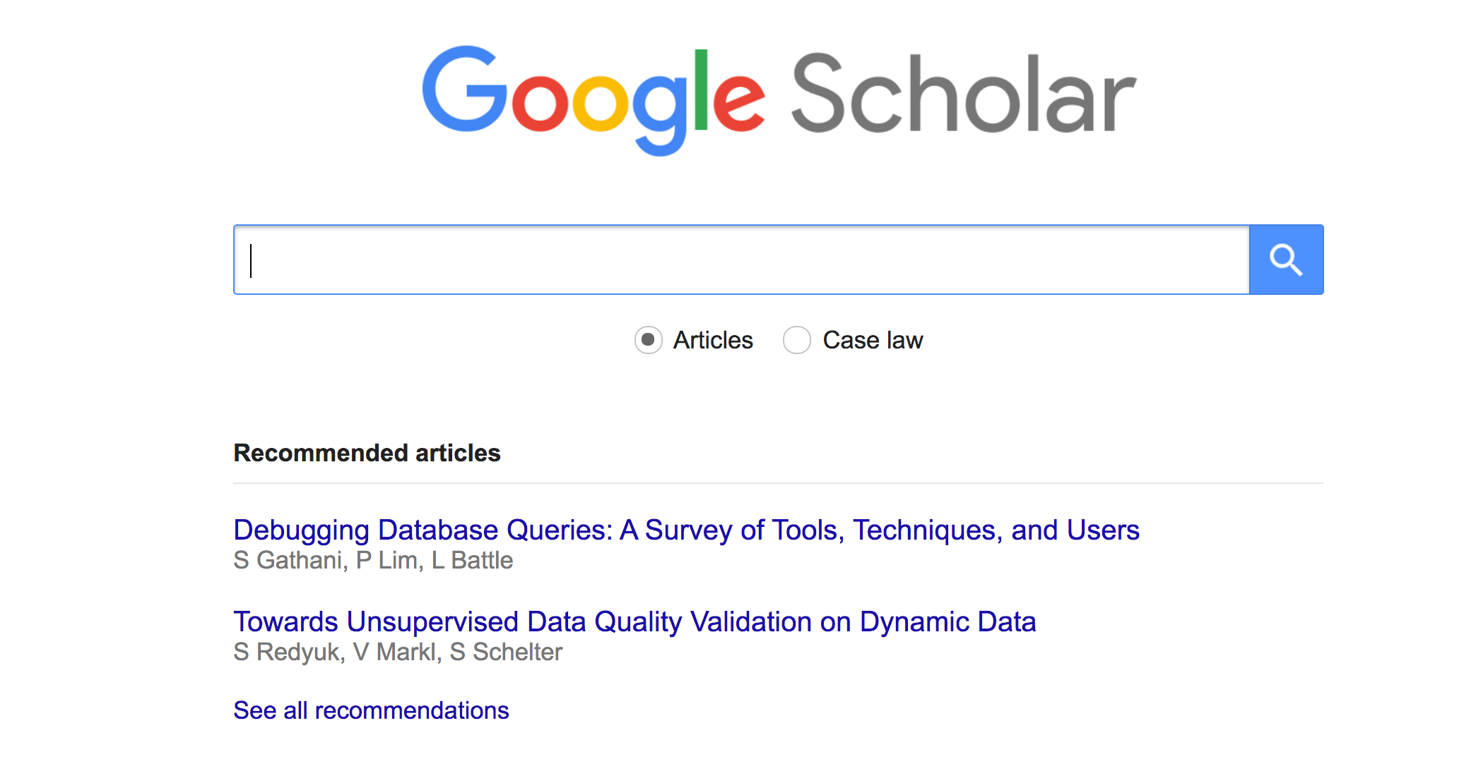
Administrivia
Resources
google scholar recs

Slide 6
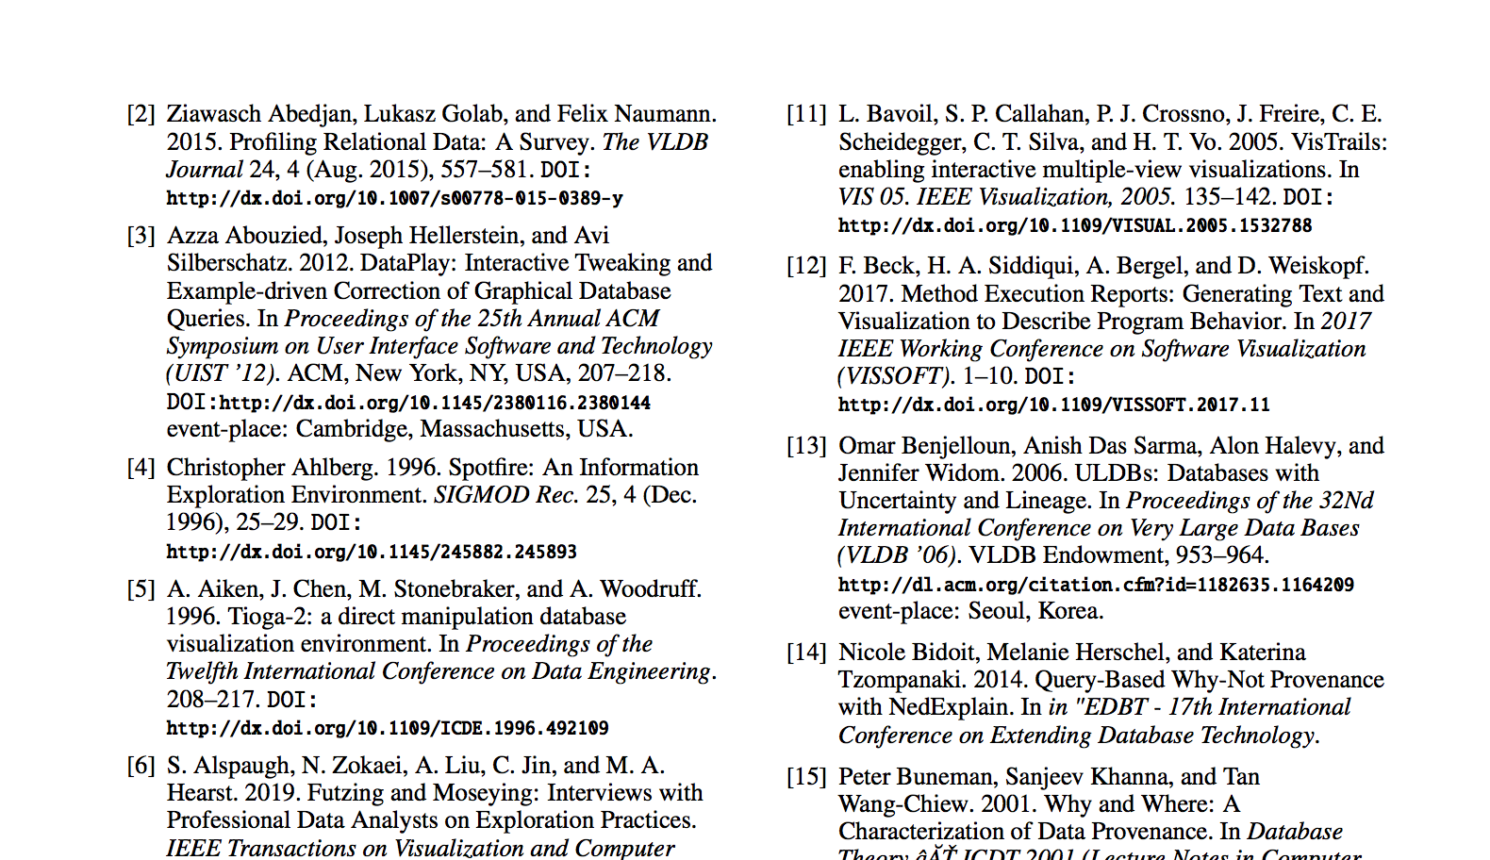
Administrivia
Resources
related work sections, survey papers
staff can help seed your search

Slide 7
Administrivia
A1 grades released

Slide 8
Comparison Paper Discussion

