Slide 1
Week 14 Query Explanations

Slide 2
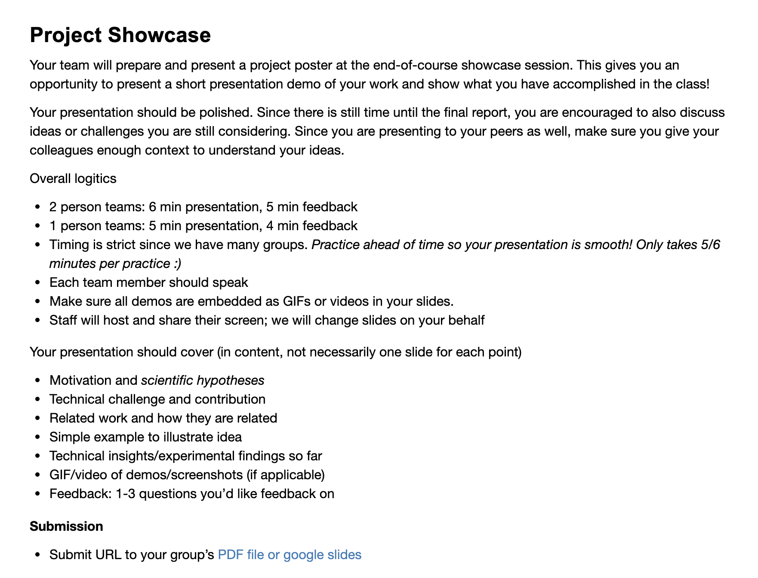
Administrivia
Thank you for the insightful reviews this semester!
Showcase in 1 week

Slide 3
Showcase Logistics
9 groups
2 person teams: 6 min presentation, 5 min feedback
1 person teams: 5 min presentation, 4 min feedback
Timing is strict, so practice!
Every team member should speak
Submit slides by Monday night before showcase
Staff will share & control screen for all presentations

Slide 4
Showcase Details
Presentation should contain (in substance, not necessary slides)
Motivation and hypotheses
Technical challenge and contribution
Related work and how they are related
Simple example to illustrate idea
Technical insights/experimental findings so far
GIF/video of demos/screenshots (if applicable)
Feedback: 1-3 questions you’d like feedback on

Slide 5
Recall
If project is a perceptual/user study
Focus is on the task that the study will better illuminate
Show: new understanding of users
If project is a system/tool/interaction design
Focus is on the task that is improved
Show: novelty, performance, ease of use
If project is an algorithm
Focus is an existing or new task
Show: novelty, correctness, scalability

Slide 6
Topics in Database Research w6113.github.io
DATABASES
HOW DO THEY WORK?
(learn in 6113!)

Slide 7
Scorpion: Explaining Away Outliers in Aggregate Queries
Presenter: Richard Zhang
Scribe: Zachary Huang
DIFF: A Relational Interface for Large-Scale Data Explanation
Presenter: Zachary Huang
Scribe: Richard Zhang

