Slide 1
Recommendation Week 4

Slide 2
Draco

Slide 3
Motivation
Choosing a good vis design for a dataset is hard
Factors that determine “good” constantly changing
result of perceptual/usability studies
Way to leverage evolving vis research for auto-visualization?

Slide 4
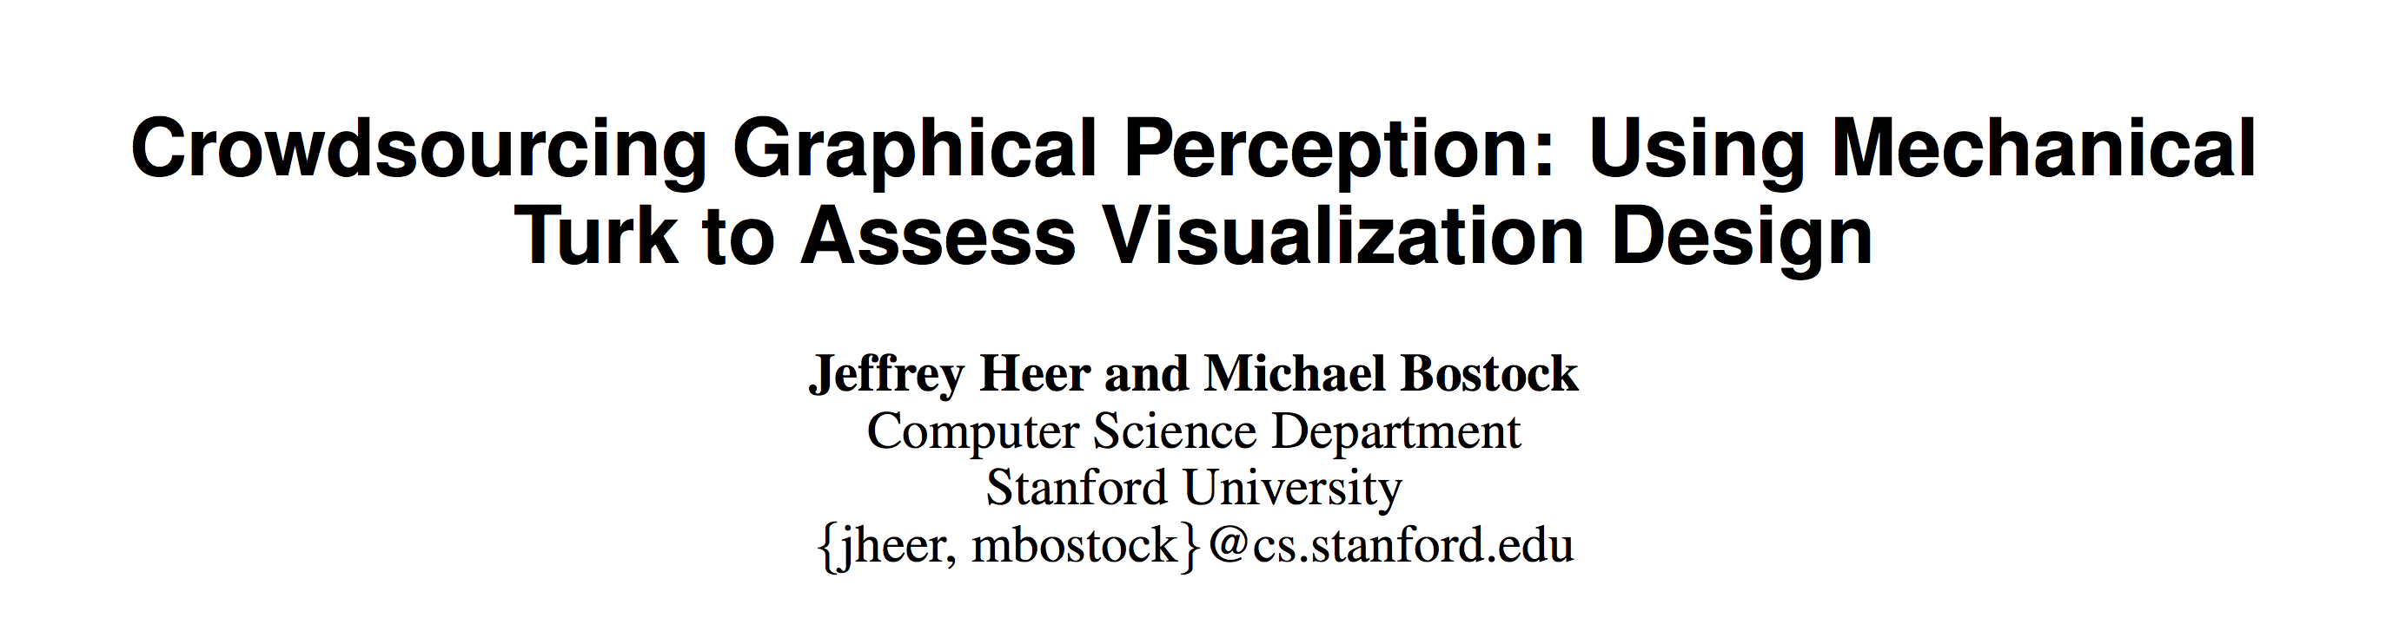
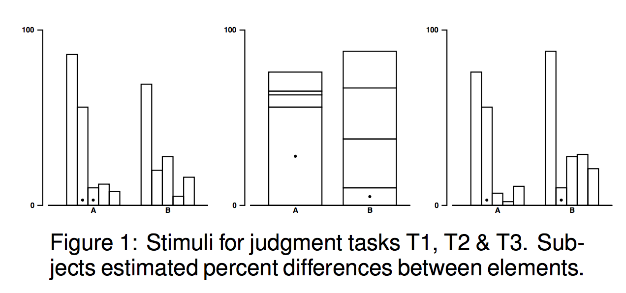
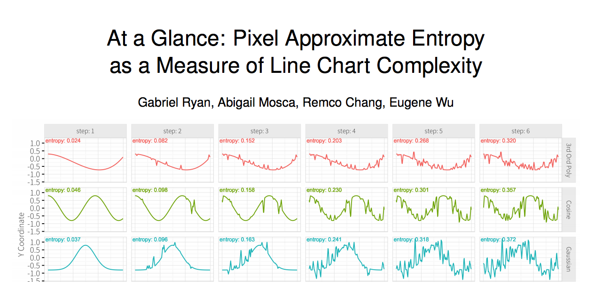
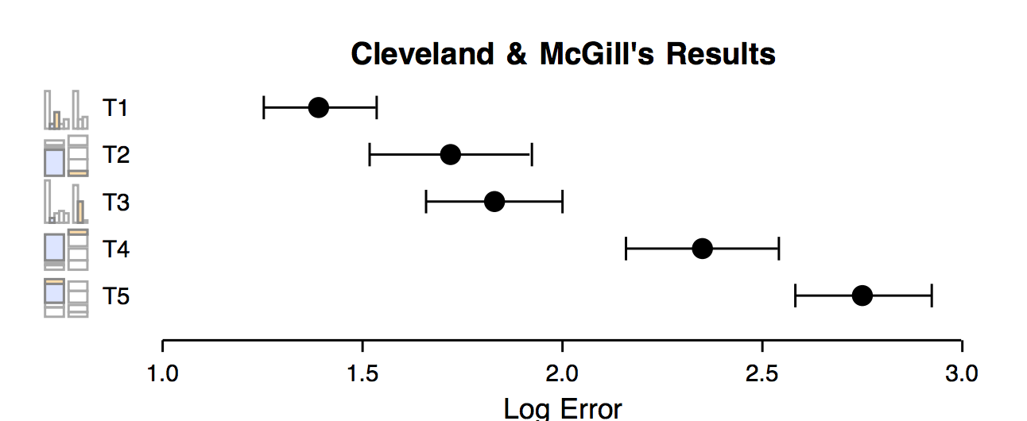
Perceptual Studies

Slide 5
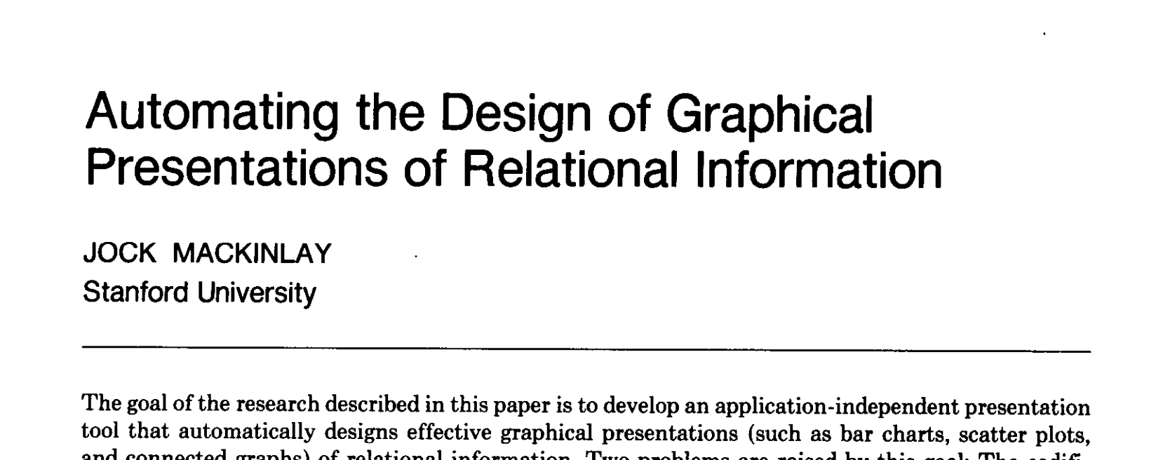
APT

Slide 6
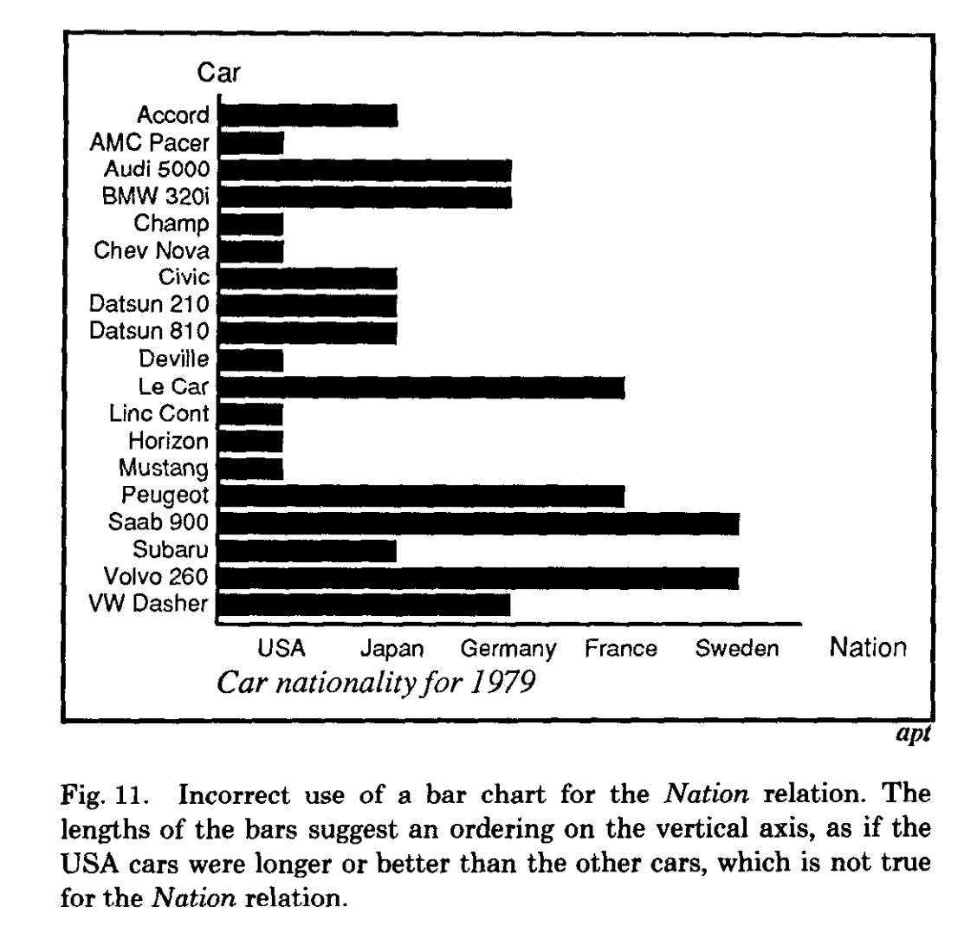
APT
Proposed two criteria for automatically choosing designs
Expressiveness
all facts and only those facts are expressed in the graphical design

Slide 7
APT
Proposed two criteria for automatically choosing designs
Expressiveness
all facts and only those facts are expressed in the graphical design
Effectiveness
user can easily and unambiguously decode the graphical image
Want: most effective design that exactly expresses the data

Slide 8
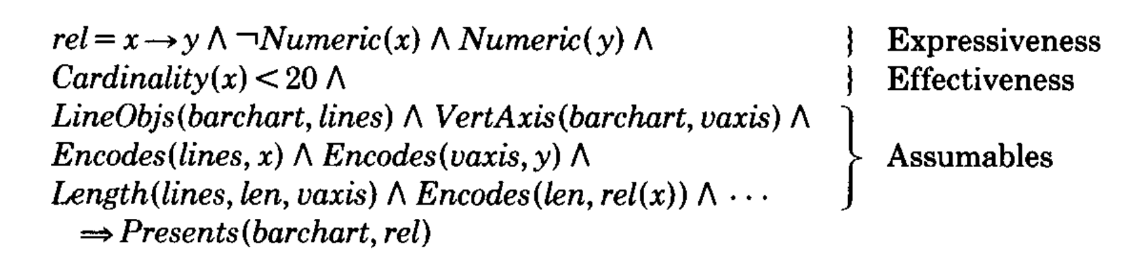
APT
Logic program with hard constraints
Exhaustive search
Bar Chart Rule

Slide 9
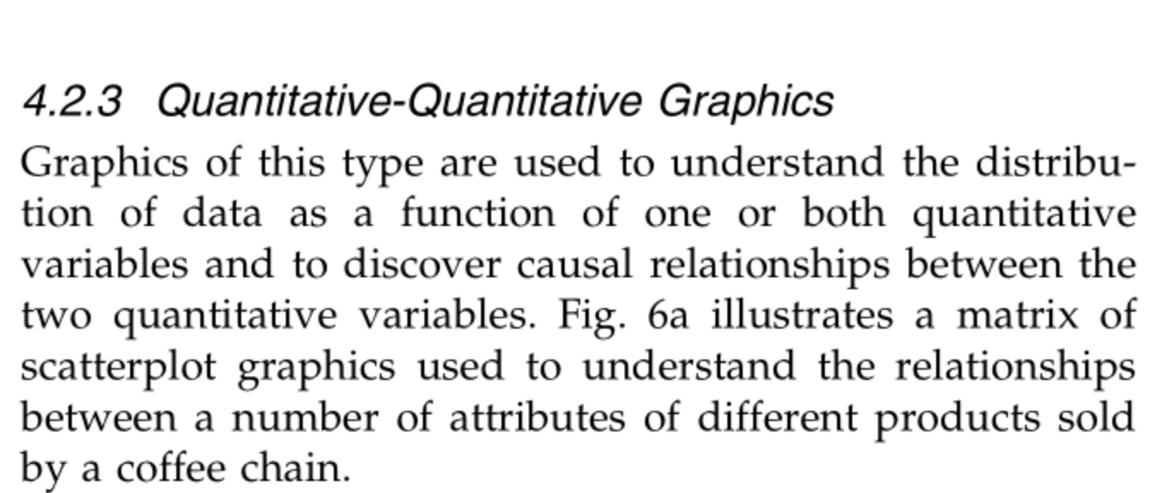
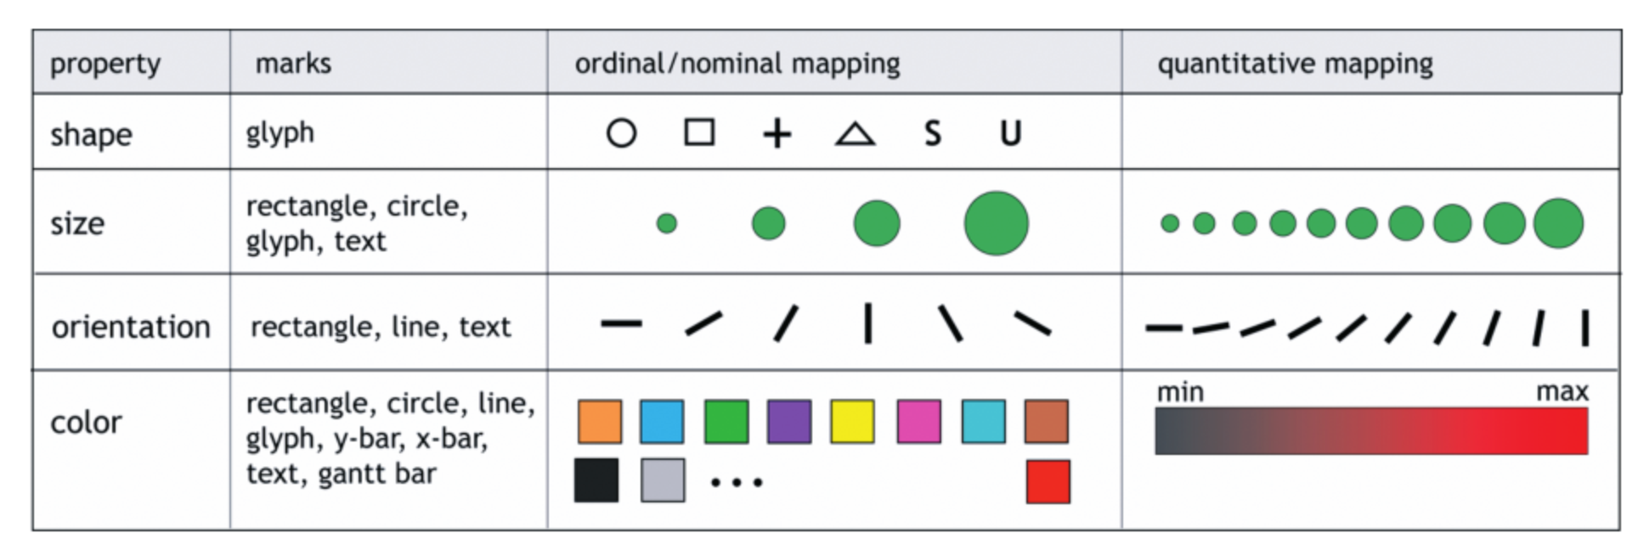
Tableau
Rule-based Heuristics

Slide 10
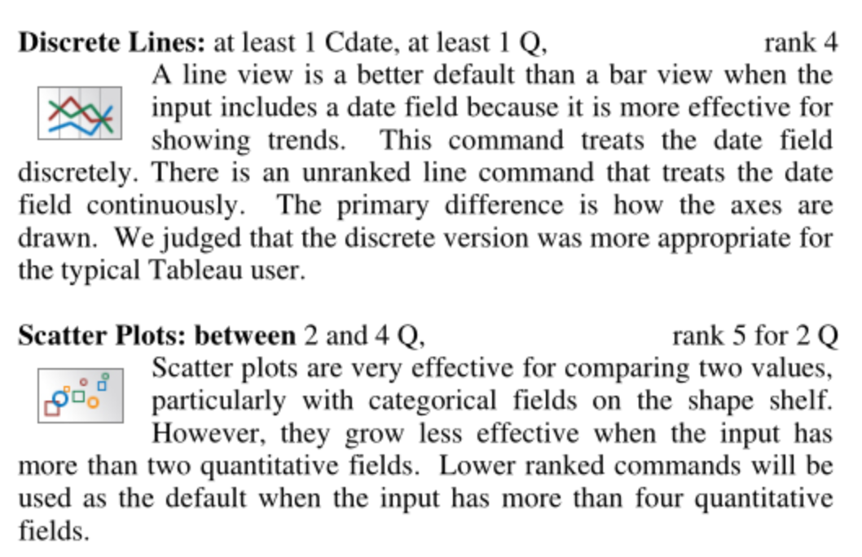
ShowMe
Rule-based heuristics

Slide 11
Voyager
Hard coded heuristics and search procedure

Slide 12
Order of works
APT → Polaris Defaults → ShowMe → Compass/Voyager → Draco

Slide 13
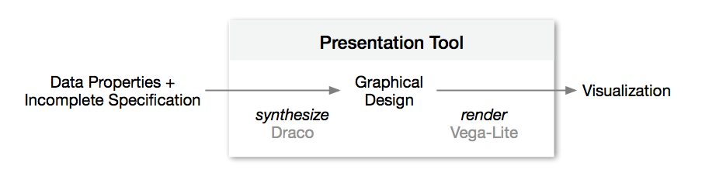
Contributions
Use constraint programming (ASP)
Encode design studies as hard/soft constraints
Perception papers define partial rankings
Learn weight penalties automatically

Slide 14
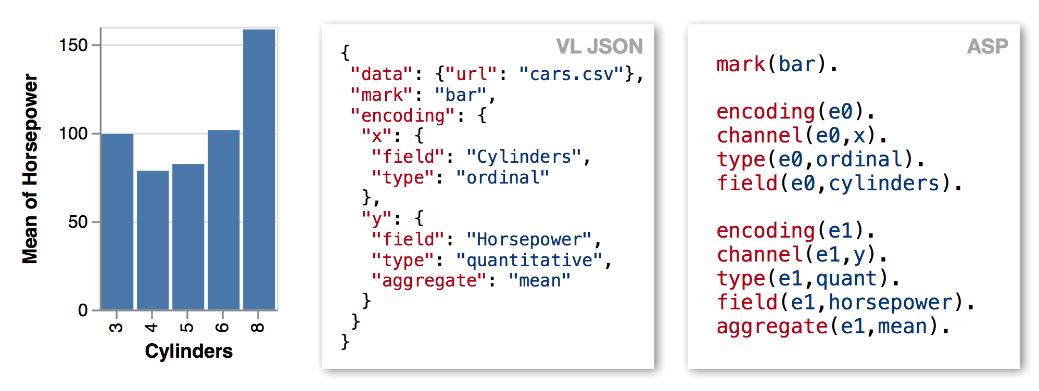
Constraint Language
Search space: vega-lite specs
Hard constraints: incorrect specs
Soft constraints: preferences/ranking
Challenge: encoding vega-lite as ASP statements
expressiveness
effectiveness

Slide 15
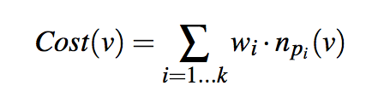
Constraint Language
Atom :- L1, ..., Ln. // Atom is true if L1,...,Ln are true
Atom // Atom is true (like a data row)
:- L1, ..., Ln. // L1,...,Ln evaluates to False
:- L1, ..., Ln. [2] // Penalize result by 2 if violated
Return set of Atoms that obey the rules and minimize penalties
weight
# violations of rule p_{i}

Slide 16
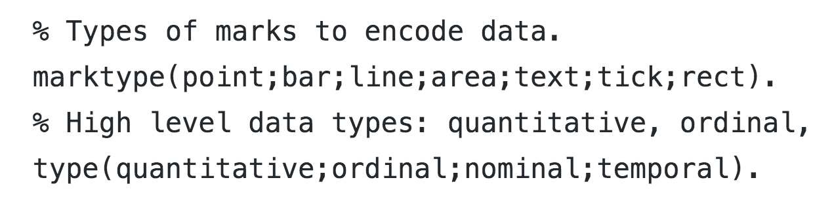
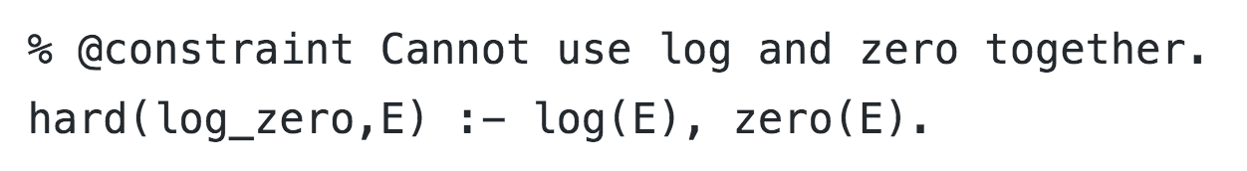
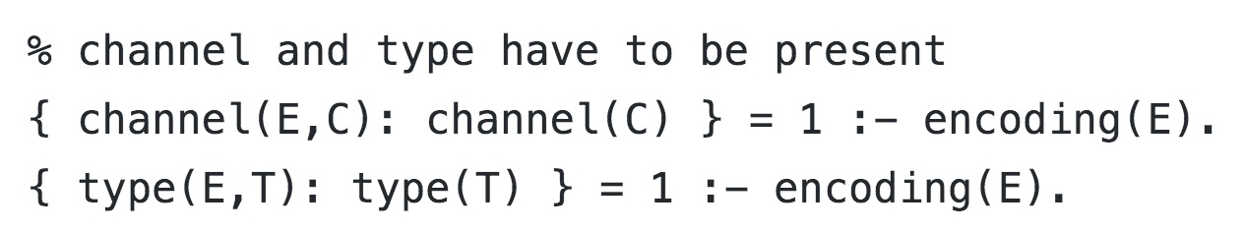
Constraint Language Examples
Define types
Hard Constraints
Encodings require channel and type

Slide 17
Learning Soft Weights
Dozens, hundreds of soft constraints, how to assign weights?
(is hand assignment as hard as heuristics)?
User studies generate pairs of (v₁, v₂) where v₁ preferred over v₂
Use RankSVM to learn what soft constraint weights will most preserve the ranking
Run draco and count # violations of each rule for each vis v_{i}
Rule = feature vector of violation counts
Train SVM to learn weights

Slide 18
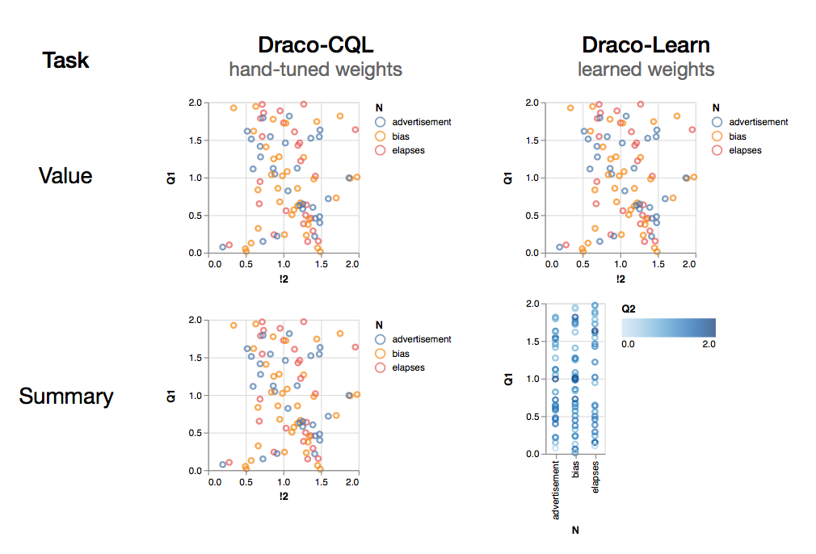
Evaluation/Experiments
Should show
Can express previous systems (APT, Voyager/Compass)
Not embarassingly slow (benefits from fast constraint solver)
Can incorporate new user studies
Weight learning works

Slide 19
Draco Discussion

Slide 20
Draco
What are the killer use cases for a system like Draco?
Data variation, not design variation

Slide 21
Draco
What are the limitations of Draco’s ASP approach?
ASP rules need to flatten the grammar (search space)
Composition of transformations.
Data statistics
Generates static views
Leverage features from rendered output (e.g., overplotting)
More complex/high-level tasks?

Slide 22
Draco

Slide 23
Voyager Discussion

Slide 24
Voyager
Was the evaluation “fair”? What would you have done?

Slide 25
Voyager
Is breadth vs depth the appropriate axis to study?
What are the pros and cons of breadth-oriented exploration?

Slide 26
Voyager
What characteristics should be important in recommendation?

Slide 27
Voyager
What characteristics should be important in recommendation?
Task/user goals (what does the task of exploration mean?)
Directly find “interesting” views
Perceptual appropriateness

