Slide 1

Interpretable Machine Learning
Kevin Gao

Slide 2
Overview and Structure
Current State of Machine Learning with respect to explainability and interpretability
Why we need explainable ML models
Rudin’s Analysis: Make models explainable from the root!
Survey of Post-Hoc methods of explanation
Perturbation analysis
Partial Dependence Plot
ICE Plot
SHAP (Shapley Additive Explanations)
Other models covered in Interpretable ML (Molnar book)
Notes:
Reminder to take a quick note on my own background: I worked with CNN’s in the financial industry, and was personally in charge of dealing with getting our models approved by risk management. Thus, explaining ML models and finding ways to explain them were huge parts of my job

Slide 3
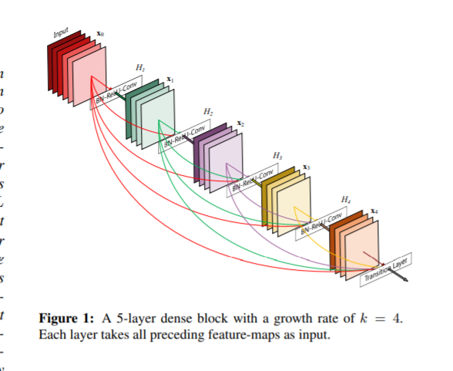
Current State of Machine Learning
Broadly speaking, most current machine learning models can be divided into Explainable models and Unexplainable models (mostly, variants of Neural Nets)
Tree-based models are broadly easy to understand and interpret: you split on known features and values, so each branch can be easily explained
Tree-based models often have limited expressiveness, why?
Neural-Net models are also known as ‘black-box’ models, because of incredible complexity and relationships
Each output channel is a very complicated linear product of inputs
See: Densenet (densely connected neural network), Huang, et al.
Notes:
Answer: because tree-based models have no training for how to deal with non-interpolated data

Slide 4

Why do we want to interpret black-box models?
Discuss!

Slide 6

Reasons
Increasing prevalence of black-box models in our everyday life:
Determining prison sentences: minorities more likely to see harsher penalties than white people
Risk assessment for mortgages
Healthcare
Account login + security
We need to understand what is going on!

Slide 8

The Goals of Interpretable Machine Learning
Broadly speaking, understand how the model interacts with and treats each input variable.
To help humans understand and perceive how the ‘machine’ model makes decisions: these decisions do not always follow human logic!
Offer justification as to why the machine makes decisions as it has: prove that decision was made without racial bias, etc
Limit risk and exposure for users
Ph'nglui mglw'nafh Cthulhu R'lyeh wgah'nagl fhtagn

Slide 9

What Is Interpretable ML (according to Rudin)?
’An interpretable machine learning model is constrained in model form so that it is either useful to someone, or obeys structural knowledge of the domain’
’Interpretable models could use case-based reasoning for complex domains.’
Sparsity is a useful measure of interpretability, since humans can handle at most 7±2 cognitive entities at once.

Slide 10
Rudin’s Analysis
At its core: All AI models should be ‘interpretable’
What is ‘interpretable’
‘Understanding’ of how the model works
Less complicated/computationally expensive
Fewer variables, less entanglement (i.e. neural networks)
Not a ‘Black Box’ model, black boxes are:
Too computationally complex for a human to understand (most neural networks): we can consider these models ‘organically’ black-boxed
Black-boxed due to patents and company-designated proprietary knowledge: we can considered these models ‘artificially’ black boxed
Notes:
Ask the class (at end): is it better to have more explainable ML models that sacrifice potential power for risk mitigation, or to engage in post-hoc explanatory models to justify more powerful initial models?

Slide 11
The Myth Between Transparency and Interpretability
‘There is no significant difference in performance between more complex classifiers and much simpler classifiers’- Rudin
‘The most accurate models were sparse models with meaningful features that were constructed through the iterative process’
‘The small differences between machine learning algorithms can be overwhelmed by the ability to interpret results and process the data better at the next iteration… more interpretability leads to better overall accuracy’
‘As of yet, I have not encountered an application (in which a black-box model is required for a high-stakes decision’
Notes:
Ask- Are there any gaps to this analysis?
Consider: What if high-stakes decision-making models are needed in the financial markets? What about applications where ‘good enough’ is not ‘good enough’? What situations can you imagine where a black box model is needed

Slide 12
Explainable ML Doesn’t ‘explain’ ML
‘Explainable ML methods provide explanations that are not faithful to what the original model computes’
Essentially, argues that
any explained ML model either abridges some information or else the model would be ‘interpretable’.
Any explanation model that ends up abridging information is insufficient for trust and fidelity in the resultant model
Thus, since any explanation model abridges information and an abridged model is untrustworthy, all explanation models are untrustworthy’
Argues that ‘explanations’ are better thought of as ‘predictions of predictions’
COMPAS redicivision model of explanation

Slide 13
Explanations Don’t Make Sense!!!
(Combining iii-v here)
Possible that explanation leaves out so much information that the explanation itself makes no sense
Ex: saliency map: could be a husky, could be a transverse flute. But the map itself doesn’t look different due to confirmation bias
Black boxes cannot take into account unique exterior data: consider COMPAS and needing to consider whether a crime is a misdemeanor or a murder
Black Box models might lead to decision paths that can lead into human error: see, typographical errors in machine-input that lead to actual possible harms

Slide 14
Key Issues with Interpretable ML
Corporations make money out of black boxes:
Artificial black-boxed model: could be a coin flip. But without any interior data, who’s to know what these models actually do?
CORELS vs COMPAS model: CORELS is basically the same as COMPAS but is a 4-statement if-else switch.
Google’s air quality model completely wrong
Black-box medical models can be wrong
Artificial black-boxes are kept as such for purely-profit motive.
Notes:
Ask: are these concerns valid, or scaremongering? In theory or in practicality?
Did anyone else notice the distinct lack of examples in the medical example?

Slide 15
Other Problems
Interpretable models take significant domain knowledge to build/engineer
How would we build these models if the human knowledge to build these models does not exist?
Optimization can be NP-hard
Black Box Models uncover hidden patterns
But it’s the model-builder’s responsibility to offer models that also have some human explanation (according to Rudin)

Slide 17
Discuss
Do you agree with Rudin?
How do you propose do:
Build Interpretable ML models for models that do not have sufficient domain knowledge?
Do you feel that the Rudin’s requirements are too onerous?
What social impacts do you feel might arise from implementation of Rudin’s arguments?
Notes:
In my own experience, black-box models are sometimes needed when working at the very edge of margins and depends on your own individual business needs.

Slide 18


Slide 19
Algorithmic Challenges in Interpretable ML
Challenge 1: Building logically optimal models, aka rule list
Can be computationally hard.
Challenge is to create algorithms that can actually solve real-world problems given the real-world constraints
Challenge 2: Create computationally efficient scoring models
Many extant models are the result of hard optimization problems. Challenge is to find efficient ways to create these efficient models.
Challenge 3: Interpretability needs to be defined for specific domains, and methods need to be created accordingly
Reliant on domain knowledge, although possible. Research is still in nascency
Notes:
Do you feel like these challenges are surmountable? What about fields where human knowledge is limited or that have not been subject to technological attention?

Slide 20
‘Interpretable’ Machine Learning Models
Great resource is Molnar’s ‘Interpretable Machine Learning’
Quick survey of a few black-box interpretation models
As we go through these, consider: how do these models address Rudin’s concerns about black-box models
Do you feel that we should use black-box models given explanations provided by these methodologies?

Slide 21
Perturbation Analysis
Attempts to estimate ‘feature importance’ by changing the value of each column into a normalized random number.
By evaluating how performance degrades after each ‘perturbed’ column, can roughly estimate the importance of each feature
Very slow to run in practice
N! Coefficient to attempt to measure full-feature interaction (every possible combination)

Slide 22
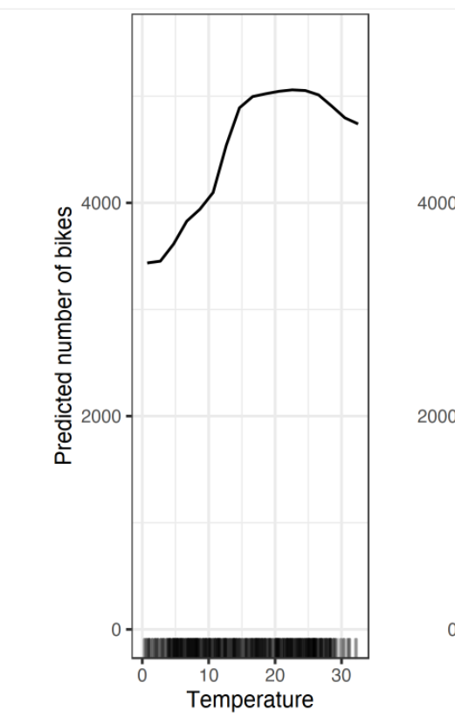
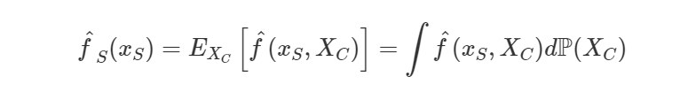
PDP Plot
Partial Dependence Plot
Used to show marginal effect of one or two features on machine learning model prediction
Uses Monte Carlo simulation to compute partial function
Shows expected prediction as given variable changes
Notes:
Note that from this point on I’m basically summarizing

Slide 23
SHAP Plot
Stands for ‘SHapley Additive Explanations’
Based on game-theoretically optimal Shapley Values to estimate overall feature importance
Ranks 3 Desirable Properties:
Local accuracy
Missingness (missing features get 0 value)
Consistency

Slide 24
Thank You!

