Slide 1


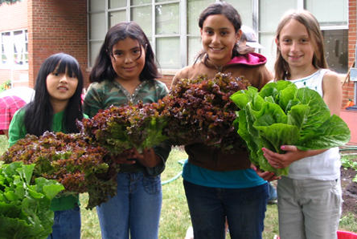
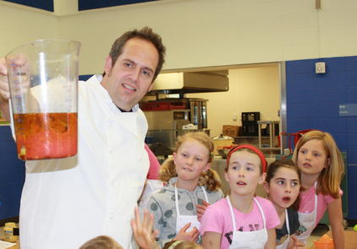
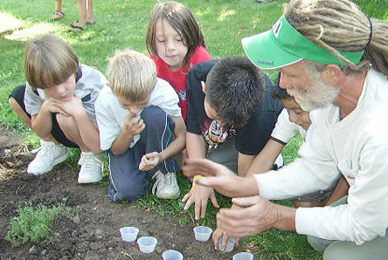
Columbine Elementary
Garden & Greenhouse
To Table Program

Slide 2
Columbine Garden & Greenhouse To Table Program Goals:
  1) Encourage children to seek, grow, prepare and eat nourishing, delicious and sustainably grown food
  2) Empower them to make choices that have a positive influence on their personal health, family, community and surrounding environment.
  3) Create a more vibrant learning environment.

Slide 3
Why is this important?
Today, nearly 3 x as many children and adolescents are overweight or obese compared to the 1980s. Childhood obesity has reached epidemic proportions. 70-80% of obese adolescents may remain so as adults.
Obesity can lead to Type II diabetics and other health conditions
Although Boulder County is a very fit and healthy community in general, childhood overweight and obesity have become problems in recent years. Averaged between 2008-2010, 1 in 4 CO children was overweight or obese with Boulder County rate of obese or overweight children at 18.8%
Food, nutrition and healthy lifestyles is integrated into BVSD curriculum primarily with the new Integrated Health Standards.
The garden and greenhouse enable teachers to teach healthy eating and food education to the standards year round in a hands-on, engaging way! The greenhouse would be an excellent “outdoor classroom” that teachers could use to teach many subjects.

Slide 4
Colorado Obesity Statistics
While Colorado is often touted as America’s “leanest” state, we are not immune to the growing health crisis of obesity.
Adults
58% of Colorado adults are overweight or obese. (1)
If trends continue, only 33% of Colorado adults will be a healthy weight by 2020. (2)
The obesity rate for Colorado adults 18-64 has risen from just below 20% to 22% in the last year. (3)
While we remain the leanest state for adults, prior to 2011, we were the only state with an obesity rate below 20%. Colorado now loses that point of distinction.
This current adult obesity rate, which makes Colorado the “leanest” state in the nation today, would have made it the “fattest” state in 1995. (4)
Children
23% of Colorado children (ages 2-14) are overweight or obese. (5)
With a ranking of 23rd in the nation, Colorado’s childhood obesity rate is rising at the second-fastest rate
of increase in the nation. (6)
Between 2003 and 2007, Colorado’s childhood obesity national ranking dropped from 3rd leanest to 23rd and the number of obese 10-17 year olds rose from 48,000 to 72,000. (7)
Economy
In 2009, Colorado spent $1.637 billion treating diseases and conditions related to obesity. (8)
1 Behavioral Risk Factor Surveillance System, Centers for Disease Control and Prevention, 2010.
2 Adjusted forecast by the Colorado Health Institute based on the average yearly change in obesity rates in Colorado data from the 1995-2010 Behavioral Risk
Factor Surveillance System.
3 Behavioral Risk Factor Surveillance System, Centers for Disease Control and Prevention, 2010
4 Centers for Disease Control and Prevention, Obesity Trends
5 Colorado Child Health Survey, Colorado Department of Public Health and Environment, 2010
6 2007 National Survey of Children’s Health
7 National Survey of Children's Health, 2010 (Cited in: 2009 Colorado Health Report Card, The Colorado Health Foundation, 2010)
8 Trogdon, J.G., Finkelstein, E.A

Slide 5
Childhood Obesity Statistics
Impacts on our Children’s Health and Prosperity
Due to obesity-related disease, this is the first generation of children predicted to have a lower life expectancy than their parents.
National Statistics
One out of three American children is overweight or obese.i
Over the past three decades, childhood obesity in the U.S. has doubled among ages 2-5 and more than tripled among ages 6-11 and 12-19. (ii)
An overweight adolescent has a 70% chance of becoming an overweight or obese adult. Obese 6- to 8-year-olds are approximately 10 times more likely to become obese adults than those with a lower body mass index. (iii)
Overweight children are more likely to have asthma, type 2 diabetes, high blood pressure and high cholesterol (risk factors for cardiovascular disease), apnea, joint problems, social stigmatization, and other health problems. (iv)
According to current estimates, one-third of all children born today (and one-half of
Latino and black children) will develop type 2 diabetes in their lifetime. (v)
Data suggest that obese children and adolescents miss more school days than their normal-weight peers regardless of age, ethnicity, sex, and school attended. (vi)
Overweight or obese children and adolescents in every grade experience poorer academic outcomes than their normal-weight peers. (vii)
Childhood obesity is responsible for $14.1 billion in direct annual medical costs in the U.S. viii)
Children treated for obesity are four times more expensive for the health care system than the average insured child. In 2009, the average annual cost for an obese child with private health insurance was $5,271 compared to $1,320 for all children with health coverage. (ix)
i Accelerating Progress in Obesity Prevention: Solving the Weight of the Nation (2012). Institute of Medicine; The National Academies Press, 2012.
Ii Odgen, C.L., Carroll, M. Prevalence of Obesity Among Children and Adolescents: Unites States, Trends 1963-1965 Through 2007-2008. Centers for Disease Control and Prevention.
Iii Freedman, D.S., Khan, L.K., Serdula, M.K. et al. The relation of childhood BMI to adult adiposity: the Bogalusa Heart Study. Pediatrics. 115(1), 22-7, 2005.
Iv Overweight and Obesity, Health Consequences. Centers for Disease Control and Prevention.
V Narayan, K. M., Boyle, J.P., Thompson, T.J., Sorensen, S.W., & Williamson, D.F. (2003). Lifetime risk for diabetes mellitus in the United States. Journal of the American Medical Association 290(14):1884-1890. (Cited in Accelerating Progress in Obesity Prevention: Solving the Weight of the Nation, 2012).
Vi Geier, A. B., G. D. Foster, L. G. Womble, J. McLaughlin, K. E. Borradaile, J. Nachmani, S. Sherman, S. Kumanyika, and J. Shults. 2007. The relationship between relative weight and school attendance among elementary schoolchildren. Obesity (Silver Spring) 15(8):2157-2161. (Cited in Accelerating Progress in Obesity Prevention: Solving the Weight of the Nation, 2012).
Vii Taras, H., and W. Potts-Datema. 2005. Obesity and student performance at school. Journal of School Health 75(8):291-295. (Cited in Accelerating Progress in Obesity Prevention: Solving the Weight of the Nation, 2012).
Viii Accelerating Progress in Obesity Prevention: Solving the Weight of the Nation, 2012 (Medical Expenditure Panel Survey for 2000-2005).
Ix 2011 Thomson Reuters analysis based on the national MarketScan databases of claims and medical encounters for approxim

Slide 6
Current Garden to Table Program with the Growe Foundation:
Focus Areas for Lessons:
Our theme-based program allows teachers to integrate four focus areas into core curriculum to provide students with hands-on learning opportunities:
Organic Vegetable Gardens
By planting, weeding, and harvesting the organic garden, students develop applicable skills and a stronger connection to the food they put in their bodies. In addition, students gain knowledge about the ecosystems that support plant growth by learning about the complex interrelationships between plants, insects, soil, and people.
Wellness Promotion
Hands-on gardening experiences provide students with information about personal wellness, knowledge about nutrition, and the skills needed to make healthy eating choices throughout their lives.
Healthy Food Preparation
Meal preparation skills, combined with knowledge of different culinary traditions, encourage students to practice making healthy food choices.
Environmental Sustainability
By spending time in the garden and connecting with others, students learn about biodiversity and the scarcity of natural resources, while gaining the knowledge needed to live an environmentally sustainable lifestyle. This further helps them become good stewards of the planet.

Slide 7
Garden To Table Goals:
Garden to Table has three main objectives: to enrich student education, to foster a school culture in which students live healthier, more sustainable lives, and to build strong communities.
1. Enriching Student Education
By providing students with hands-on experiences, such as growing food and preparing fresh meals, we’re able to offer a context for applying learning from core curriculum lessons to everyday life. Students develop a positive attitude toward personal wellness by exploring the relationships between nature, food choices, nutrition, and social influences. As they develop a personal relationship with their school garden, children strengthen their appreciation for the environment and sensitivity to the importance of environmental stewardship.
2. Fostering a Healthy School Environment
Parents and teachers play a vital role in creating a school culture that is characterized by healthy and sustainable living. Encouraging parental involvement helps instill social responsibility in students and aids teachers in integrating lessons with core curriculum. Hands-on learning opportunities offer students richer interactions with their peers, which can positively impact how they care for nature and their bodies, while helping them gain a greater respect for food traditions from around the world.
3. Building Strong Communities
By leveraging the power of communities to support schools in tackling health, environmental, and social issues, we aim to strengthen the relationship between schools and their communities. We offer the community many volunteer opportunities, which provide students with positive role models and help to improve relationships between parents, families, schools, and the larger community.

Slide 8
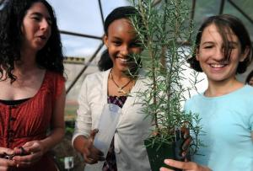
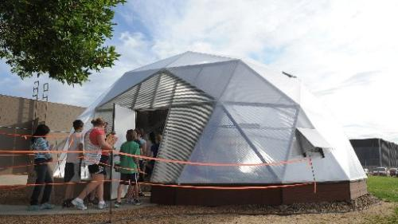
Geodesic Dome Greenhouse
Great supplement to our current Garden To Table Program.
Provides year-round gardening and “outdoor classroom” for all subjects.
"It's hands on, it's inquiry, and more than just reading it in a book, they get to experience it," said Flagstaff Academy science teacher Stacy Wolff.
"It's kind of cool," said student Delina Gebrekidan, of the experiments in the geodome. "I learn more hands-on than reading a textbook."

Slide 9
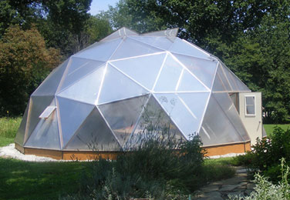



Geodesic Dome by Growing Spaces
Would fit a class of ~33 students
850 square feet of floor area.
Height 14 ft. 10in.
Fresh produce for 8 to 10 people
Classic Kit - $19,950

Slide 10
Raising funds for the Greenhouse
So far we have raised ~$1400 through the Whole Foods Bag Donation at Ideal Market for the greenhouse.
We were selected as this quarter’s recipient of the Whole Foods Bag Donation on Pearl St. = $5,000-7,000!
Will need to raise an additional ~$10,000

Slide 11
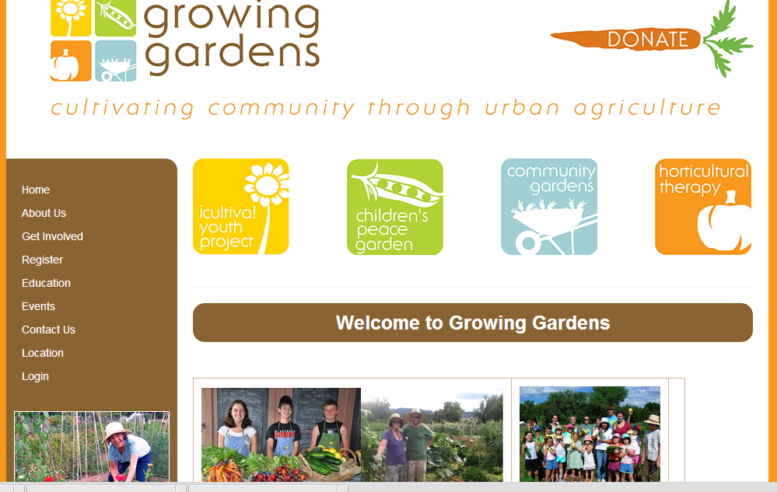
New partnership for programming:

Slide 12
Bag Donation Fundraiser with Whole Foods Market on Pearl St.
Please spread the word – shop at the Pearl St. store, bring your bags and tell them you donate the credit!
Here are some events that you are welcome to help with:
Saturday, February 23rd from 1-3pm Red Carpet Weekend - simple table set up for you. Get the word out about the school and put a face to the beneficiaries of the program.
Saturday, March 9th 12-2pm, Parmesan Cracking event. This is an annual event where we crack an 80 lb. wheel of parmesan cheese and celebrate all things parm. The store is always super busy and has a great energy for this event.
Affordable Health Food for the Whole Family Tours – March 14th at 6/7pm and Saturday, March 23rd at 9am.

Slide 13
Next Steps:
Please join the Garden Club if you want to help us plan and assist in the garden during scheduled class visits! Sign up sheets nearby.
We will continue to raise funds for the greenhouse! Let us know if you have ideas.
THANKS!

