Slide 1
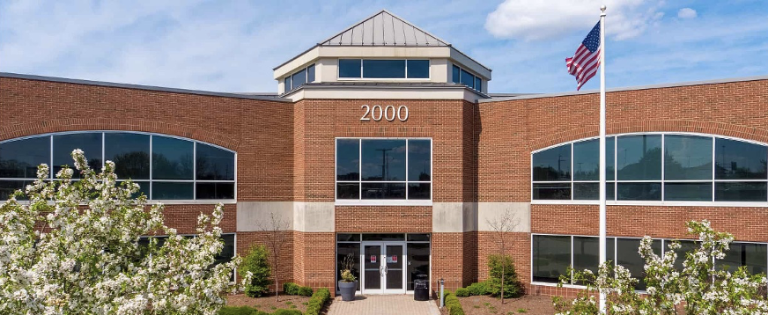

KINDERGARTEN
GRADES 6-8
GRADES 1-5
GRADES 9-12

