Slide 1
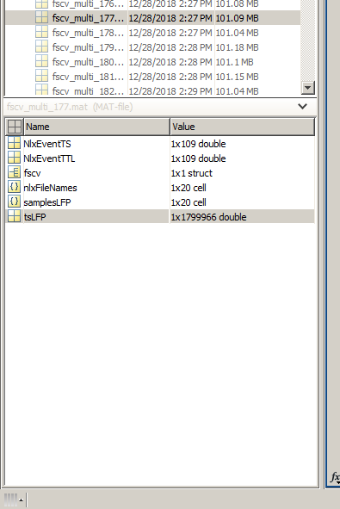
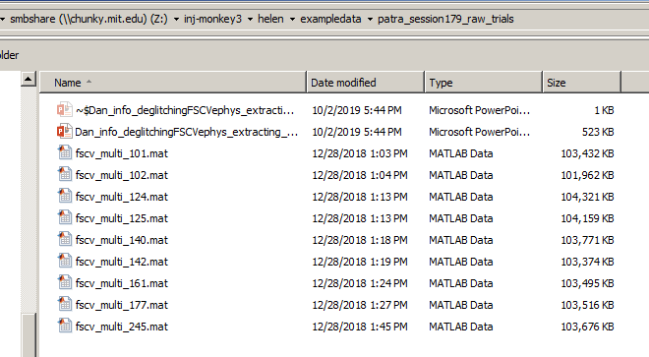
Trial data structure:
Each mat file contains 60s of measurements from all ephys recorded channels
samplesLFP contains ephys measurements (60s long) for each channel in an individual cell
tsLFP contains time stamps for each data point in the cell of samplesLFP
Cells that we want to look at initially are samplesLFP{7} (best striatal recording in this session) and samplesLFP{6} (2nd best)
samplesLFP{12}-{14} are recordings from SN area (artifacts much smaller and smoothed)

Slide 2
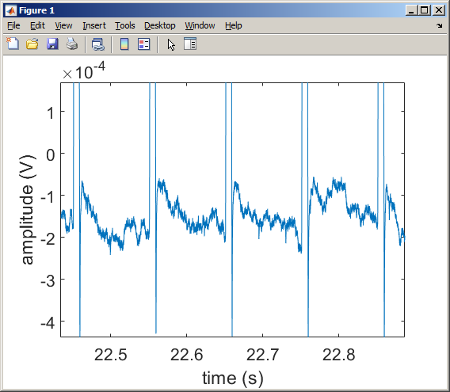
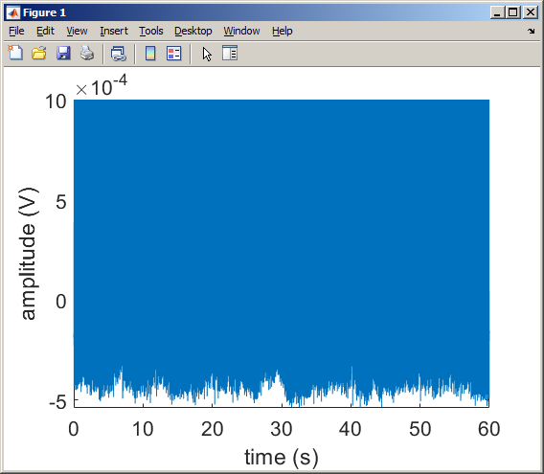
Quick functions to plot & visualize data
load('Z:\inj-monkey2\patra_fscv2\patra_chronic179_11052018\1dr\cvtotxt\matlab\bigreward\fscv_multi_177.mat')
figure; plot(tsLFP-tsLFP(1),samplesLFP{7})
ff=gcf
ax1=gca
xlabel('time (s)')
ylabel('amplitude (V)');
set(ax1,'fontsize',16)

Slide 3
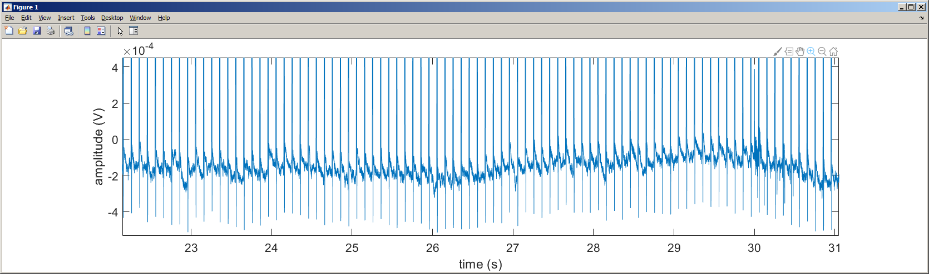
Time points of interest
Each trial is aligned to reward delivery occurring at 30s in each file,
Fixation occurs at 23 s
Target occurs at 26 s
Reward at 30 s
Artifacts after reward (next page)

Slide 4
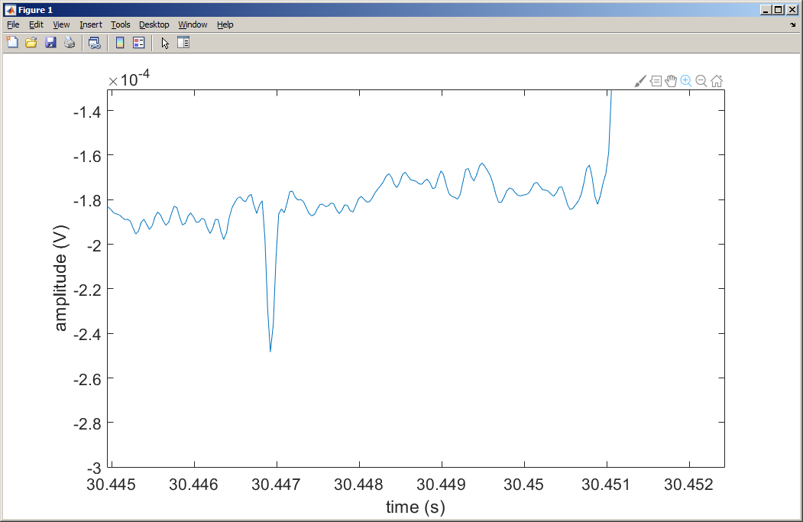
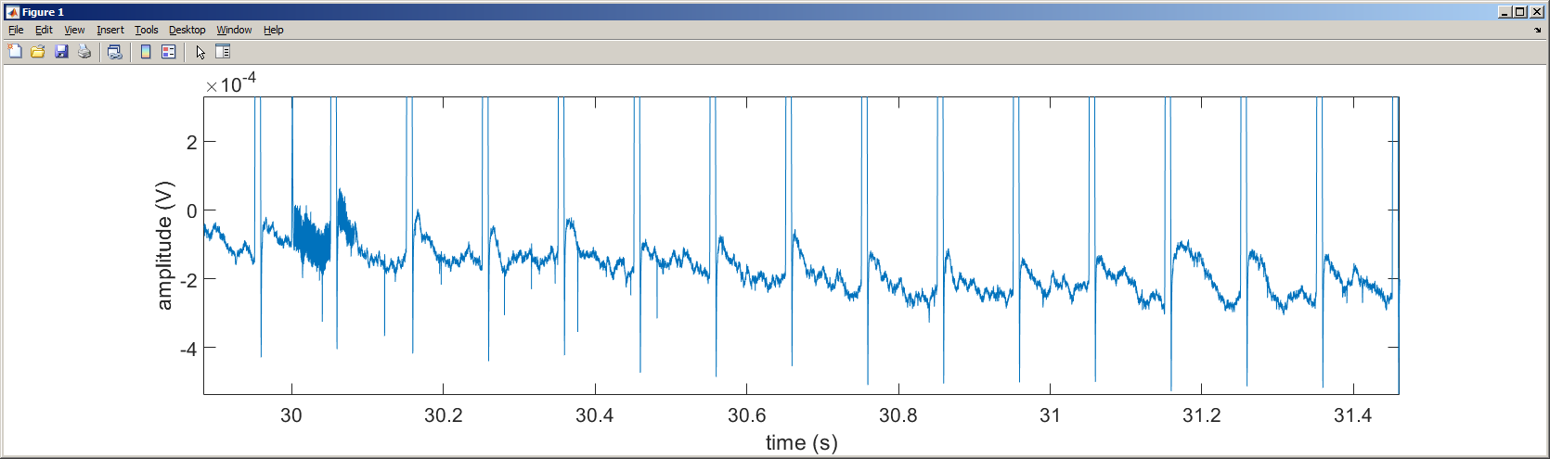
Additional deglitching
A lot of high frequency glitches occur during reward delivery, that must be deglitched, and we also have smaller high frequency spikes that are clearly artifacts related to licking/static discharge based on the very small duration of the spikes that should be deglitched as well
artifacts

