Slide 1
NEBIUS
Running OpenClaw
on Nebius
From zero to a live AI agent in 15 minutes
ClawCamp Workshop | claw.camp/curriculum/agent-inference
ClawCamp

Slide 2
NEBIUS
The Problem
Running AI agents is expensive and complicated
A Mac Mini for local inference: $1,000+
Exposes your home network
Runs ONE agent at a time
No scaling, no redundancy, no sleep
What if you could run 100 agents for the cost of one Mac Mini?
ClawCamp

Slide 3
NEBIUS
Liberate Your OpenClaw
You don't need Claude or OpenAI.
Provider | Models | Pricing
Nebius Token Factory | Kimi K2.5, Llama 3.3 70B, DeepSeek-R1 | Pay per token
Hugging Face | GLM-5, thousands more | $2/mo free credits
Local (llama.cpp) | Any GGUF model | Free (your hardware)
Today's focus: Token Factory. Fast, cheap, production-ready.
ClawCamp

Slide 4
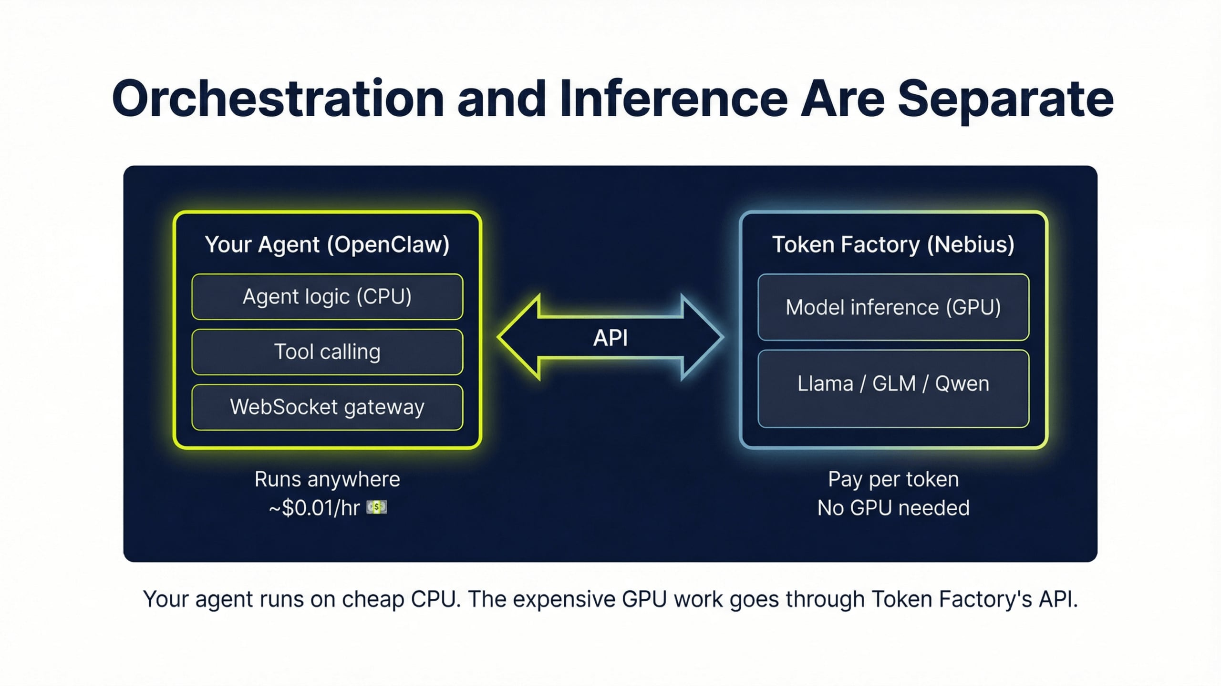

Slide 5
NEBIUS
Three Ways to Deploy
Method | Time | Best For
npm install | 5 min | Local dev, fastest start
Docker | 10 min | Isolated, repeatable, server deploys
Nebius Serverless | 20 min | Production, auto-scaling, zero-ops
ClawCamp

Slide 6
NEBIUS
Step 1 — Get Your Token Factory API Key
1. Go to console.nebius.com
2. Navigate to Token Factory
3. Click Create API Key
4. Copy the key
export NEBIUS_API_KEY="your-key-here"
# Persist:
echo 'export NEBIUS_API_KEY="..."' >> ~/.zshrc
Never commit this key to git.
ClawCamp

Slide 7
NEBIUS
Step 2 — Install OpenClaw
npm install -g @openclaw/cli
Verify:
openclaw --version
That's it. No Docker, no containers, no VMs (yet).
ClawCamp

Slide 8
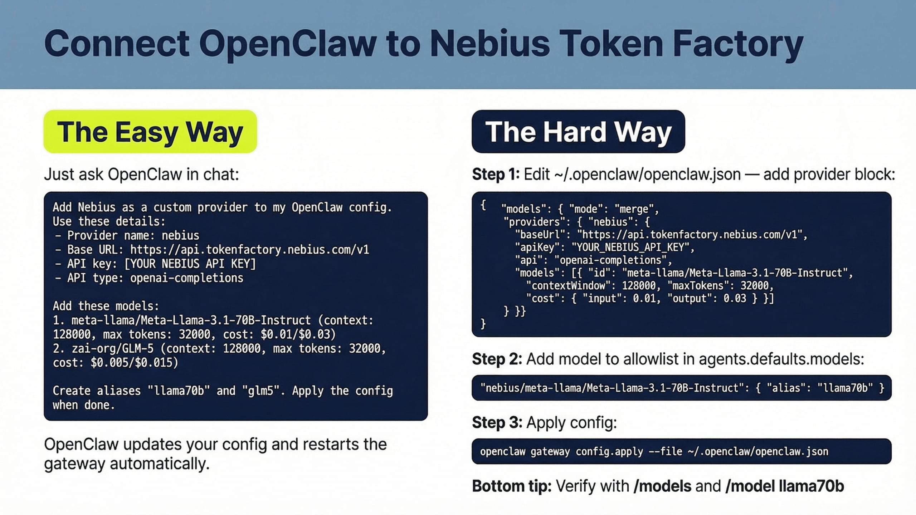

Slide 9
NEBIUS
Config: ~/.openclaw/openclaw.json
{
models: {
mode: "merge",
providers: {
nebius: {
baseUrl: "https://api.tokenfactory.nebius.com/v1/",
apiKey: "${NEBIUS_API_KEY}",
api: "openai-completions",
models: [
{ id: "moonshotai/Kimi-K2.5",
name: "Kimi K2.5", contextWindow: 128000 },
{ id: "meta-llama/Llama-3.3-70B-Instruct-fast",
name: "Llama 3.3 70B", contextWindow: 128000 },
{ id: "deepseek-ai/DeepSeek-R1-0528",
name: "DeepSeek R1", reasoning: true }
]
}
}
},
agents: { defaults: {
model: { primary: "nebius/moonshotai/Kimi-K2.5" },
models: {
"nebius/moonshotai/Kimi-K2.5": { alias: "kimi" },
"nebius/.../Llama-3.3-70B": { alias: "llama70b" },
"nebius/.../DeepSeek-R1-0528": { alias: "deepseek" }
}
}}
}
ClawCamp

Slide 10
NEBIUS
Step 4 — Start and Verify
openclaw start
Open: http://localhost:18789
/models # List all models
/model kimi # Switch to Kimi K2.5
/status # Check connection
Your agent is live. Connected to Kimi K2.5 on Nebius.
ClawCamp

Slide 11
NEBIUS
Model Selection
Model | ID | Speed | Best For
Kimi K2.5 | moonshotai/Kimi-K2.5 | Fast | Recommended all-rounder
Llama 3.3 70B | meta-llama/Llama-3.3-70B-Instruct-fast | Fast | Tool calling
DeepSeek-R1 | deepseek-ai/DeepSeek-R1-0528 | Medium | Reasoning
GLM-5 | zai-org/GLM-5 | Very Fast | High throughput
Qwen3 | Qwen/Qwen3-30B-A3B | Fast | Code, multilingual
Switch anytime:
/model kimi # or /model llama70b, /model deepseek
ClawCamp

Slide 12
NEBIUS
Docker Deployment
Use Docker when:
Skip Docker when:
Isolated environment
Server deployments
Repeatable builds
Fastest dev cycle
Just prototyping
export OPENCLAW_IMAGE="ghcr.io/openclaw/openclaw:latest"
./scripts/docker/setup.sh
# Docker + Token Factory:
docker compose run --rm --no-deps --entrypoint node \
openclaw-gateway dist/index.js onboard \
--custom-base-url "https://api.tokenfactory.nebius.com/v1/" \
--custom-model-id "moonshotai/Kimi-K2.5" \
--custom-api-key "$NEBIUS_API_KEY"
ClawCamp

Slide 13
NEBIUS
Structured Tool Calling
JSON mode for reliable tool calling
{
"tool": "get_weather",
"arguments": {
"city": "Oakland",
"units": "fahrenheit"
}
}
Works with Kimi K2.5, Llama 3.3, and DeepSeek-R1.
ClawCamp

Slide 14
NEBIUS
Going to Production
Nebius Serverless
curl -sSL https://storage.ai.nebius.cloud/ncp/install.sh | bash
nebius msp serverless v1alpha1 endpoint create \
--name openclaw-agent \
--image openclaw/gateway:latest \
--memory 512MB
Auto-scales to zero. Spins up on demand.
ClawCamp

Slide 15
NEBIUS
Cost Breakdown
Usage | Tokens/day | Cost/day | Cost/month
Light (100 msgs) | ~500K | $0.15 | $4.50
Medium (1K msgs) | ~5M | $1.50 | $45
Heavy (10K msgs) | ~50M | $15 | $450
H100 GPU = $2-3/hr = $1,500-2,200/month
Token Factory: pay per token, not per hour.
ClawCamp

Slide 16
NEBIUS
Security Checklist
Set a gateway token
Bind to loopback in dev, 0.0.0.0 behind proxy
Enable HTTPS via reverse proxy
Set API budget caps in Token Factory
Use network security groups
Docker: runs as non-root node (uid 1000)
ClawCamp

Slide 17
NEBIUS
Troubleshooting
Problem | Fix
Gateway won't start | lsof -i :18789
Token Factory 401 | Verify API key with curl
"model not allowed" | Add to allowlist
Model not in /models | Check providers[] AND allowlist
Docker OOM (137) | Increase to 2GB
Slow responses | /model kimi
ClawCamp

Slide 18
NEBIUS
What You Built Today
1. Installed OpenClaw (npm or Docker)
2. Connected to Nebius Token Factory
3. Selected a model and configured tool calling
4. Understand three deployment methods
5. Know how to go from prototype to production
No Claude. No OpenAI. Just open-source on Nebius.
ClawCamp

Slide 19
NEBIUS
Resources
Resource | Link
OpenClaw Docs | docs.openclaw.ai
Docker Install | docs.openclaw.ai/install/docker
Token Factory Docs | docs.tokenfactory.nebius.com
Cookbook Repo | github.com/nebius/token-factory-cookbook
ClawCamp Tutorials | claw.camp/curriculum
Discord | discord.gg/clawcamp
ClawCamp

Slide 20
NEBIUS
Next Steps
Beginner
Intermediate
Advanced
Deploy via Console (20m)
Install Scripts (15m)
Deploy Patterns (45m)
Private Agents (55m)
Agent Lifecycle (70m)
Robotics (75m)
ClawCamp

Slide 21
NEBIUS
Running OpenClaw
on Nebius
Open-source models. Pay-per-token. No vendor lock-in.
claw.camp
discord.gg/clawcamp
hello@claw.camp
Join the personal AI revolution.
ClawCamp

