Slide 1
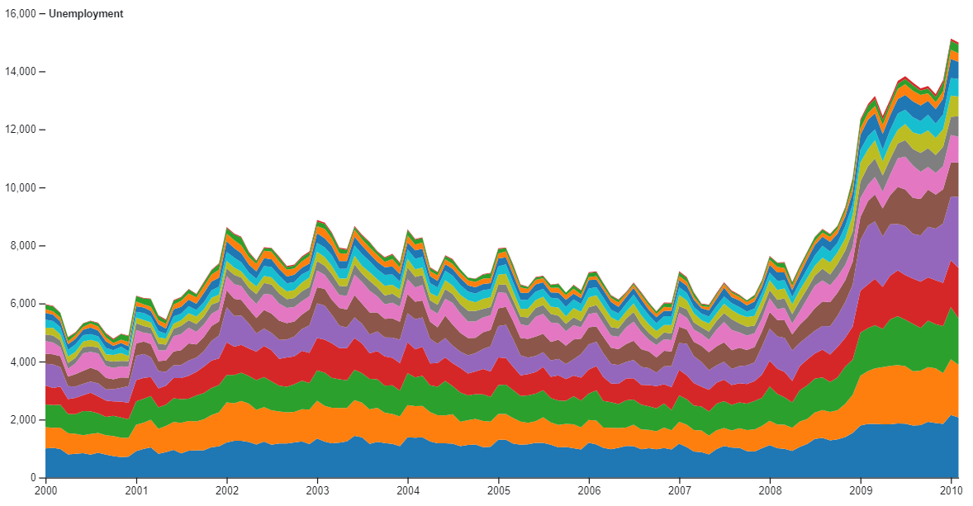
Evolution of the success of each genre over time
Selection area to zoom on specific period
Success of the genre
Time

Slide 2
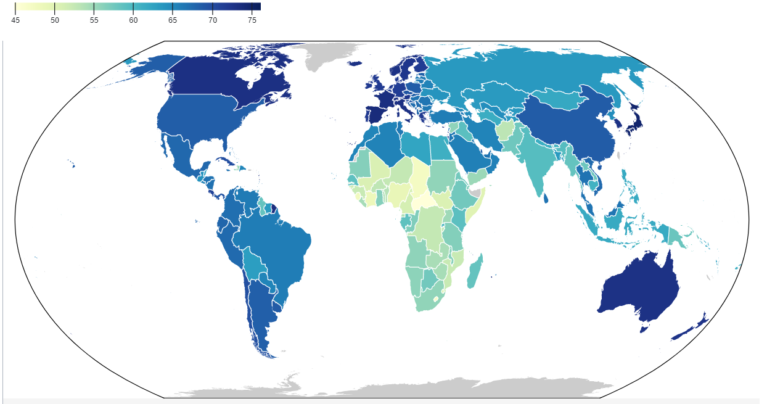
Production Countries of Films
Number of films produced

Slide 3
Most Successfull People in the History of Cinema
Actors
Film Directors
Number of Films
Time [years]

Slide 4
Who has worked with who?
Uma Thurman
Michael Madsen
Richard Driscoll
Quentin Tarantino
Actors
Film Directors

