Slide 1

Visualising Voting Patterns and Polling Data
Process Book

Slide 2

Introduction
The Eurovision Song Contest is an annual song contest running since 1956. Each participating country is represented by an artist and song, and a winner is crowned after each country awards their points. The points are allocated based off of a jury and public vote.
Goal
Each country awards points from a public vote and a jury vote, both of which are weighted equally. The public vote is comprised of televoters, and the jury vote is comprised of a panel of juries.
In recent years, this system has come under scrutiny. Two issues in particular are often raised:
Voting blocs have emerged where countries give the most points to each other
The fan favourite does not win as the jury vote prevents the public winner from winning
The goal of our project is to create a website with interactive visualisations that will allow us to explore the voting patterns and find out which songs were fan favourites. With our website, it will be simple to view how countries have voted across multiple editions of the contest and see whether certain countries vote for each other. In addition, it will be clear to see whether or not the public and jury votes align and whether the jury vote really does prevent the fan favourite from lifting the Eurovision trophy.

Slide 3
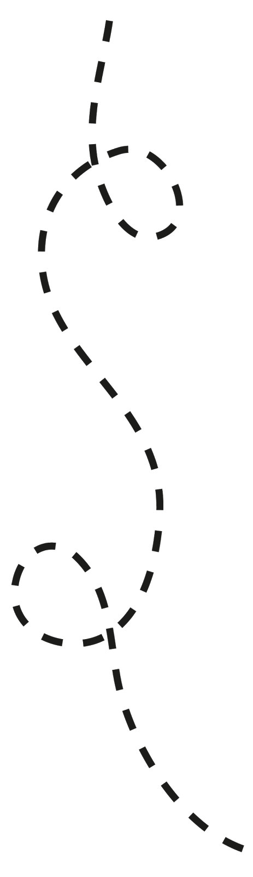
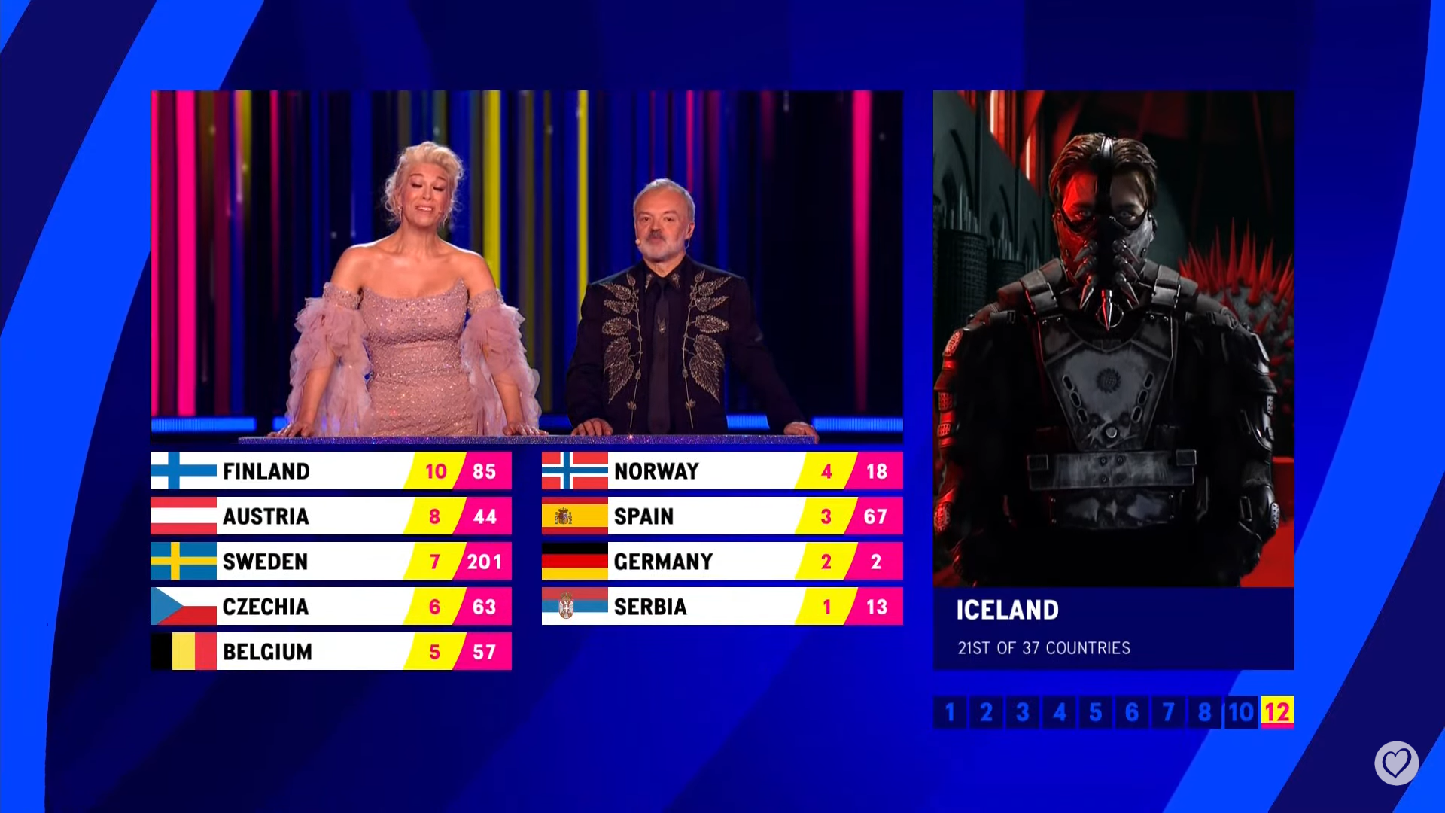

The Journey
Dataset
The first step was to see which data we could obtain. Since editions are infrequent and the voting results are made public, we believed that the data that we will need would be easily accessible. Indeed, we found the Eurovision Song Contest Data dataset on Kaggle to contain the data we needed – the allocation of televotes and jury votes from each country each year, and the results from the two biggest polls of Eurovision fans on who should win the contest. Fortunately for us, the dataset is complete and did not require any cleaning.
After carrying out an exploratory analysis of our data, we would need to decide which visualisations we would create. Then, we could determine which format we would need our data to be in and transform it accordingly, as the format that the data was in was unlikely the most suitable one to work with.
Brainstorming Ideas
Once we could see exactly what data we have, we started coming up with ideas on how we could visualise our data. We started by looking at the voting data. During the Eurovision broadcasts, the votes are presented in a tabular format, as shown below.
This format is suitable for the show since this screen appears for almost a minute per country. This gives the viewers enough time to assimilate the information. However, we want to present this information in such a way where for a given country, the points awarded can be understood in a matter of seconds. Therefore, using a similar format would not work for our goals. The main issue is that each entry has to be read one by one to assimilate everything.

Slide 4
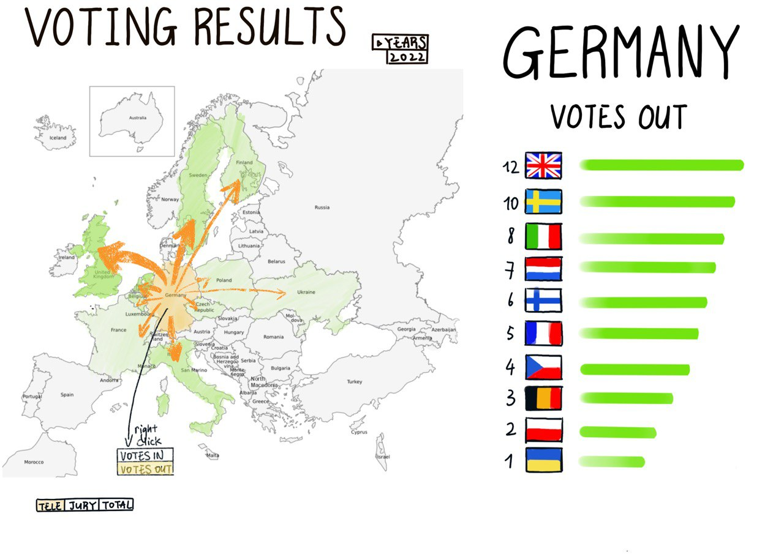
Voting Data
We came up with the idea to try and display this information on a map instead. In one quick glance, the same information should be easily extracted. Our first sketch of what this could look like combined the tabular view with a would-be interactive map.
In this view, we are able to quickly where the German public awarded their points. The bar chart to the right provides the exact details of the voting, and the arrows show a summary of who received the most points. We imagine that someone can, in a short amount of time, click on their countries of interest and quickly see from whom they voted for.
Drop down box to select year
Drop down box to select year
Australia moved into view
Shading intensity and arrow thickness indicate more points
Ordered bar chart as a detailed side-view
Right-click to switch between view of votes to and from a country
3-way toggle to select televote, jury vote, or combined vote

Slide 5
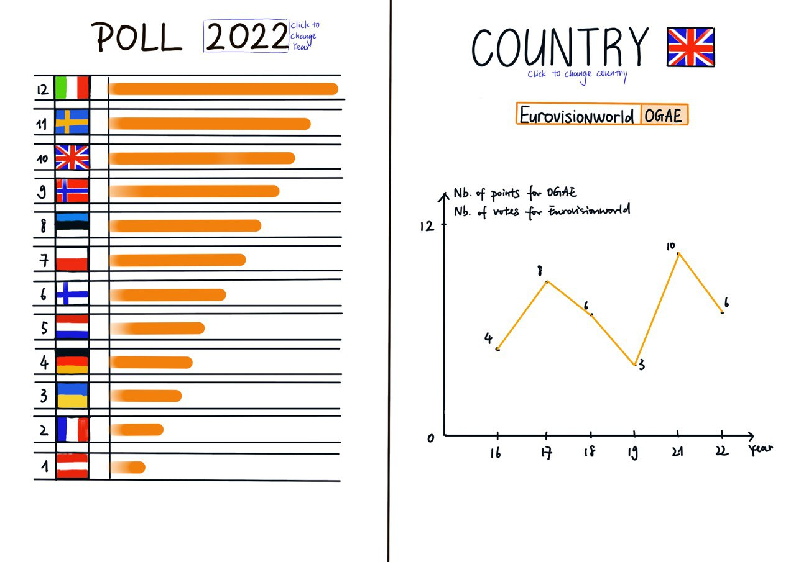
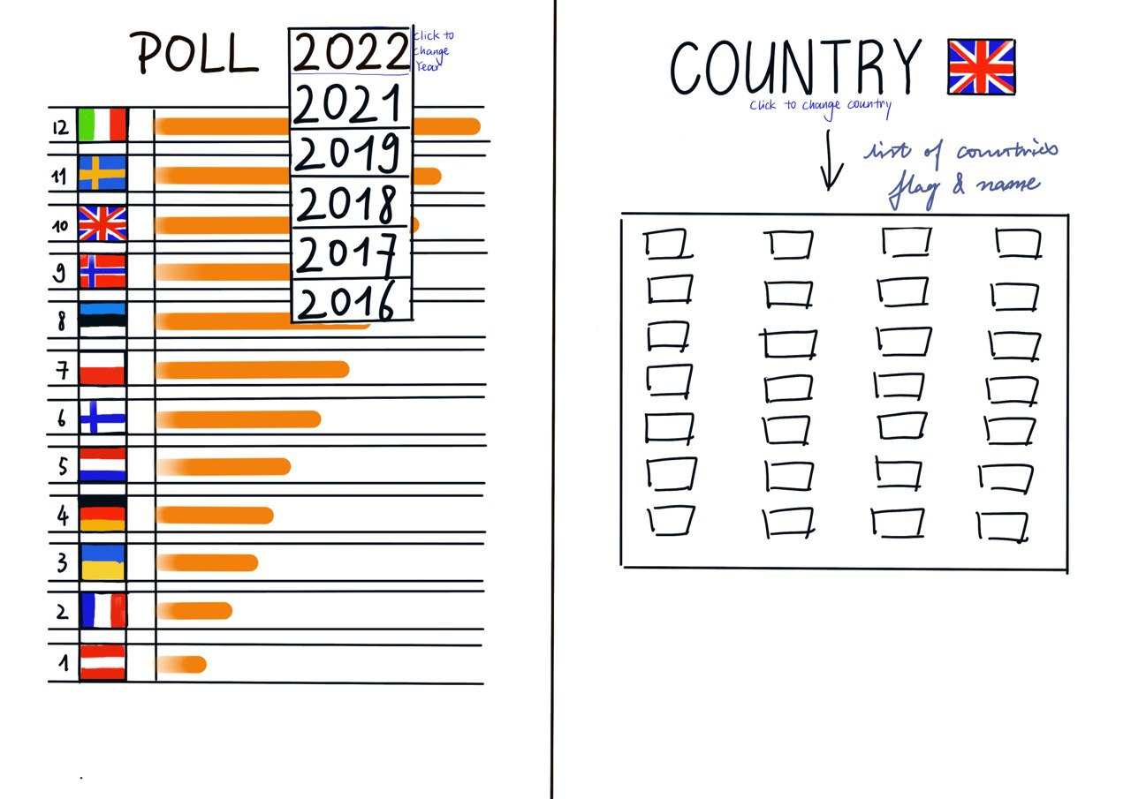
Polling Data
We have data from 2 fan polls. One (Eurovisionworld) asks fans which song they think should win the contest, and the poll counts the number of votes each country receives. Another (OGAE) asks fans to award their own points to countries, and the poll tracks the average number of points each country receives.
We chose to present this data using bar charts for each individual year, and for specific countries line charts to show how the trend of how popular countries are over time.
We also sketched out how the year and country selection could look. We decided it would be most intuitive to show a grid of flags to select the country, as a list of country names would be too long.
Drop down box to change year
Country selection
Countries ordered from most to least popular, according to poll
Toggle between polls
Line graph of popularity over time

Slide 6
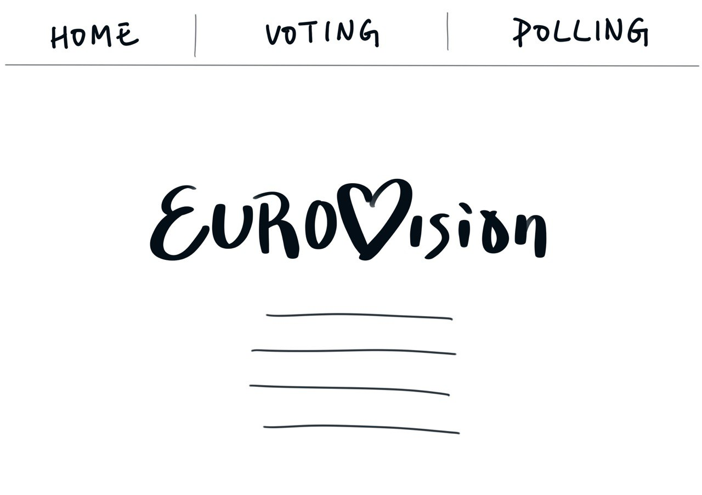
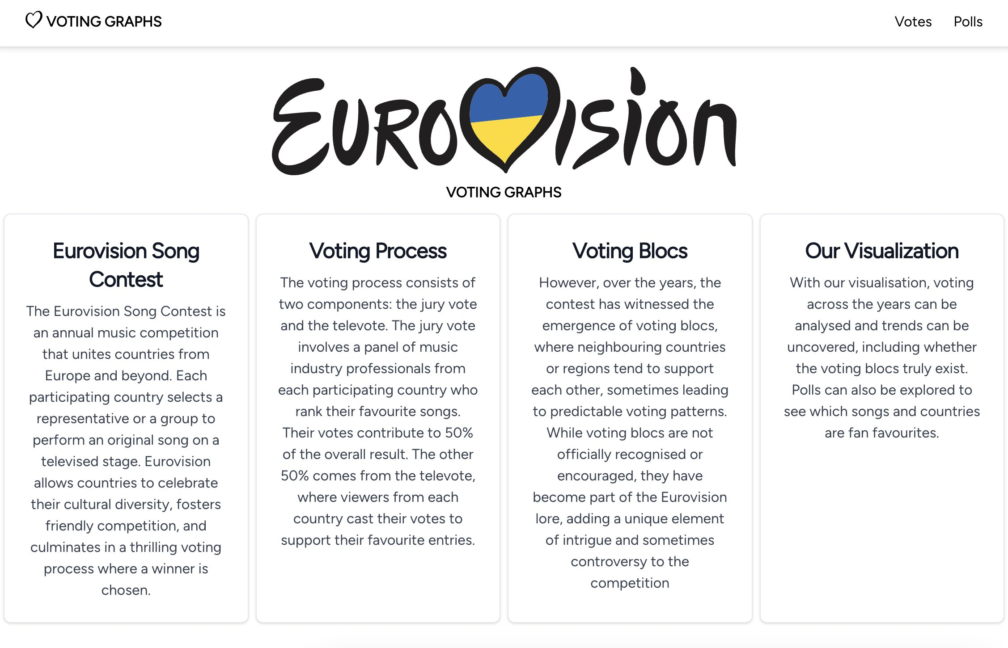
Landing Page
The landing page is where the user arrives when they visit our website to view the different visualisations. We first imagined the landing page as being very simple and having only a brief description of the Eurovision Song Contest. Our first mock-up contained this in the centre with a navigation bar at the top.
We later reimagined our vision as we felt it was insufficient to give a very brief introduction to the contest as other information was lacking (e.g. what we are trying to show through our visuals).
We reimagined it as being a hub where the Eurovision Song Contest is briefly explained (as many people are likely unfamiliar with what it is as well as its format), what the problems facing the contest are, and how our visualisations help to visualise the problem.
As seen above, we kept a similar layout with the information centred and the navigation bar up top. This time, we expanded the introduction and highlighted the 4 key points: what is the website about (the Eurovision Song Contest), which aspect of it are we investigating (the voting system), why we need to explore it (voting blocs), and how we can explore it (with our visualisations).

