Slide 1
The Power of Together

Slide 2
Main objectives
Develop a LFE approach for a specific security risk analysis, needed security measures and an architecture for a use cases of LFE.
We will 'test' this approach for an important use case, the compas module. Therefore, the 'test' is serious, and it should deliver more or less serious a security advise for the project compas module itself.
Notes:
Benoit and Justin/Jonas leading functional
Eric and Sander leading data

Slide 3
Agenda
Welcome
Part 1 – Re-cap scope of the use case
Part 2 – Security risk analysis of the use case
Security impact assessment with Stride Approach
Threat Modeling with BowTies
Part 3 – Security measures for the use case
Part 4 – Security architectural principles for the use case
Discussion
David Wheeler
Sander Jansen
Next steps

Slide 4
Welcome
Introduction participants
Notes:
Benoit and Justin/Jonas leading functional
Eric and Sander leading data

Slide 5
Part 1 – Recap scope of the use case

Slide 6
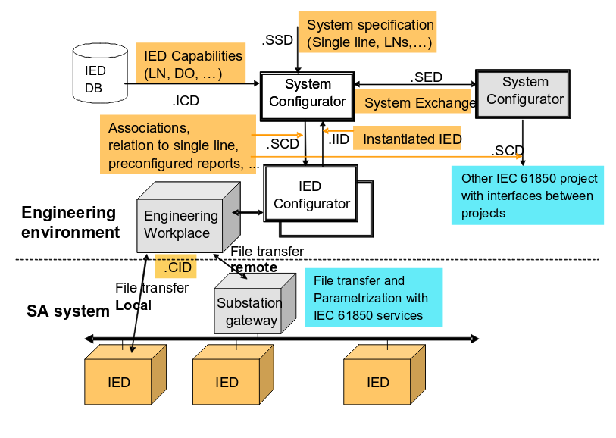
Scripting
engine
The main functional blocks:
System configuration: “System Specification Description (SSD)” to “Substation Configuration Description (SCD)” conversion, PACS policy registry (scripts?), API to vendor specific IED configurators
IEC61850 profile management: logical device/function builder, library of common profiles for usual functions, versioning, definition of reusable user profile of IEC 61850 data model (potentially continue/restart ENTSO-E profiling tool)
Conformity verification of System Configuration description Language (SCL) files
System specification: profile to “System Specification Description (SSD)” conversion, PACS policy registry (scripts?), API to vendor specific “IED Capability Description (ICD)” tools, ICD conformity check, ICD compatibility management, ICD versioning / repository
Availability of Substation PACS data at enterprise level (Functions & settings, operational process data)

Slide 7
Part 2 – Security risk analysis

Slide 8
Security risk assessment
Agenda:
Impact assessment: analyze what information is processed by the application and what the impact is if the confidentiality, integrity or availability is compromised
Threat assessment: analyze how the data could be compromised

Slide 9
Impact assessment

Slide 10
Information assets
Information asset | Compromise of confidentiality | Compromise of integrity | Compromise of availability
Configuration (by means of the Compas Module) for setting the protection relays. |  | Protection relay will not be active (if the configuration by means of the Compas Module is not integer), when there is a primary eletrotechnical fault. The result clould be physical damage substation. When it comes to the threat assessment a distinction should be made between: Processing of the data. The database (DB) where the data are retrieved.

Slide 11
Information assets
Information asset | Compromise of confidentiality | Compromise of integrity | Compromise of availability
Configuration setting by means of the Compas Module for maintenane | If the data are stolen, the threat actor has a lot knowledge of the specific configuration and architecture of a substation, which gives a basic knowledge for a threat scenario which could effect even the cross border high voltage grid. For instance, the SCD file contains all the IP-adresses. It is a XML-file. There are no passwords, but a lot of information of the substation, its position in the whole grid and its connections (hence, big power plant). | The impact could be rework. When there are tests, probably the issues with integrity will be identified. If the test gives the wrong result, there is impact (rework) . | The use of the Compas Module is for big projects. How critical the Compas Module is, is dependent on the way of working of the TSO/DSO. The impact is probably limited, because you could copy versions of other substations, and proceed with this data for maintenance for other substations. However, if the availability is longer, the impact is higher.

Slide 12
Information assets
Information asset | Compromise of confidentiality | Compromise of integrity | Compromise of availability
Substation is present in the SCADA by means of the Compas Module ('SCADA modeling') | With this data, the hacker can understand how the status data, the measurement data etc. are made (based on the configuration) |  | Limited
Substation can be switched in the SCADA by means of the Compas Module ('SCADA modeling') | If this data is stolen, the hacker could make its own switch command, inject this message in the network (to the dispatching centre and/or substations) and the hacker is able to create significant impact on the grid. | If the command is corrupted, it is visible (no switch) | Limited

Slide 13
Threat assessment

Slide 14
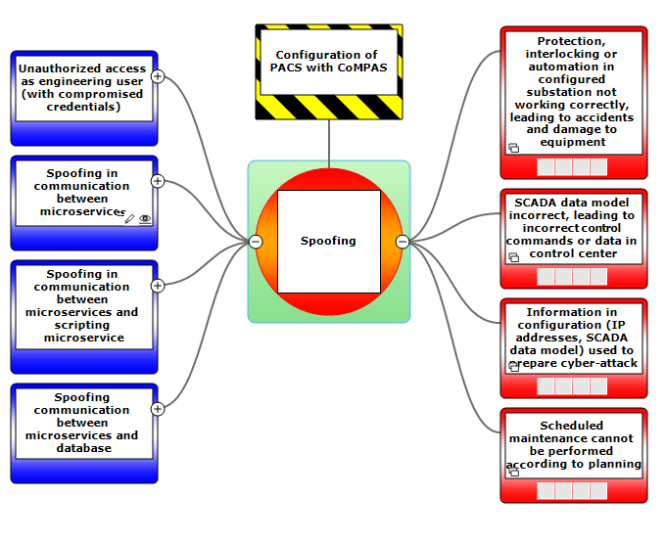
Spoofing

Slide 15
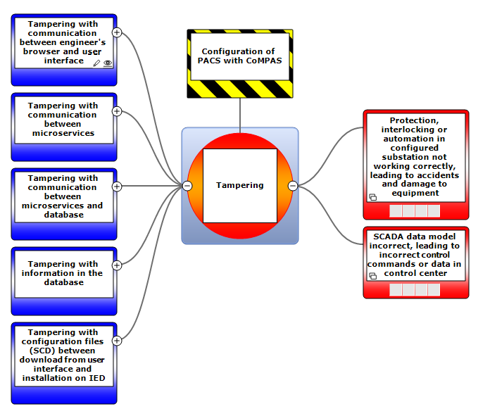
Tampering

Slide 16
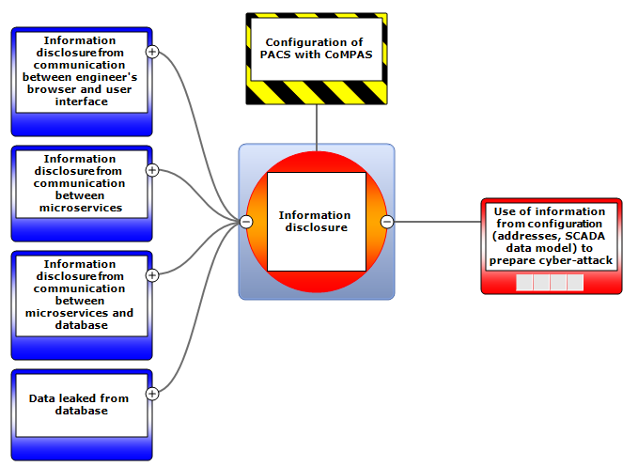
Information disclosure

Slide 17
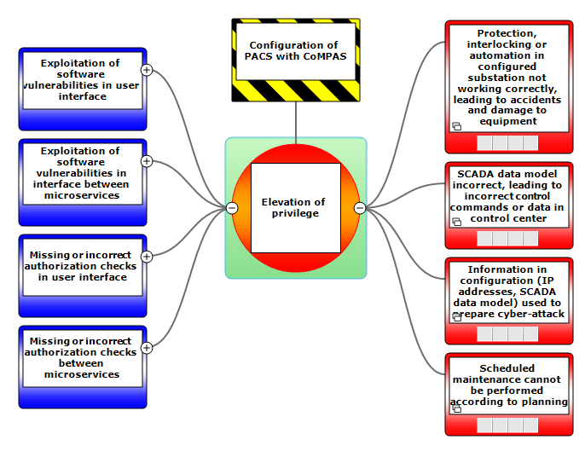
Elevation of privilege

Slide 18
Part 3 – Security measures for the use case

Slide 19
In the building process, the deployment process, the running process, there should be a validation process, if the code is actually the right (open source) code (like, https://reproducible-builds.org/). Binary
Logging, modification of the configuration (into a CMDB)
Logging, modification of the configuration (into a CMDB)
Logging, modification of the configuration (into a CMDB)
Communication security: like TLS etc.
Communication security: like TLS etc.
Communication security: like TLS etc.
Communication security: like TLS etc.
Scripting
engine
Protection of the data file in the system specification
Validate the signing of the input from the DB / other system configurator
Add signed hash to the output which is send to the
IED configurator / other system configurator
Protection of the data file in the IED DB (signing)
Validate the signing of the input from the DB / other system configurator
Validate the signing of the input from the DB / other system configurator
Authorization of the users
Authentication and authorization of the users
Validate the signing of the input system configurator (dependent of the vendors)
Roles
Check if the (open source) libraries are the right ones, Github could check this (is it activated, is it applicable)?
- Code quality (like using Sonar cube, but also do code review, by means of a third party / other developer: 4 – eye principle)
- Secure build environment
- Good versioning (like using Github)

Slide 20
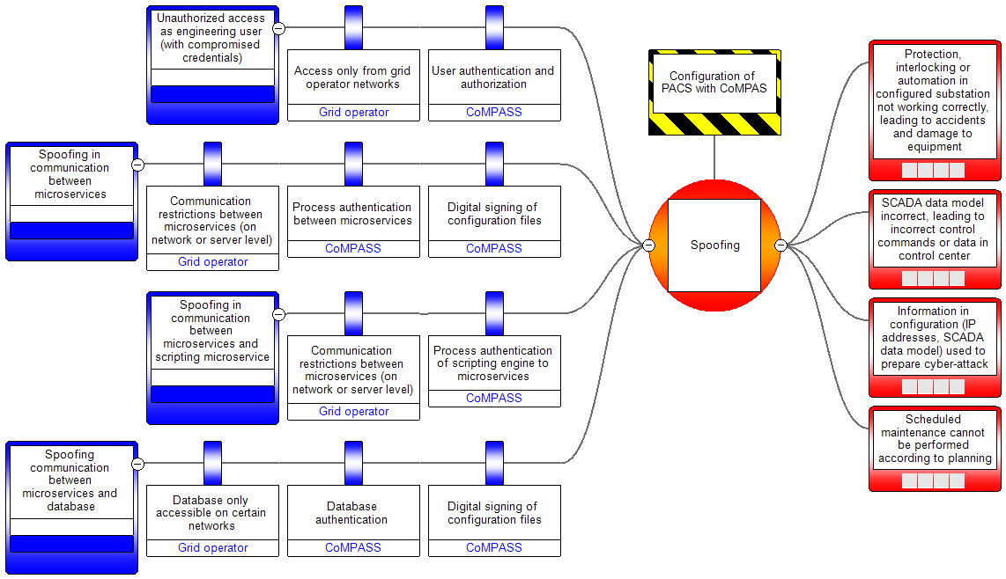
Spoofing

Slide 21
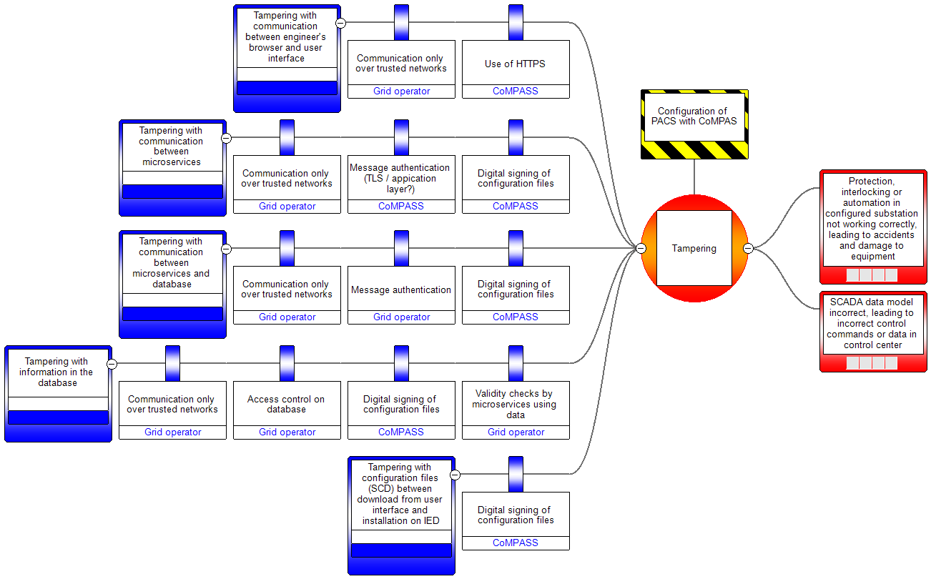
Tampering

Slide 22
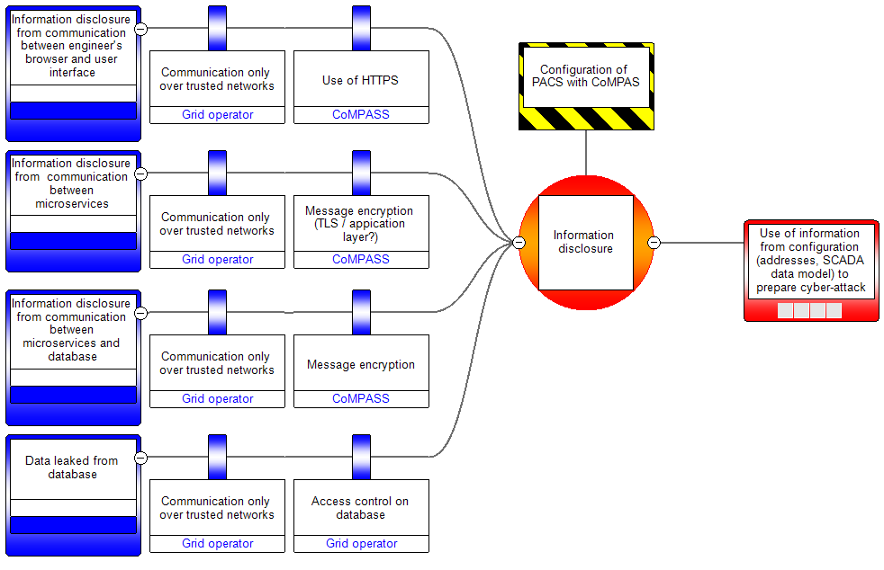
Information disclosure

Slide 23
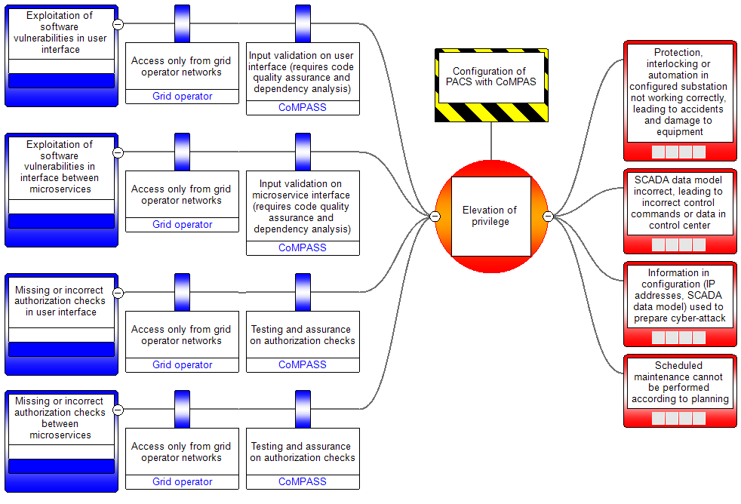
Elevation of privilege

Slide 24
Part 4 – Security architectural principles for the use case

Slide 25
The differences
Closed systems | Open platforms
Limited amount of (internal) stakeholders | Lots of (external) stakeholders
Limited set of internal interests | Lots of external 3rd party interests
Total control in our own hands | More control in the marked, out of our hands
Unidirectional information flows from high to lower secure zones | Bidirectional information flows
Exclusive use of own information sources | Use of external information sources for automated decision-making
Information for safety and efficiency | Information for safety, efficiency and money (Congestion Management)
 | Information becomes 'money'
 | More APT's active in energy sector
Notes:
Open questions (to be answered after the launch of the project):
Database or file-based storage?
For a file based approach: GIT could be a base to do versioning, traceability, etc.
Programming languages? Development frameworks?
Authentication? Single sign on?
Authorization / User roles & rights?

Slide 26


The balance between trust and verification
Trust for a good relationship
Verification for a reliable outcome
Notes:
Open questions (to be answered after the launch of the project):
Database or file-based storage?
For a file based approach: GIT could be a base to do versioning, traceability, etc.
Programming languages? Development frameworks?
Authentication? Single sign on?
Authorization / User roles & rights?

Slide 27




Security architectural principles for the use case
Verify
Trust,
but verify
When the outcome is essential and matters more than the (human) relationship
Don't trust, just verify
When the outcome is essential and the (human) relationship is not important
Don't trust, don't verify
When both the outcome and (human) relationship is not important
Trust,
don't verify
When the (human) relationship is essential and matters more than the outcome
Trust
Don't trust
Don't verify
Notes:
Open questions (to be answered after the launch of the project):
Database or file-based storage?
For a file based approach: GIT could be a base to do versioning, traceability, etc.
Programming languages? Development frameworks?
Authentication? Single sign on?
Authorization / User roles & rights?

Slide 28
Discussion
David Wheeler
I strongly encourage using a dependency analyzer (aka software composition analyzer aka origin analyzer) to look for included software with known vulnerabilities. They won't catch all publicly-known vulnerabilities in your software system, but they're a big help.
So if you're on GitHub, enable it. GitLab also provides this service (via Gymnasium).
If you can, I suggest using at least two different ones; none are perfect, and in particular they differ on what components they spot & the databases they use. LF projects will also be able to get this service via CommunityBridge (that one is based on Synk).
These tools are *much* more effective if you work *with* them. In particular, use a package manager where possible, so that the tool can simply examine the package manager's database to determine what's being reuse. Some tools can look line-by-line, but they're more expensive & that will be less accurate (because the task they're trying to do is FAR more difficult).
Sander Jansen
This is the Github feature for dependancies:
https://help.github.com/en/github/managing-security-vulnerabilities/about-alerts-for-vulnerable-dependencies
It is already used in the GXF project:
https://github.com/OSGP/open-smart-grid-platform/pulls
Github makes a disclaimer:
Note: GitHub's security features do not claim to catch all vulnerabilities. Though we are always trying to update our vulnerability database and alert you with our most up-to-date information, we will not be able to catch everything or alert you to known vulnerabilities within a guaranteed time frame. These features are not substitutes for human review of each dependency for potential vulnerabilities or any other issues, and we recommend consulting with a security service or conducting a thorough vulnerability review when necessary.

Slide 29
Next Steps

